Slide 1
ITI 1120 - Lab # 8 Fall 2022
(2D) lists, matrices, files
1

Slide 2
Lab 8 overview
Open a browser and log into Brightspace
On the left hand side under Labs tab, find lab8 material contained in lab8-students.zip
Upload the files to your Google drive and unzip it.
Put everything in the EXACT location of your Google drive
My Drive/ITI1120/Lab8/
(This is VERY IMPORTANT!)
2

Slide 3
What is in this lab?
This lab has 2 Tasks . They exist as a notebook, please run them when asked to in the slides and understand how they work.
8 programming exercises (0 to 7, for your Lab Grades).
Please note that you need this material for your assignment 3.
The slides that are included here but do not explain either Tasks or Programming exercises are there as reminder of some relevant material that is needed for this lab.
3

Slide 4
Introduction to matrices
A matrix is a two-dimensional rectangular grid of numbers:
The dimensions of the matrix are the numbers of rows and columns (in the above case: row dimension 3, column dimension 3).
A value within a matrix is referred to by its row and column indices, in that order.
Math: number rows and columns from 1, from upper left corner
In math notation, M_{1,2} = 2
In Python, matrices are implemented via 2D lists and indices start from 0, as they do in (1D) lists.
Thus, M[0][1] is 2

Slide 5
Matrix element processing
To visit every element of an array, we must use a loop.
To visit every element of a matrix, we need to use a loop inside a loop (nested loops):
Typically, the outer loop goes through each row of a matrix
And the inner loop goes through each column within one row of a matrix.
Can go the other way

Slide 6
Intro to matrices in python and programming exercises 0 to 4
Open the file called Lab8_tasks.ipynb and spend time studying all the matrix functions there.
Then open the file called Lab8_Exercises.ipynb and implement (and test) the 5 functions labeled as programming exercise 0 to 4 in that file.
Two notes about exercises 1 and 4:
E1: For clarification of programming exercise 1 see the next page
E4: In programming exercise 4, try to find a solution that does not create any extra list. Or even better, find two solutions, one that creates an extra list and one that does not

Slide 7
Details about Prog Ex 1
Find the sum of the upper triangle of a square matrix (i.e. the diagonal and above).
0 1 2 3 4
1 4 5 3 2
6 3 6 4 6
M = 4 3 6 7 2
3 4 2 2 4
2 3 8 3 5
How do we know if an element of a square matrix is on or above the main diagonal?
0
1
2
3
4
row_index <= column_index

Slide 8
Exercise 5 : Magic square
An n x n matrix forms a magic square if the following conditions are met :
The elements of the matrix are numbers 1, 2, 3, …, n²
The sum of the elements in each row, in each column and in the two diagonals is the same value
https://en.wikipedia.org/wiki/Magic_square

Slide 9
Learn how to populate a 2D list from a file
View the content of the file called alkaline_metals.txt
This file contains the name, atomic number, and atomic weight of the alkaline earth metals separated by space. Records about different metals are separated by new line.
The goal of this task is to learn how to write a Python program that opens, reads a file and creates a 2D lists with the relevant info about the 6 alkaline metals. Specifically, the program needs to have a function, called create_alctable(file_name), that given a string representing the name of the file as input, opens that file, reads it and returns the following 2D list:
[['beryllium', 4, 9.012], ['magnesium', 12, 24.305], ['calcium', 20, 20.078], ['strontium', 38, 87.62], ['barium', 56, 137.327], ['radium', 88, 226.0]]
Open Lab8_Tasks.py and go to the “Colab File loading” section. Then the Run Module. When prompted for the file name enter: alkaline_metals.txt
Study what the program prints and the solution code. The printouts should help you understand the code.

Slide 10
Programming exercise 6: NY times bestsellers
For this you are provided with 2 files NYT_short.txt and NYT_long.txt each containing list of New York Times for some years. Each line in a file contains the information for a separate book, which includes title, author, publisher, date it first reached #1 on one of the best seller lists, and category (fiction or nonfiction). There is a tab character between each of these pieces of information.
For this exercise you will first write a function create_books_2Dlist(file_name) that opens the file, reads it and returns a 2D lists containing a sub-list with the info about each book. For example, here is the beginning of required 2D list. See the next page for what the whole list should look like for
[['1976-04-11', '1876', 'Gore Vidal', 'Random House', 'Fiction'], … ]
Note that within each (sub)list about a book, the first element should be a string containing the date in iso format
YYYY-MM-DD
Finally, you should write a function called search_by_year(books,year1,year2) that given a 2D list of books in the above format prints all the bestsellers from year 1 to year 2. See example runs on the next 2 pages for NYT_short.txt
While working use NYT_short.txt. Once you are done you can test your program with NYT_long.txt.

Slide 11
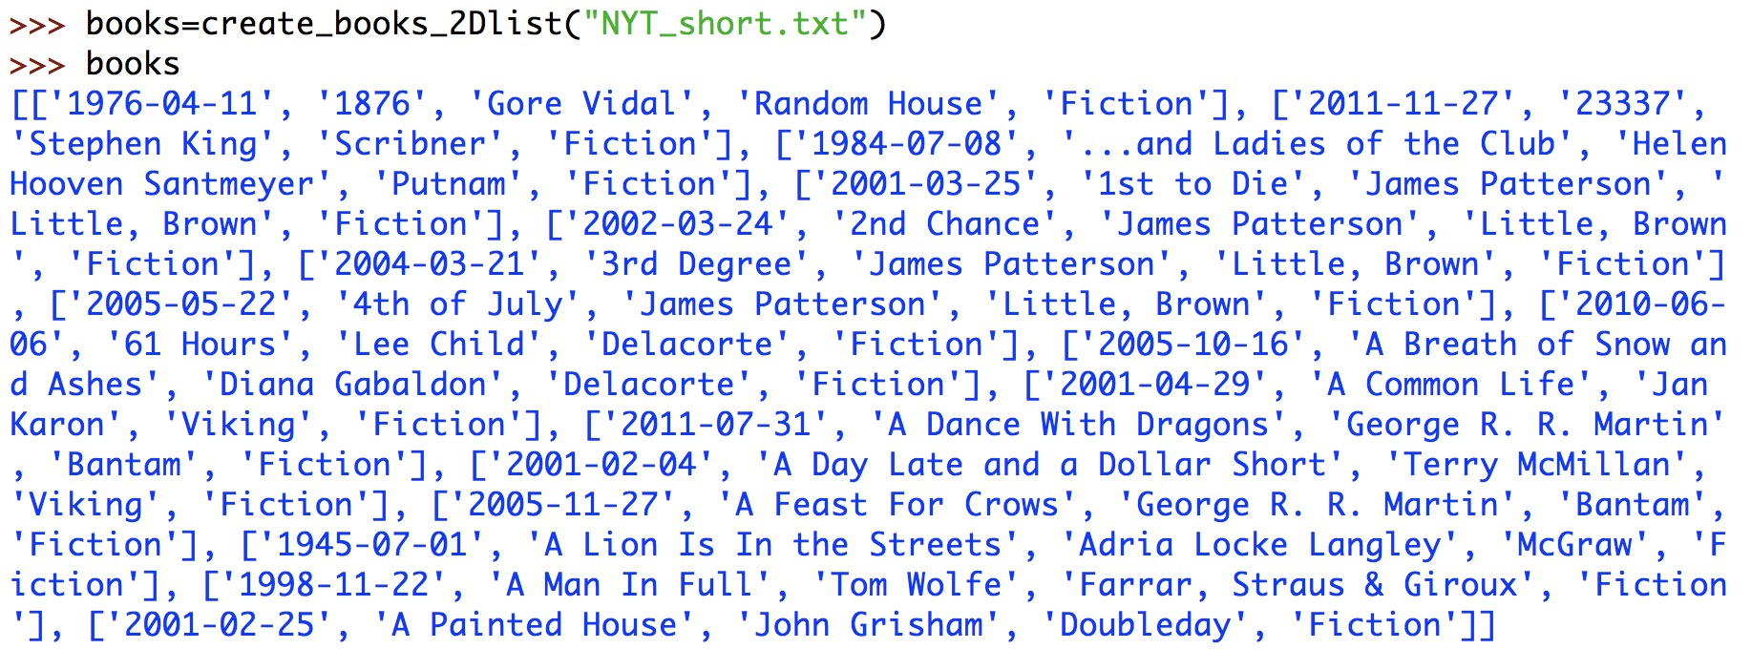
Programming exercise 6: example runs

Slide 12
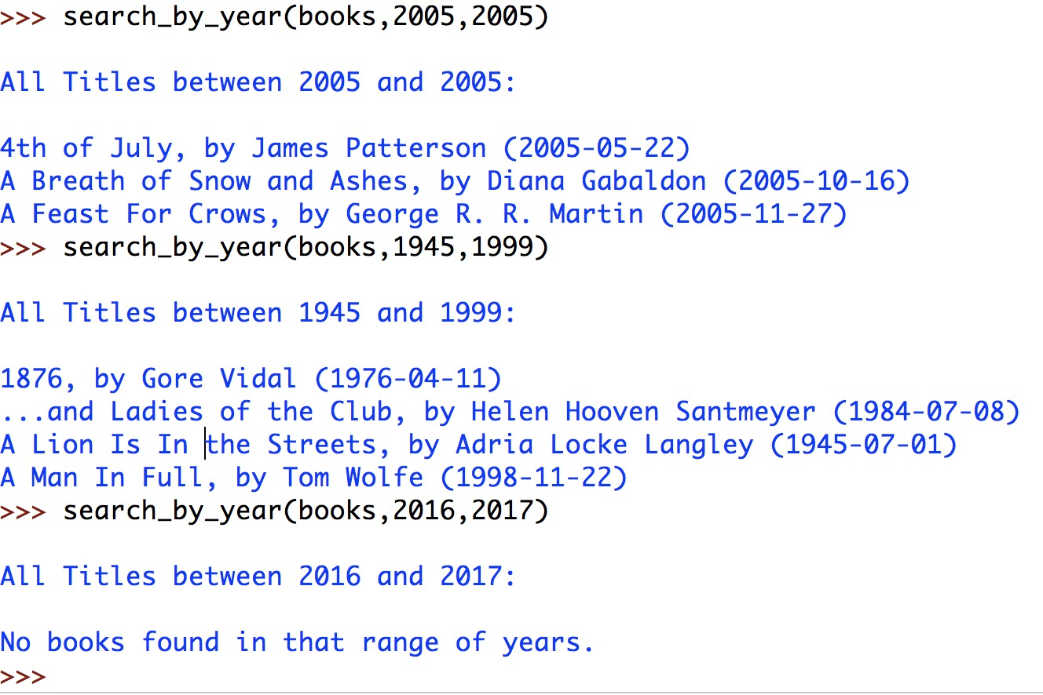
Programming exercise 6: example runs
Below the books argument is the 2D lists from the previous slide

