Slide 1
Carbon Price
Forecasting
Predicting next-year compliance carbon prices from historical
tax & ETS pricing data using supervised regression
Veer Pratap Singh

Slide 2
01 · PROJECT OBJECTIVE
What are we trying to predict?
Carbon pricing initiatives (taxes and emissions-trading systems) publish a price
every year. Given this year's context, can we forecast next year's price?
T
F
W
Problem Type
Input Features
Why It Matters
Supervised learning — regression. The target, Next_Year_Price, is a continuous numeric value.
Instrument type, region, income group, current year, and current price of the initiative.
Governments & businesses use carbon price outlooks to plan compliance costs and climate policy.
2

Slide 3
02 · THE DATASET
Compliance Carbon Price Table
A self-sourced Kaggle dataset tracking carbon tax & ETS prices for compliance
carbon-pricing initiatives worldwide, in wide (year-per-column) format.
79
36
2
6
Initiatives
Years (1990–2025)
Instrument Types
World Bank Regions
Columns in the raw file
Example row (raw, wide format)
• Unique_ID · Name · Instrument_Type
Tax_SE · Sweden carbon tax · Carbon tax
Europe & Central Asia · High income
... 1994: 43.43 1995: 47.9 1996: ...
• Region · Income_group · Metric
• 1990, 1991, ... , 2025 (one price column per year)
3

Slide 4
03 · DATA CLEANING
Taming a malformed CSV
The raw export had inconsistent row lengths and stray header rows mixed into
the data, so a plain read_csv() would misalign columns.
1
Define an explicit header
Named all 42 columns manually (ID, Name, Instrument, Region, Income group, Metric + years 1990–2025) instead of trusting the file's own header row.
df = pd.read_csv(
'Compliance_Price-Table1.csv',
names=header,
on_bad_lines='skip'
)
df = df[~df['Unique_ID'].isin(
['income', 'Unique ID', 'nan']
)].copy()
df = df.dropna(subset=['Unique_ID'])
2
Skip bad lines
Used on_bad_lines='skip' while reading, so malformed rows don't break the import.
3
Drop garbage rows
Removed rows where Unique_ID was actually a misplaced header value ('income', 'Unique ID') or missing entirely.
4

Slide 5
04 · RESHAPING THE DATA
From wide years to one tidy Year column
pd.melt() unpivots the 36 year-columns into two: Year and Price — the format
models and plotting libraries expect.
BEFORE · wide
AFTER · long
79 rows × 42 columns
809 rows × 8 columns
ID | Name | ... | 1990 | 1991 | ... | 2025
→
ID | Name | Instrument | Region |
Income group | Metric | Year | Price
One row per initiative, one column per year.
One row per initiative-year observation, after coercing Year/Price to numeric and dropping missing prices.
5

Slide 6
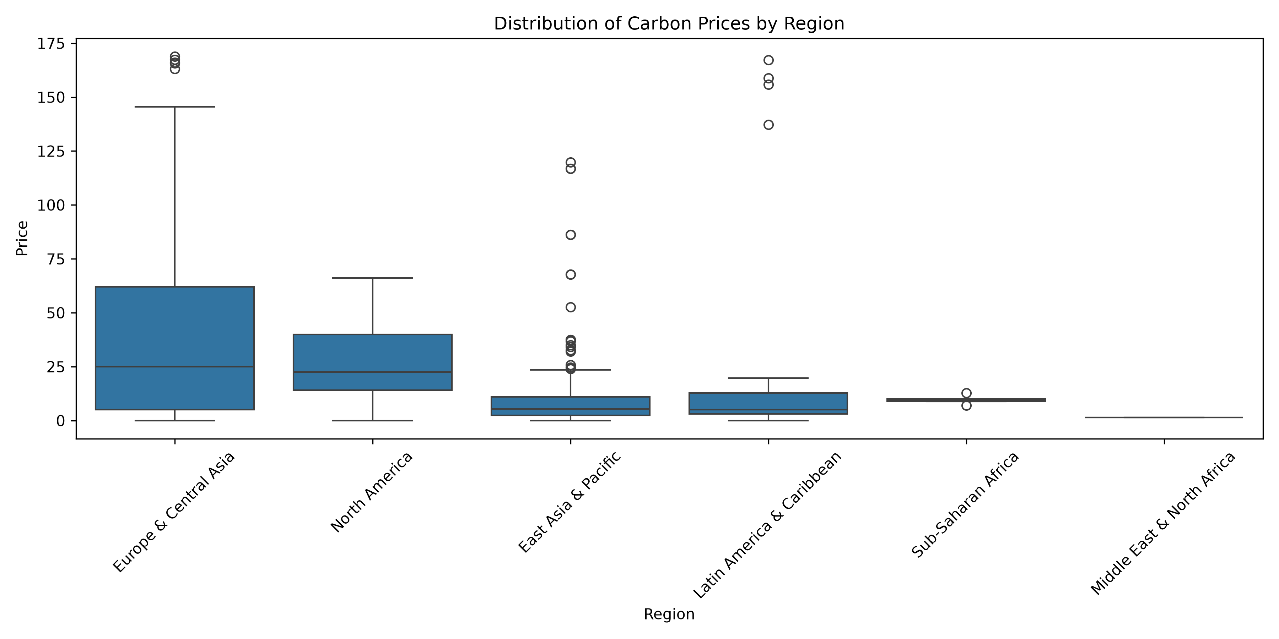
05 · EXPLORATORY DATA ANALYSIS
Price distribution by region
What it shows
Europe & Central Asia has by far the most initiatives (26) and the widest price spread, reflecting the EU ETS and multiple national carbon taxes.
Several regions show visible outliers — high-priced Nordic taxes sit far above the regional median.
These outliers motivate the IQR filtering step later.
6

Slide 7
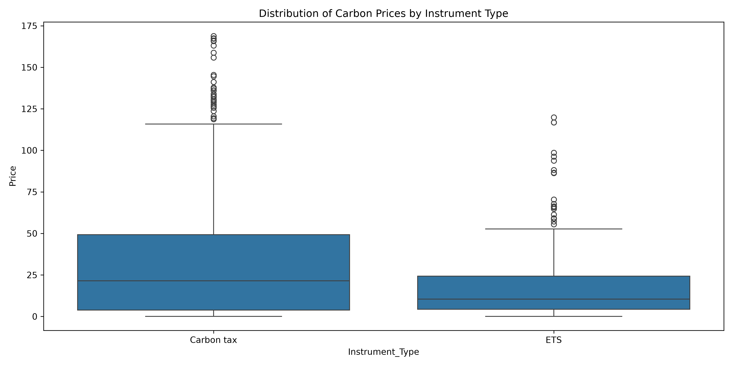
05 · EXPLORATORY DATA ANALYSIS
Price distribution by instrument type
What it shows
Of the 79 initiatives, 40 are ETS (Emissions Trading Systems) and the rest are carbon taxes.
Carbon taxes tend to show a wider price range — some jurisdictions set very high fixed rates, others near-zero — while ETS prices, set by market trading, cluster more tightly.
7

Slide 8
06 · OUTLIER REMOVAL
Filtering extreme prices with the IQR method
The boxplots revealed a handful of extreme prices that would distort model training. We used the classic Interquartile Range rule to drop them.
The rule
RESULT
IQR = Q3 − Q1
Lower bound = Q1 − 1.5 × IQR
Upper bound = Q3 + 1.5 × IQR
68
outliers removed
Any Price outside [lower, upper] is treated as an outlier and dropped from the modeling dataset.
809 rows → 741 rows
Clean dataset carried forward into feature engineering and model training.
8

Slide 9
07 · FEATURE ENGINEERING
Building the prediction target
There's no ready-made “next year price” column — we engineer it by shifting each
initiative's own price series forward by one year.
Model inputs (X)
df_clean.groupby('Unique_ID')['Price']
.shift(-1)
→ Next_Year_Price
Instrument_Type
Region
Income_group
Sorted by Unique_ID and Year first, so each initiative's prices shift within its own timeline — not across different initiatives.
Year
Price (current year)
Target (y): Next_Year_Price · Split: 80/20 → 533 training rows
9

Slide 10
08 · MODEL PIPELINE
Preprocessing, then three regressors
A single ColumnTransformer scales numeric features and one-hot encodes categorical ones, wrapped in a Pipeline with the model — so the same steps apply at prediction time.
Numeric — StandardScaler
Categorical — OneHotEncoder
Year, Price
Instrument_Type, Region, Income_group
Standardizes scale so no feature dominates by magnitude.
handle_unknown='ignore' keeps unseen categories from breaking inference.
Three candidate models
Linear Regression
Random Forest
Gradient Boosting
Simple, interpretable baseline
Ensemble of decision trees, captures non-linearity
Sequentially corrects errors, often strongest fit
10

Slide 11
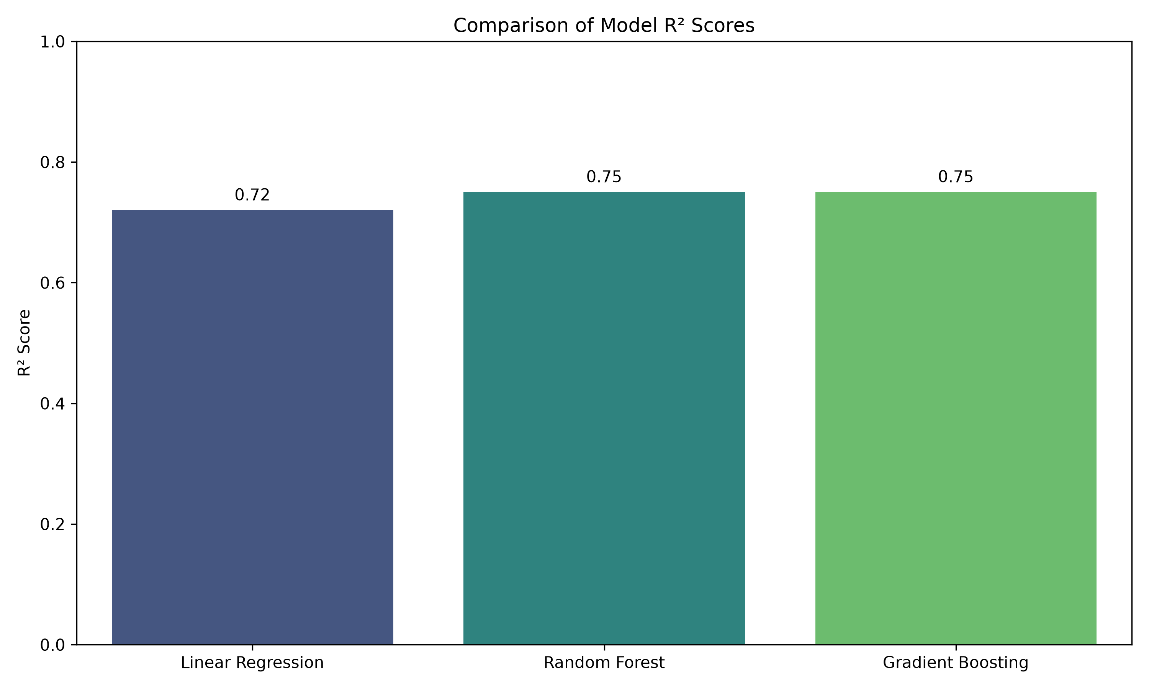
09 · MODEL EVALUATION
Comparing model performance
Model | RMSE | R² Score
Linear Regression | 11.71 | 0.72
Random Forest | 11.02 | 0.75
Gradient Boosting ★ | 11.09 | 0.75
Lower RMSE and higher R² both indicate a better fit. Random Forest and Gradient Boosting perform almost identically and clearly beat the linear baseline — the relationship between price history and next-year price isn't purely linear.
11

Slide 12
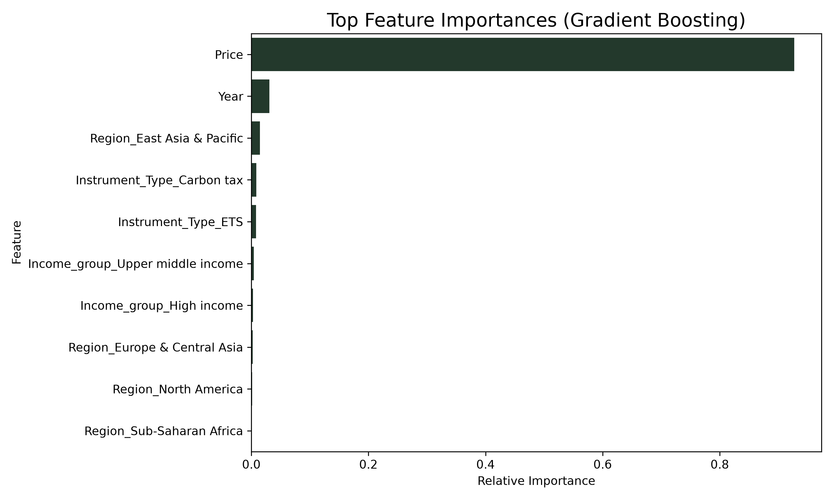
10 · MODEL INTERPRETATION
Feature Importances
Which inputs influence the Gradient Boosting model's prediction the most?
Key Driver
The current year's 'Price' overwhelmingly drives the prediction for the next year. Carbon prices follow strong auto-regressive trends.
Secondary Effects
The Year and Income group provide secondary context, allowing the tree to adjust for inflation/time and regional wealth disparities.
12

Slide 13
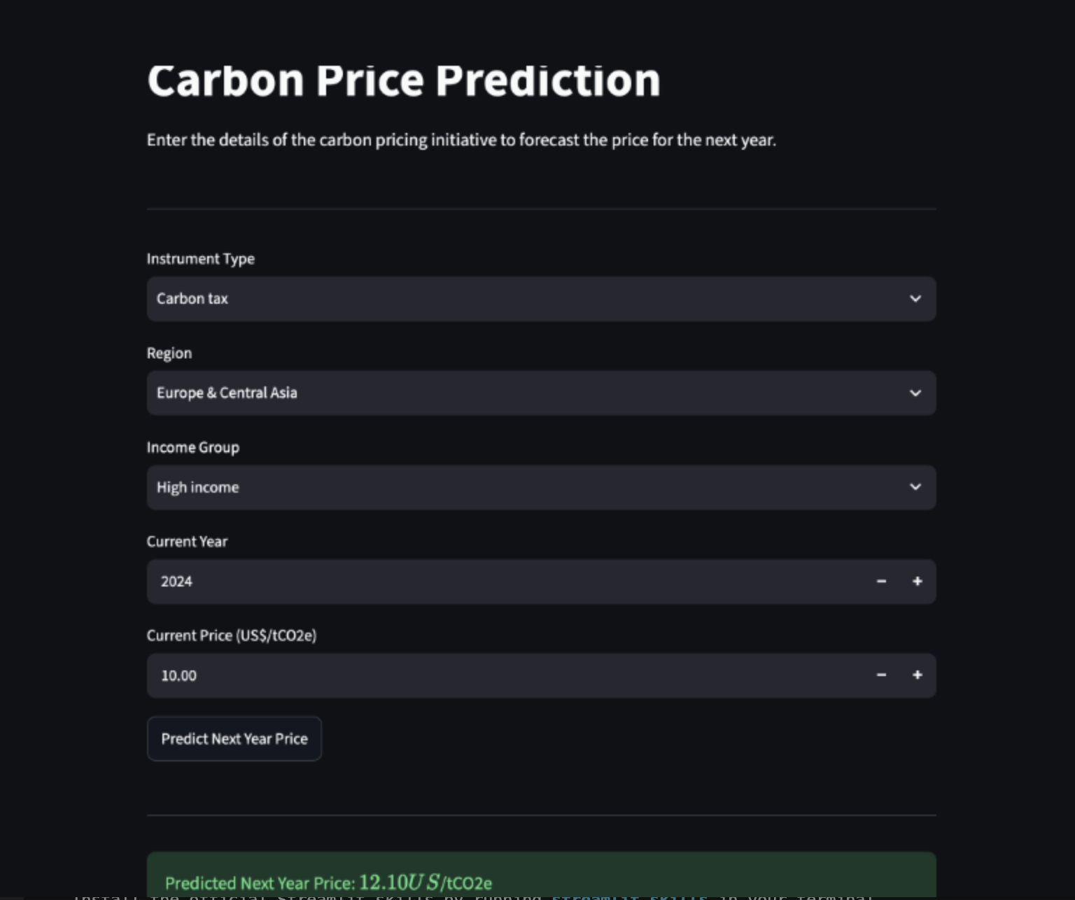
11 · FINAL MODEL & DEPLOYMENT
Gradient Boosting, shipped as a Streamlit app
FINAL MODEL
STREAMLIT UI
Gradient Boosting
Regressor
R² = 0.745
on held-out test data
Trained on the full pipeline and exported with joblib.
joblib.dump(best_pipeline,
'carbon_model.pkl')
14

Slide 14
12 · CONCLUSION
Takeaways & where this could go next
What we built
Cleaned a malformed, self-sourced carbon pricing dataset
Future Work
Hyperparameter tuning (GridSearch / Optuna) on the boosting model
Reshaped 79 initiatives into 741 clean year-level observations
Engineered a forward-looking Next_Year_Price target
Add macroeconomic features — energy prices, GDP, policy events
Compared 3 regressors; Gradient Boosting reached R² = 0.745
Try time-series-specific models (ARIMA, Prophet) per initiative
Deployed the model behind a live Streamlit interface
Expand the dataset with more recent and more granular price data
15

Slide 15
Thank You
Questions & discussion welcome
Veer Pratap Singh · Carbon Price Forecasting

