Slide 1
Opening Turkish Restaurant in Bucharest
By Veerendra Gvs
August 2020

Slide 2

Business Problem
Bucharest is the capital and biggest city of Romania, as well as its cultural, industrial, and financial center having 1.883.425(2018) population.
Opening new Turkish restaurant in Bucharest may be profitable for restaurant owner. Our problem is Where to open Turkish restaurant in Bucharest?

Slide 3
Data Sources
I get the neighborhood data of Bucharest from Wikipedia
I get the neighborhood data of Bucharest from Wikipedia
I use python geocoder library to get geographical coordinates of neighborhoods
I use Foursquare API venues explore method to get the venues of given neighborhoods of Bucharest.
I use Foursquare API venues method to get ranks and likes of restaurants by given venue id.

Slide 4
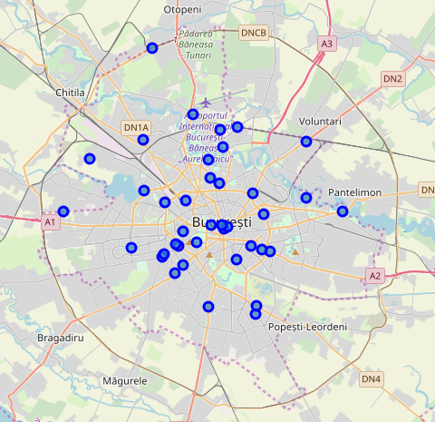
Methodology
I took neighborhood from wikipedia and put blue dots on Bucharest map to see centers of neighborhoods. There are 40 neighborhoods in Bucharest

Slide 5
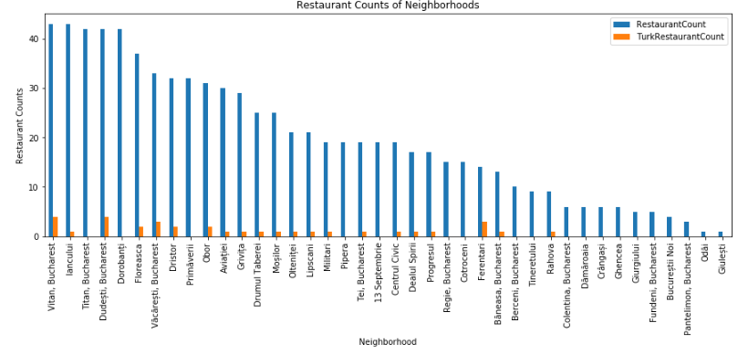
Methodology
By using Foursquare API I got venues 1 km around center of each neighborhood with limit 100 venue. I merged data with Neighborhood data.
I filtered All restaurants and Turkish restaurant. We can see from histogram of restaurants, 19 neighborhoods has not Turkish restaurant

Slide 6
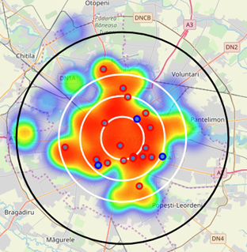
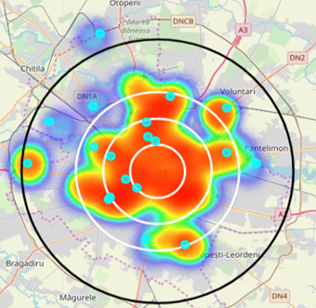
Methodology
I superimposed Turkish restaurants with red markers on map and blue markers as Turkish restaurants with rating less than 7 restaurants. That means these restaurants are not liked too much.
I superimposed neighborhoods without any Turkish restaurant with cyan markers in another heat map.

Slide 7
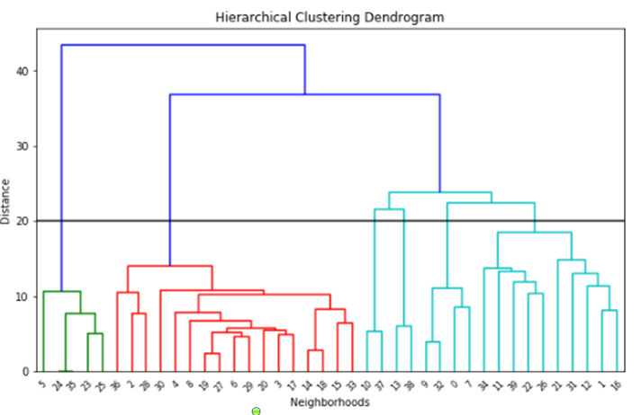
Methodology - Clustering
I used Agglomerative Clustering to cluster neighborhoods according to count of venue categories in each neighborhood. According to the below graph, I decided to separate our neighborhoods into 6 clusters (cut at distance of 20, horizontal black line).

Slide 8
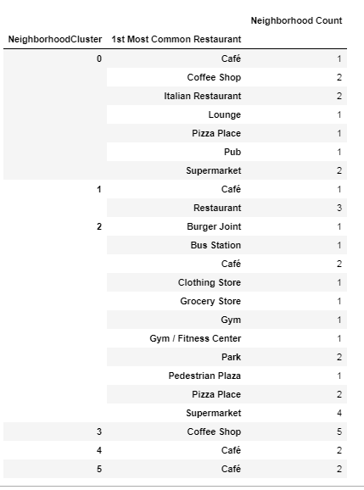
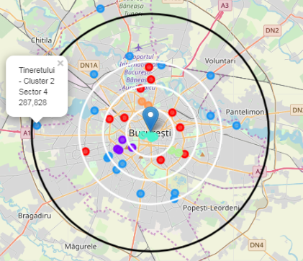
Methodology - Clustering
Agglomerative Clustering gives me 6 clusters:
Cluster 0 ( Red ) : Italian Restaurant , Pizza, Café
Cluster 1 ( Purple) : Restaurant , Bar
Cluster 2 (Blue) : Park , Plaza, Clothing stores , Museum, Gym
Cluster 3 (Cyan) : Coffee Shop, Hotel, Pub
Cluster 4 (Green) : Café, Supermarket
Cluster 5 (Orange) : Café

Slide 9
Results
Turkish restaurant counts in Bucharest is 4.18%
Total number of restaurants: 502
Total number of Turkish restaurants: 21
From bar chart
Vitan is the neighborhood having most restaurants
Dorobanti is has lots of restaurants , but no Turkish restaurant
Odai and Gluesti are neighborhoods having least number of restaurants
19 neighborhoods do not have any Turkish restaurant. We can choose one of these to open restaurant.
From heat maps
Too many restaurants in 4 km to the center
Enough restaurants between 4-6 km to the center
There are not many restaurants after 6 km to center
Turkish restaurants are located in South, North , East, between 2-4 Km distance around center
There are not Turkish Restaurants in West and North West part
Some Turkish restaurants gets bad points. That means people does not prefer these restaurant too much and any turkish restaurant may be opened around

Slide 10
Discussions
Cluster 2 suffers from restaurant. Especially there is no Turkish restaurant in west part of Cluster 2 . This area may be thought as new restaurant location
Cluster 0 especially likes Italian tastes , may be these neighborhoods will not like Turkish tastes .
Cluster 1, 2, 3 are centers full of restaurants as we saw in the heat map. So we cannot think about these areas

Slide 11
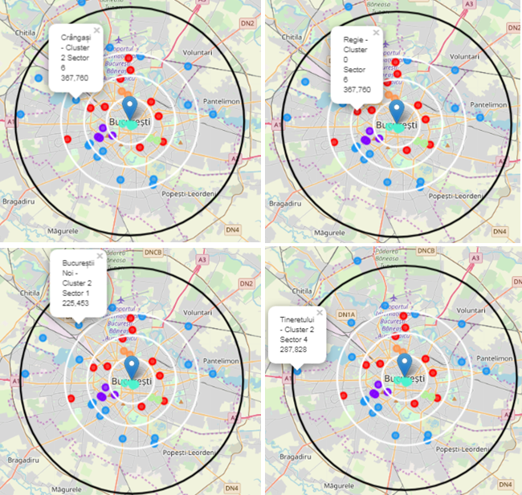
Conclusion
I choosed Regie , since west part of Bucharest has not Turkish restaurant and Regie is close to center . Regie is red cluster which is same with the other 2 red markers having Turk restaurant. Red clusters populations may like Turkish food.
I choosed Bucharest-noi , since west part of Bucharest has not Turkish restaurant and even not too much restaurant after 6 km distance to center . One restaurant will be good for this area.
I choosed Crangasi , since Crangasi and west part of Bucharest has not Turkish restaurant and from bar chart we can see that this neighborhood has not too much restaurant. Also this neighborhood is in Sector 6 and this sector has biggest population which will handle one more restaurant
I choosed Tineretului , since Tineretului has not Turkish restaurant and from bar chart we can see that this neighborhood has not too much restaurant

Slide 12
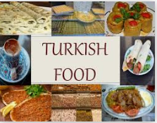
Thank You…
Wish you days with full of flavors☺

