Slide 1
Blood-Bank
Donate blood and save lifes
presented by
sk.mubeen ahmad

Slide 2
Introduction :
A blood bank collects, tests and stores blood until a patient needs it.
Blood shall be accepted only from voluntary, non-remunerated, low risk, safe and healthy donor with informed consent. No person shall donate blood more than once in three months. Donor should be in age group of 18 to 65 years,Not less than 45 KG for whole blood and 50 KG for components.

Slide 3
Tools used :
HTML(Hyper Text Markup language) :
It is a standard language for creating web pages.
It describes the structure of a web page.
CSS(cascading Style Sheet) :
CSS describes how HTML elements are to be displayed on the screen.
CSS saves a lot of works,it can control the layout of multiple webpages all at once.

Slide 4
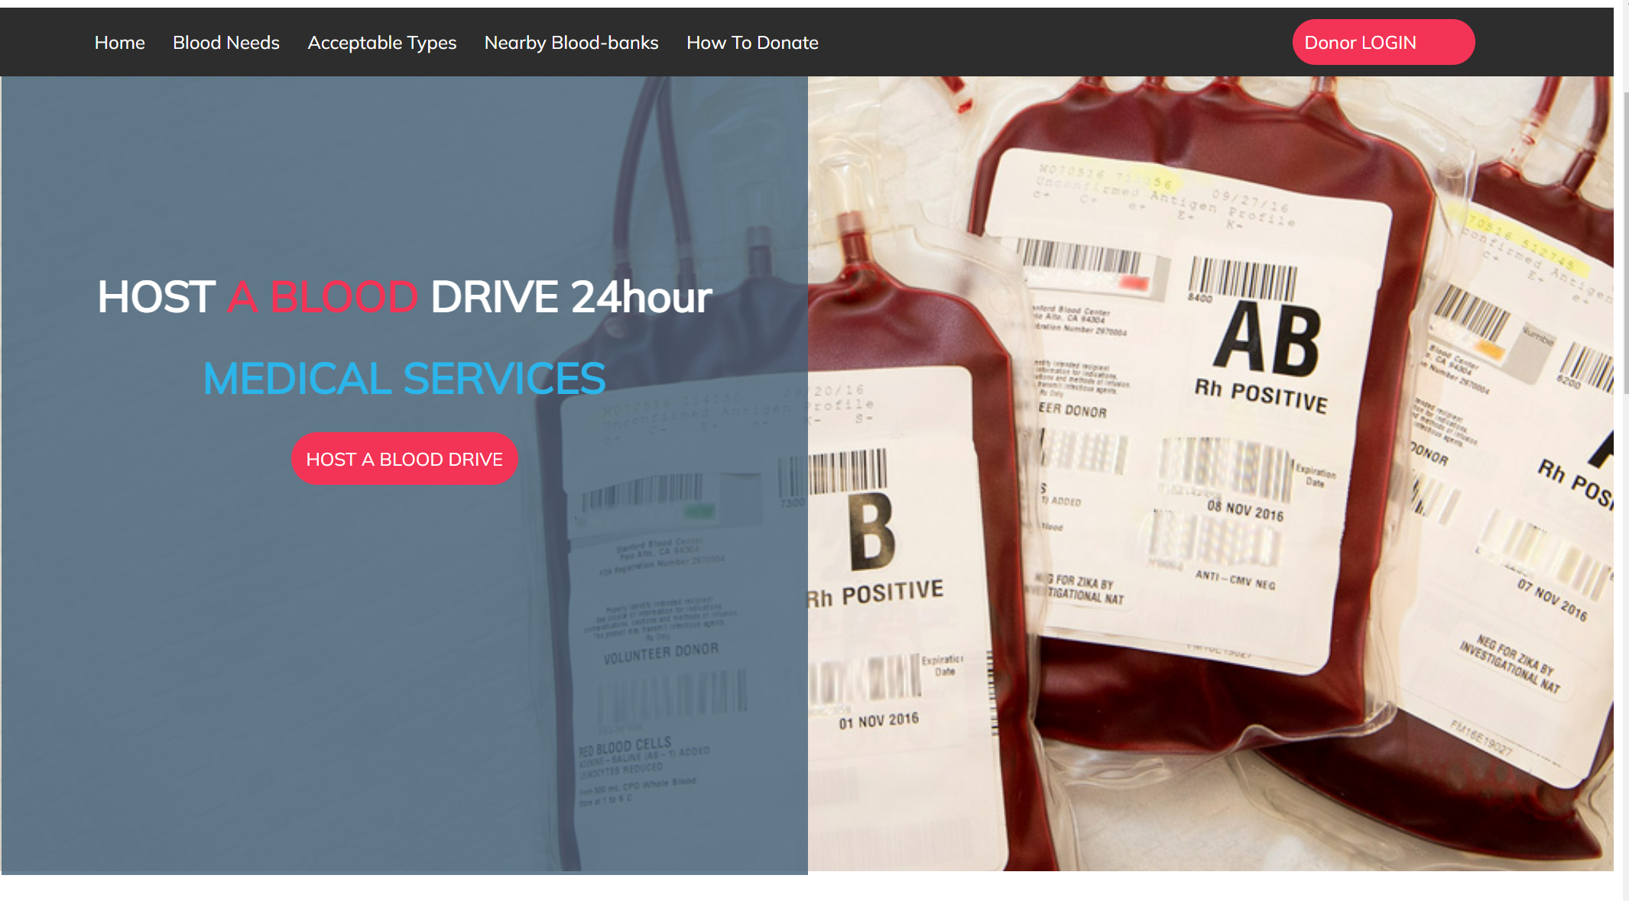
Screenshot :

Slide 5
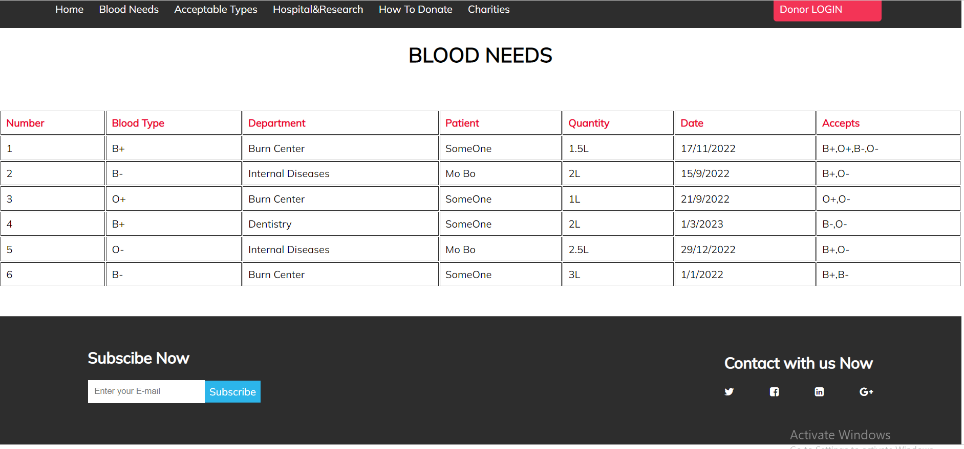

Slide 6
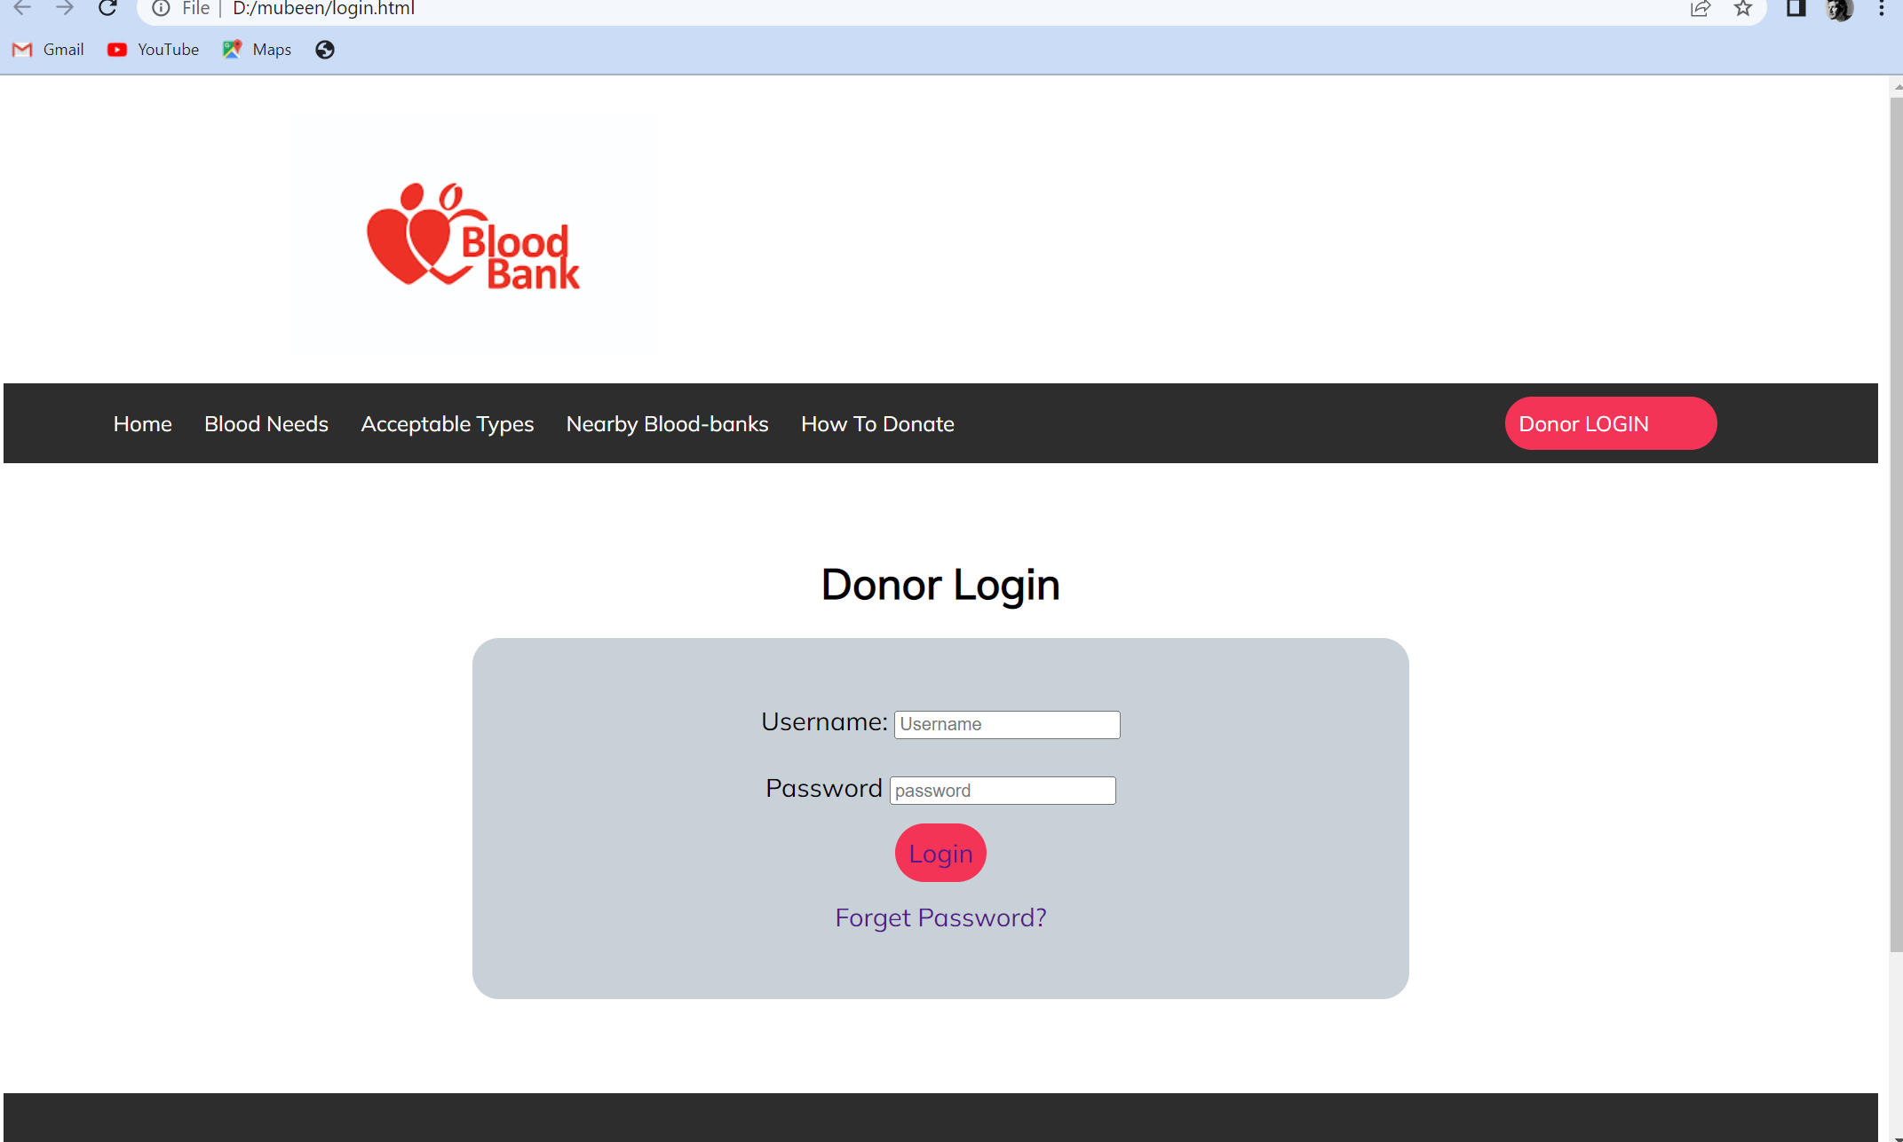

Slide 7
Observation :
in our daily life we seen that most of them needs blood at the time of medical emergencies
By this project , we provide blood for blood needies
The main goal of the Blood Bank and Donor Management System project is to monitor Blood Bank data, Blood stock, Donor List.

