Slide 1


Slide 2
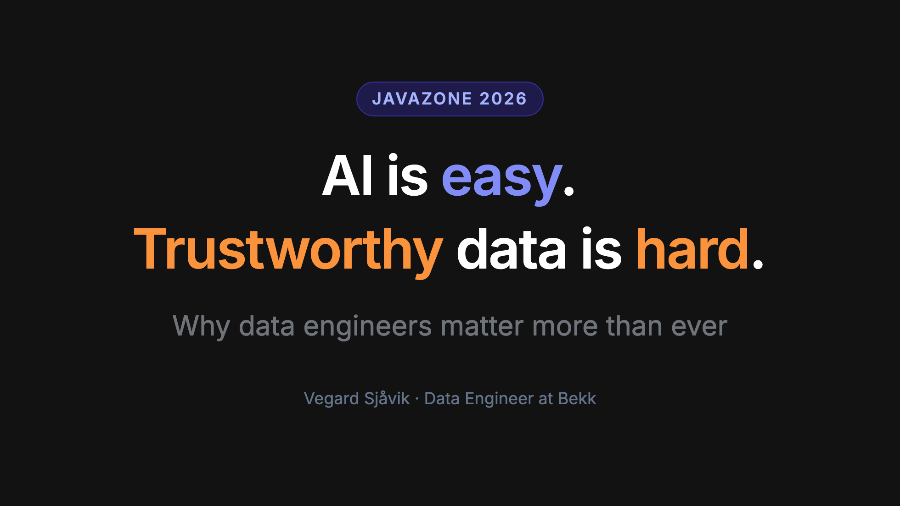

Slide 3
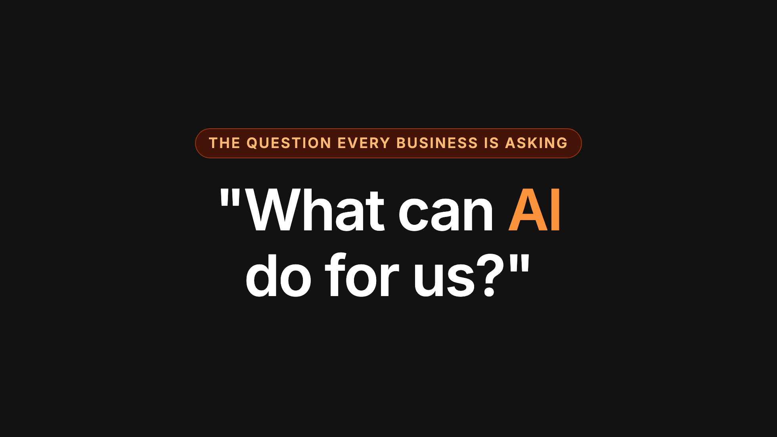

Slide 4
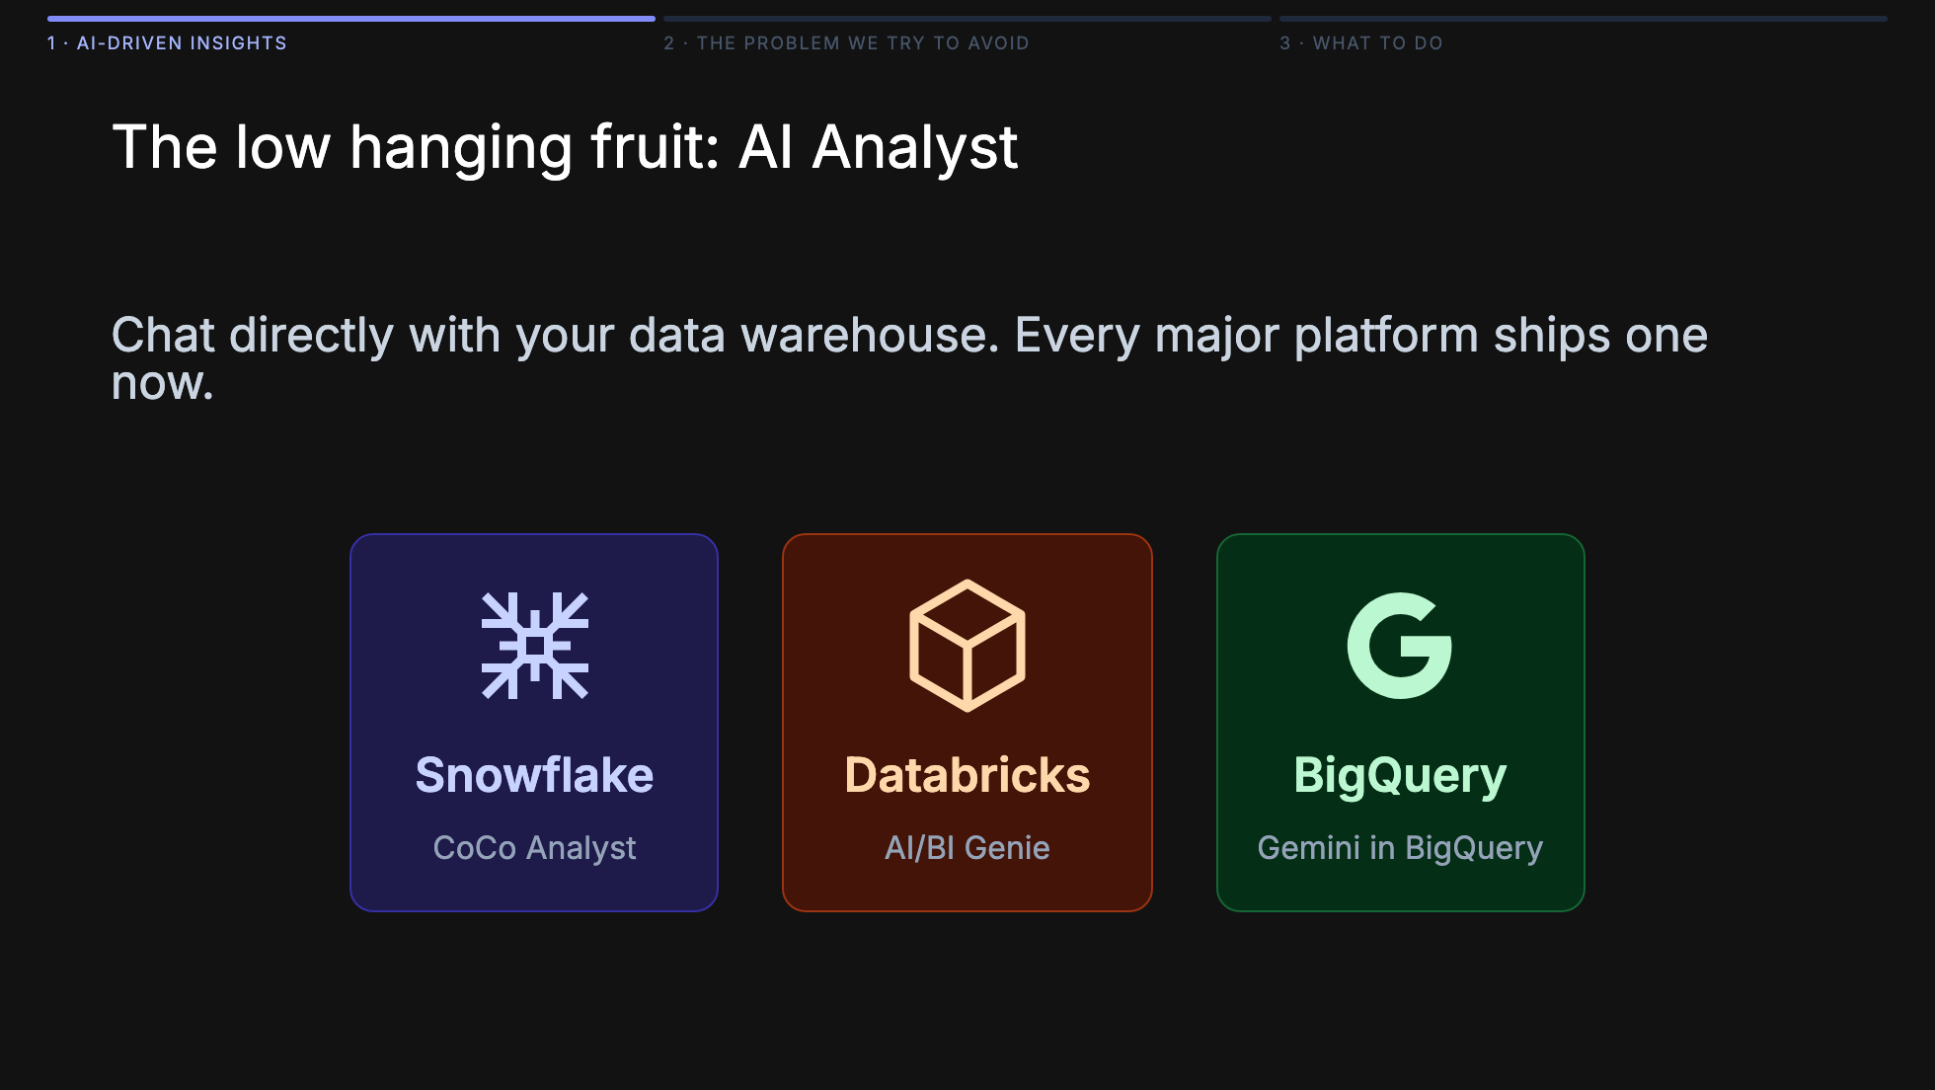

Slide 5
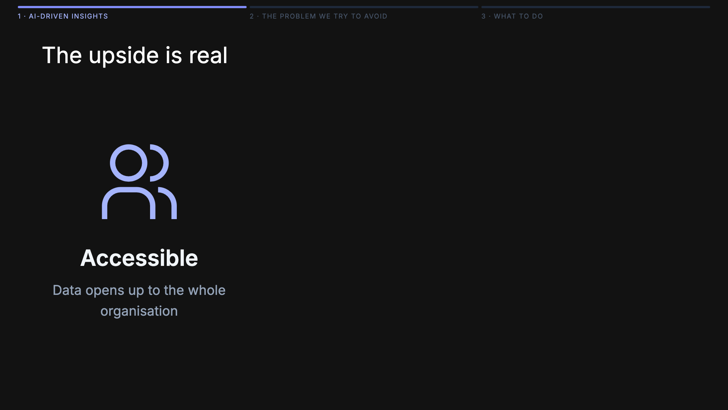

Slide 6
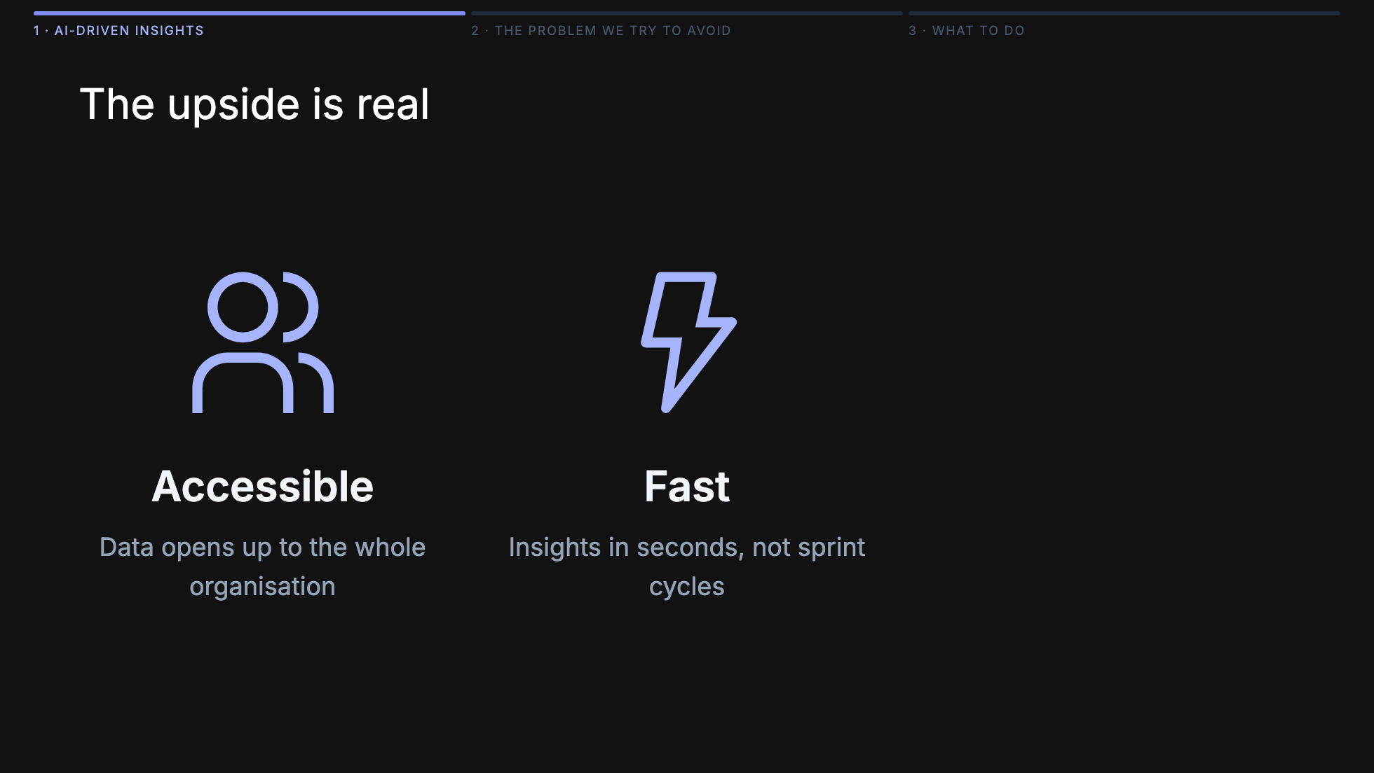

Slide 7
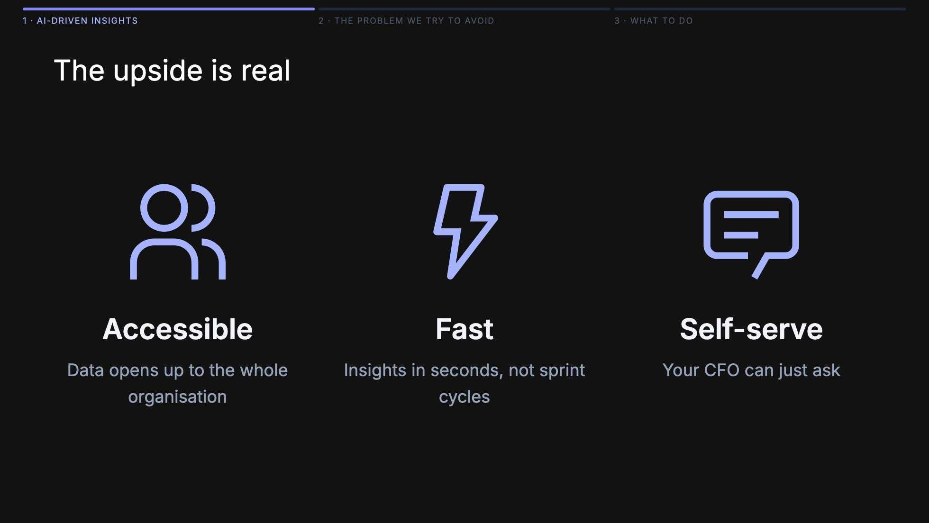

Slide 8
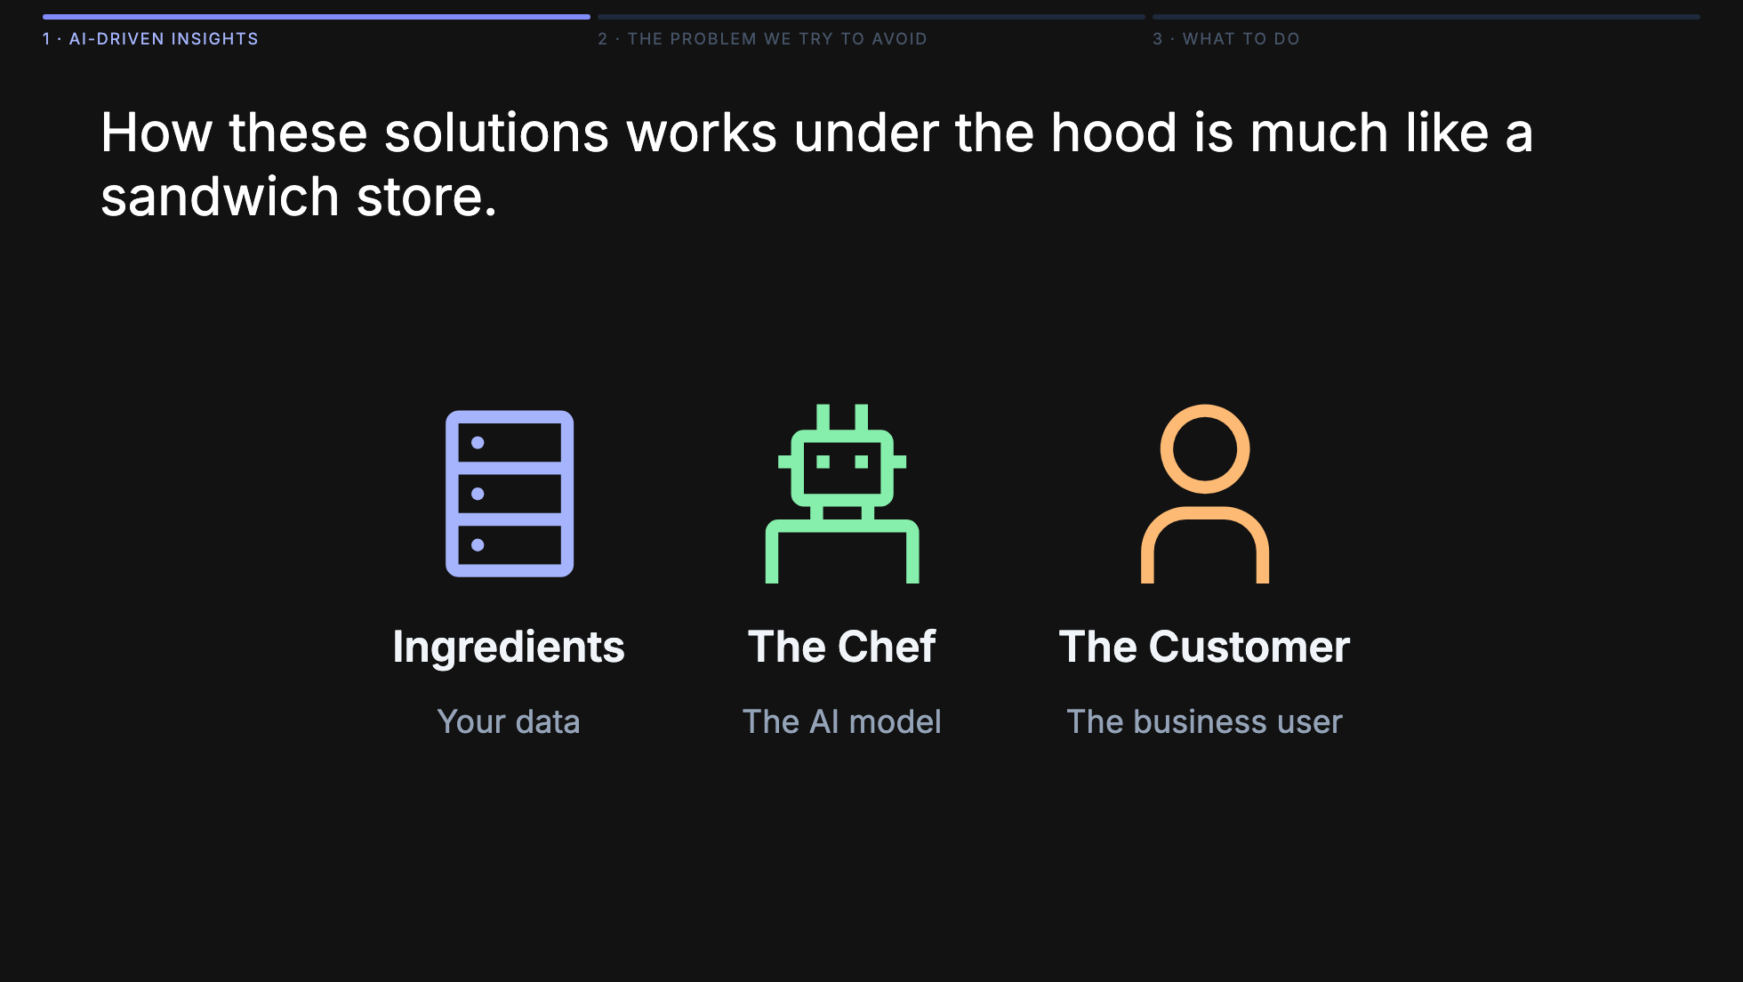
Notes:
The hard engineering happened at OpenAI, Anthropic, and Google. The chef is basically solved. What no vendor can fix for you: the ingredients. Even the best chef in the world can't rescue a dish made from rotten ingredients — and that's exactly what happens when you point a great model at a messy warehouse.

Slide 9
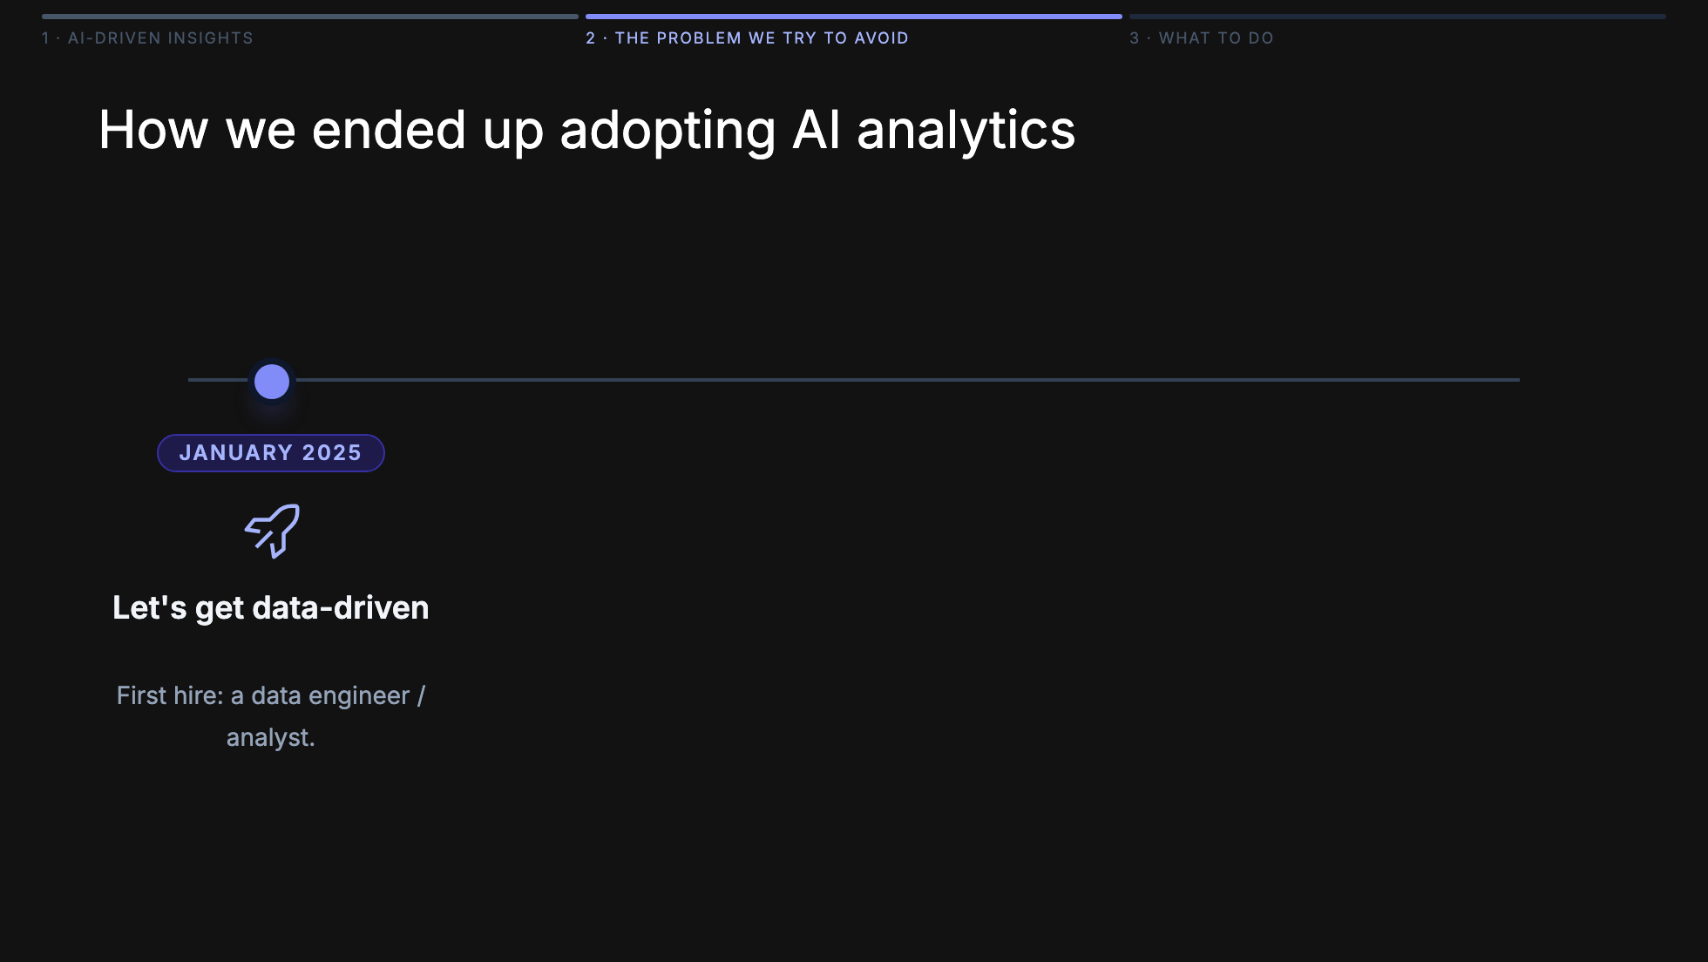
Notes:
This is a year in the life of a data team — and the moment AI walked in. January: first data hire. June: Snowflake + PowerBI, leadership is happy. August: sales wants churn data, requests pile up. December: the team is drowning, and someone points at Cortex Analyst as the way out. That's the moment we're really talking about today.

Slide 10
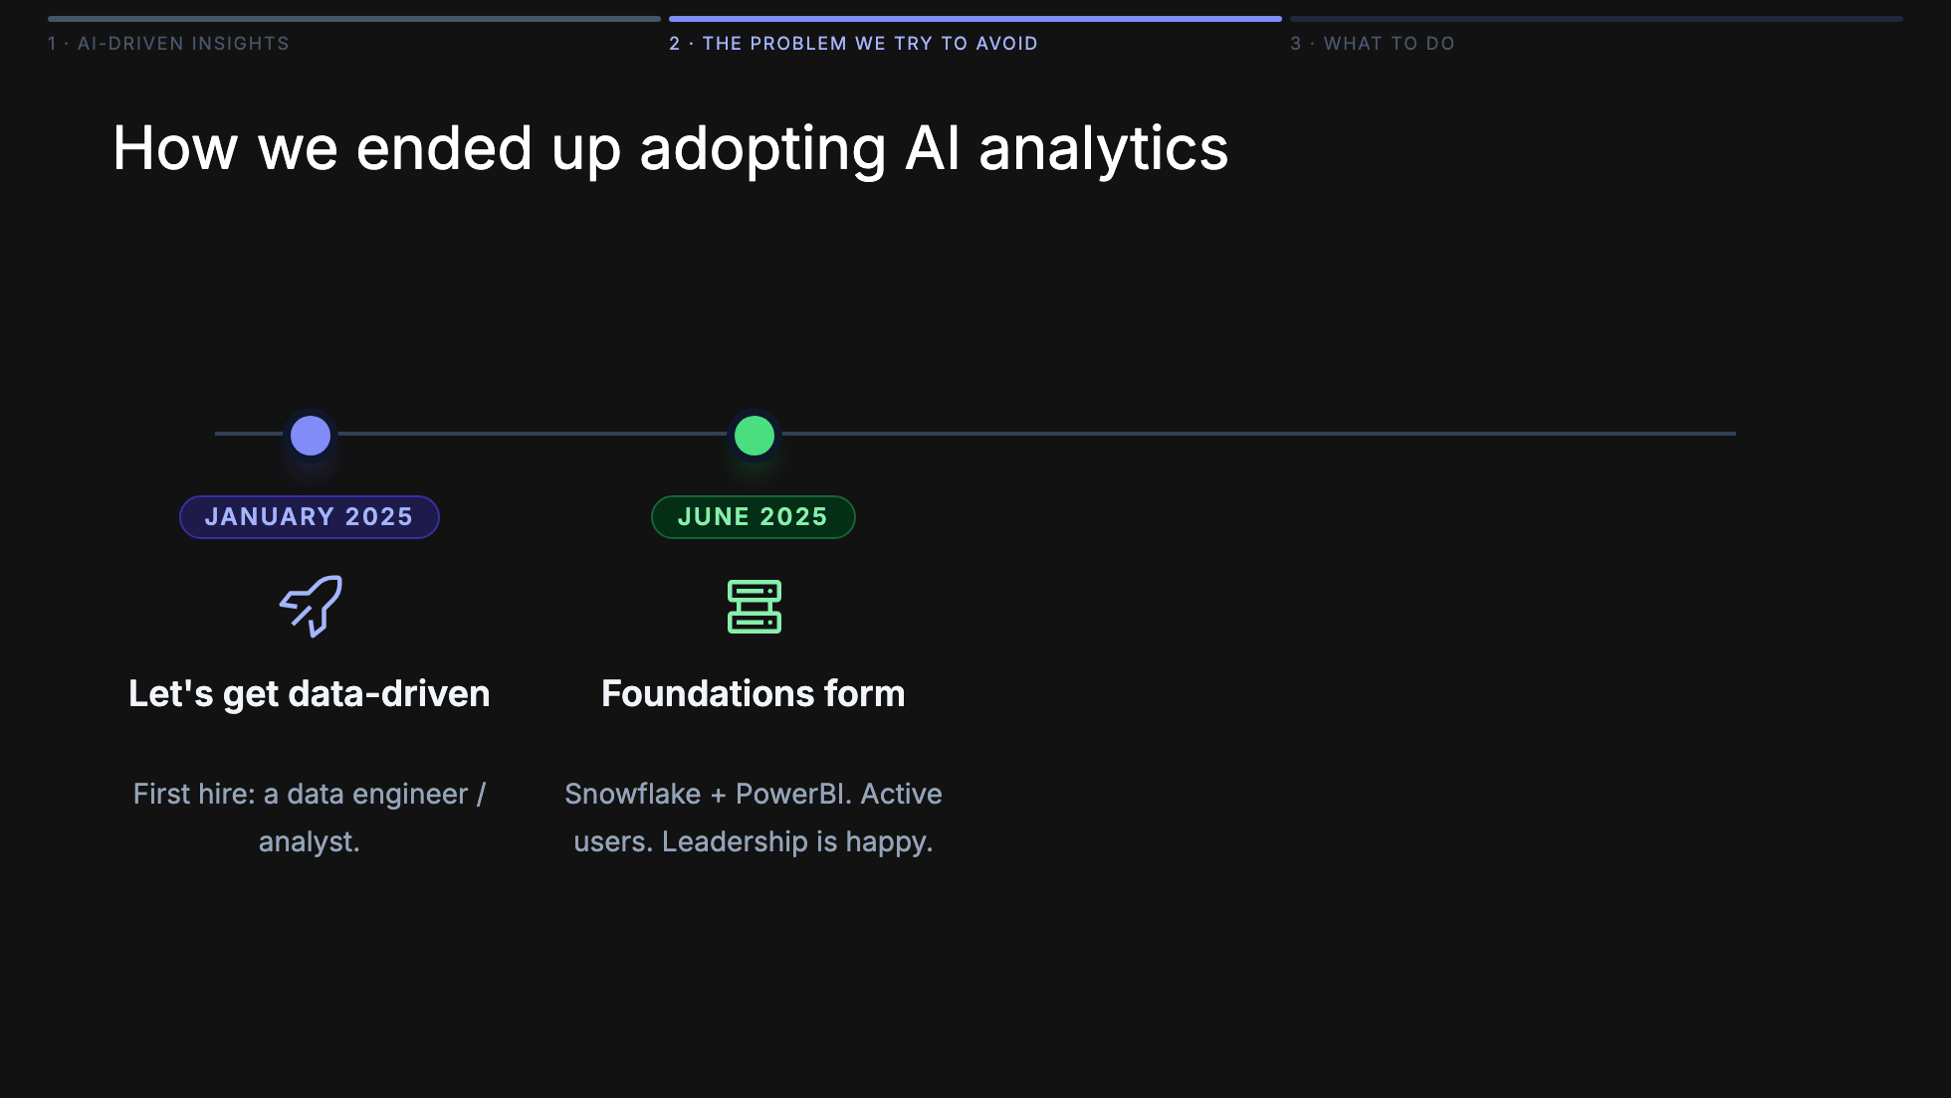
Notes:
This is a year in the life of a data team — and the moment AI walked in. January: first data hire. June: Snowflake + PowerBI, leadership is happy. August: sales wants churn data, requests pile up. December: the team is drowning, and someone points at Cortex Analyst as the way out. That's the moment we're really talking about today.

Slide 11
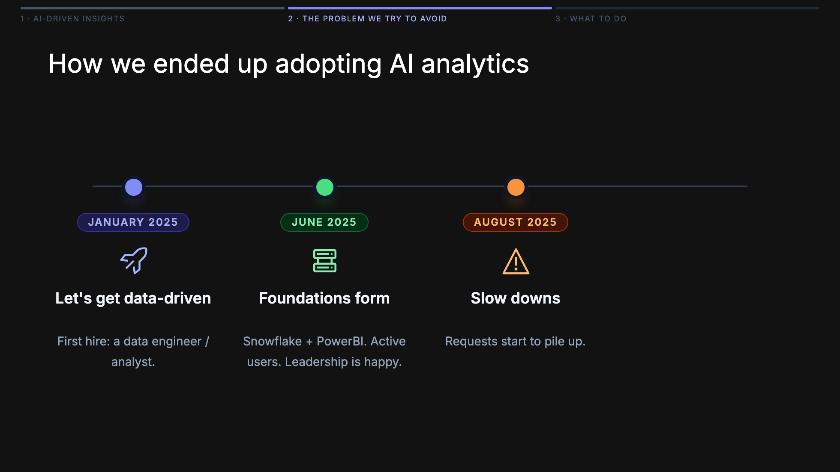
Notes:
This is a year in the life of a data team — and the moment AI walked in. January: first data hire. June: Snowflake + PowerBI, leadership is happy. August: sales wants churn data, requests pile up. December: the team is drowning, and someone points at Cortex Analyst as the way out. That's the moment we're really talking about today.

Slide 12
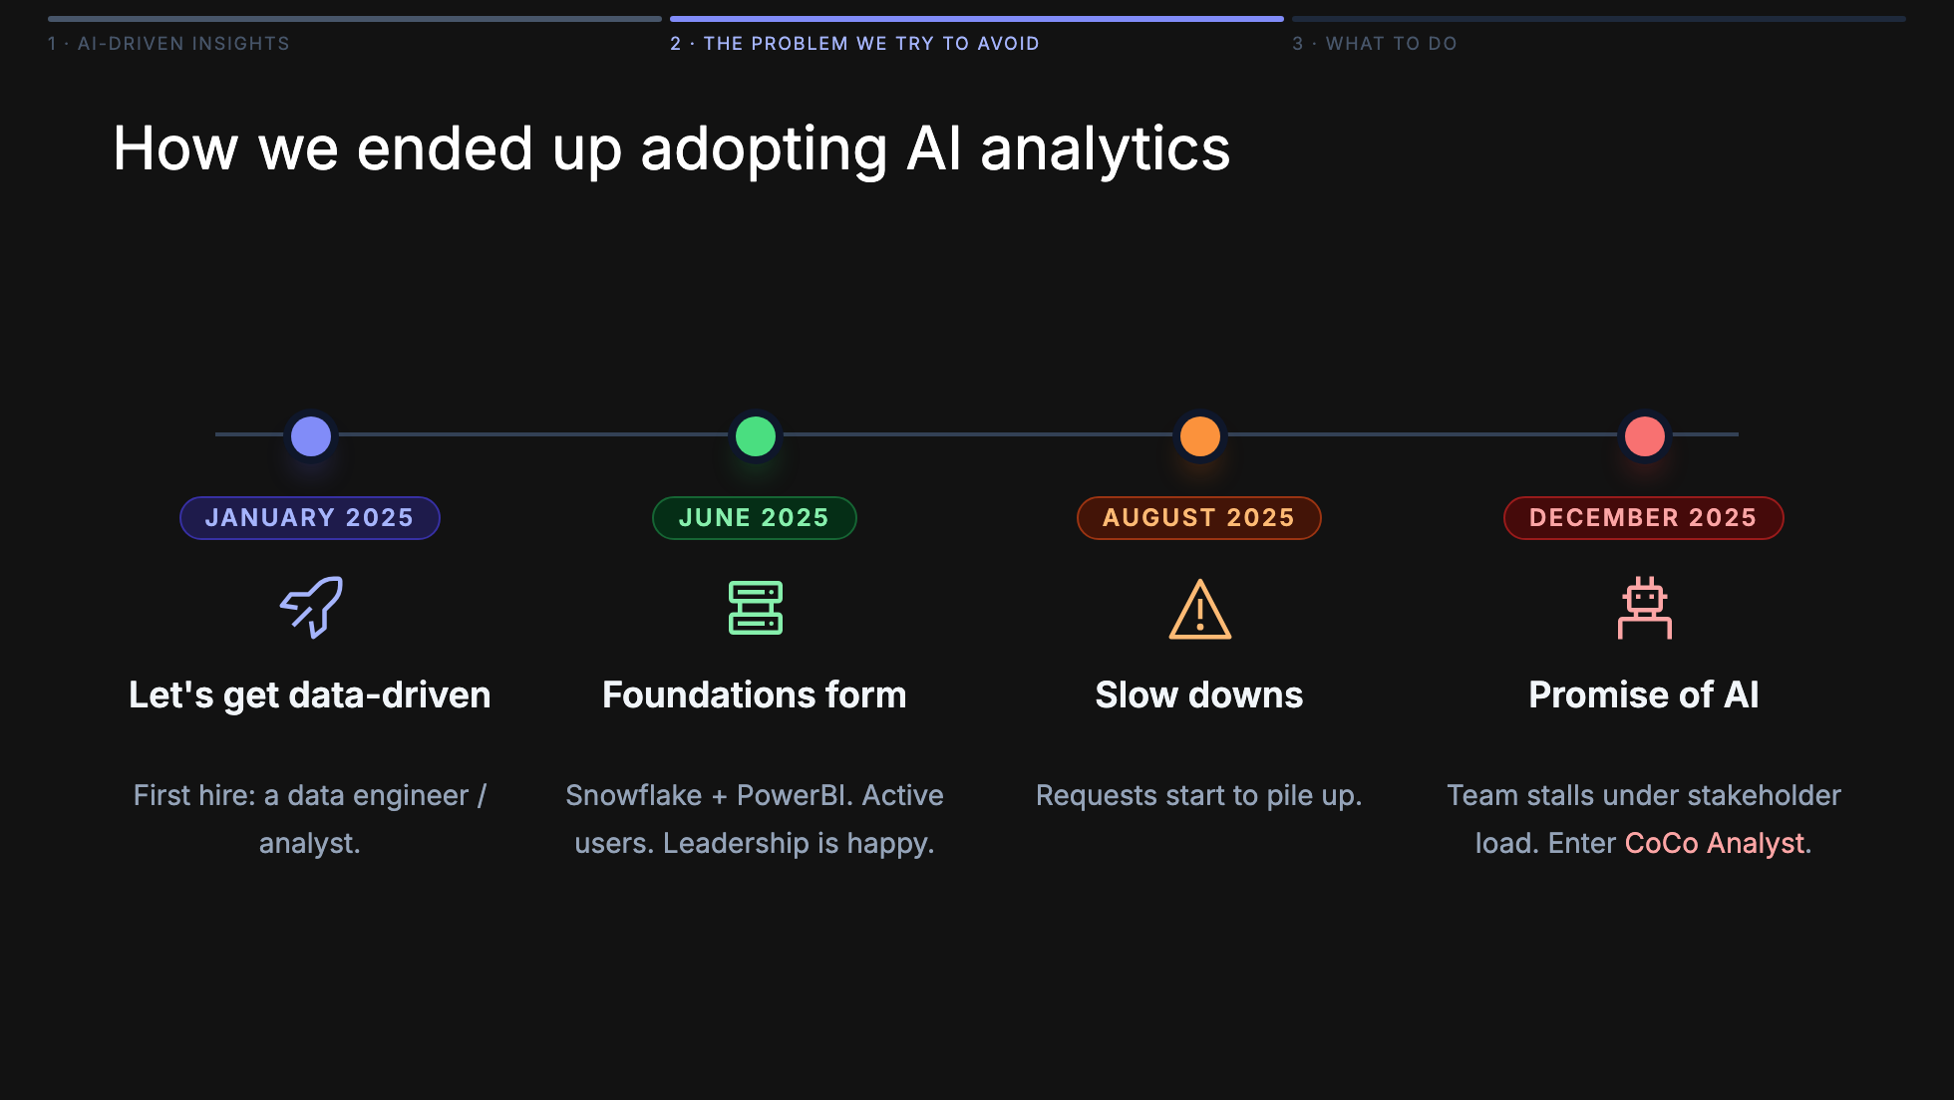
Notes:
This is a year in the life of a data team — and the moment AI walked in. January: first data hire. June: Snowflake + PowerBI, leadership is happy. August: sales wants churn data, requests pile up. December: the team is drowning, and someone points at Cortex Analyst as the way out. That's the moment we're really talking about today.

Slide 13
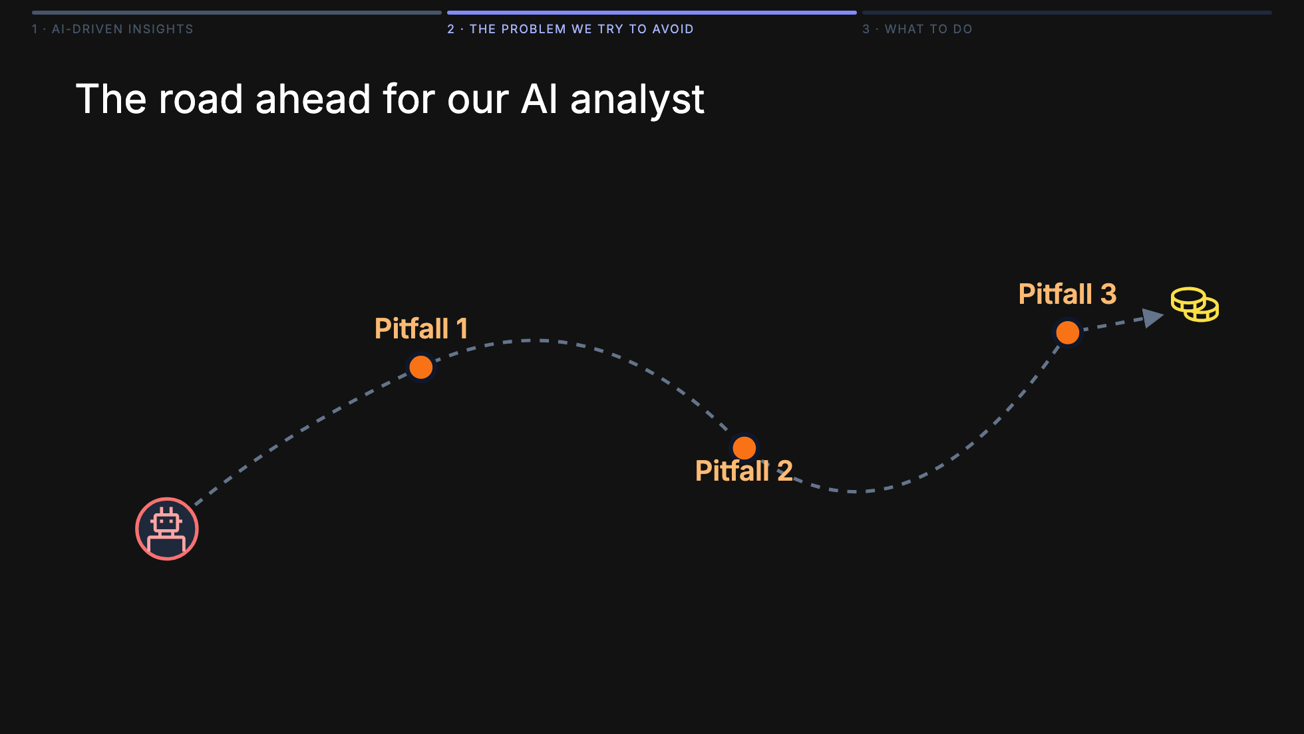
Notes:
Before we dive in, here's the map. Our AI analyst sets off full of promise — and hits three stops along the way. Each one is a pitfall we actually walked into. We're going to visit them in order.

Slide 14
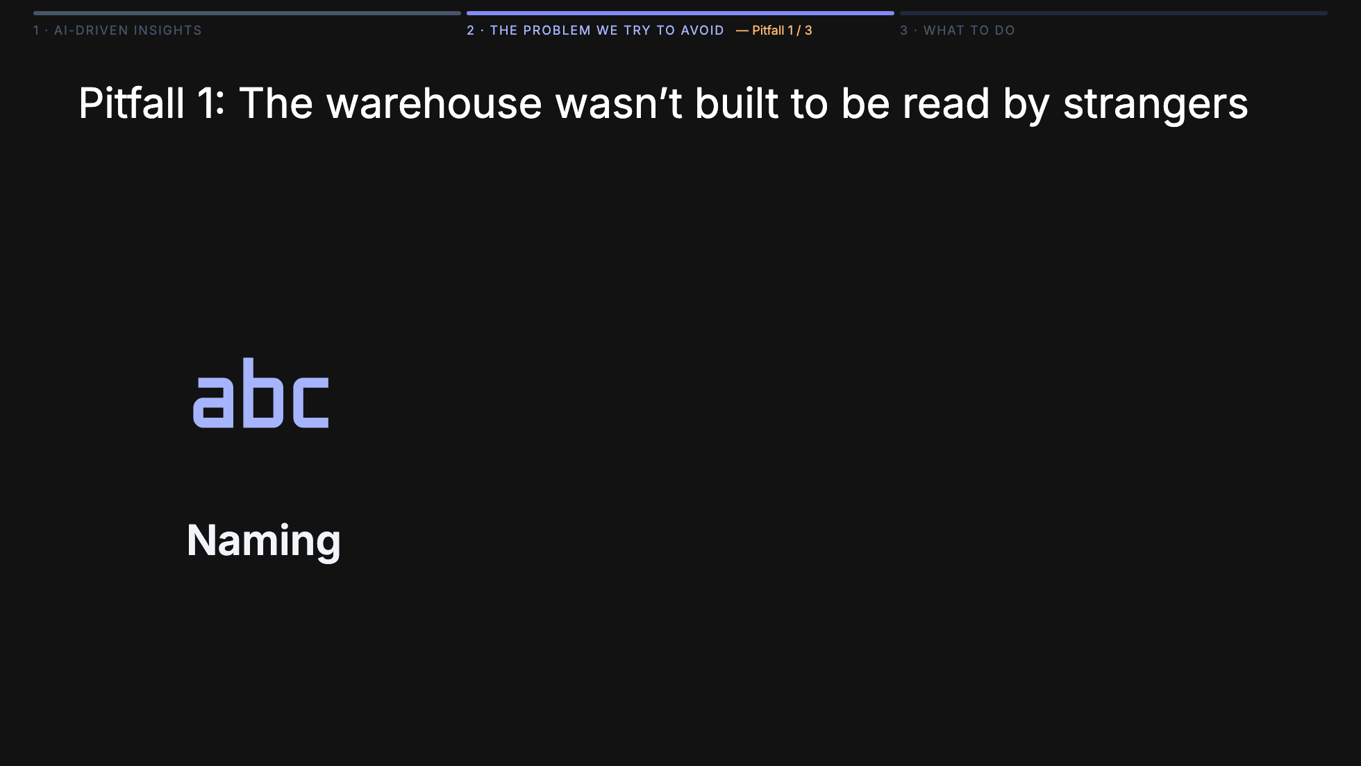
Notes:
Three things had to change, not one. Naming: usr_chn_flg_30d might be perfectly clear to whoever wrote it, but it's opaque to everyone else — and completely opaque to a model. Rename it so it reads like English. Structure: our warehouse had years of TBL_A_v3_final, customers_new, tmp_join_use_this — the kind of sprawl every team accumulates. No AI, and no new engineer, can navigate that. We had to reorganize into clear layers — raw, staging, marts — with predictable names in each layer. Documentation: almost no column had a description. Even the perfectly named column needs a sentence explaining what it actually means, what edge cases it excludes, who owns it. Without that, the model — and every human after us — is guessing. The bigger point: the whole warehouse was built by a small team for that team. To make AI work on top of it, we effectively have to rebuild it to be self-documenting and unambiguous.

Slide 15
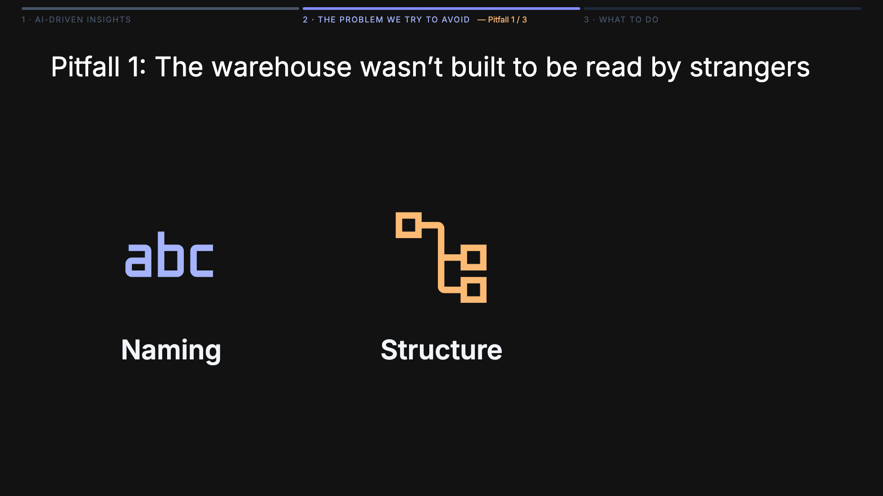
Notes:
Three things had to change, not one. Naming: usr_chn_flg_30d might be perfectly clear to whoever wrote it, but it's opaque to everyone else — and completely opaque to a model. Rename it so it reads like English. Structure: our warehouse had years of TBL_A_v3_final, customers_new, tmp_join_use_this — the kind of sprawl every team accumulates. No AI, and no new engineer, can navigate that. We had to reorganize into clear layers — raw, staging, marts — with predictable names in each layer. Documentation: almost no column had a description. Even the perfectly named column needs a sentence explaining what it actually means, what edge cases it excludes, who owns it. Without that, the model — and every human after us — is guessing. The bigger point: the whole warehouse was built by a small team for that team. To make AI work on top of it, we effectively have to rebuild it to be self-documenting and unambiguous.

Slide 16
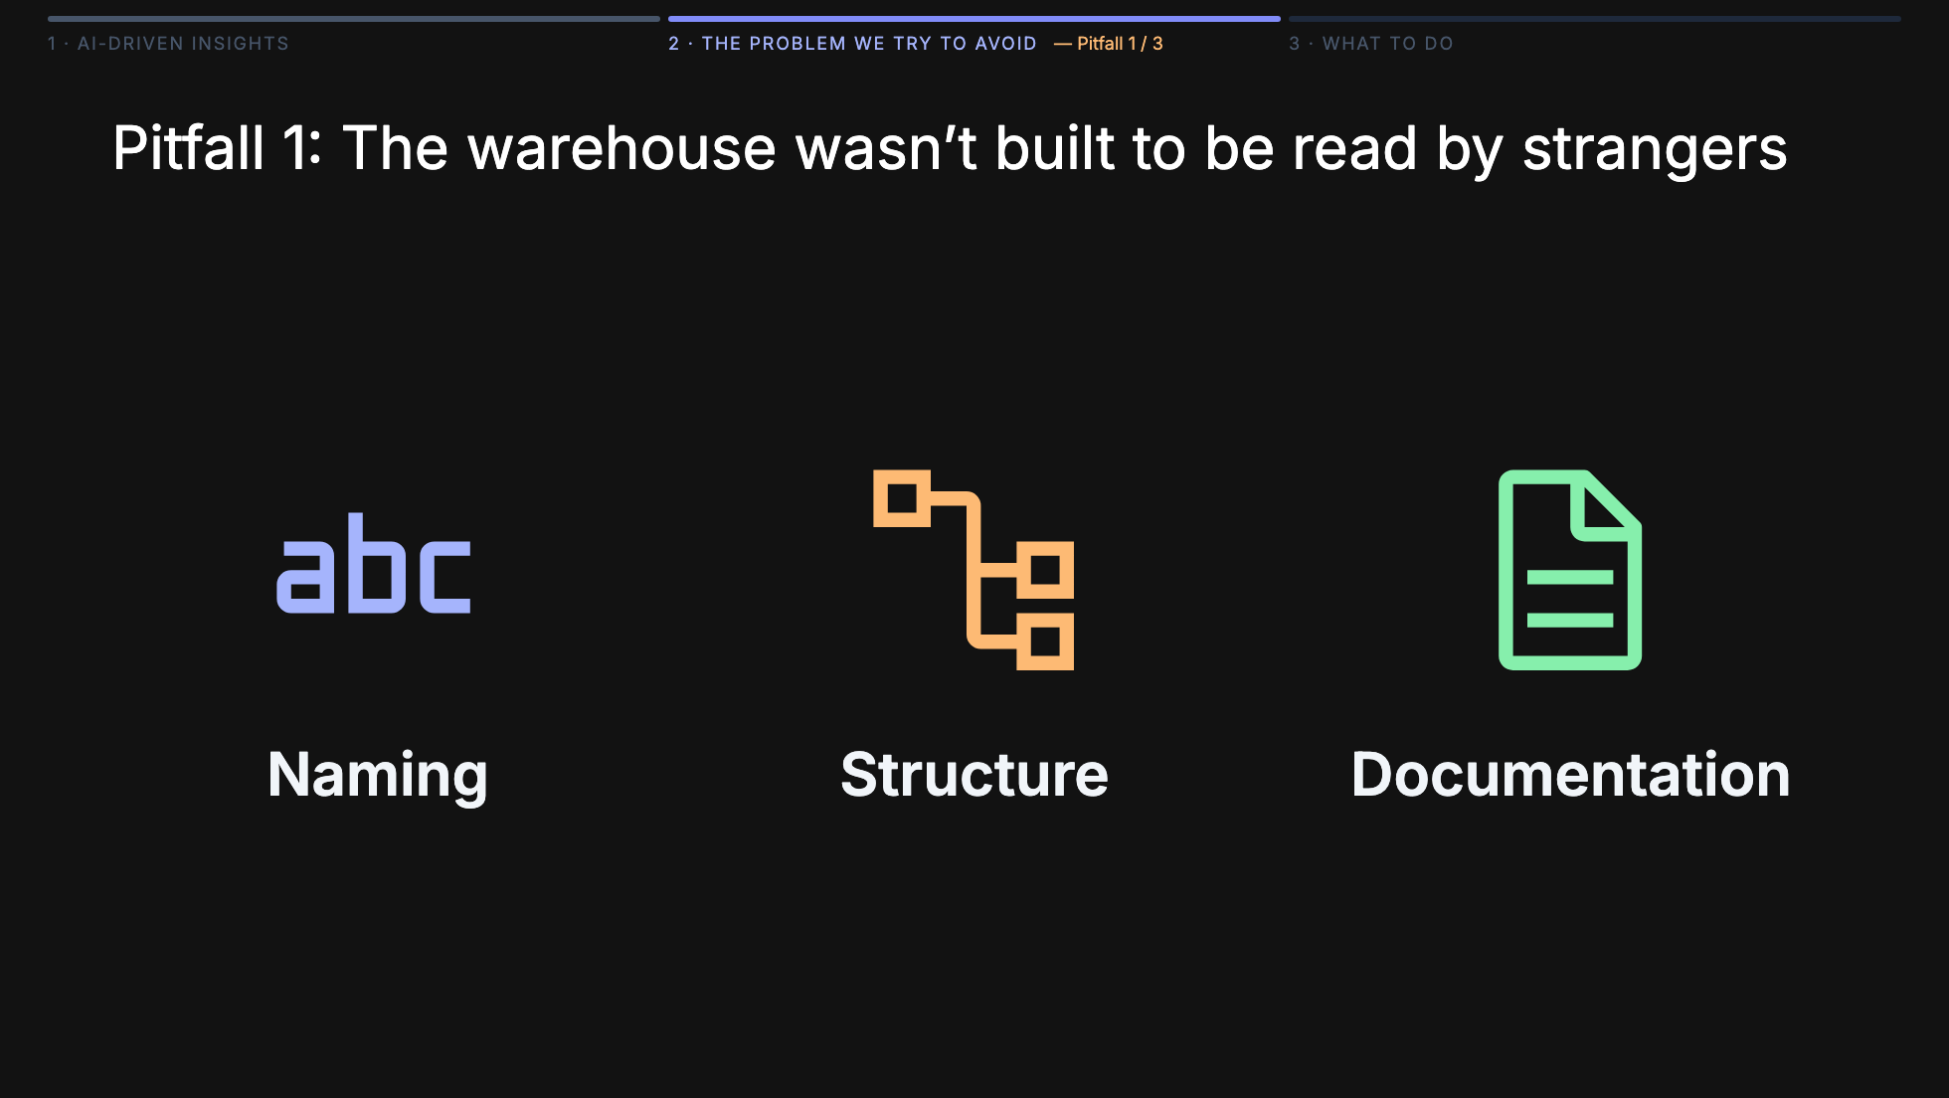
Notes:
Three things had to change, not one. Naming: usr_chn_flg_30d might be perfectly clear to whoever wrote it, but it's opaque to everyone else — and completely opaque to a model. Rename it so it reads like English. Structure: our warehouse had years of TBL_A_v3_final, customers_new, tmp_join_use_this — the kind of sprawl every team accumulates. No AI, and no new engineer, can navigate that. We had to reorganize into clear layers — raw, staging, marts — with predictable names in each layer. Documentation: almost no column had a description. Even the perfectly named column needs a sentence explaining what it actually means, what edge cases it excludes, who owns it. Without that, the model — and every human after us — is guessing. The bigger point: the whole warehouse was built by a small team for that team. To make AI work on top of it, we effectively have to rebuild it to be self-documenting and unambiguous.

Slide 17
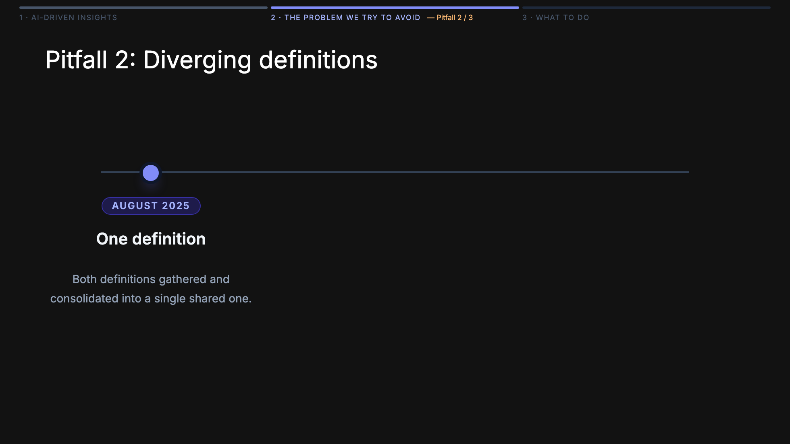

Slide 18
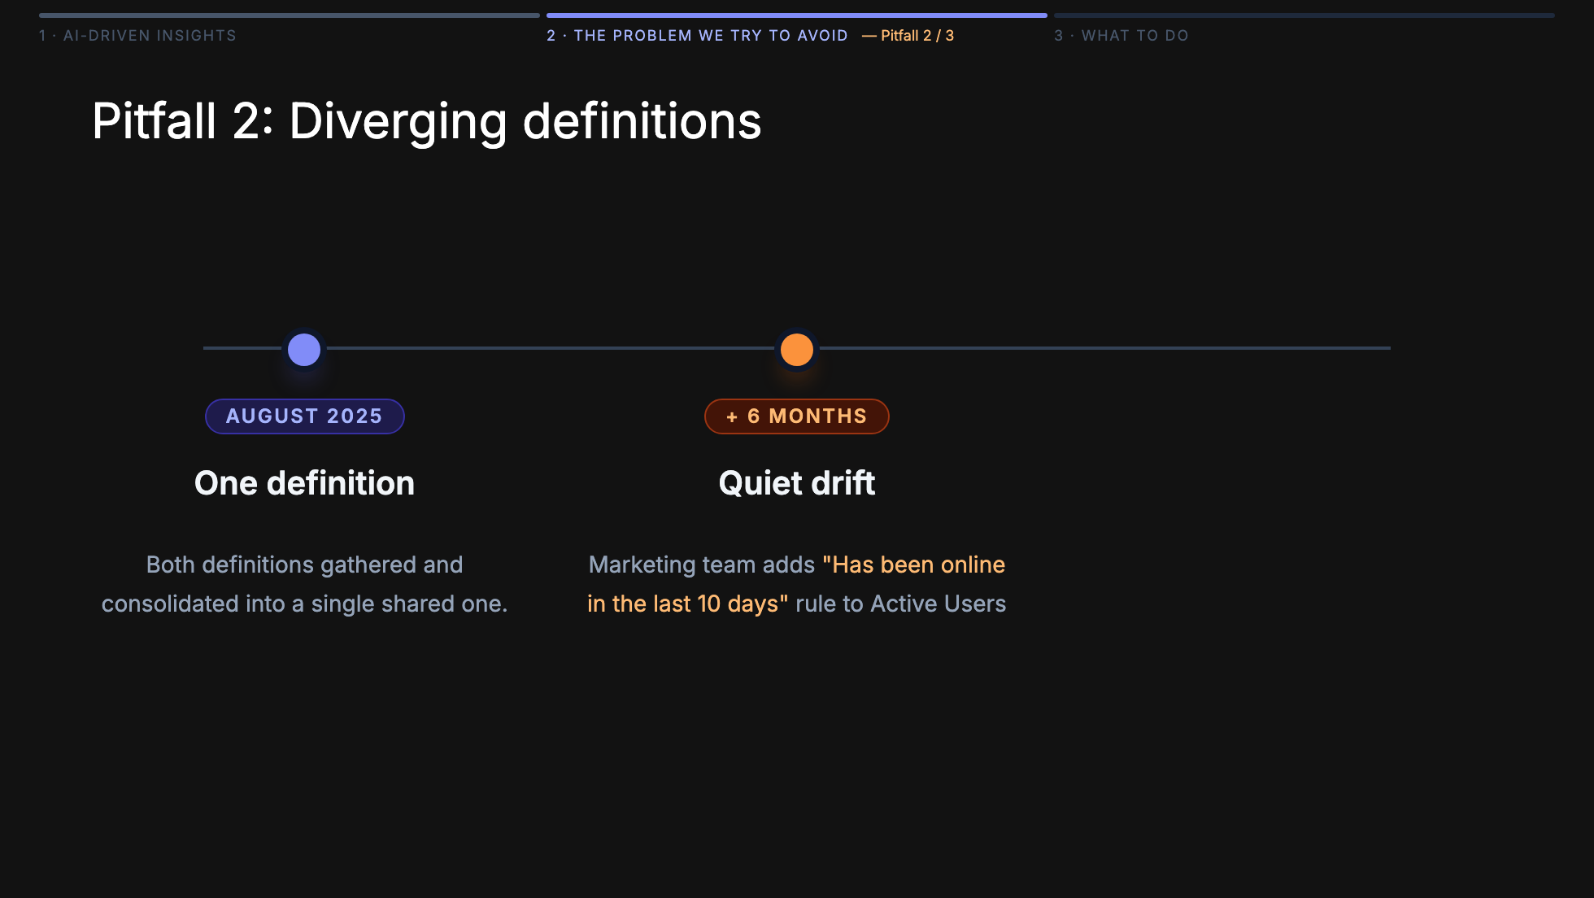

Slide 19
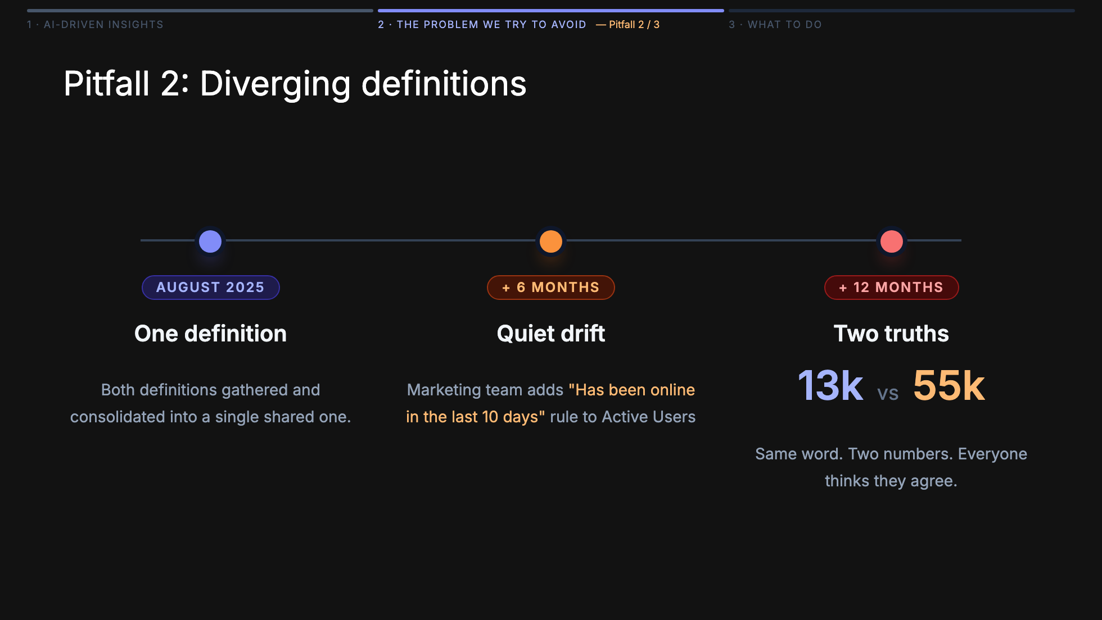

Slide 20
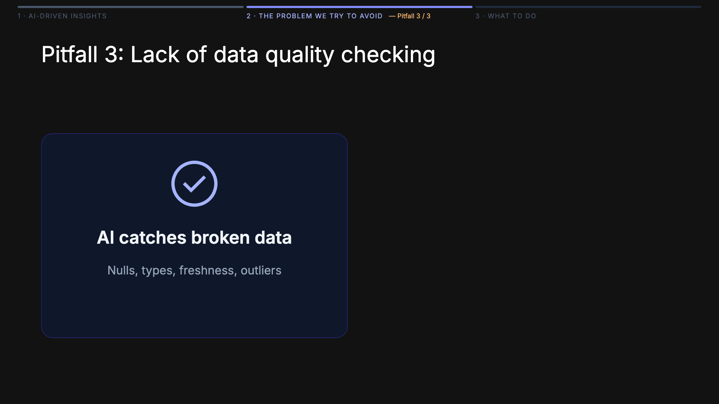
Notes:
A model will happily spot nulls, outliers, broken joins — the syntactic stuff. What it cannot spot: that "active customer" quietly started including trial users last quarter. The left side is what AI sees: schemas, freshness, null rates, statistical anomalies — syntactically valid, domain-blind. The right side is what only a human knows: what a field actually means this quarter, which edge cases are real customers vs noise, when a perfectly clean-looking number is lying. Context lives in people, not columns.

Slide 21
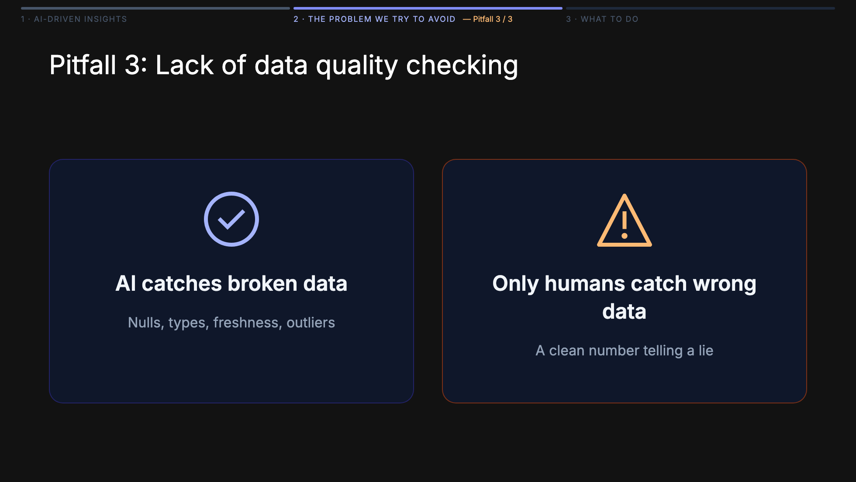
Notes:
A model will happily spot nulls, outliers, broken joins — the syntactic stuff. What it cannot spot: that "active customer" quietly started including trial users last quarter. The left side is what AI sees: schemas, freshness, null rates, statistical anomalies — syntactically valid, domain-blind. The right side is what only a human knows: what a field actually means this quarter, which edge cases are real customers vs noise, when a perfectly clean-looking number is lying. Context lives in people, not columns.

Slide 22
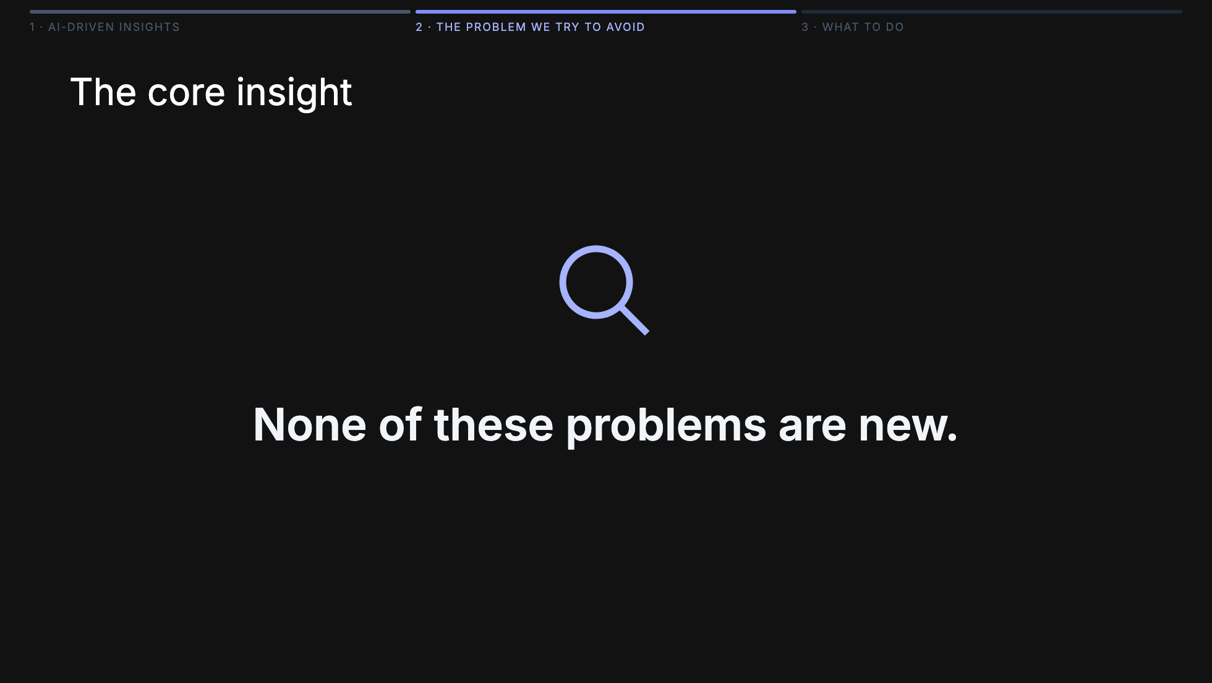

Slide 23
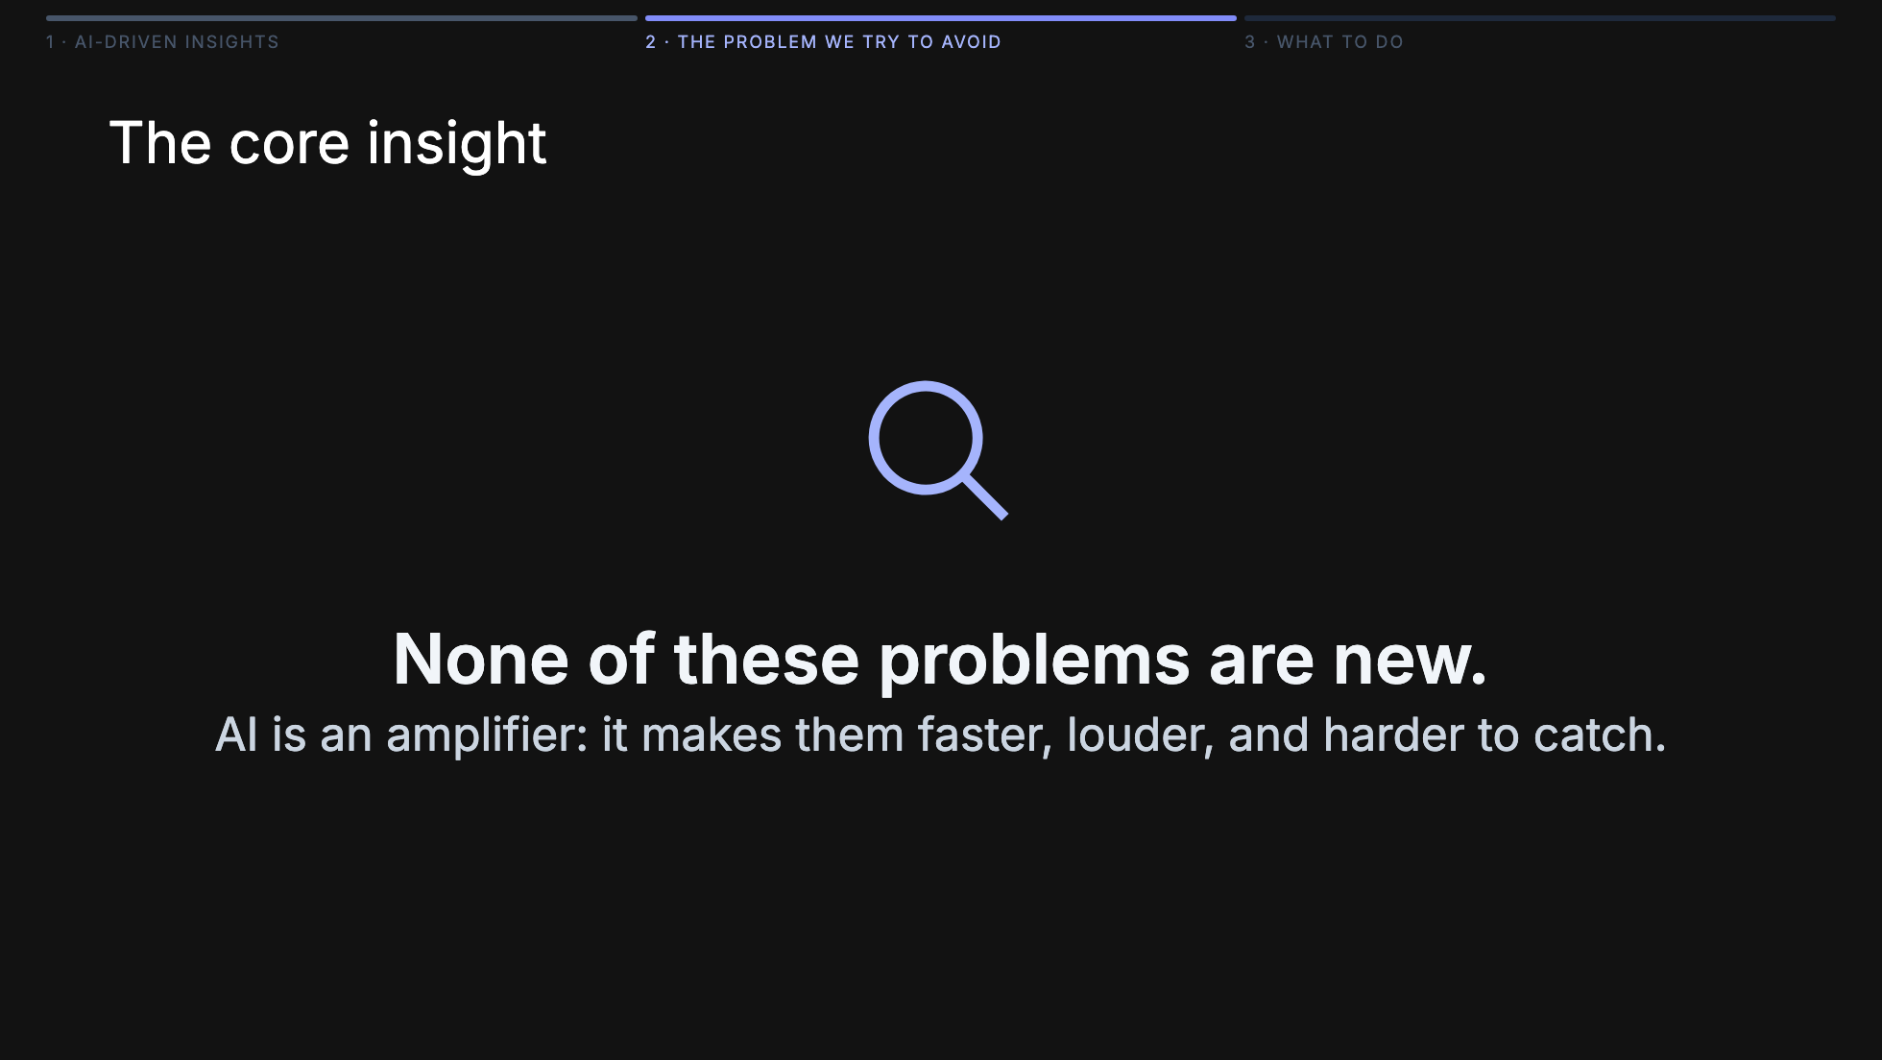

Slide 24
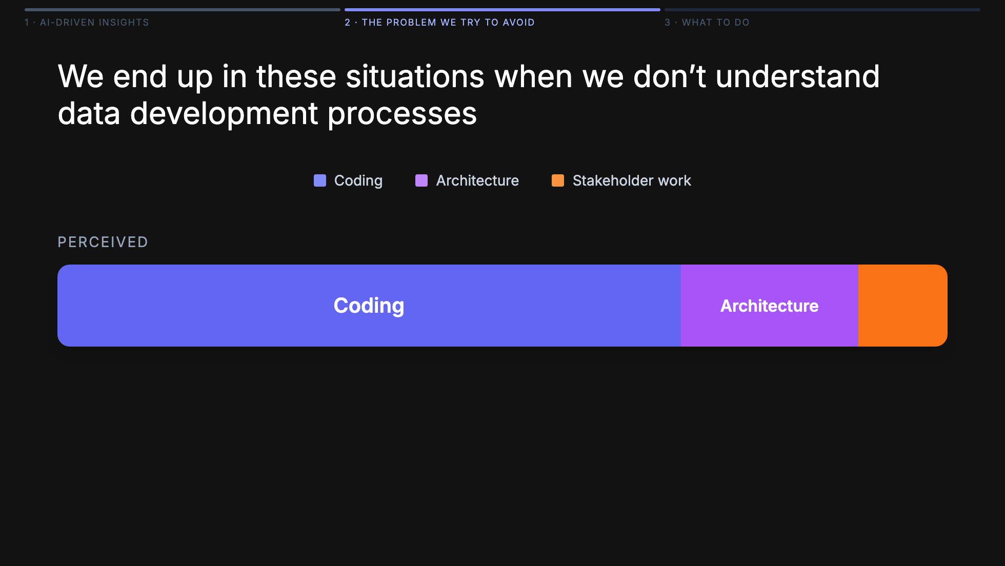
Notes:
Here's the punchline behind reason number one. The business — and honestly a lot of engineers before they've done the job — thinks data engineering is 70% coding, 20% architecture, 10% talking to people. That's the picture that makes AI look like a silver bullet: if the job is mostly code, then a code-writing model must eat most of the job. The reality is almost inverted. In my experience it's more like 70% stakeholder work — chasing definitions, reconciling metrics, sitting between finance and product, translating a vague question into a query someone can actually trust — and only about 15% each on architecture and code. So when a vendor drops an AI chatbot on top of your warehouse, it doesn't shrink the 70%. It grows it. Every new consumer of data becomes a new source of ambiguous questions, drifting definitions, and confident-looking wrong answers you now have to defend. The bottleneck was never the code.

Slide 25
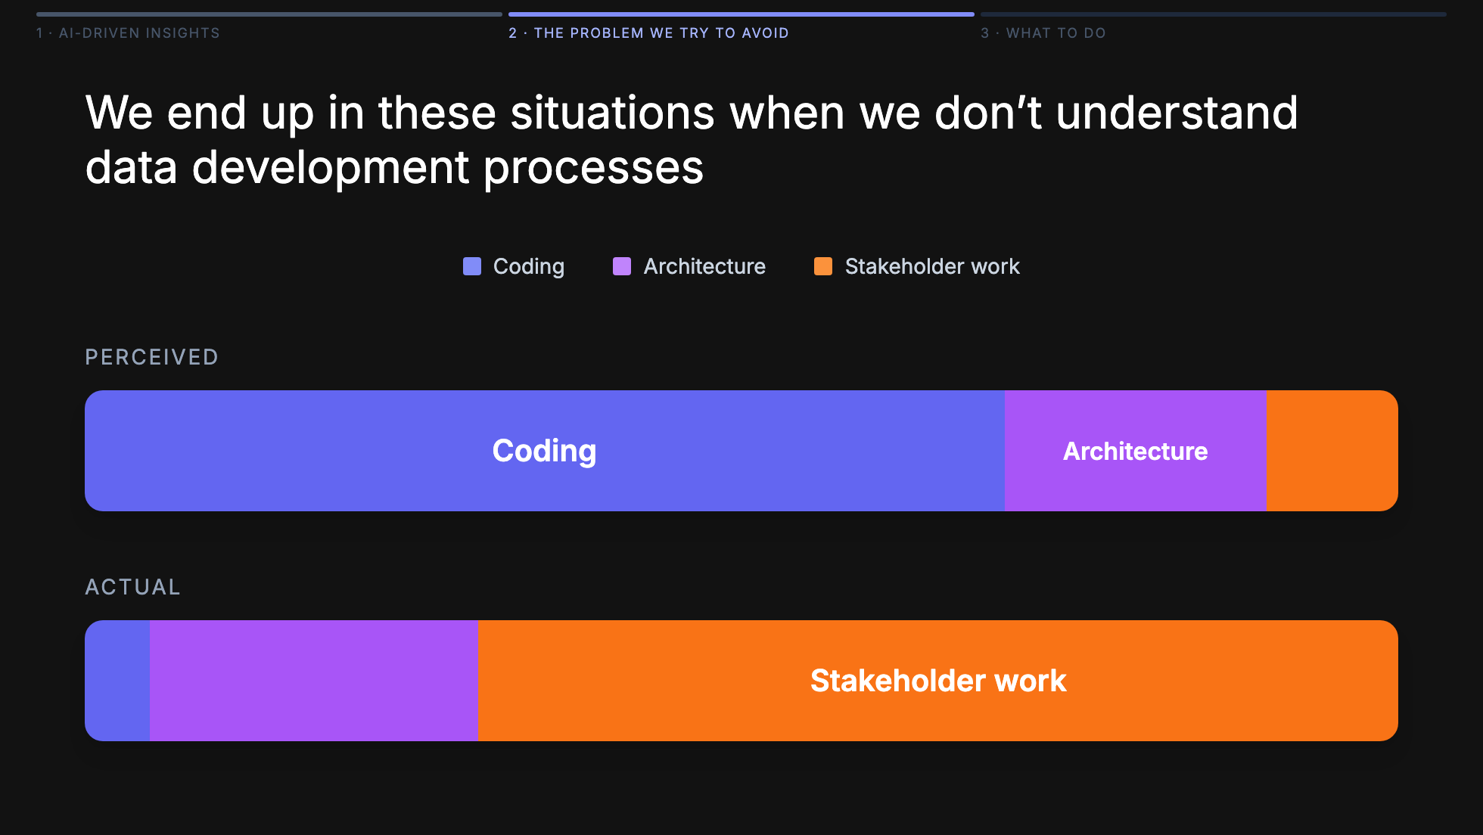
Notes:
Here's the punchline behind reason number one. The business — and honestly a lot of engineers before they've done the job — thinks data engineering is 70% coding, 20% architecture, 10% talking to people. That's the picture that makes AI look like a silver bullet: if the job is mostly code, then a code-writing model must eat most of the job. The reality is almost inverted. In my experience it's more like 70% stakeholder work — chasing definitions, reconciling metrics, sitting between finance and product, translating a vague question into a query someone can actually trust — and only about 15% each on architecture and code. So when a vendor drops an AI chatbot on top of your warehouse, it doesn't shrink the 70%. It grows it. Every new consumer of data becomes a new source of ambiguous questions, drifting definitions, and confident-looking wrong answers you now have to defend. The bottleneck was never the code.

Slide 26
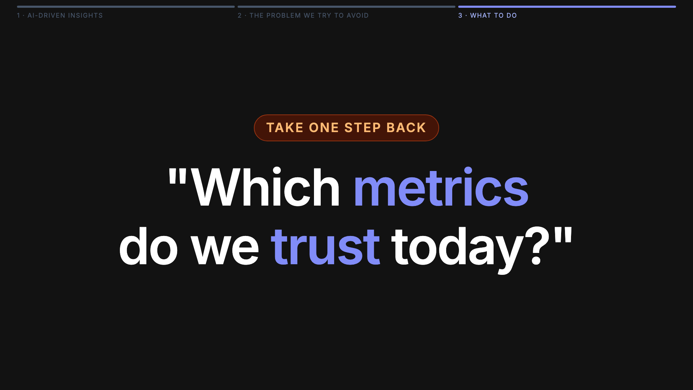

Slide 27
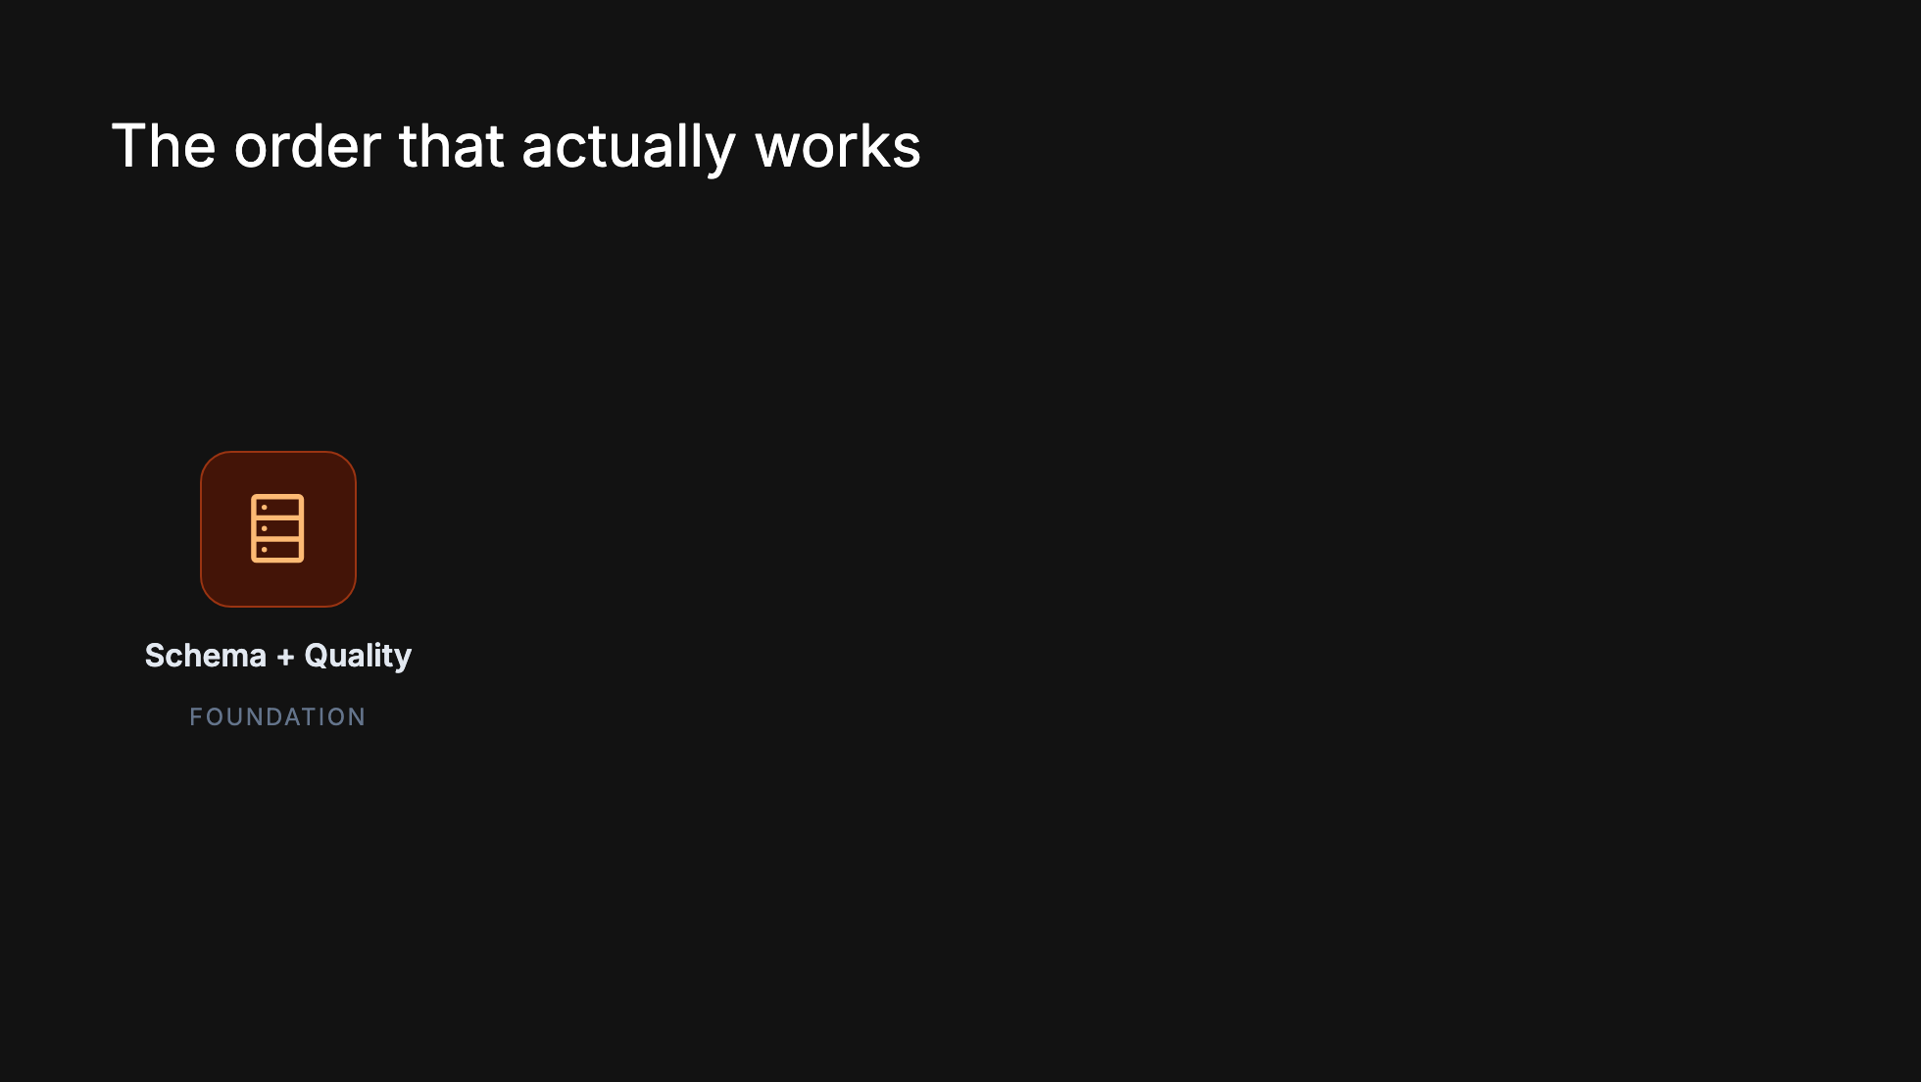
Notes:
Foundation first: schema and quality. Then agreed metrics on top of that. Then dashboards you actually trust. Then, and only then, AI on top as the capstone. You cannot skip a step — AI on shaky ground falls faster than dashboards on shaky ground, because it moves faster and speaks with more confidence.

Slide 28
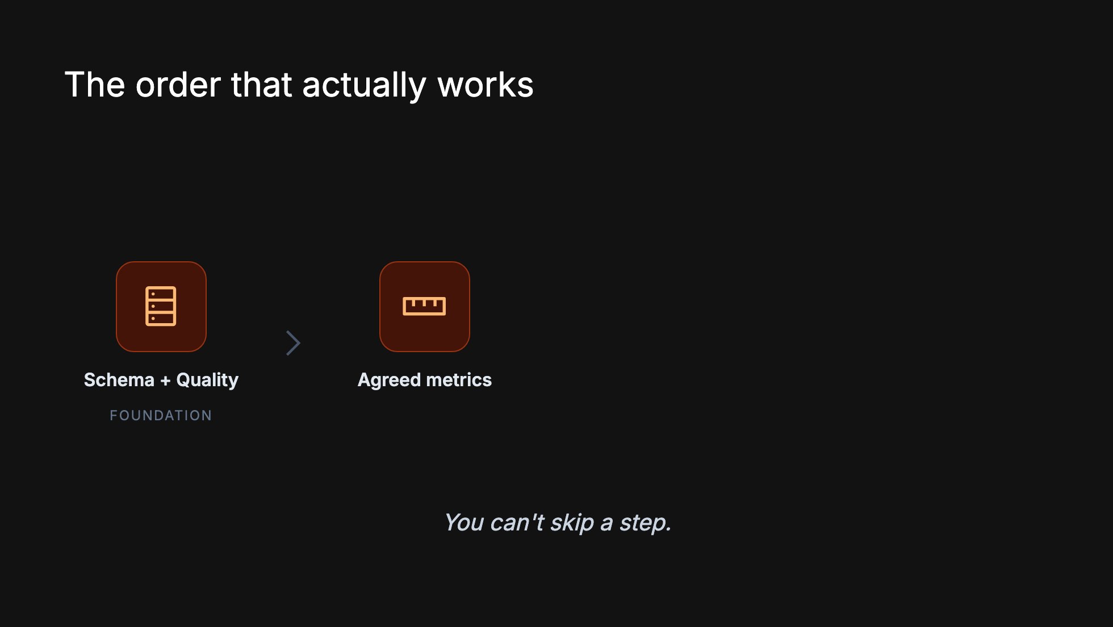
Notes:
Foundation first: schema and quality. Then agreed metrics on top of that. Then dashboards you actually trust. Then, and only then, AI on top as the capstone. You cannot skip a step — AI on shaky ground falls faster than dashboards on shaky ground, because it moves faster and speaks with more confidence.

Slide 29
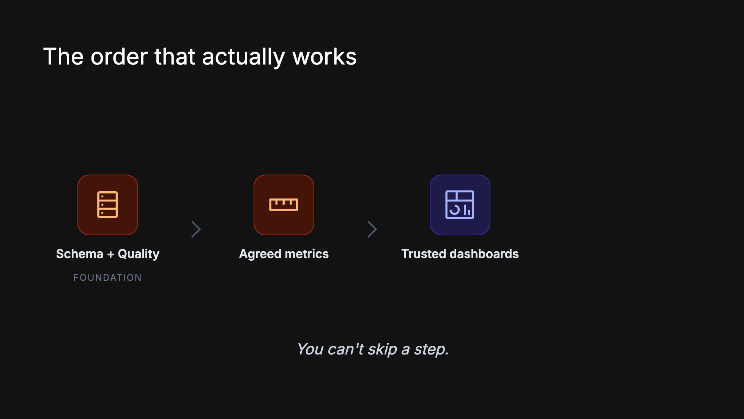
Notes:
Foundation first: schema and quality. Then agreed metrics on top of that. Then dashboards you actually trust. Then, and only then, AI on top as the capstone. You cannot skip a step — AI on shaky ground falls faster than dashboards on shaky ground, because it moves faster and speaks with more confidence.

Slide 30
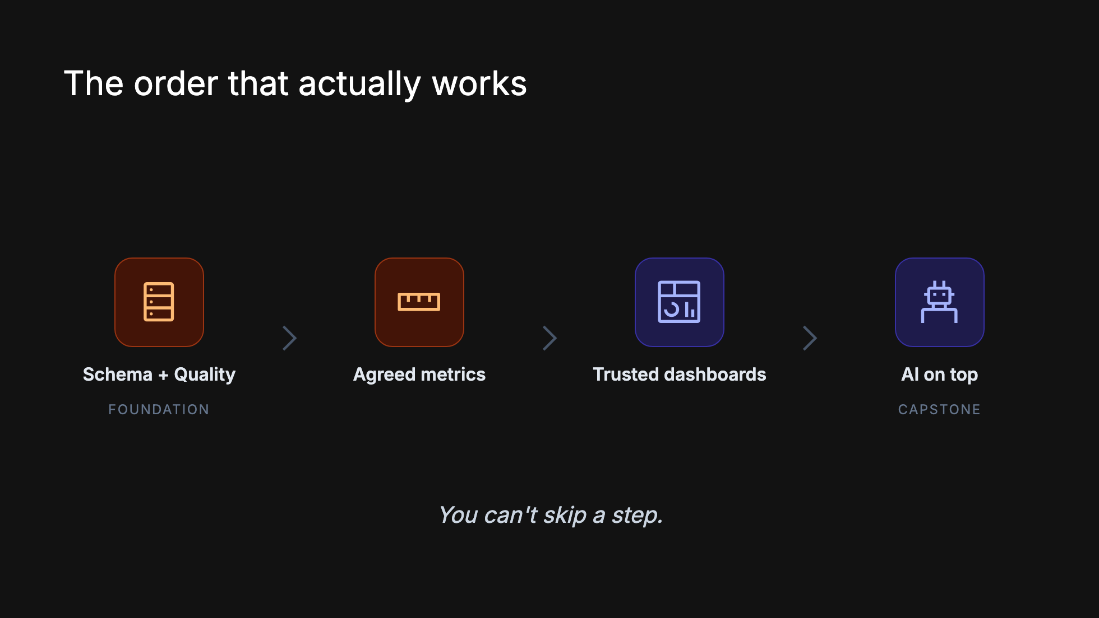
Notes:
Foundation first: schema and quality. Then agreed metrics on top of that. Then dashboards you actually trust. Then, and only then, AI on top as the capstone. You cannot skip a step — AI on shaky ground falls faster than dashboards on shaky ground, because it moves faster and speaks with more confidence.

Slide 31
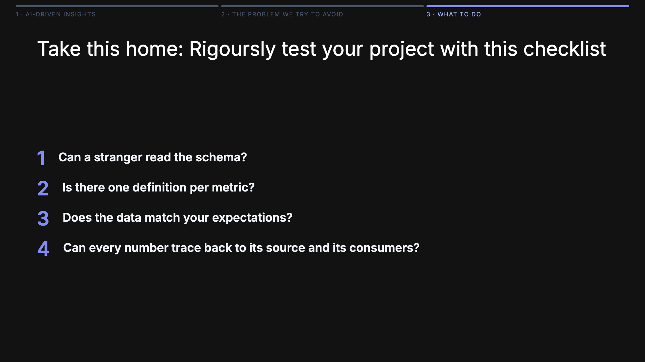
Notes:
Run these against your own company on Monday morning. Any "no" is where AI will hurt you first. One: can a stranger read the schema? Column names, descriptions — the usr_chn_flg_30d problem. Two: is there one definition per metric — written, findable, agreed? The active-customer problem. Three: does the data actually match your expectations? Quality checks, domain sanity, and coverage of the questions the business actually asks. Four: can every number trace back to its source and its consumers? Lineage, ownership, access. If you can't trace it, you can't trust it.

Slide 32
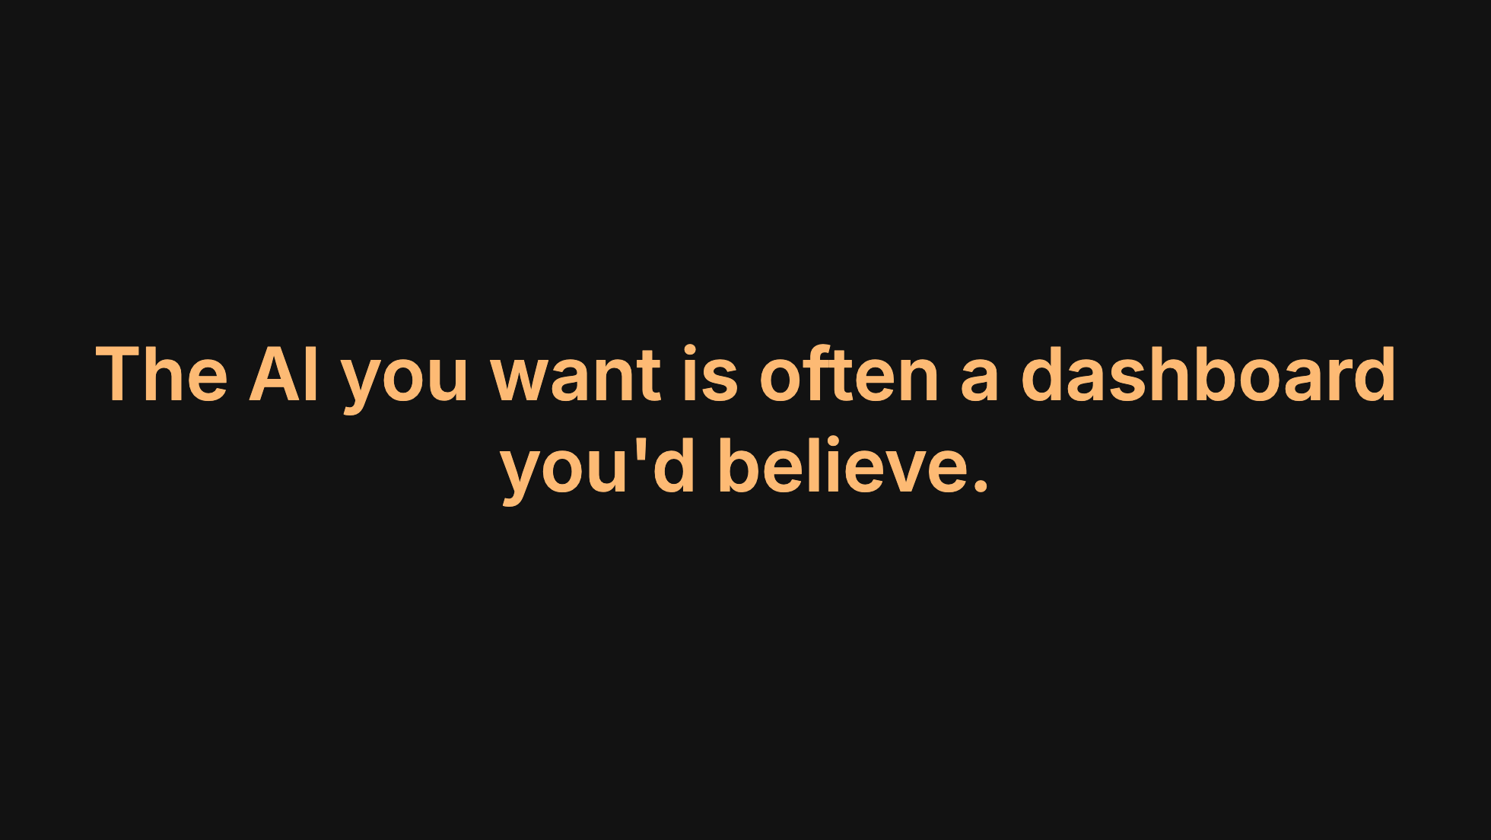

Slide 33
