Slide 1


BASEL BOSTON CHICAGO DALLAS FRANKFURT LONDON LOS ANGELES MIAMI
Healthcare Nomenclature Workshop
NEW YORK RALEIGH-DURHAM ROCKVILLE SAN FRANCISCO SEATTLE SEOUL TOKYO TORONTO
Project KARKINOS
November 12, 2015

Slide 2

Contents
Introduction & Meeting Objectives
Project Timeline
Name Development Process
Naming Objectives
Product Overview
Mechanism of Action
Competitive Landscape
Creative Direction
Refined Creative Direction
Brand Naming Strategies
Name Candidate Evaluation
Q & A - Discuss Next Steps

Slide 3
Introduction & Meeting Objectives
Brand Institute is pleased to work with Pfizer on the brand/proprietary name development for PF-04449913 (USAN/pINN: glasdegib), under investigation for the treatment of AML (Acute Myeloid Leukemia) and relapsed/refractory MF (Myelofibrosis). Additional trials are being/will be conducted for high-risk MDS (Myelodysplastic Syndrome) and first-line MF.
Services will include Creative, Trademark Screening, Linguistics and Regulatory Consult. This name must be acceptable from all perspectives (legal, regulatory, commercial, linguistic, competitive) and should support the product’s point(s) of differentiation through messaging and/or tonality. The new brand name should be acceptable in all key markets.
During this Nomenclature Workshop we will:
  Review and discuss potential name candidates
  Select name candidates that meet the branding objectives
  Identify concepts, key words, imagery and messages to explore/avoid
  Create new names based on names/concepts presented
  Discuss next steps

Slide 4
Project Timeline
PHASE | DATE | Day of Week
Brand Strategy Recommendation Meeting [1st Project Team Meeting] | 28-Apr-2014 | Monday
Creative Name Development Begins | 28-Apr-2014 | Monday
Nomenclature Workshop Meeting/Conference Call [2nd Project Team Meeting] | 29-May-2014 | Thursday
Creative Name Refinement Begins | 29-May-2014 | Thursday
Nomenclature Workshop #2 Meeting/Conference Call [3rd Project Team Meeting] | 18-June-2014 | Wednesday
Creative Name Refinement Begins | 18-June-2014 | Wednesday
B.I. BrandMatrix™ Posted | Late June | TBD
Pfizer Completes Brand Matrix | Late June | TBD
BrandMatrix™ Results Conference Call | Early July | TBD
BrandSearch™ Trademark Screening Begins - Methodology & Timing Approved | July | TBD
BrandSearch™ Trademark Results Sent to Client | July | TBD
BrandSearch™ Trademark Opinion Conference Call | July | TBD
Pfizer Legal Searching Begins | August | TBD
Linguistic Screening Begins | TBD | TBD
B.I. Linguistic & DSI Consult Completed | TBD | TBD
Bold indicates Project Team involvement

Slide 5

Name Development Process
1. Project Team Brand Strategy Recommendation – Meeting #1 [Previous]
  Review project timeline, scope and deliverables
  Discuss the product and competitive environment
  Identify key attributes, benefits and root words
  Prioritize key attributes, benefits and root words
  Project Team creative Brandstorming session
2. Brand Institute Brand Ideation™ Creative Development
  Create additional names based on BSR direction
  BrandReality™ Trademark Prescreening
    Trademark classes: US, CTM, WIPO
    Trademark registries: 5 & 10
200-300 NAMES
CREATIVE
TM SCREENING
50-75 NAMES
LG SCREENING
MARKET
RESEARCH
10-15 NAMES
SHORT LIST OF NAMES

Slide 6

Name Development Process
3. Project Team Nomenclature Workshop – Meeting #2 [Today]
  Review 100 - 125 name candidates
  Retain favorable name candidates
  Project Team new name creation
  Identify attributes, benefits and root words for refinement
4. Brand Institute Brand Ideation™ Creative Refinement
  Create additional names based on refined direction
  BrandReality™ Trademark Prescreening
5. Project Team BrandMatrix™ Online Name Evaluation Tool
  Project team evaluates 125+ name candidates
  Global project team input
  Identify ~75 names for BrandSearch™ trademark screening

Slide 7
Product Overview
Product Profile (PF-04449913)
Drug class/classification: antineoplastic
Nonproprietary/generic name: glasdegib
USAN/INN stem: -degib (hedgehog pathway inhibitors)
Indication(s): Lead indications: AML (Acute Myeloid Leukemia) and relapsed/refractory MF (Myelofibrosis), Also conducting trials for high-risk MDS (Myelodysplastic Syndrome) and first-line MF
Standard dose/additional dose(s): 100mg (assuming that the current Ph 2 doses for AML end up working for all indications)
Formulation: Tablets
Route(s) of administration: Oral
Frequency of administration: QD

Slide 8
Product Overview
Product Description
PF-04449913 is a novel oral small molecule inhibitor that selectively binds and targets Smoothened (SMO), a membrane protein regulating the Hedgehog pathway
SMO is the principal component required for activating the Hh/Gli signaling pathway, and plays a key role in human malignancies when it is activated
Hh signaling is initiated when Hh binds to Patched (PTCH) and deactivates its function, which in the absence of Hh, negatively regulates signaling
After Hh deactivates PTCH, SMO, which is normally held in an inactive state by PTCH, is released to activate a signaling cascade that ultimately regulates the Gli family of transcription factors
Hh pathway has received increasing attention as a pleiotropic oncogenic pathway that has been implicated in both hematopoietic and solid tumor malignancies by diverse mechanisms, including direct cell cycle and anti-angiogenic effects

Slide 9
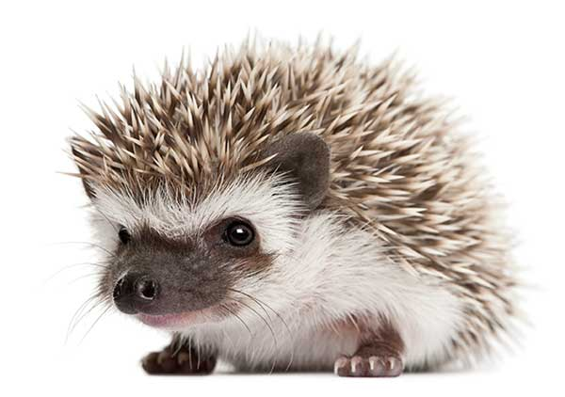
Mechanism of Action
Mechanism of Action
PF-04449913 is a novel oral small molecule inhibitor that selectively binds and targets Smoothened (SMO), a membrane protein regulating the Hedgehog pathway

Slide 10
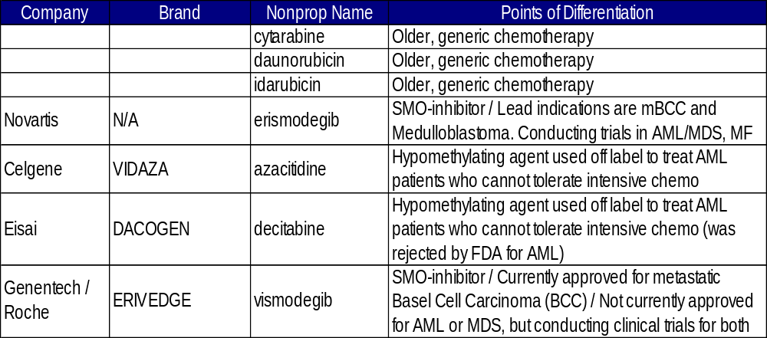


Competitive Landscape
Erinaceinae
Scientific name for hedgehog
Vida (Spanish for Life) +
azacitidine

Slide 11
Creative Direction
Attributes/Benefits
Targeted
  Niche targeting
  Ultra selective
Reshaping/remodeling the protumorigenic environment to remove immunosuppression and enhance other drugs
Comprehensive/broad inhibition
Resistance (to progression)
  Long disease-free intervals, targeting resistance, targets cancer cells of today AND tomorrow
Backbone of therapy
  Many cancers may turn on this pro-growth cell signaling pathway, so this drug may function as a backbone component of a combination of therapeutics
Partnership
  Alters the microenvironment around the tumor to make it more susceptible to other antineoplastic agents
Tolerable

Slide 12
Creative Direction
Imagery
Hedgehog
  Cute, but efficacious spikes
  Resourceful
  Intelligent
  Other hedgehog attributes/characteristics OK to explore
  Explore different types of hedgehogs (e.g., Sonic, Desert and Indian)
Sniper
Taking out just the bricks necessary in the wall of cancer
A dam (or similar) – holding back the cancer
A roadblock (not a speed bump)
Front line of defense
Goalie/goalkeeper
The drug targets a developmental gene that functions to shape the growth, architecture and 3D organization of cells in organs. Using the drug, therefore, may be akin to time travel.

Slide 13
Creative Direction
MOA
SMO inhibition
Three-pronged attack
Stromal modulation
Finesse
Rebooting/restarting
  The SMO pathway is turned on in tumors – this drug turns it off – a “reboot” or “restart”
Gli transcription factors
  -GLI- is a USAN/INN stem in all positions (prefix, infix and suffix) and must be avoided
Stop (cancer) growth at the source
  There will be a repertoire or mutations that can be inhibited (either excess ligand or PTCH mutations)

Slide 14
Creative Direction
Avoid
Severe or harsh names
Competitors: sonidegib, seridigib, vismodegib, taladegib, ERIVEDGE (vismodegib), erismodegib, VIDAZA (azacitidine), DACOGEN (decitabine), idarubicin, daunorubicin and cytarabine
Double consonants
Side effects: Hair loss, taste loss, muscle spasms
Exclusive references to this drug as a combo therapy. It will be a monotherapy, too.
Single indication
  Already the drug is in trials for 3 different indications (MF, MDS, and AML). The plan is to expand beyond these hematological indications.
Overt Hematology references

Slide 15








Brand Strategy Options
Attribute  Cardiovascular, EPA-only Omega-3
Benefit  Tranquility, Advantage
Image  Victory
Indication  Clears Clostridium difficile
Therapeutic Area  Allergic
MOA  Anti-Androgen (Androgen Receptor Inhibitor)
Base Brand/Family  Amyloid Plaque, Avid (A---VID) Radiopharmaceuticals
Blank Canvas  Tonality-Driven

Slide 16
Naming Objectives - Marketing
Marketing Criteria
Supportive of concept, attributes and benefits
Suggestive, evocative or colorful in some way
Differentiated from the competition
Trademarkable
Easy or pleasing to read, pronounce and write

Slide 17
Naming Objectives - Regulatory
Regulatory Criteria and Suggestions
Names should avoid being derived from the nonproprietary name, if being considered for Mexico and Europe
Names should avoid USAN/INN stems within the prescribed position of the name, including the following 2-letter stems:
  -AC (suffix) - anti-inflammatory agents
  -AJ- (infix) - ajmaline derivatives
  -FO- (infix) - phosphorus derivatives
  -IO- (prefix/infix) - iodine-containing contrast media
  -NI- (prefix/infix) - NO₂ derivatives
  -OX (suffix) - aluminium derivatives
  -UR (suffix) - uridine derivatives used as antiviral agents and as antineoplastics
Names should avoid having all the same character heights (e.g. Brain versus Crane), include downstrokes and upstrokes in the name (e.g., Bradin, Bradey)

Slide 18
Naming Objectives - Regulatory
Regulatory Criteria and Suggestions (continued)
Names should avoid product specific attributes (e.g., NameORAL, NameTABS, NameLYOPHYLIZED)
Names should avoid placing emphasis on 1 active ingredient of a combination drug product (fair balance)
Names should avoid placing emphasis on any “inactive” ingredient
Names should avoid common medical abbreviations or coined abbreviations
Names should avoid being within one to two letters of another marketed name
Names for the US should avoid being identical to foreign trademarks that has different active ingredient(s)
Names should avoid being promotional or misleading
Names should avoid being confused with other marketed drug names
Names should avoid being in any language that can be translated in other EU languages
Names should avoid incorporating the sponsor’s name across multiple products (e.g., ABCname1, ABCname2)
Names should not be reused from a discontinued product with a different active ingredient

Slide 19



Name Candidate Evaluation
Step 1. Identify roots (prefix/infix/suffix) that are on target
Keep Neutral to Positive names
Step 2. Identify roots that are off target
Eliminate Inappropriate names
Step 3. Create new names based on preferred roots
Project Team creates 2-3 new names per candidate

Slide 20
Name Candidate
Positive
proposed PF-04449913 (USAN/pINN: glasdegib) brand name candidates
Neutral
Negative
Newly Created Name Candidates
[New Names]
[Explore]
[Avoid]

Slide 21

Name Candidate
Positive
Attribute/Benefit
Neutral
APTIERA
Negative
[New Names]
Apt (Capable, Skilled), Tier (Suggests High Efficacy)
[Explore]
[Avoid]

Slide 22
Name Candidate
Positive
Attribute/Benefit
Neutral
ARCTECA
Negative
[New Names]
Coined from Architecture (Reshapes Cellular Architecture)
[Explore]
[Avoid]

Slide 23
Name Candidate
Positive
Attribute/Benefit
Neutral
ARKIZEL
Negative
[New Names]
Reshapes Cellular Architecture
[Explore]
[Avoid]

Slide 24
Name Candidate
Positive
Attribute/Benefit
Neutral
AVENSIVE
Negative
[New Names]
Avenue (Path), Comprehensive
[Explore]
[Avoid]

Slide 25
Name Candidate
Positive
Attribute/Benefit
Neutral
FUTROZEL
Negative
[New Names]
Suggests Targeting Cancer Cells of Today and Tomorrow (Future)
[Explore]
[Avoid]

Slide 26
Name Candidate
Positive
Attribute/Benefit
Neutral
KLAUSTRA
Negative
[New Names]
Coined from Claustra (Latin - Barrier)
[Explore]
[Avoid]

Slide 27
Name Candidate
Positive
Attribute/Benefit
Neutral
OMPRIENCE
Negative
[New Names]
Comprehensive, -ence (State, Fact or Quality Of)
[Explore]
[Avoid]

Slide 28
Name Candidate
Positive
Attribute/Benefit
Neutral
ORYNEO
Negative
[New Names]
Oral Antineoplastic
[Explore]
[Avoid]

Slide 29
Name Candidate
Positive
Attribute/Benefit
Neutral
PANHIBYX
Negative
[New Names]
Connotes Broad/Comprehensive Inhibition
[Explore]
[Avoid]

Slide 30
Name Candidate
Positive
Attribute/Benefit
Neutral
PERHENSA
Negative
[New Names]
Connotes Comprehensive
[Explore]
[Avoid]

Slide 31
Name Candidate
Positive
Attribute/Benefit
Neutral
PLYKADA
Negative
[New Names]
Connotes Applicability (In a Variety of Cancers)
[Explore]
[Avoid]

Slide 32
Name Candidate
Positive
Attribute/Benefit
Neutral
REBUTRA
Negative
[New Names]
Coined from Reboot (Restart)
[Explore]
[Avoid]

Slide 33
Name Candidate
Positive
Attribute/Benefit
Neutral
SOVRIGAN
Negative
[New Names]
Regain Sovereignty (Independence, Strength, Self-Determination)
[Explore]
[Avoid]

Slide 34
Name Candidate
Positive
Attribute/Benefit
Neutral
TRIETTO
Negative
[New Names]
Connotes Three-Pronged
[Explore]
[Avoid]

Slide 35
Name Candidate
Positive
Image
Neutral
ALMYNDRA
Negative
[New Names]
Coined from Almendra (Famous Dam in Spain)
[Explore]
[Avoid]

Slide 36
Name Candidate
Positive
Image
Neutral
AMURYS
Negative
[New Names]
Coined from Amur (Species of Hedgehog)
[Explore]
[Avoid]

Slide 37
Name Candidate
Positive
Image
Neutral
BARCADO
Negative
[New Names]
Coined from Barricade (Roadblock Concept)
[Explore]
[Avoid]

Slide 38
Name Candidate
Positive
Image
Neutral
BRIKOTA
Negative
[New Names]
Connotes Taking Out Select Bricks in the Wall of Cancer
[Explore]
[Avoid]

Slide 39
Name Candidate
Positive
Image
Neutral
DAURIANT
Negative
[New Names]
Coined from Daurian (Species of Hedgehog)
[Explore]
[Avoid]

Slide 40
Name Candidate
Positive
Image
Neutral
FORFENSA
Negative
[New Names]
Coined from Forefence (Defense in Front, i.e., First Link of Defense)
[Explore]
[Avoid]

Slide 41
Name Candidate
Positive
Image
Neutral
GLEPEUS
Negative
[New Names]
Glasdegib, Asclepius (Greek God of Health/Healing)
[Explore]
[Avoid]

Slide 42
Name Candidate
Positive
Image
Neutral
HUVAR
Negative
[New Names]
Coined from Hoover (Famous Dam)
[Explore]
[Avoid]
(C)

Slide 43
Name Candidate
Positive
Image
Neutral
IBATYS
Negative
[New Names]
Coined from Abatis (A Defensive "Front Line" Obstacle in Warfare)
[Explore]
[Avoid]

Slide 44
Name Candidate
Positive
Image
Neutral
LYGZATO
Negative
[New Names]
Coined from Legato (Music Term Denoting Play "Smoothly")
[Explore]
[Avoid]

Slide 45
Name Candidate
Positive
Image
Neutral
MIRAQADE
Negative
[New Names]
Mirabilis (Latin - Wonderful), Barricade (Roadblock Concept)
[Explore]
[Avoid]

Slide 46
Name Candidate
Positive
Image
Neutral
ORBICTA
Negative
[New Names]
Coined from Orbicularis (Muscle)
In Hedgehogs, Responsible for Rolling Up and Bristling Their Spins
[Explore]
[Avoid]

Slide 47
Name Candidate
Positive
Image
Neutral
SNEPRI
Negative
[New Names]
Anagram of Sniper (Ultra Selective/Targeted)
[Explore]
[Avoid]

Slide 48
Name Candidate
Positive
Image
Neutral
STRYTIN
Negative
[New Names]
Coined from Triton (Three-Pronged Staff of Poseidon)
[Explore]
[Avoid]

Slide 49
Name Candidate
Positive
Image
Neutral
VARIKADE
Negative
[New Names]
Various (Cancers), Barricade (Roadblock Concept)
[Explore]
[Avoid]

Slide 50
Name Candidate
Positive
MOA
Neutral
ALENVIO
Negative
[New Names]
Alters the Microenvironment Around the Tumor
[Explore]
[Avoid]

Slide 51
Name Candidate
Positive
MOA
Neutral
DEPATCHA
Negative
[New Names]
Connotes PTCH Deactivation
[Explore]
[Avoid]

Slide 52
Name Candidate
Positive
MOA
Neutral
ENVALTRO
Negative
[New Names]
Alters the Microenvironment Around the Tumor
[Explore]
[Avoid]

Slide 53
Name Candidate
Positive
MOA
Neutral
GLAVERSA
Negative
[New Names]
GLI Transcription Factors, Versatile (Multiple Cancers) - Links to Glasdegib
[Explore]
[Avoid]

Slide 54
Name Candidate
Positive
MOA
Neutral
HEDGITA
Negative
[New Names]
Coined from Hedgehog
[Explore]
[Avoid]

Slide 55
Name Candidate
Positive
MOA
Neutral
HEDGORIN
Negative
[New Names]
Oral Inhibitor of Hh Pathway Signaling
[Explore]
[Avoid]

Slide 56
Name Candidate
Positive
MOA
Neutral
OFZIG
Negative
[New Names]
Turns "Off the Signaling" Pathway
[Explore]
[Avoid]

Slide 57
Name Candidate
Positive
MOA
Neutral
ONPLET
Negative
[New Names]
Pleiotropic Oncogenic Pathway
[Explore]
[Avoid]

Slide 58
Name Candidate
Positive
MOA
Neutral
PATHEDGE
Negative
[New Names]
Inhibits Hh Pathway Signaling
[Explore]
[Avoid]
(C)

Slide 59
Name Candidate
Positive
MOA
Neutral
REDESMO
Negative
[New Names]
Remodel, SMO
[Explore]
[Avoid]

Slide 60
Name Candidate
Positive
MOA
Neutral
SMOLORIN
Negative
[New Names]
Oral Small Molecule SMO Inhibitor
[Explore]
[Avoid]

Slide 61
Name Candidate
Positive
MOA
Neutral
TARISMO
Negative
[New Names]
Targets SMO
[Explore]
[Avoid]

Slide 62
Name Candidate
Positive
MOA
Neutral
TREGALIR
Negative
[New Names]
GLI Transcription Factor Regulation
[Explore]
[Avoid]

Slide 63
Name Candidate
Positive
MOA
Neutral
TUVOMOD
Negative
[New Names]
Connotes Remodeling the Microenvironment Around the Tumor
[Explore]
[Avoid]

Slide 64
Name Candidate
Positive
Blank Canvas
Neutral
ANTHEDO
Negative
[New Names]
[Explore]
[Avoid]

Slide 65
Name Candidate
Positive
Blank Canvas
Neutral
EXIMPTA
Negative
[New Names]
[Explore]
[Avoid]

Slide 66
Name Candidate
Positive
Blank Canvas
Neutral
LANCERIN
Negative
[New Names]
[Explore]
[Avoid]

Slide 67
Name Candidate
Positive
Blank Canvas
Neutral
NATYMOS
Negative
[New Names]
[Explore]
[Avoid]

Slide 68
Name Candidate
Positive
Blank Canvas
Neutral
ORPALO
Negative
[New Names]
[Explore]
[Avoid]

Slide 69
Name Candidate
Positive
Blank Canvas
Neutral
QUPRAZIL
Negative
[New Names]
[Explore]
[Avoid]

Slide 70
Name Candidate
Positive
Blank Canvas
Neutral
STRALADA
Negative
[New Names]
[Explore]
[Avoid]

Slide 71
Name Candidates - Summary

