Slide 1

BASEL BOSTON CHICAGO DALLAS FRANKFURT LONDON LOS ANGELES MIAMI
Healthcare Nomenclature Workshop
NEW YORK RALEIGH-DURHAM ROCKVILLE SAN FRANCISCO SEATTLE SEOUL TOKYO TORONTO
Insert Client
Logo Here
Project DETTORE
November 11, 2015

Slide 2

Contents
Introduction & Meeting Objectives
Project Timeline
Name Development Process
Product Overview
Mechanism of Action
Competitive Landscape
Naming Objectives
Brand Strategy Options
Traditional vs. Novel Names
Brandstorming Session
Q & A - Discuss Next Steps

Slide 3
Introduction & Meeting Objectives
Brand Institute is pleased to work with Brand Institute on the brand/proprietary name development for Macro, under development for the treatment of Nomenclature Workshop Presentations, to be marketed in the U.S., Europe, Canada, and Asian Markets. Services will include Creative, Trademark Screening, Linguistics, Market & Safety Research, Design.
This name must be acceptable from all perspectives (legal, regulatory, commercial, linguistic, competitive) and should support the product’s point(s) of differentiation through messaging and/or tonality. The new brand name should be acceptable in all key markets.
During this Nomenclature Workshop we will:
  Review and discuss potential name candidates
  Select name candidates that meet the branding objectives
  Identify concepts, key words, imagery and messages to explore/avoid
  Create new names based on names/concepts presented
  Discuss next steps

Slide 4
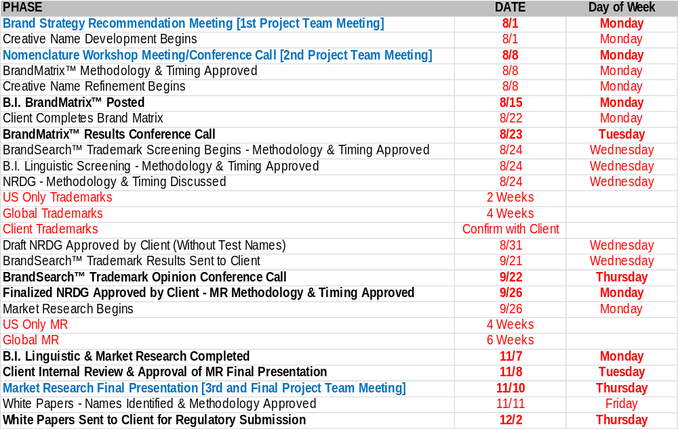
Project Timeline
Bold indicates Project Team involvement

Slide 5

Name Development Process
1. Project Team Brand Strategy Recommendation – Meeting #1 [Previous]
  Review project timeline, scope and deliverables
  Discuss the product and competitive environment
  Identify key attributes, benefits and root words
  Prioritize key attributes, benefits and root words
  Project Team creative Brandstorming session
2. Brand Institute Brand Ideation™ Creative Development
  Create additional names based on BSR direction
  BrandReality™ Trademark Prescreening
    Trademark classes: US, CTM, WIPO
    Trademark registries: 5 & 10
200-300 NAMES
CREATIVE
TM SCREENING
50-75 NAMES
LG SCREENING
MARKET
RESEARCH
10-15 NAMES
SHORT LIST OF NAMES

Slide 6

Name Development Process
3. Project Team Nomenclature Workshop – Meeting #2 [Today]
  Review 100 - 125 name candidates
  Retain favorable name candidates
  Project Team new name creation
  Identify attributes, benefits and root words for refinement
4. Brand Institute Brand Ideation™ Creative Refinement
  Create additional names based on refined direction
  BrandReality™ Trademark Prescreening
5. Project Team BrandMatrix™ Online Name Evaluation Tool
  Project team evaluates 125+ name candidates
  Global project team input
  Identify ~75 names for BrandSearch™ trademark screening

Slide 7
Product Overview
Product Profile
Drug class/classification: xxxx
Nonproprietary/generic name: xxxx
USAN/INN stem: xxxx
Indication(s): xxxx
Standard dose/additional dose(s): xxxx
Formulation: xxxx
Route(s) of administration: xxxx
Frequency of administration: xxxx

Slide 8
Product Overview
Product Description
xxxxx
Concept Statement
xxxxx

Slide 9
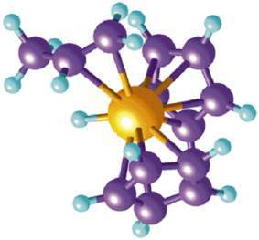
Mechanism of Action
Mechanism of Action
xxxxx

Slide 10
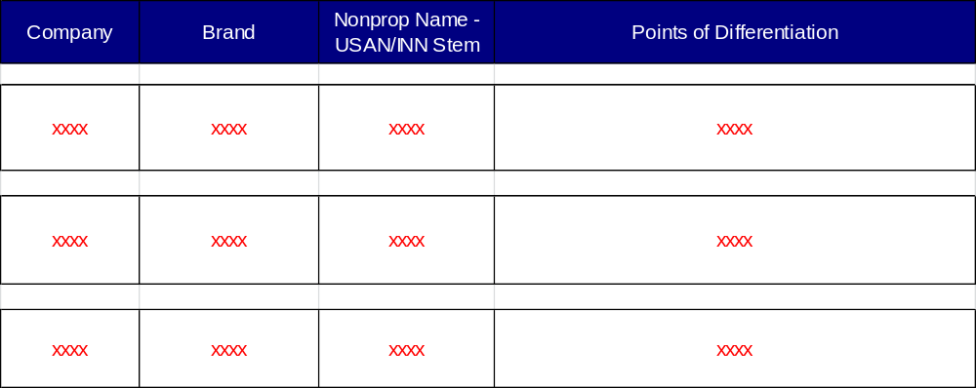
Competitive Landscape

Slide 11








Brand Strategy Options
Attribute  Cardiovascular, EPA-only Omega-3
Benefit  Tranquility, Advantage
Image  Victory
Indication  Clears Clostridium difficile
Therapeutic Area  Allergic
MOA  Anti-Androgen (Androgen Receptor Inhibitor)
Base Brand/Family  Amyloid Plaque, Avid (A---VID) Radiopharmaceuticals
Blank Canvas  Tonality-Driven

Slide 12
Naming Objectives - Marketing
Marketing Criteria
Supportive of concept, attributes and benefits
Suggestive, evocative or colorful in some way
Differentiated from the competition
Trademarkable
Easy or pleasing to read, pronounce and write

Slide 13
Name Candidate
Positive
Neutral
Negative
Newly Created Name Candidates
[New Names]
[Explore]
[Avoid]

Slide 14

Name Candidate
Positive
Attribute/Benefit
Neutral
APTIERA
Negative
[New Names]
Apt (Capable, Skilled), Tier (Suggests High Efficacy)
[Explore]
[Avoid]

Slide 15
Name Candidate
Positive
Attribute/Benefit
Neutral
ARCTECA
Negative
[New Names]
Coined from Architecture (Reshapes Cellular Architecture)
[Explore]
[Avoid]

Slide 16
Name Candidate
Positive
Attribute/Benefit
Neutral
ARKIZEL
Negative
[New Names]
Reshapes Cellular Architecture
[Explore]
[Avoid]

Slide 17
Name Candidate
Positive
Attribute/Benefit
Neutral
AVENSIVE
Negative
[New Names]
Avenue (Path), Comprehensive
[Explore]
[Avoid]

Slide 18
Name Candidate
Positive
Attribute/Benefit
Neutral
FUTROZEL
Negative
[New Names]
Suggests Targeting Cancer Cells of Today and Tomorrow (Future)
[Explore]
[Avoid]

Slide 19
Name Candidate
Positive
Attribute/Benefit
Neutral
KLAUSTRA
Negative
[New Names]
Coined from Claustra (Latin - Barrier)
[Explore]
[Avoid]

Slide 20
Name Candidate
Positive
Attribute/Benefit
Neutral
OMPRIENCE
Negative
[New Names]
Comprehensive, -ence (State, Fact or Quality Of)
[Explore]
[Avoid]

Slide 21
Name Candidate
Positive
Attribute/Benefit
Neutral
ORYNEO
Negative
[New Names]
Oral Antineoplastic
[Explore]
[Avoid]

Slide 22
Name Candidate
Positive
Attribute/Benefit
Neutral
PANHIBYX
Negative
[New Names]
Connotes Broad/Comprehensive Inhibition
[Explore]
[Avoid]

Slide 23
Name Candidate
Positive
Attribute/Benefit
Neutral
PERHENSA
Negative
[New Names]
Connotes Comprehensive
[Explore]
[Avoid]

Slide 24
Name Candidate
Positive
Attribute/Benefit
Neutral
PLYKADA
Negative
[New Names]
Connotes Applicability (In a Variety of Cancers)
[Explore]
[Avoid]

Slide 25
Name Candidate
Positive
Attribute/Benefit
Neutral
REBUTRA
Negative
[New Names]
Coined from Reboot (Restart)
[Explore]
[Avoid]

Slide 26
Name Candidate
Positive
Attribute/Benefit
Neutral
SOVRIGAN
Negative
[New Names]
Regain Sovereignty (Independence, Strength, Self-Determination)
[Explore]
[Avoid]

Slide 27
Name Candidate
Positive
Attribute/Benefit
Neutral
TRIETTO
Negative
[New Names]
Connotes Three-Pronged
[Explore]
[Avoid]

Slide 28
Name Candidate
Positive
Image
Neutral
ALMYNDRA
Negative
[New Names]
Coined from Almendra (Famous Dam in Spain)
[Explore]
[Avoid]

Slide 29
Name Candidate
Positive
Image
Neutral
AMURYS
Negative
[New Names]
Coined from Amur (Species of Hedgehog)
[Explore]
[Avoid]

Slide 30
Name Candidate
Positive
Image
Neutral
BARCADO
Negative
[New Names]
Coined from Barricade (Roadblock Concept)
[Explore]
[Avoid]

Slide 31
Name Candidate
Positive
Image
Neutral
BRIKOTA
Negative
[New Names]
Connotes Taking Out Select Bricks in the Wall of Cancer
[Explore]
[Avoid]

Slide 32
Name Candidate
Positive
Image
Neutral
DAURIANT
Negative
[New Names]
Coined from Daurian (Species of Hedgehog)
[Explore]
[Avoid]

Slide 33
Name Candidate
Positive
Image
Neutral
FORFENSA
Negative
[New Names]
Coined from Forefence (Defense in Front, i.e., First Link of Defense)
[Explore]
[Avoid]

Slide 34
Name Candidate
Positive
Image
Neutral
GLEPEUS
Negative
[New Names]
Glasdegib, Asclepius (Greek God of Health/Healing)
[Explore]
[Avoid]

Slide 35
Name Candidate
Positive
Image
Neutral
HUVAR
Negative
[New Names]
Coined from Hoover (Famous Dam)
[Explore]
[Avoid]
(C)

Slide 36
Name Candidate
Positive
Image
Neutral
IBATYS
Negative
[New Names]
Coined from Abatis (A Defensive "Front Line" Obstacle in Warfare)
[Explore]
[Avoid]

Slide 37
Name Candidate
Positive
Image
Neutral
LYGZATO
Negative
[New Names]
Coined from Legato (Music Term Denoting Play "Smoothly")
[Explore]
[Avoid]

Slide 38
Name Candidate
Positive
Image
Neutral
MIRAQADE
Negative
[New Names]
Mirabilis (Latin - Wonderful), Barricade (Roadblock Concept)
[Explore]
[Avoid]

Slide 39
Name Candidate
Positive
Image
Neutral
ORBICTA
Negative
[New Names]
Coined from Orbicularis (Muscle)
In Hedgehogs, Responsible for Rolling Up and Bristling Their Spins
[Explore]
[Avoid]

Slide 40
Name Candidate
Positive
Image
Neutral
SNEPRI
Negative
[New Names]
Anagram of Sniper (Ultra Selective/Targeted)
[Explore]
[Avoid]

Slide 41
Name Candidate
Positive
Image
Neutral
STRYTIN
Negative
[New Names]
Coined from Triton (Three-Pronged Staff of Poseidon)
[Explore]
[Avoid]

Slide 42
Name Candidate
Positive
Image
Neutral
VARIKADE
Negative
[New Names]
Various (Cancers), Barricade (Roadblock Concept)
[Explore]
[Avoid]

Slide 43
Name Candidate
Positive
MOA
Neutral
ALENVIO
Negative
[New Names]
Alters the Microenvironment Around the Tumor
[Explore]
[Avoid]

Slide 44
Name Candidate
Positive
MOA
Neutral
DEPATCHA
Negative
[New Names]
Connotes PTCH Deactivation
[Explore]
[Avoid]

Slide 45
Name Candidate
Positive
MOA
Neutral
ENVALTRO
Negative
[New Names]
Alters the Microenvironment Around the Tumor
[Explore]
[Avoid]

Slide 46
Name Candidate
Positive
MOA
Neutral
GLAVERSA
Negative
[New Names]
GLI Transcription Factors, Versatile (Multiple Cancers) - Links to Glasdegib
[Explore]
[Avoid]

Slide 47
Name Candidate
Positive
MOA
Neutral
HEDGITA
Negative
[New Names]
Coined from Hedgehog
[Explore]
[Avoid]

Slide 48
Name Candidate
Positive
MOA
Neutral
HEDGORIN
Negative
[New Names]
Oral Inhibitor of Hh Pathway Signaling
[Explore]
[Avoid]

Slide 49
Name Candidate
Positive
MOA
Neutral
OFZIG
Negative
[New Names]
Turns "Off the Signaling" Pathway
[Explore]
[Avoid]

Slide 50
Name Candidate
Positive
MOA
Neutral
ONPLET
Negative
[New Names]
Pleiotropic Oncogenic Pathway
[Explore]
[Avoid]

Slide 51
Name Candidate
Positive
MOA
Neutral
PATHEDGE
Negative
[New Names]
Inhibits Hh Pathway Signaling
[Explore]
[Avoid]
(C)

Slide 52
Name Candidate
Positive
MOA
Neutral
REDESMO
Negative
[New Names]
Remodel, SMO
[Explore]
[Avoid]

Slide 53
Name Candidate
Positive
MOA
Neutral
SMOLORIN
Negative
[New Names]
Oral Small Molecule SMO Inhibitor
[Explore]
[Avoid]

Slide 54
Name Candidate
Positive
MOA
Neutral
TARISMO
Negative
[New Names]
Targets SMO
[Explore]
[Avoid]

Slide 55
Name Candidate
Positive
MOA
Neutral
TREGALIR
Negative
[New Names]
GLI Transcription Factor Regulation
[Explore]
[Avoid]

Slide 56
Name Candidate
Positive
MOA
Neutral
TUVOMOD
Negative
[New Names]
Connotes Remodeling the Microenvironment Around the Tumor
[Explore]
[Avoid]

Slide 57
Name Candidate
Positive
Blank Canvas
Neutral
ANTHEDO
Negative
[New Names]
[Explore]
[Avoid]

Slide 58
Name Candidate
Positive
Blank Canvas
Neutral
EXIMPTA
Negative
[New Names]
[Explore]
[Avoid]

Slide 59
Name Candidate
Positive
Blank Canvas
Neutral
LANCERIN
Negative
[New Names]
[Explore]
[Avoid]

Slide 60
Name Candidate
Positive
Blank Canvas
Neutral
NATYMOS
Negative
[New Names]
[Explore]
[Avoid]

Slide 61
Name Candidate
Positive
Blank Canvas
Neutral
ORPALO
Negative
[New Names]
[Explore]
[Avoid]

Slide 62
Name Candidate
Positive
Blank Canvas
Neutral
QUPRAZIL
Negative
[New Names]
[Explore]
[Avoid]

Slide 63
Name Candidate
Positive
Blank Canvas
Neutral
STRALADA
Negative
[New Names]
[Explore]
[Avoid]

Slide 64
Name Candidates - Summary

Slide 65
Naming Objectives - Regulatory
Regulatory Criteria and Suggestions
Names should avoid being derived from the nonproprietary name, if being considered for Mexico and Europe
Names should avoid USAN/INN stems within the prescribed position of the name, including the following 2-letter stems:
  -AC (suffix) - anti-inflammatory agents
  -AJ- (infix) - ajmaline derivatives
  -FO- (infix) - phosphorus derivatives
  -IO- (prefix/infix) - iodine-containing contrast media
  -NI- (prefix/infix) - NO₂ derivatives
  -OX (suffix) - aluminium derivatives
  -UR (suffix) - uridine derivatives used as antiviral agents and as antineoplastics
Names should avoid having all the same character heights (e.g. Brain versus Crane), include downstrokes and upstrokes in the name (e.g., Bradin, Bradey)

Slide 66
Naming Objectives - Regulatory
Regulatory Criteria and Suggestions (continued)
Names should avoid product specific attributes (e.g., NameORAL, NameTABS, NameLYOPHYLIZED)
Names should avoid placing emphasis on 1 active ingredient of a combination drug product (fair balance)
Names should avoid placing emphasis on any “inactive” ingredient
Names should avoid common medical abbreviations or coined abbreviations
Names should avoid being within one to two letters of another marketed name
Names for the US should avoid being identical to foreign trademarks that has different active ingredient(s)
Names should avoid being promotional or misleading
Names should avoid being confused with other marketed drug names
Names should avoid being in any language that can be translated in other EU languages
Names should avoid incorporating the sponsor’s name across multiple products (e.g., ABCname1, ABCname2)
Names should not be reused from a discontinued product with a different active ingredient

