Slide 1

BASEL BOSTON CHICAGO DALLAS FRANKFURT LONDON LOS ANGELES MIAMI
Healthcare Nomenclature Workshop
NEW YORK RALEIGH-DURHAM ROCKVILLE SAN FRANCISCO SEATTLE SEOUL TOKYO TORONTO
Insert Client
Logo Here
Project DETTORE
November 11, 2015

Slide 2

Contents
Introduction & Meeting Objectives
Project Timeline
Name Development Process
Product Overview
Mechanism of Action
Competitive Landscape
Naming Objectives
Brand Strategy Options
Traditional vs. Novel Names
Brandstorming Session
Q & A - Discuss Next Steps

Slide 3
Introduction & Meeting Objectives
Brand Institute is pleased to work with Brand Institute on the brand/proprietary name development for Macro, under development for the treatment of Nomenclature Workshop Presentations, to be marketed in the U.S., Europe, Canada, and Asian Markets. Services will include Creative, Trademark Screening, Linguistics, Market & Safety Research, Design.
This name must be acceptable from all perspectives (legal, regulatory, commercial, linguistic, competitive) and should support the product’s point(s) of differentiation through messaging and/or tonality. The new brand name should be acceptable in all key markets.
During this Nomenclature Workshop we will:
  Review and discuss potential name candidates
  Select name candidates that meet the branding objectives
  Identify concepts, key words, imagery and messages to explore/avoid
  Create new names based on names/concepts presented
  Discuss next steps

Slide 4
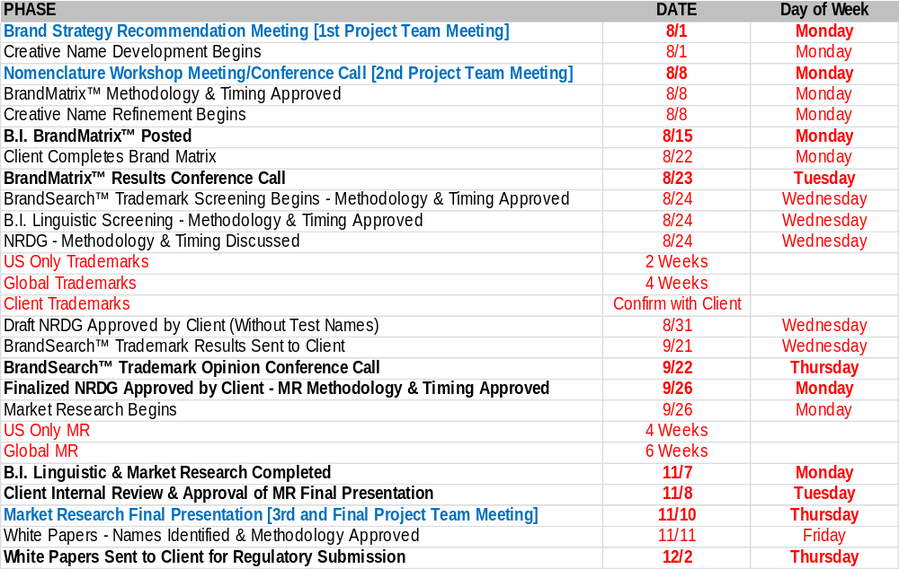
Project Timeline
Bold indicates Project Team involvement

Slide 5
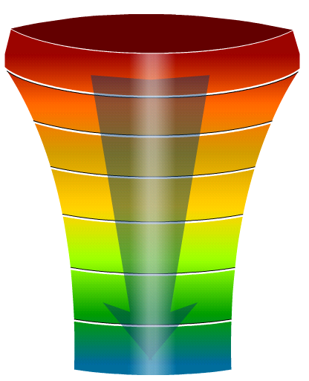
Name Development Process
1. Project Team Brand Strategy Recommendation – Meeting #1 [Previous]
  Review project timeline, scope and deliverables
  Discuss the product and competitive environment
  Identify key attributes, benefits and root words
  Prioritize key attributes, benefits and root words
  Project Team creative Brandstorming session
2. Brand Institute Brand Ideation™ Creative Development
  Create additional names based on BSR direction
  BrandReality™ Trademark Prescreening
    Trademark classes: US, CTM, WIPO
    Trademark registries: 5 & 10
200-300 NAMES
CREATIVE
TM SCREENING
50-75 NAMES
LG SCREENING
MARKET
RESEARCH
10-15 NAMES
SHORT LIST OF NAMES

Slide 6

Name Development Process
3. Project Team Nomenclature Workshop – Meeting #2 [Today]
  Review 100 - 125 name candidates
  Retain favorable name candidates
  Project Team new name creation
  Identify attributes, benefits and root words for refinement
4. Brand Institute Brand Ideation™ Creative Refinement
  Create additional names based on refined direction
  BrandReality™ Trademark Prescreening
5. Project Team BrandMatrix™ Online Name Evaluation Tool
  Project team evaluates 125+ name candidates
  Global project team input
  Identify ~75 names for BrandSearch™ trademark screening

Slide 7
Product Overview
Product Profile
Drug class/classification: xxxx
Nonproprietary/generic name: xxxx
USAN/INN stem: xxxx
Indication(s): xxxx
Standard dose/additional dose(s): xxxx
Formulation: xxxx
Route(s) of administration: xxxx
Frequency of administration: xxxx

Slide 8
Product Overview
Product Description
xxxxx
Concept Statement
xxxxx

Slide 9
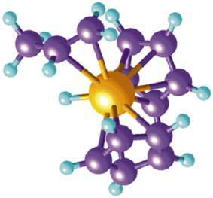
Mechanism of Action
Mechanism of Action
xxxxx

Slide 10
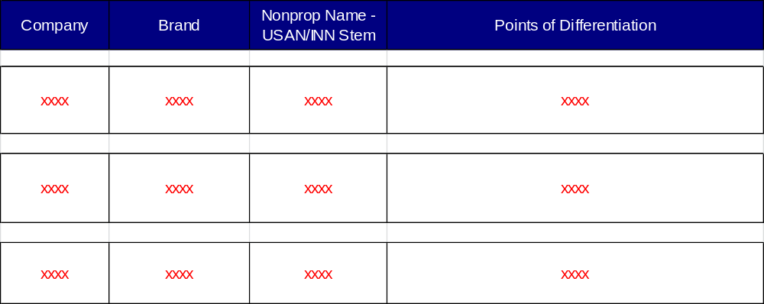
Competitive Landscape

Slide 11








Brand Strategy Options
Attribute  Cardiovascular, EPA-only Omega-3
Benefit  Tranquility, Advantage
Image  Victory
Indication  Clears Clostridium difficile
Therapeutic Area  Allergic
MOA  Anti-Androgen (Androgen Receptor Inhibitor)
Base Brand/Family  Amyloid Plaque, Avid (A---VID) Radiopharmaceuticals
Blank Canvas  Tonality-Driven

Slide 12
Name Candidate
Positive
Neutral
Negative
Newly Created Name Candidates
[New Names]
[Explore]
[Avoid]

Slide 13

Name Candidate
Positive
Attribute/Benefit
Neutral
ALTYNAZE
Negative
[New Names]
Alter (the Situation), Intranasal
[Explore]
[Avoid]

Slide 14
Name Candidate
Positive
Attribute/Benefit
Neutral
ANAPNEO
Negative
[New Names]
Greek for "I Breathe"
[Explore]
[Avoid]
(C)

Slide 15
Name Candidate
Positive
Attribute/Benefit
Neutral
ANZAUS
Negative
[New Names]
Anybody Can Use (i.e., Less Training)
[Explore]
[Avoid]

Slide 16
Name Candidate
Positive
Attribute/Benefit
Neutral
AYJILT
Negative
[New Names]
Coined from Agility
[Explore]
[Avoid]

Slide 17
Name Candidate
Positive
Attribute/Benefit
Neutral
AZELNAZE
Negative
[New Names]
Accelerated, Intranasal
[Explore]
[Avoid]

Slide 18
Name Candidate
Positive
Attribute/Benefit
Neutral
BRETAUSE
Negative
[New Names]
Breath, Easy to Use
[Explore]
[Avoid]

Slide 19
Name Candidate
Positive
Attribute/Benefit
Neutral
EMERNAZE
Negative
[New Names]
Emergency, Intranasal
[Explore]
[Avoid]

Slide 20
Name Candidate
Positive
Attribute/Benefit
Neutral
EMERTU
Negative
[New Names]
RTU (Ready to Use) in an Emergency
[Explore]
[Avoid]

Slide 21
Name Candidate
Positive
Attribute/Benefit
Neutral
EMRETUN
Negative
[New Names]
RTU (Ready to Use) in an Emergency
[Explore]
[Avoid]

Slide 22
Name Candidate
Positive
Attribute/Benefit
Neutral
EMTREAZ
Negative
[New Names]
Emergency Treatment
[Explore]
[Avoid]

Slide 23
Name Candidate
Positive
Attribute/Benefit
Neutral
EMVELOC
Negative
[New Names]
Emergency, Velocity (Quickness) $ Suffix Also Suggests Blocking Overdose
[Explore]
[Avoid]

Slide 24
Name Candidate
Positive
Attribute/Benefit
Neutral
EMVERZ
Negative
[New Names]
Emergency Reversal
[Explore]
[Avoid]

Slide 25
Name Candidate
Positive
Attribute/Benefit
Neutral
EMZUPRO
Negative
[New Names]
Emergency Support
[Explore]
[Avoid]

Slide 26
Name Candidate
Positive
Attribute/Benefit
Neutral
ENAZORP
Negative
[New Names]
Intranasal Absorption
[Explore]
[Avoid]

Slide 27
Name Candidate
Positive
Attribute/Benefit
Neutral
FASNAZE
Negative
[New Names]
Fast, Intranasal
[Explore]
[Avoid]

Slide 28
Name Candidate
Positive
Attribute/Benefit
Neutral
HALQOVA
Negative
[New Names]
Inhaled Recovery
[Explore]
[Avoid]

Slide 29
Name Candidate
Positive
Attribute/Benefit
Neutral
IMNYSTRA
Negative
[New Names]
Immediate Administration $ Infix Suggests Nostril (Intranasal)
[Explore]
[Avoid]

Slide 30
Name Candidate
Positive
Attribute/Benefit
Neutral
INMERJ
Negative
[New Names]
Intranasal, for Emergency
[Explore]
[Avoid]

Slide 31
Name Candidate
Positive
Attribute/Benefit
Neutral
INQLERITY
Negative
[New Names]
Inhaled Clarity
[Explore]
[Avoid]

Slide 32
Name Candidate
Positive
Attribute/Benefit
Neutral
INSTIACT
Negative
[New Names]
Instinct/Instantly Act
[Explore]
[Avoid]

Slide 33
Name Candidate
Positive
Attribute/Benefit
Neutral
INTRAQOVE
Negative
[New Names]
Intranasal, Recovery
[Explore]
[Avoid]

Slide 34
Name Candidate
Positive
Attribute/Benefit
Neutral
MERZETRA
Negative
[New Names]
Emergency Treatment
[Explore]
[Avoid]

Slide 35
Name Candidate
Positive
Attribute/Benefit
Neutral
NEDOPNO
Negative
[New Names]
No-Needle Option
[Explore]
[Avoid]

Slide 36
Name Candidate
Positive
Attribute/Benefit
Neutral
NOVONAZE
Negative
[New Names]
Novo (Latin - Make New), Intranasal
[Explore]
[Avoid]

Slide 37
Name Candidate
Positive
Attribute/Benefit
Neutral
NTRACUE
Negative
[New Names]
Intranasal Rescue
[Explore]
[Avoid]

Slide 38
Name Candidate
Positive
Attribute/Benefit
Neutral
NTRELITY
Negative
[New Names]
Connotes Intranasal Control
[Explore]
[Avoid]

Slide 39
Name Candidate
Positive
Attribute/Benefit
Neutral
NTRONOS
Negative
[New Names]
Intranasal, Overall Survival (Live Longer via Rescue)
[Explore]
[Avoid]

Slide 40
Name Candidate
Positive
Attribute/Benefit
Neutral
PREVIAY
Negative
[New Names]
Proven Efficacy
[Explore]
[Avoid]

Slide 41
Name Candidate
Positive
Attribute/Benefit
Neutral
QUVESQU
Negative
[New Names]
Quick, Rescue (Rapid Help, Emergency Treatment)
[Explore]
[Avoid]

Slide 42
Name Candidate
Positive
Attribute/Benefit
Neutral
RECNAZA
Negative
[New Names]
Recovery, Intranasal
[Explore]
[Avoid]

Slide 43
Name Candidate
Positive
Attribute/Benefit
Neutral
SELRECO
Negative
[New Names]
Celerity (Speed), Recovery
[Explore]
[Avoid]

Slide 44
Name Candidate
Positive
Attribute/Benefit
Neutral
STRILJET
Negative
[New Names]
Nostril (Nose), Jet (Spray)
[Explore]
[Avoid]

Slide 45
Name Candidate
Positive
Attribute/Benefit
Neutral
TILGIAY
Negative
[New Names]
Anagram of Agility
[Explore]
[Avoid]

Slide 46
Name Candidate
Positive
Attribute/Benefit
Neutral
VYTUVI
Negative
[New Names]
Suggests Back to Life $ Vi (Life Associations)
[Explore]
[Avoid]

Slide 47
Name Candidate
Positive
Attribute/Benefit
Neutral
ZIMNAZE
Negative
[New Names]
Simplicity, Intranasal
[Explore]
[Avoid]

Slide 48
Name Candidate
Positive
Attribute/Benefit
Neutral
ZYOPRI
Negative
[New Names]
Save from Opioid Overdose
[Explore]
[Avoid]

Slide 49
Name Candidate
Positive
Image
Neutral
AGARDYS
Negative
[New Names]
Coined from Guardian
[Explore]
[Avoid]

Slide 50
Name Candidate
Positive
Image
Neutral
ALVAYGE
Negative
[New Names]
Coined from Salvage
[Explore]
[Avoid]

Slide 51
Name Candidate
Positive
Image
Neutral
BRETLIA
Negative
[New Names]
Connotes Breathing Life into the Patient
[Explore]
[Avoid]

Slide 52
Name Candidate
Positive
Image
Neutral
LUVISIE
Negative
[New Names]
Shielding Loved One
[Explore]
[Avoid]

Slide 53
Name Candidate
Positive
Image
Neutral
LYPREZE
Negative
[New Names]
Coined from Life Preserver
[Explore]
[Avoid]

Slide 54
Name Candidate
Positive
Image
Neutral
NEMVERIS
Negative
[New Names]
Nemesis to Overdose
[Explore]
[Avoid]

Slide 55
Name Candidate
Positive
Image
Neutral
POSOIDO
Negative
[New Names]
Poseidon (Greek God of the Sea, i.e., Control, Calm), Opioid Overdose
[Explore]
[Avoid]

Slide 56
Name Candidate
Positive
Image
Neutral
SECNATRA
Negative
[New Names]
Second Nature (Natural Instinct)
[Explore]
[Avoid]

Slide 57
Name Candidate
Positive
Image
Neutral
TAQOYD
Negative
[New Names]
Attack Opioid Overdose
[Explore]
[Avoid]

Slide 58
Name Candidate
Positive
Image
Neutral
ZEBDUEL
Negative
[New Names]
Subdue, Duel (Fight Overdose)
[Explore]
[Avoid]

Slide 59
Name Candidate
Positive
Indication/Therapeutic Area
Neutral
BREZOPI
Negative
[New Names]
Breeze (Inhalation), Opioid (Overdose)
[Explore]
[Avoid]

Slide 60
Name Candidate
Positive
Indication/Therapeutic Area
Neutral
ERVERZE
Negative
[New Names]
Reverse Overdose
[Explore]
[Avoid]

Slide 61
Name Candidate
Positive
Indication/Therapeutic Area
Neutral
INTUOPE
Negative
[New Names]
Intuitive, Opioid Antagonist
[Explore]
[Avoid]

Slide 62
Name Candidate
Positive
Indication/Therapeutic Area
Neutral
NOSPIO
Negative
[New Names]
Nostril-Based Opioid Overdose Treatment
[Explore]
[Avoid]

Slide 63
Name Candidate
Positive
Indication/Therapeutic Area
Neutral
OPAZYLE
Negative
[New Names]
Opioid Antagonist, Nasal
[Explore]
[Avoid]

Slide 64
Name Candidate
Positive
Indication/Therapeutic Area
Neutral
OPBLOQ
Negative
[New Names]
Opioid, Blocker
[Explore]
[Avoid]

Slide 65
Name Candidate
Positive
Indication/Therapeutic Area
Neutral
OPBLOXA
Negative
[New Names]
Opioid, Blocker $ Embeds Elements of Naloxone
[Explore]
[Avoid]

Slide 66
Name Candidate
Positive
Indication/Therapeutic Area
Neutral
OPIVELO
Negative
[New Names]
Novel Opioid Addiction Treatment
[Explore]
[Avoid]

Slide 67
Name Candidate
Positive
Indication/Therapeutic Area
Neutral
OPMERJ
Negative
[New Names]
Opioid Emergency
[Explore]
[Avoid]

Slide 68
Name Candidate
Positive
Indication/Therapeutic Area
Neutral
OPOSTRYL
Negative
[New Names]
Opioid, Nostril
[Explore]
[Avoid]

Slide 69
Name Candidate
Positive
Indication/Therapeutic Area
Neutral
OPRITZA
Negative
[New Names]
Opioid, Spritz (Intranasal Spray)
[Explore]
[Avoid]

Slide 70
Name Candidate
Positive
Indication/Therapeutic Area
Neutral
OPSENTI
Negative
[New Names]
Opioid, Sentinel
[Explore]
[Avoid]

Slide 71
Name Candidate
Positive
Indication/Therapeutic Area
Neutral
OPSIDUE
Negative
[New Names]
Opioid Overdose, Subdue
[Explore]
[Avoid]

Slide 72
Name Candidate
Positive
Indication/Therapeutic Area
Neutral
OPVERTREL
Negative
[New Names]
Opioid Overdose Control
[Explore]
[Avoid]

Slide 73
Name Candidate
Positive
Indication/Therapeutic Area
Neutral
OPYDANT
Negative
[New Names]
Anti-Opioid
[Explore]
[Avoid]

Slide 74
Name Candidate
Positive
Indication/Therapeutic Area
Neutral
REFUOID
Negative
[New Names]
Refuse, Opioid
[Explore]
[Avoid]

Slide 75
Name Candidate
Positive
Indication/Therapeutic Area
Neutral
TECTOPI
Negative
[New Names]
Protect, Opioid
[Explore]
[Avoid]

Slide 76
Name Candidate
Positive
Indication/Therapeutic Area
Neutral
VERZODI
Negative
[New Names]
Reverse Overdose
[Explore]
[Avoid]

Slide 77
Name Candidate
Positive
Indication/Therapeutic Area
Neutral
VERZYOD
Negative
[New Names]
Reverse Overdose
[Explore]
[Avoid]

Slide 78
Name Candidate
Positive
Indication/Therapeutic Area
Neutral
XEPTODI
Negative
[New Names]
Intercept Overdose
[Explore]
[Avoid]

Slide 79
Name Candidate
Positive
Indication/Therapeutic Area
Neutral
ZAYVODI
Negative
[New Names]
Save from Overdose
[Explore]
[Avoid]

Slide 80
Name Candidate
Positive
Nonproprietary Name
Neutral
ALORTU
Negative
[New Names]
Naloxone, RTU (Ready To Use)
[Explore]
[Avoid]

Slide 81
Name Candidate
Positive
Nonproprietary Name
Neutral
ALOXCUE
Negative
[New Names]
Naloxone, Rescue
[Explore]
[Avoid]

Slide 82
Name Candidate
Positive
Nonproprietary Name
Neutral
ALOXQUE
Negative
[New Names]
Naloxone, Rescue
[Explore]
[Avoid]

Slide 83
Name Candidate
Positive
Nonproprietary Name
Neutral
ALOXOID
Negative
[New Names]
Naloxone for Opioid Overdose
[Explore]
[Avoid]

Slide 84
Name Candidate
Positive
Nonproprietary Name
Neutral
ALVIGE
Negative
[New Names]
Naloxone, Salvage
[Explore]
[Avoid]

Slide 85
Name Candidate
Positive
Nonproprietary Name
Neutral
AYRLOXO
Negative
[New Names]
Air, Naloxone
[Explore]
[Avoid]

Slide 86
Name Candidate
Positive
Nonproprietary Name
Neutral
FYNDRELON
Negative
[New Names]
Defend, Naloxone
[Explore]
[Avoid]

Slide 87
Name Candidate
Positive
Nonproprietary Name
Neutral
INALITY
Negative
[New Names]
Intranasal, Naloxone
[Explore]
[Avoid]

Slide 88
Name Candidate
Positive
Nonproprietary Name
Neutral
LOXARESC
Negative
[New Names]
Naloxone, Rescue
[Explore]
[Avoid]

Slide 89
Name Candidate
Positive
Nonproprietary Name
Neutral
LOXWIFT
Negative
[New Names]
Naloxone, Swift
[Explore]
[Avoid]

Slide 90
Name Candidate
Positive
Nonproprietary Name
Neutral
NHALIO
Negative
[New Names]
Inhale, Naloxone
[Explore]
[Avoid]

Slide 91
Name Candidate
Positive
Nonproprietary Name
Neutral
NYLOXNO
Negative
[New Names]
No-Needle Naloxone
[Explore]
[Avoid]

Slide 92
Name Candidate
Positive
Nonproprietary Name
Neutral
PREPNALO
Negative
[New Names]
Prepared Naloxone
[Explore]
[Avoid]

Slide 93
Name Candidate
Positive
Nonproprietary Name
Neutral
STRILEXONE
Negative
[New Names]
Nostril (Nose), Naloxone
[Explore]
[Avoid]

Slide 94
Name Candidate
Positive
Nonproprietary Name
Neutral
TRELNALYS
Negative
[New Names]
Control, Naloxone
[Explore]
[Avoid]

Slide 95
Name Candidate
Positive
Nonproprietary Name
Neutral
ALOXWIFT
Negative
[New Names]
Swift, Naloxone
[Explore]
[Avoid]

Slide 96
Name Candidate
Positive
Nonproprietary Name
Neutral
ZWIFNAL
Negative
[New Names]
Swift, Naloxone
[Explore]
[Avoid]

Slide 97
Name Candidate
Positive
Blank Canvas
Neutral
ANVELQ
Negative
[New Names]
[Explore]
[Avoid]

Slide 98
Name Candidate
Positive
Blank Canvas
Neutral
ASEMZER
Negative
[New Names]
[Explore]
[Avoid]

Slide 99
Name Candidate
Positive
Blank Canvas
Neutral
DUVOSI
Negative
[New Names]
[Explore]
[Avoid]

Slide 100
Name Candidate
Positive
Blank Canvas
Neutral
EMPRIELT
Negative
[New Names]
[Explore]
[Avoid]

Slide 101
Name Candidate
Positive
Blank Canvas
Neutral
HURAVIO
Negative
[New Names]
[Explore]
[Avoid]

Slide 102
Name Candidate
Positive
Blank Canvas
Neutral
KYNAFA
Negative
[New Names]
[Explore]
[Avoid]

Slide 103
Name Candidate
Positive
Blank Canvas
Neutral
MYPLISO
Negative
[New Names]
[Explore]
[Avoid]

Slide 104
Name Candidate
Positive
Blank Canvas
Neutral
TULERZO
Negative
[New Names]
[Explore]
[Avoid]

Slide 105
Name Candidate
Positive
Blank Canvas
Neutral
XAYPORA
Negative
[New Names]
[Explore]
[Avoid]

Slide 106
Name Candidate
Positive
Blank Canvas
Neutral
XIAMRO
Negative
[New Names]
[Explore]
[Avoid]

Slide 107
Retained Name Candidates
Positive Retained Names

Slide 108
Retained Name Candidates
Neutral Retained Names

Slide 109
Project Team Name Candidates
New Names

Slide 110
Project Team Name Candidates
New Names

Slide 111
Roots/Concepts to Explore
Roots/Concepts to Explore

Slide 112
Roots/Concepts to Avoid
Roots/Concepts to Avoid

Slide 113
Naming Objectives - Marketing
Marketing Criteria
Supportive of concept, attributes and benefits
Suggestive, evocative or colorful in some way
Differentiated from the competition
Trademarkable
Easy or pleasing to read, pronounce and write

Slide 114
Naming Objectives - Regulatory
Regulatory Criteria and Suggestions
Names should avoid being derived from the nonproprietary name, if being considered for Mexico and Europe
Names should avoid USAN/INN stems within the prescribed position of the name, including the following 2-letter stems:
  -AC (suffix) - anti-inflammatory agents
  -AJ- (infix) - ajmaline derivatives
  -FO- (infix) - phosphorus derivatives
  -IO- (prefix/infix) - iodine-containing contrast media
  -NI- (prefix/infix) - NO₂ derivatives
  -OX (suffix) - aluminium derivatives
  -UR (suffix) - uridine derivatives used as antiviral agents and as antineoplastics
Names should avoid having all the same character heights (e.g. Brain versus Crane), include downstrokes and upstrokes in the name (e.g., Bradin, Bradey)

Slide 115
Naming Objectives - Regulatory
Regulatory Criteria and Suggestions (continued)
Names should avoid product specific attributes (e.g., NameORAL, NameTABS, NameLYOPHYLIZED)
Names should avoid placing emphasis on 1 active ingredient of a combination drug product (fair balance)
Names should avoid placing emphasis on any “inactive” ingredient
Names should avoid common medical abbreviations or coined abbreviations
Names should avoid being within one to two letters of another marketed name
Names for the US should avoid being identical to foreign trademarks that has different active ingredient(s)
Names should avoid being promotional or misleading
Names should avoid being confused with other marketed drug names
Names should avoid being in any language that can be translated in other EU languages
Names should avoid incorporating the sponsor’s name across multiple products (e.g., ABCname1, ABCname2)
Names should not be reused from a discontinued product with a different active ingredient

