Slide 1
230 Processor Demonstration
Johnathan Carlson, Tyler Zinsmaster, Jake Ediger

Slide 2
Purpose
This presentation details the development and usage of a processor created in VHDL. The design and plans for the processor will be described at a high level, without getting deep into unnecessary details.
The Demonstration is a reaction time game, played on the Altera FPGA. The game consists of a user attempting to press a push button when the LED light above the button is lit, with each success resulting in a higher difficulty.

Slide 3
High level description
The processor was designed in 5 phases, each phase building on the previous parts. Various parts needed to be updated as different components were added. In Phases I and II, basic instruction capabilities were added to allow a very low functionality. Phase III integrated many more possible instructions, allowing for more complex operations. Phase IV, the final required phase, incorporated I/O on the FPGA board. Phase V built on phase IV I/O, resulting in relatively high functionality. A few extra credit parts were added as well, including a fast adder, and a two-pass assembler.

Slide 4
Instructions
The 4 types of instructions in this processor are mundane and commonly known to the audience, so they will not be discussed in detail.
Instruction types are:
R-type
J-type
D-type
B-type
Interesting fact: Since R-types do not allow for adding immediates(addi), it was necessary to make r0 =1 in order to be able to test any of the operations. Otherwise, no values could be placed into any registers to begin with. This problem was solved with the implementation of D-Types.

Slide 5
Assembler
The two-pass assembler created for use with the processor was written in python.
Initially, the assembler was going to have very basic capabilities, only meeting minimal requirements. However, as designing the processor became more difficult in later phases, it was clear that the assembler could be used as a debugging tool as well as assembling.
The assembler was improved in many ways, most notably an easy way to change to any input file, and output a clean, easy to read result. The assembler streamlined progress in phases III and IV, proving it worthwhile to invest time into it.

Slide 6
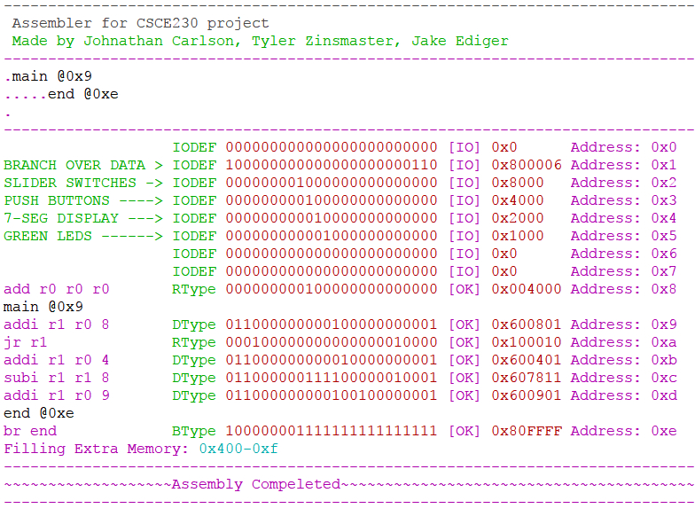
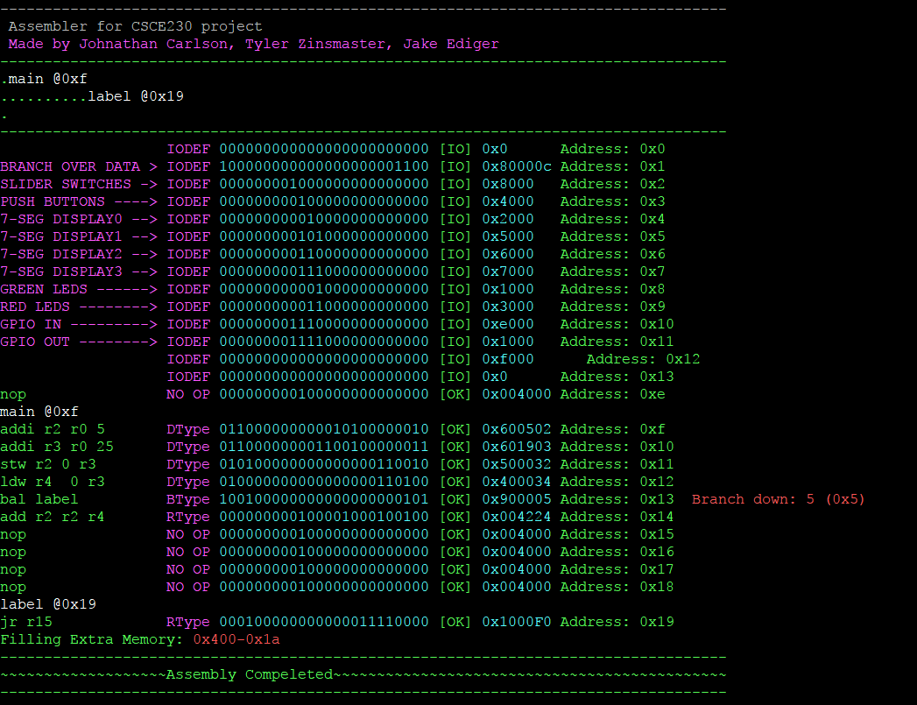
Example Assembler Outputs
Test for jr instruction
Test for bal instruction

Slide 7

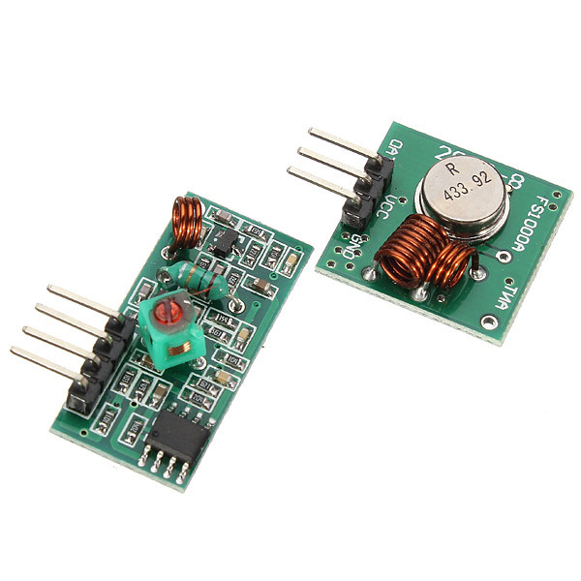
Potential Demonstration Failure
The initial idea for a demonstration was to show that it was possible to transmit data from one FPGA to another, using a 433mhz radio module. Interestingly, the problem that made it impossible was not that we couldn’t get the FPGA’s to transmit and receive. The real issue was how much interference there was around the module. Something as small as moving your hand close to the receiver would trigger the LED’s we had attached to the ends to light up. Even after adding a resistor, this demonstration proved infeasible.
A 433mhz radio module

Slide 8
Demonstration
As mentioned previously, our demonstration is a game in which the player must attempt to press a push button at the same time the LED is above the button.
Each success by the player increases the score on HEX0 by either 1 or 2 since RNG is a fun mechanic.
If the user loses all of their lives, the FPGA will display “dead”, and the game is over for that player.
The GPIO Output light turns on when you lose. When you get a score of 16 you win and then the game resets to 0 points, but your health stays the same. New Game +.

