Slide 1

Lab 4 / Project : Stocks analysis with PySpark
Business Analytics & Big Data -
Aurélien KOHL - 20170211

Slide 2

Requested Functions :
def Show40(DF):
def NumberObservation(DF):
def DetectPeriod(DF):
def Showstatistics(DF):
def CountMissings(DF):
def CorrelationBetweenTwoCollumn(DF,coll1,coll2):
def CorrelationBetweenTwoDataframe(DF1,DF2,coll):
def ChangeSizeSample(DF1,period):
def AddDayChangeCollumn(DF1):
def Add7DayChangeCollumn(DF1):
def Add30DayChangeCollumn(DF1):
o Show the first and last 40 rows of each stock price
o Get the number of observations
o Deduce programmatically what is the period you have between the data points
o Descriptive statistics for each DataFrame and each column (min, max, standard deviation)
o Number of missing values for each DataFrame and column
o Correlation between values
o What is the average of the opening and closing prices for each stock price and for different time periods (week, month, year)
o How do the stock prices change day to day and month to month (may be you can create new columns to save those calculations)

Slide 3
Requested Functions :
o Based on the opening and closing price, calculate the daily return of each stock
o What are the stocks with the highest daily return
o Calculate the average daily return for different periods (week, month, and year)
O Moving Average
O Correlation
O Return rate in different period
O show best stock return for a choosen days/month/year
def DailyReturn3(DF1):
def DailyReturnMean(DF1):
def AVGDailyReturnWeek(DF1):
def AVGDailyReturnMonth(DF1):
def AVGDailyReturnYear(DF1):
def MovingAvg(DF1,Lag,Column):
def Scatter_Matrix(DF1,DF2,Column):
def DaylyRateReturn(DF1):
def WeeklyRateReturn(DF1):
def MonthlyRateReturn(DF1):
def YearlyRateReturn(DF1):
def AVGDailyReturnYearMont(DF1):

Slide 4
8 Insights Functions :
What is the biggest intraday price swing?
Give to the trader what's was the biggest intraday swing on the stocks
What is the most that the stocks has ever exceeded its 50-day moving average?
Give to the trader when and how much the stock exceed the MA50 at the peak.
Market Cap of traded volume ?
Give to the trader a new column with the market cap of the trading day.
def BiggestSwingIntraday(df):
swing_formula = 100 * (col('High') - col('Low')) / col('Close')
df = df.withColumn("Swing", swing_formula)
# To display our new column with the inputs...
df =df.select(['High','Low','Close','Swing','Date'])
return df.orderBy(df["Swing"].desc()).head(1)[0].asDict()

Slide 5
8 Insights Functions :
What is the most active day for trading volumes?
Give to the trader the sorted list of the avg trading volume by trading day
What is the most active week for trading volumes?
Give to the trader the sorted list of the avg trading volume by month
What is the most active month for trading volumes?
Give to the trader the sorted list of the avg trading volume by trading day
def
MostActiveTradingVolumeWeek(d):
return
df.groupBy(
(weekofyear('Date’)
.alias('week')) )
.agg({'Volume': 'mean’})
.orderBy('avg(Volume)')

Slide 6
8 Insights Functions :
What was the date of the lowest daily return ?
Give to the trader when was the days with the lowest daily return.
What was the date of the highest daily return ?
Give to the trader when was the days with the highest daily return.
def LowestDailyReturn(d):
d = d.withColumn(
"Return",
log(d["Close"]/d["Open"])*100)
return
d.orderBy(d["return"].asc())
.head(1)[0].asDict()

Slide 7

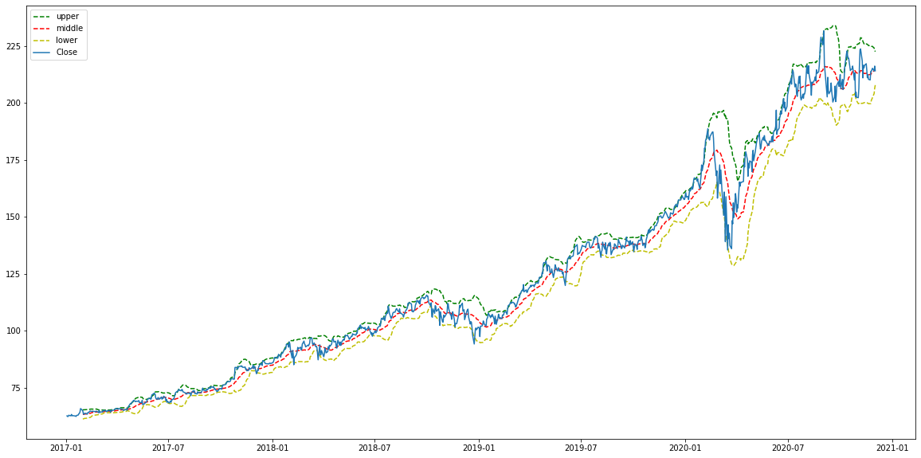
8 Insights Functions :
def bollinger_Bands(df):
df['upper_band'] =
df['Close’]
.rolling(window=20)
.mean() +
df['Close’]
.rolling(window=20).std()*2
[ middle band and lower band]
return df
Bollinger bands :
Give to the trader a new dataframe with the lowest and upper band.

Slide 8
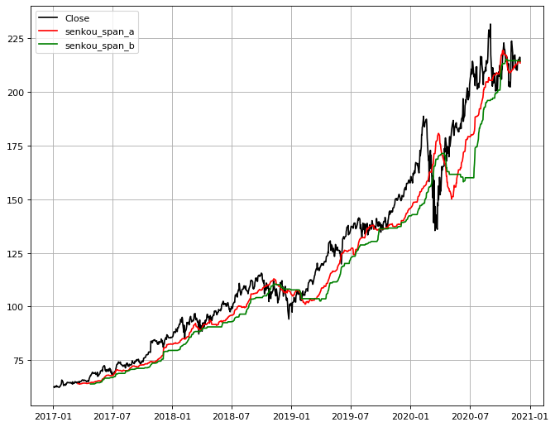
8 Insights Functions :
Kinjun + Tenkan + Chikou + Senkou Span
= Ichimoku Cloud
Add in a the dataframe the value of kinjun tankan chikou senkou, after that trader is able to plot the ichimoku cloud a take trading decisions.
def tenkan_sen(d):
def kijun_sen(d):
def Chikou_span(d):
def senkou_span(d):
Notes:
Médiane b en dessous – nuage vert
Médiane a en dessous – nuage rouge

