Slide 1
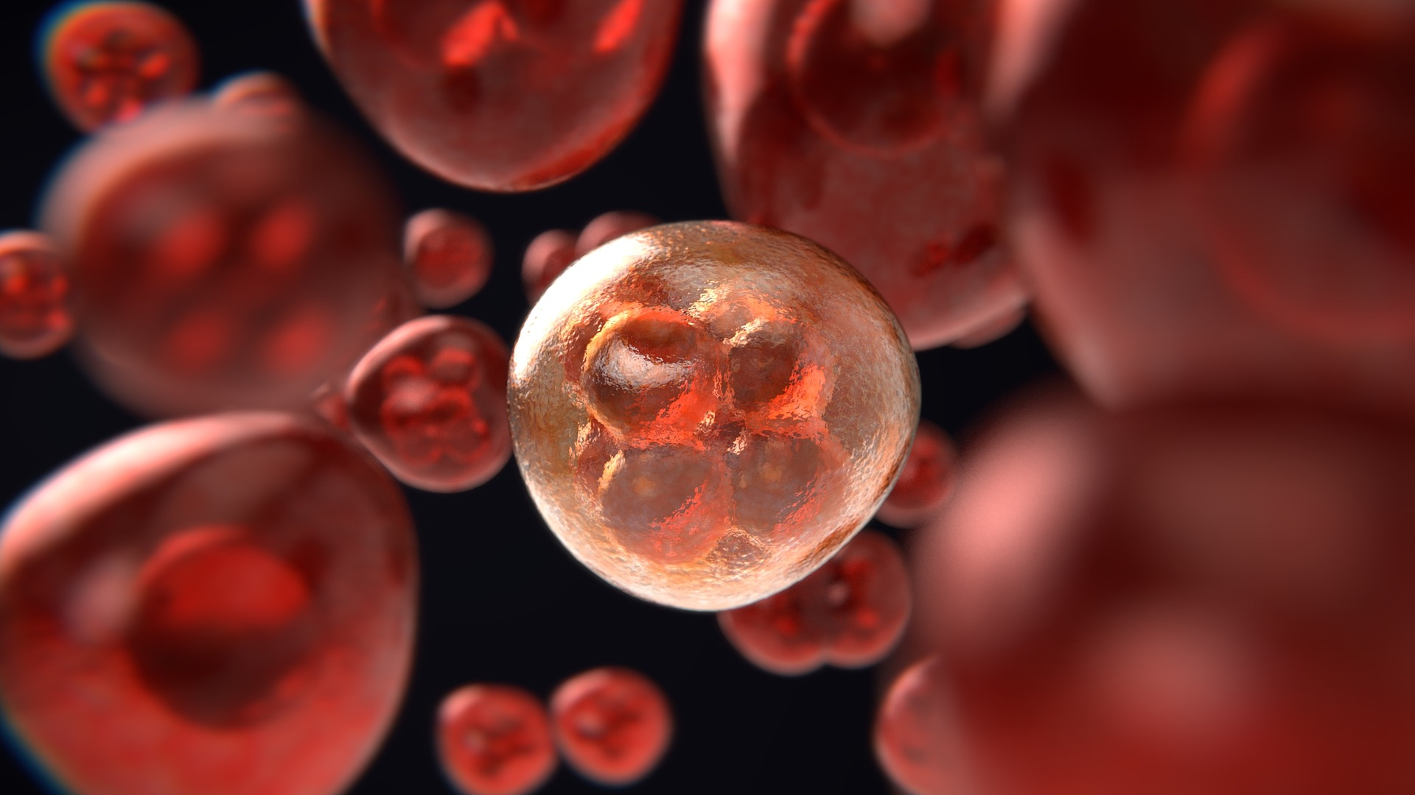
Malaria Cell Classification
By: Hardik Vegad

Slide 2
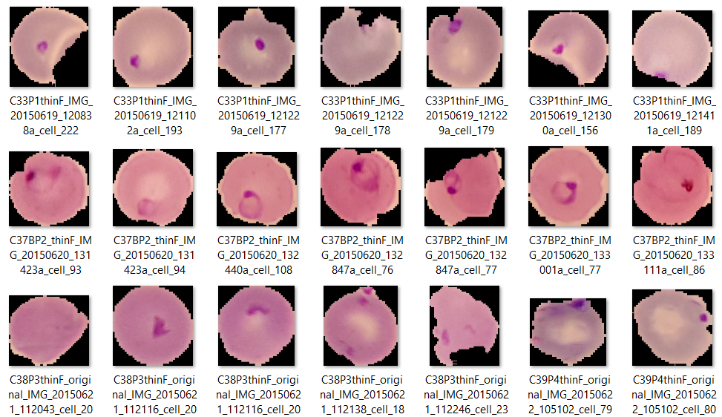
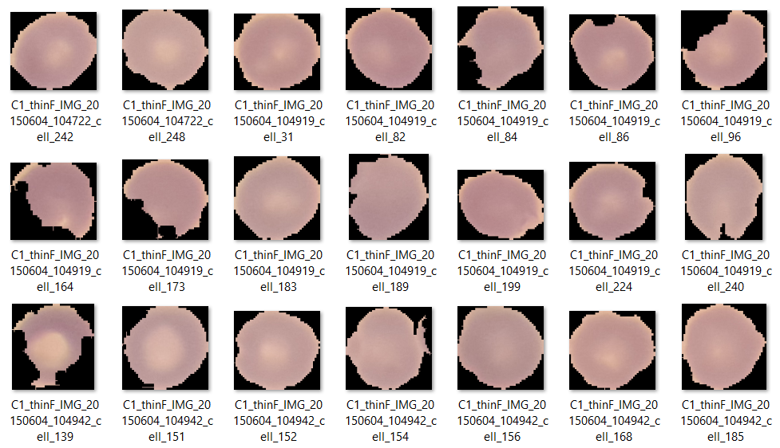
Problem Statement:
Malaria Cell Classification
Malaria is a disease caused by Plasmodium parasites that remains a major threat in global health, affecting 200 million people and causing 400,000 deaths a year. The main species of malaria that affect humans are Plasmodium falciparum and Plasmodium vivax.
So what we end up doing is attempting to build a model that just based on the image of a cell can predict whether or not it’s infected or not infected with malaria. In real life, this may save doctors a lot of time by just running images into our model instead of having to manually look at these image’s themselves and determinant.

Slide 3
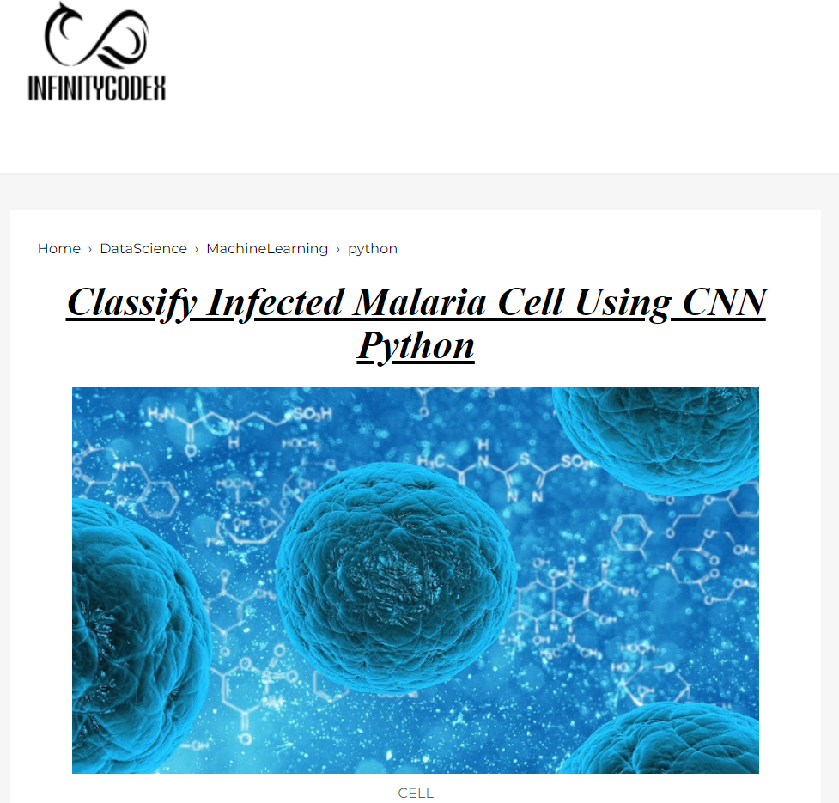
Data Source:
https://lhncbc.nlm.nih.gov/
Github Link:
https://github.com/Vegadhardik7/Imarticus-Deep-Learning-Project-Malaria-Cell-Classification
My Blog Link:
https://www.infinitycodex.in/detect-malaria-using-cnn-python

Slide 4
Project Flow:
Understand
Problem
Data Collection
Data Cleaning & Exploration
Save & Deploy
Model
Update the data features & model
Building Model

Slide 5
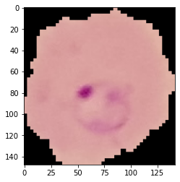
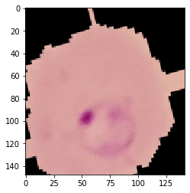
Preparing the Data for the model
There is too much data for us to read all at once in memory. We can use some built in functions in Keras to automatically process the data, generate a flow of batches from a directory, and also manipulate the images.
Image Manipulation
Its usually a good idea to manipulate the images with rotation, resizing, and scaling so the model becomes more robust to different images that our data set doesn't have. We can use the ImageDataGenerator to do this automatically for us. Check out the documentation for a full list of all the parameters you can use here!
Real Image:
Manipulated Image:

Slide 6
Project Approach:
Imports
Understand Data
Visualization
Feature Engineering
Bringing In Same Size
Model
Accuracy: 94%

Slide 7
Challenges Faced:
Loading Data due to volume of the data.
Managing Data due to complexity of the data.
Selecting efficient hyper parameters.
Training Model due to less computation power of my system.
Conclusion:
This project is completed with 94% accuracy by using Convolution Neural Network, this will help doctors and research scientist to predict what would be the treatment of that individual based on identifying the cell.

Slide 8


