Slide 1
SUNLIGHT INSURANCE pVt ltd
WEB APPLICATION
Agent portal

Slide 2
GROUP MEMBERS
Darshee Gandhi
Roll No. : 25
Divyesh Rathod
Roll No. : 44
Krunal Vegda
Roll No. : 78
Group No. :- 07
Internal Guide : Prof. Punam Shah

Slide 3

TABLE OF CONTENT
Organization profile
College certificate
Project profile
Definition
Benefits of system
Process description
Tools and technology
Entity description

Slide 4

TABLE OF CONTENT
Data flow diagram(DFD)
Context level(0thlevel)
First level(1st level)
Admin
Employee
Agent
Second level(2nd level)
Agent(Log-in)
Agent(Payment)
Entity relationship diagram
Data dictionary table

Slide 5

ORGANIZATION PROFILE
L J College of computer application (affiliated to Gujarat University ) is one of the premier institutes in Ahmedabad, imparting quality education and professional training for bachelors in computer applications.
L J College of computer application was founded by Lok Jagruti Trust, a name held high up in esteem for providing quality education, in the 1999 at its vastrapur campus.
We at LJCCA are committed to impart professional education with practical exposure, to groom young technocrats for facing the challenges and opportunities of the IT industry.

Slide 6
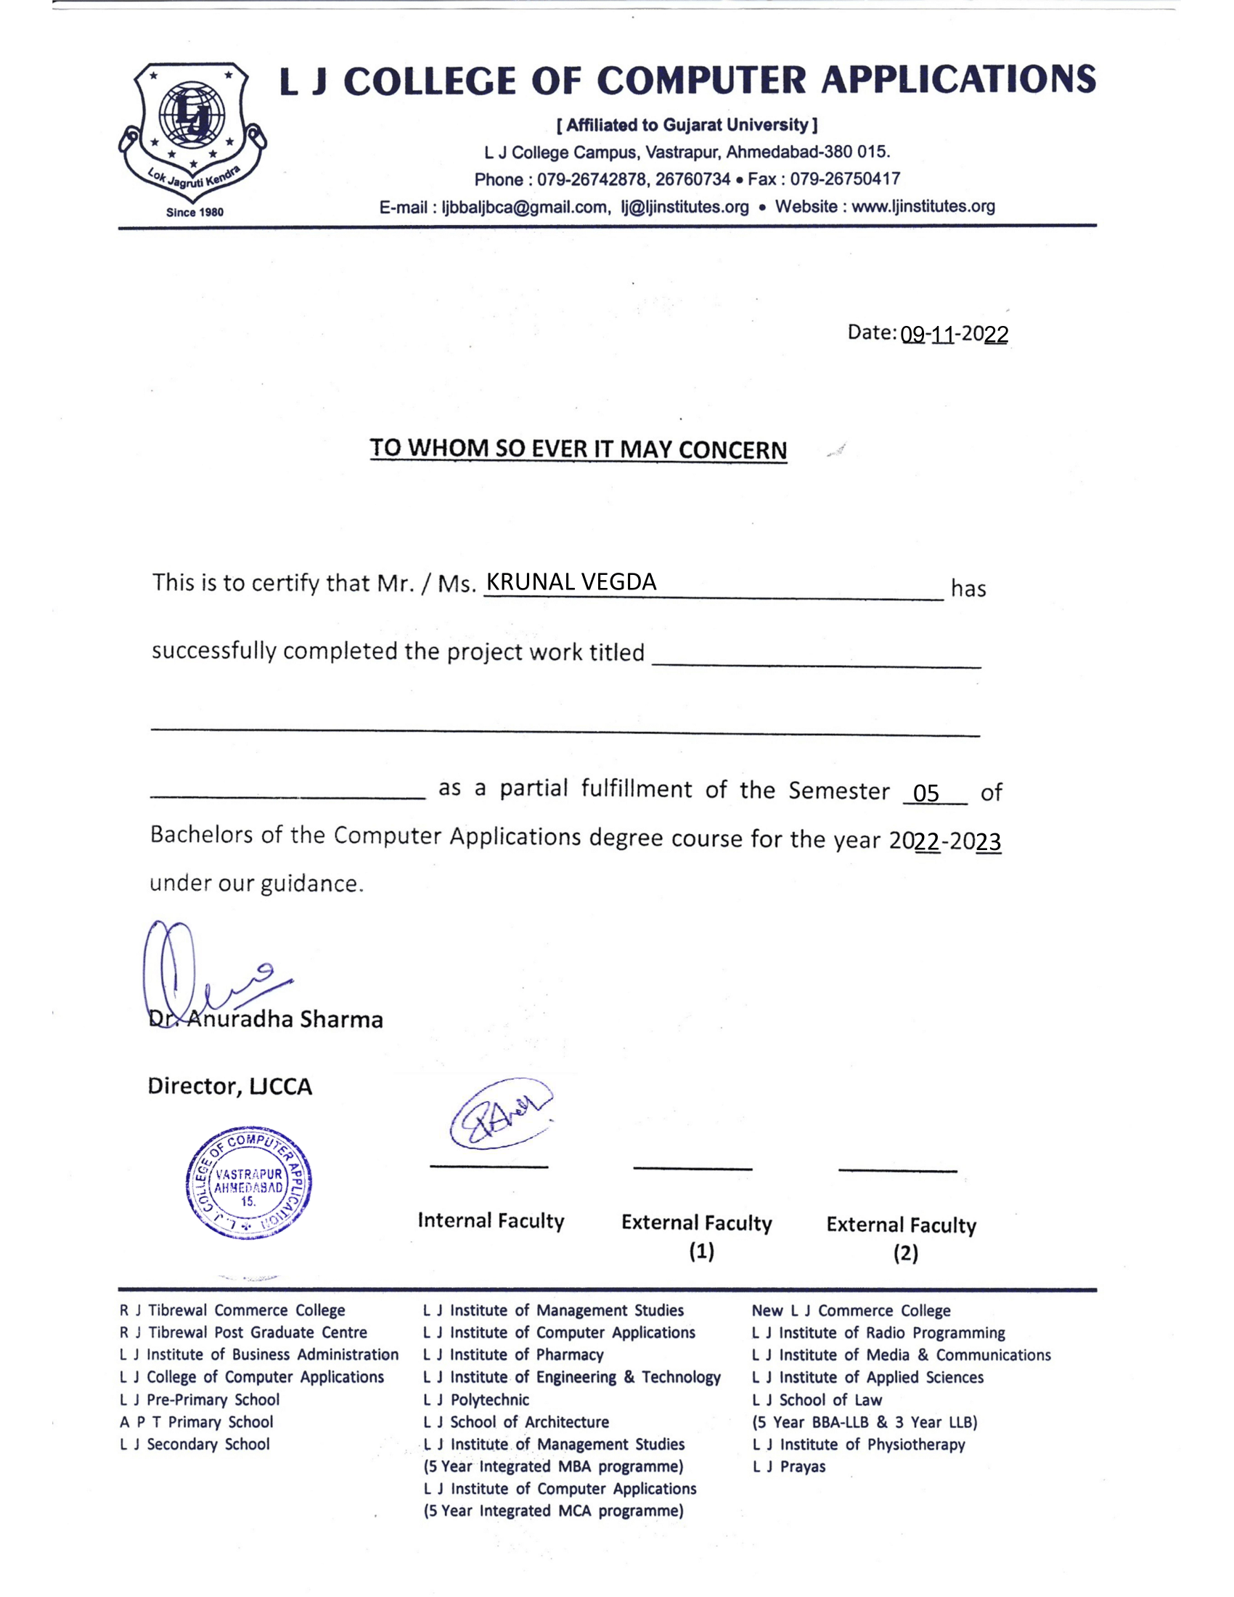
Sunlight insurance pvt ltd

Slide 7
PROJECT PROFILE
Project Guide (internal)
Prof. Punam Shah
College Name
L. J. College of Computer Application
Type of Application
Project Title
Sunlight Insurance Pvt Ltd
Web Application

Slide 8
DEFINITION
This is an advance general insurance company portal to do all the things by some easy step and helping the insurance agents and insurance companies to avoid time consuming and lengthy offline process and stop depending on each other, it can save time, money and manpower so the company can focus on their other future goals.
Our project provides agency management software for insurance agents. It offers solution for insurance quoting, sales & distribution, renewal management, claim management and more.

Slide 9
BENEFITS OF SYSTEM
Decrease the dependency of agents on insurance company and their employees.
For easy and accurate in-house procedure for quote , policy issuance and payment.
Less dependency means less errors.
Smooth and quick process for best service to clients and their business will grow.
They can keep their all clients data at one safest place.

Slide 10








PROCESS DESCRIPTION
Admin is managing risk factor of company
Customer getting issued policy
Employees are helping agents to grow their business
Costumer needs and insurance
Choose payment Method
Get in touch with insurance agent
Agent will explain terms & conditions to customer
Finalizing the premium

Slide 11
TOOLS AND TECHNOLOGY
SOFTWARE
HARDWARE
Front-end language
Html
MYSQL
CSS
JavaScript
Pro language
Asp.net
Diagram tool
drow.io
Lucid chart
C#
Back -end:
Processor
Intel core i3 & higher version also
RAM
Recommended
8 GB
SSD
256GB

Slide 12



ENTITES DESCRIPTION
An insurance underwriter someone who is managing the underwriting process
The work of an underwriter is to analysis the risk and finalize the rules of premium on behalf of company
An insurance agent is an intermediary between insurance company and customer.
His main role is to meet the clients and expand their business by selling different insurance products
Under Writer (admin)
Insurance agent
The role of employee is to handling insurance agents and collect maximum amount of business
And to make the insurance process smooth and organized in well manner
Customer is the most important factor of this process
All these process are dependent on customer’s information
Employee (Relationship manager)
Client

Slide 13

Underwriter /admin:
PROCESS OF ENTITIES
Request for login
Give quote for decline product
Approve or denied quote
Ack for cases

Slide 14
Employee
PROCESS OF ENTITIES
Request for login
Access agent portal
Forward case to underwriters
Ack for cases

Slide 15
Agent
PROCESS OF ENTITIES
Request for login
Calculate quote
Download renewal notice
Issue/renewal policies
Forward cases to underwriter
Search policy, renewal, quote
Make payment

Slide 16
Client :
PROCESS OF ENTITIES
Give details to agent of their product
Ack for premium
Make payment

Slide 17
Data Flow Diagram(DFD)

Slide 18
SYMBOL INFORMATI0N
Symbols | Information
 | External entity
 | Process
 | Data store
 | Data flow

Slide 19
Context Level(0thLevel) DFD

Slide 20
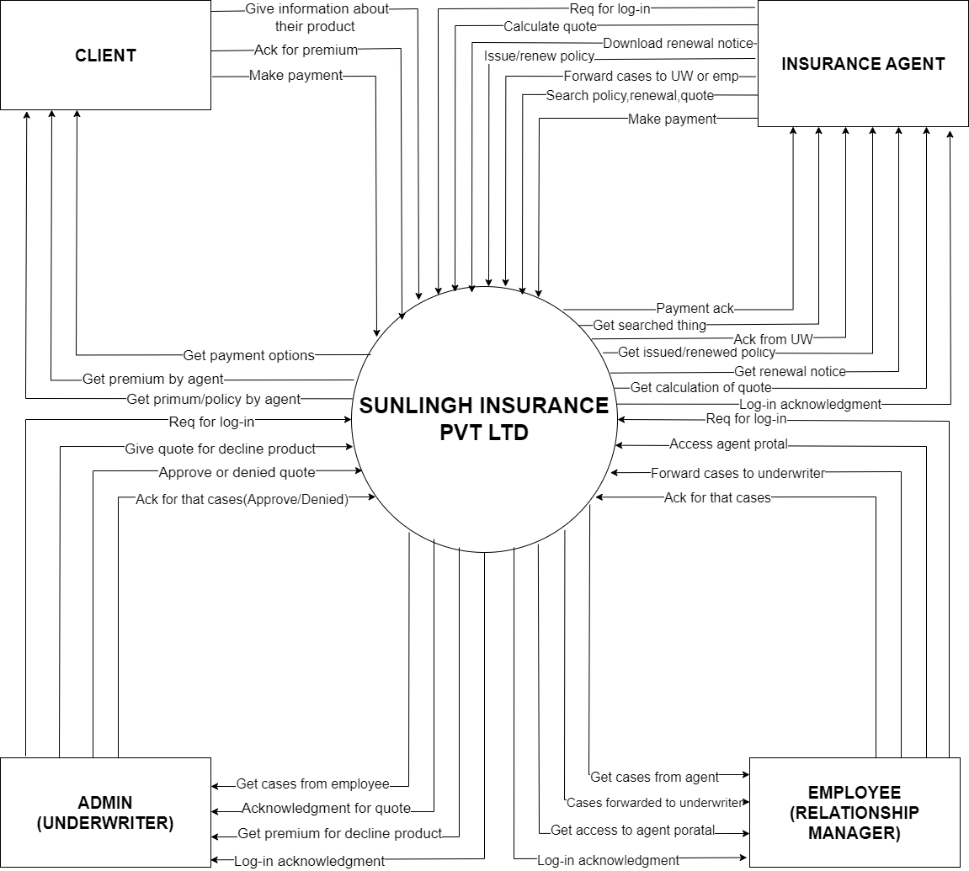

Slide 21
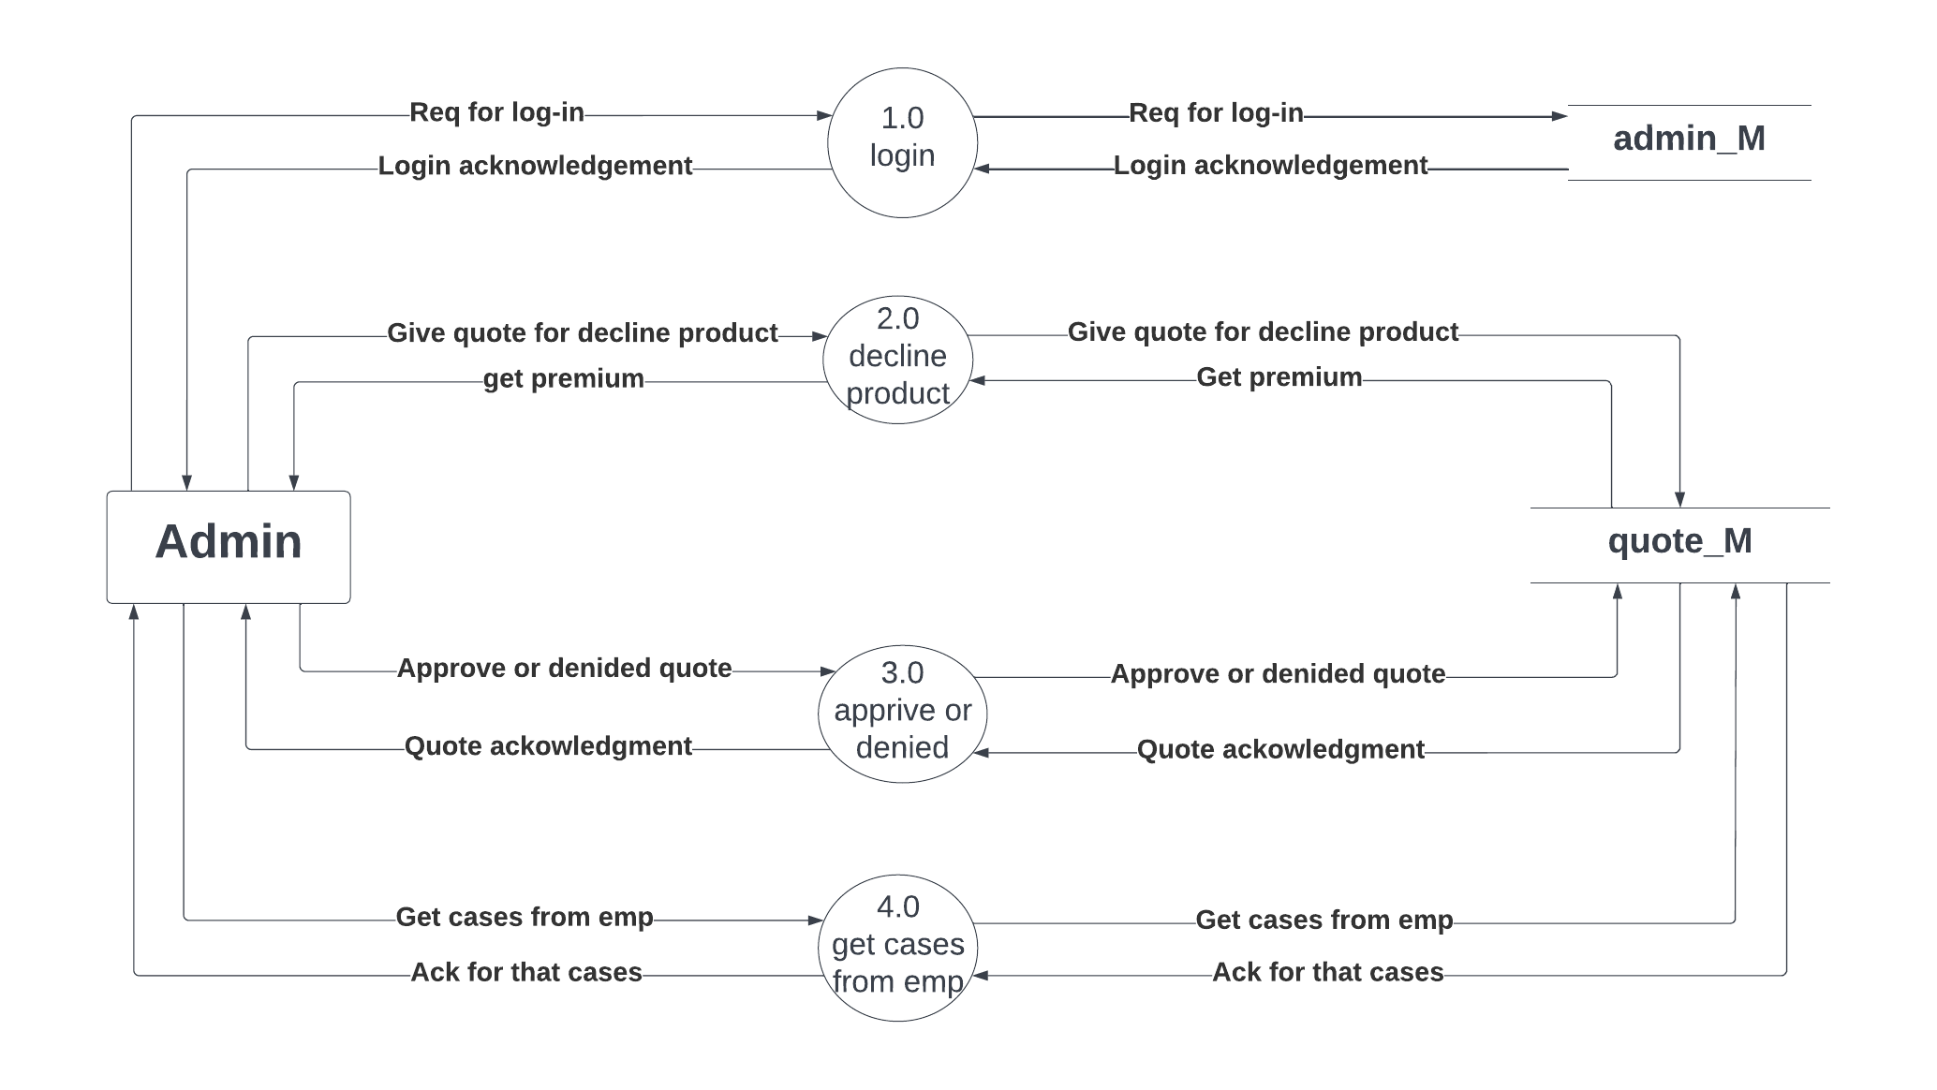
First Level(1st Level) of Admin

Slide 22
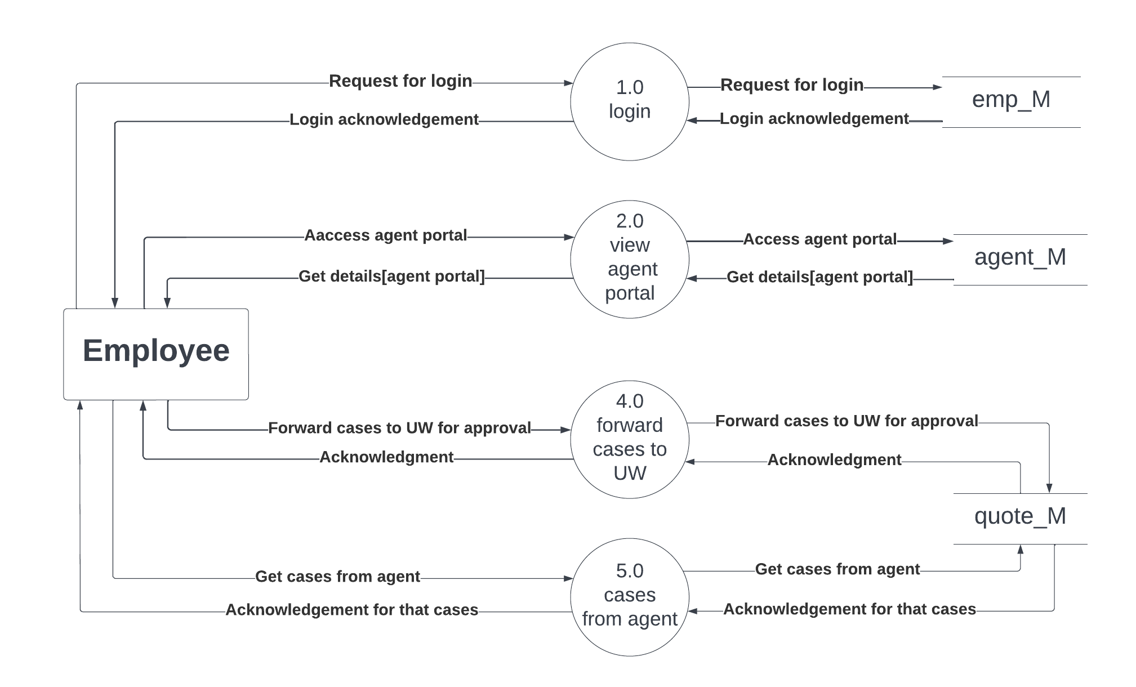
First Level(1st Level) of Employee

Slide 23
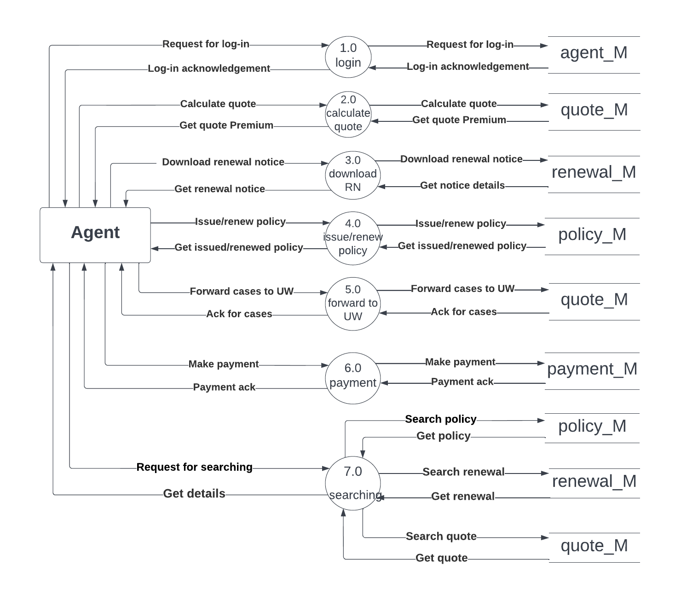
First Level(1st Level) of Agent

Slide 24
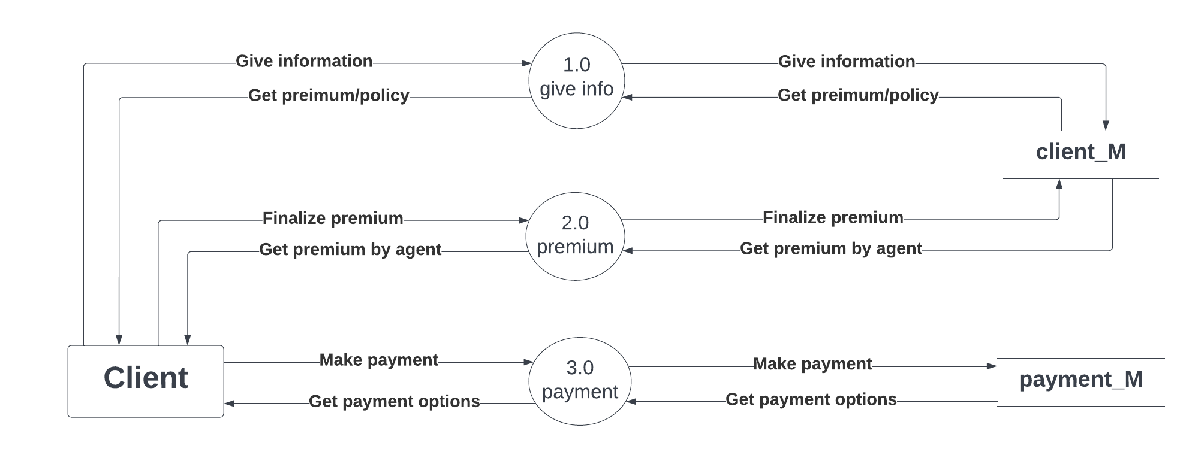
First Level(1st Level) of Client

Slide 25
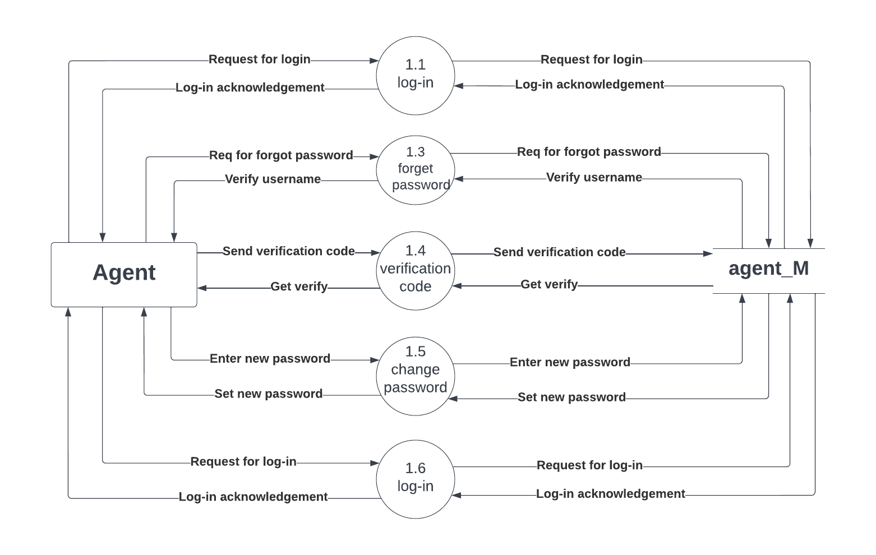
Second Level(2nd Level) of Agent

Slide 26
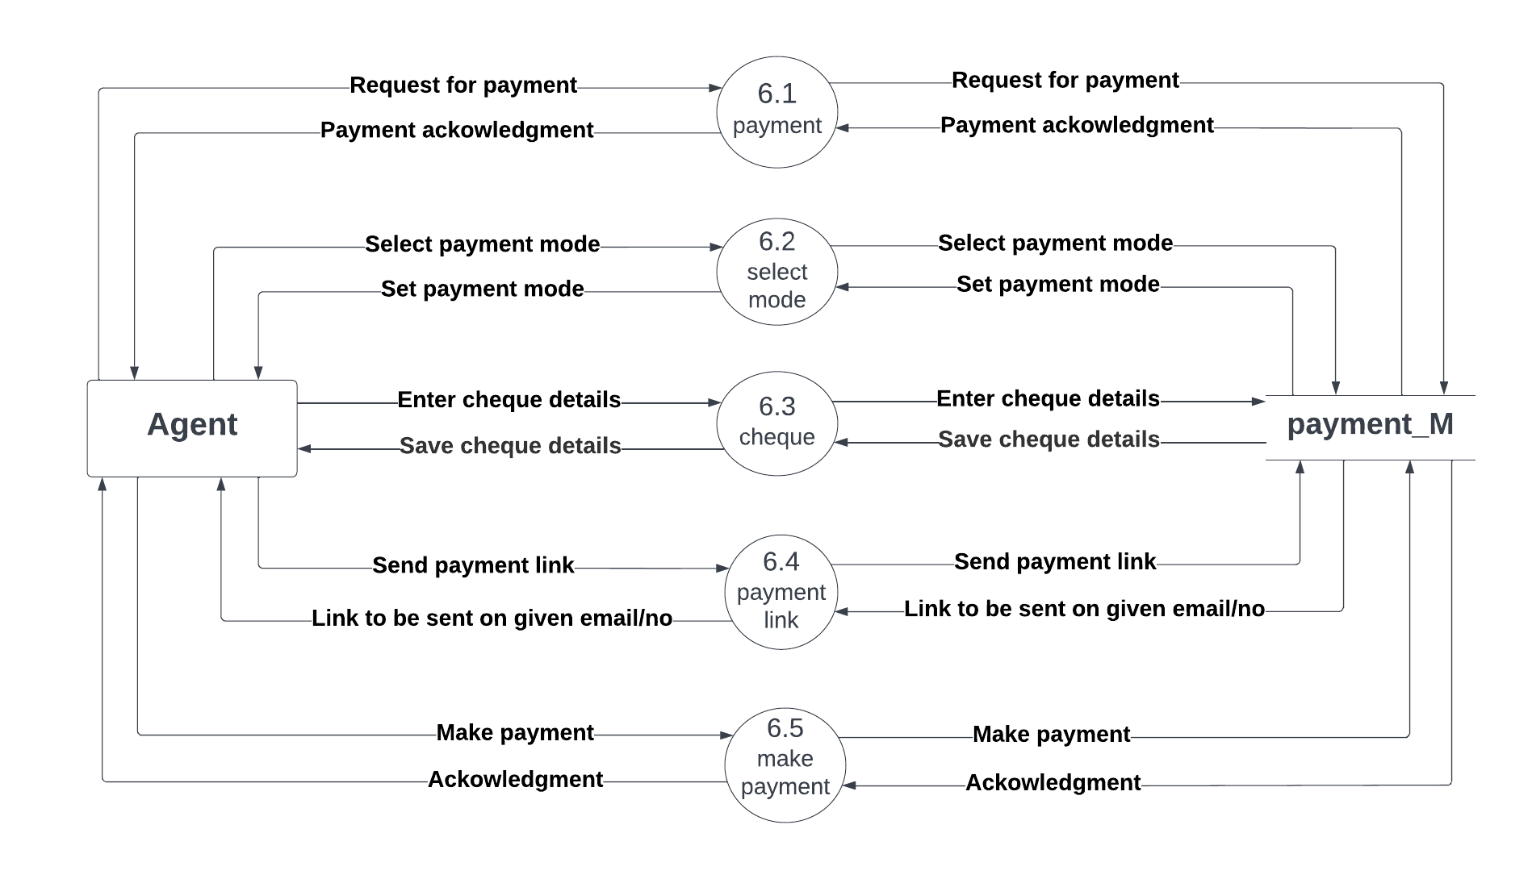
Second Level(2nd Level) of Agent

Slide 27
Entity Relationship Diagram (ERD)
An ERD is a data modelling technique that graphically illustrates an information system’s entities and the relationship between those entities.
Two types of model in the ER Diagram:
Crow’s foot model
Chain
There are three types of Relationship between entities:
One-to-Many
One-to-One
Many-to-Many

Slide 28
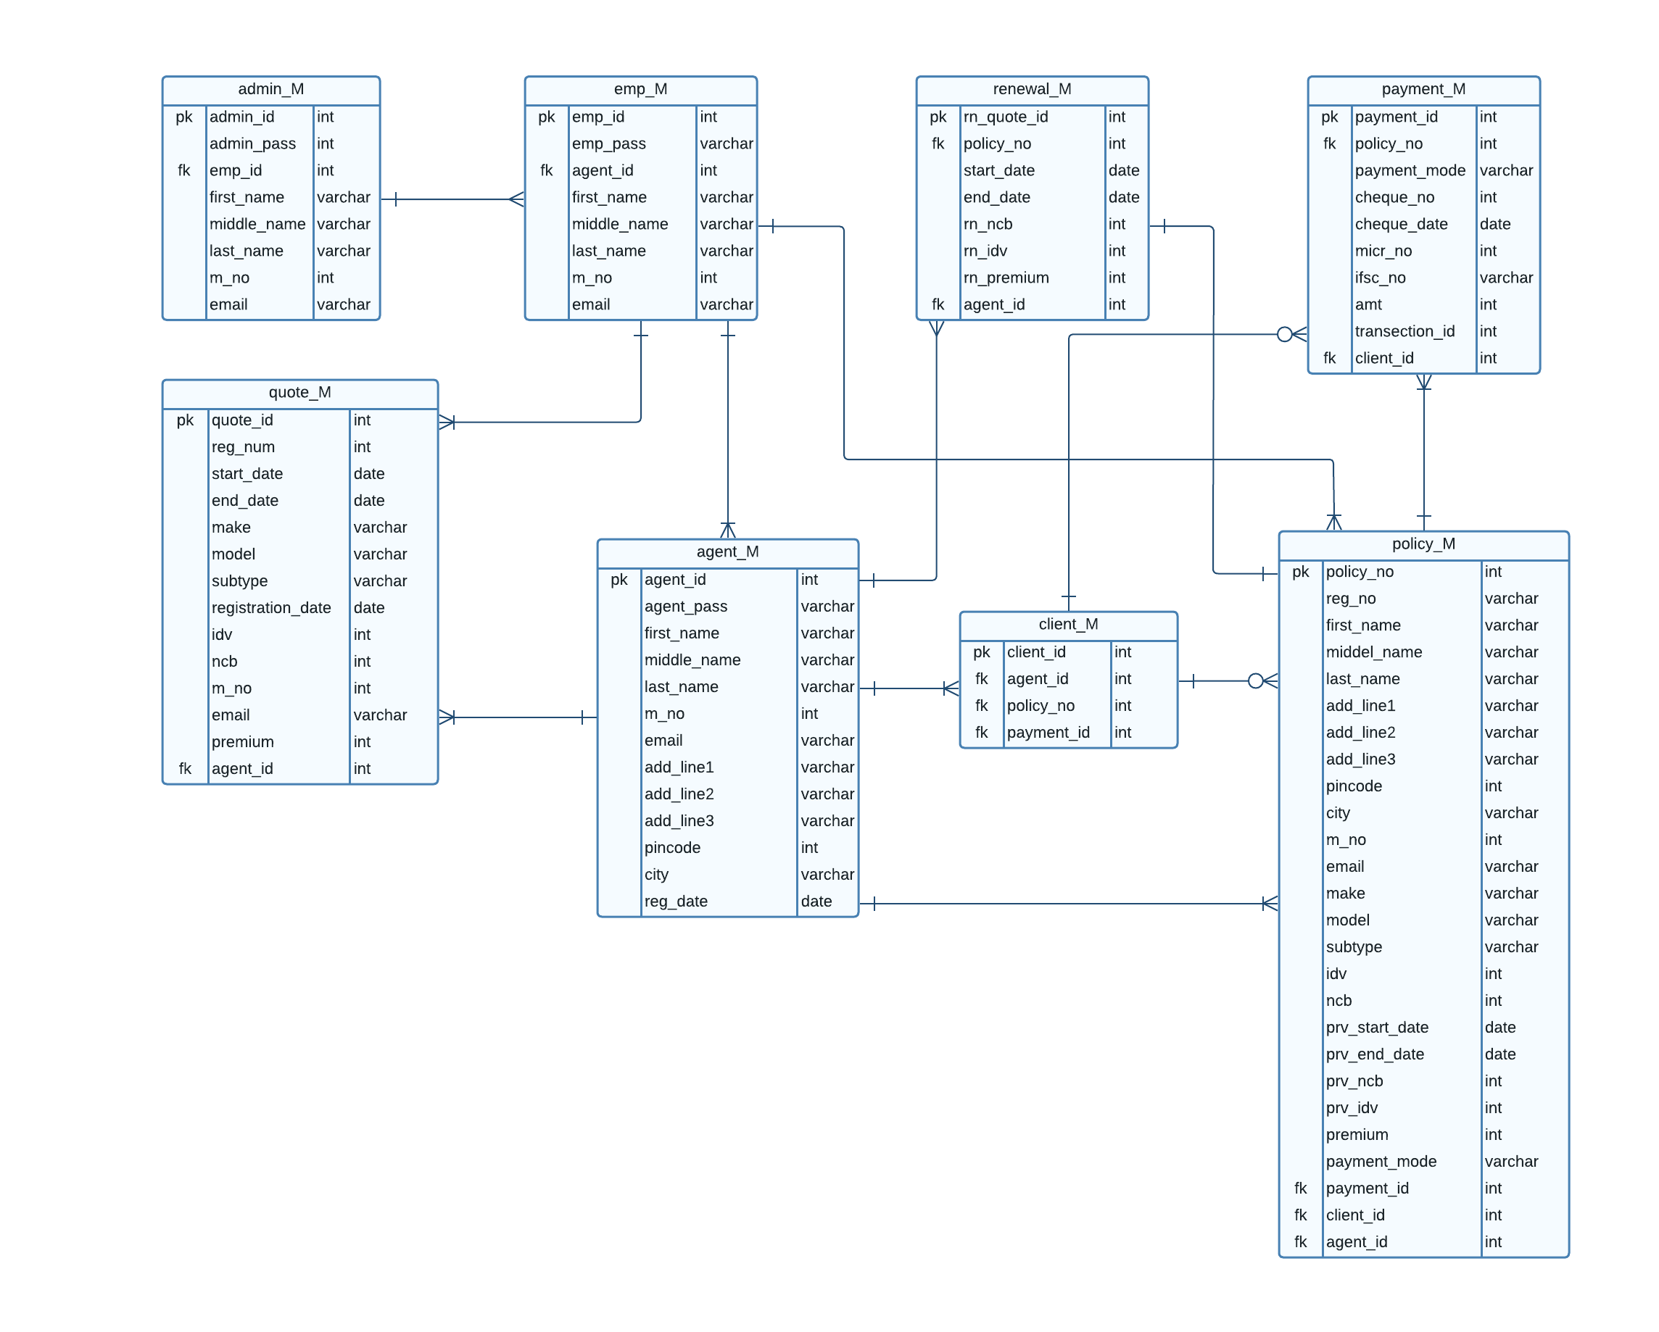

Slide 29
Data Dictionary

Slide 30
admin_M
Sr.no | Field Name | Data Type | Key
1 | admin_id | integer(10) | Primary key
2 | admin_pass | varchar(20) | Not null
3 | emp_id | Integer(10) | Foreign key
4 | first_name | varchar(20) | Not null
5 | middle_name | varchar(20) | Not null
6 | last_name | varchar(20) | Not null
7 | m_no | integer(10) | Not null
8 | email | varchar(30) | Not null

Slide 31
emp_M
Sr.no | Field Name | Data Type | Key
1 | emp_id | integer(10) | Primary key
2 | emp_pass | varchar(20) | Not null
3 | agent_id | integer(10) | Foreign key
4 | first_name | varchar(20) | Not null
5 | middle_name | varchar(20) | Not null
6 | last_name | varchar(20) | Not null
7 | m_no | integer(10) | Not null
8 | email | varchar(30) | Not null

Slide 32
agent_M
Sr.no | Field Name | Data Type | Key
1 | agent_id | integer(10) | Primary key
2 | agent_pass | varchar(20) | Not null
3 | first_name | varchar(20) | Not null
4 | middle_name | varchar(20) | Not null
5 | last_name | varchar(20) | Not null
6 | m_no | integer(10) | Not null
7 | email | varchar(30) | Not null
8 | add_line1 | varchar(20) | Not null
9 | add_line2 | varchar(20) | Not null
10 | add_line3 | varchar(20) | Not null
11 | city | varchar(20) | Not null
12 | pincode | integer(6) | Not null
13 | reg_date | date | Not null

Slide 33
Client_M
Sr.no | Field Name | Data Type | Key
1 | client_id | integer(10) | Primary key
2 | agent_id | integer(10) | Foreign key
3 | policy_no | integer(10) | Foreign key
4 | payment_id | integer(10) | Foreign key

Slide 34
quote_M
Sr.no | Field Name | Data Type | Key
1 | quote_id | integer(10) | Primary key
2 | reg_num | varchar(10) | Not null
3 | start_date | date | Not null
4 | end_date | date | Not null
5 | make | varchar(20) | Not null
6 | model | varchar(20) | Not null
7 | subtype | varchar(20) | Not null
8 | reg_date | date | Not null
9 | idv | integer(10) | Not null
10 | ncb | integer(2) | Not null
11 | m_no | integer(10) | Not null
12 | email | varchar(30) | Not null
13 | premium | integer(10) | Not null

Slide 35
policy_M
Sr.no | Field Name | Data Type | Key
1 | policy_no | integer(10) | Primary key
2 | reg_num | varchar(10) | Not null
3 | first_name | varchar(20) | Not null
4 | middle_name | varchar(20) | Not null
5 | last_name | varchar(20) | Not null
6 | add_line1 | varchar(20) | Not null
7 | add_line2 | varchar(20) | Not null
8 | add_line3 | varchar(20) | Not null
9 | city | varchar(20) | Not null
10 | pincode | integer(6) | Not null
11 | m_no | integer(10) | Not null
12 | email | varchar(30) | Not null
13 | make | varchar(20) | Not null

Slide 36
Continue….
Sr.no | Field Name | Data Type | Key
14 | model | varchar(20) | Not null
15 | subtype | varchar(20) | Not null
16 | idv | integer(10) | Not null
17 | ncb | integer(2) | Not null
18 | prv_start_date | date | Not null
19 | prv_end_date | date | Not null
20 | prv_ncb | integer(2) | Not null
21 | prv_idv | integer(10) | Not null
22 | premium | integer(10) | Not null
23 | payment_mode | varchar(10) | Not null
24 | payment_id | integer(10) | Foreign key

Slide 37
payment_M
Sr.no | Field Name | Data Type | Key
1 | payment_id | integer(10) | Primary key
2 | policy_no | integer(10) | Foreign key
3 | payment_mode | varchar(10) | Not null
4 | cheque_no | integer(6) | Not null
5 | cheque_date | date | Not null
6 | micr_no | integer(9) | Not null
7 | ifsc_no | varchar(10) | Not null
8 | amt | integer(10) | Not null
9 | transection_id | integer(10) | Not null

Slide 38
renewal_M
Sr.no | Field Name | Data Type | Key
1 | rn_quote_id | integer(10) | Primary key
2 | policy_no | integer(10) | Foreign key
3 | start_date | date | Not null
4 | end_date | date | Not null
5 | rn_ncb | integer(2) | Not null
6 | rn_idv | integer(20) | Not null
7 | rn_premium | integer(10) | Not null

Slide 39
Thank you

