Slide 1
Deep Learning based small object detection in complex scene
N Hemanth Srivathsav 2010030113
B Vegesh Sai 2010030024
Under the Guidance of
Dr. Rajib Debnath
Assistant Professor
Computer Science and Engineering Department
KL Hyderabad Off Campus, Aziz Nagar ,Hyderabad

Slide 2
Overview
Introduction
Objectives of the Project
Proposed Methodology/Architecture/Algorithm/Technique/etc
Implementation Details
Results (If any one objective is completed)
References

Slide 3
Introduction
Small object detection is a CV task that involves detecting and localizing small pixel objects within images or videos compared to the overall frame size, making them challenging to detect accurately.
Objects of interest here are knifes, guns any firearms.
Traditional object detection methods struggle with these cases due to issues like limited resolution.
Deep learning techniques like (CNNs), has shown remarkable capabilities in handling complex image analysis tasks, including object detection

Slide 4
Objectives of the Project
The project’s primary objectives are to develop an advanced deep-learning model, utilizing YOLOv8, to achieve precise and rapid firearm detection, in scenarios with low quality or pixelated images.
It will be designed to excel in complex and crowded scenes, such as public spaces or surveillance footage while maintaining a low false positive rate

Slide 5
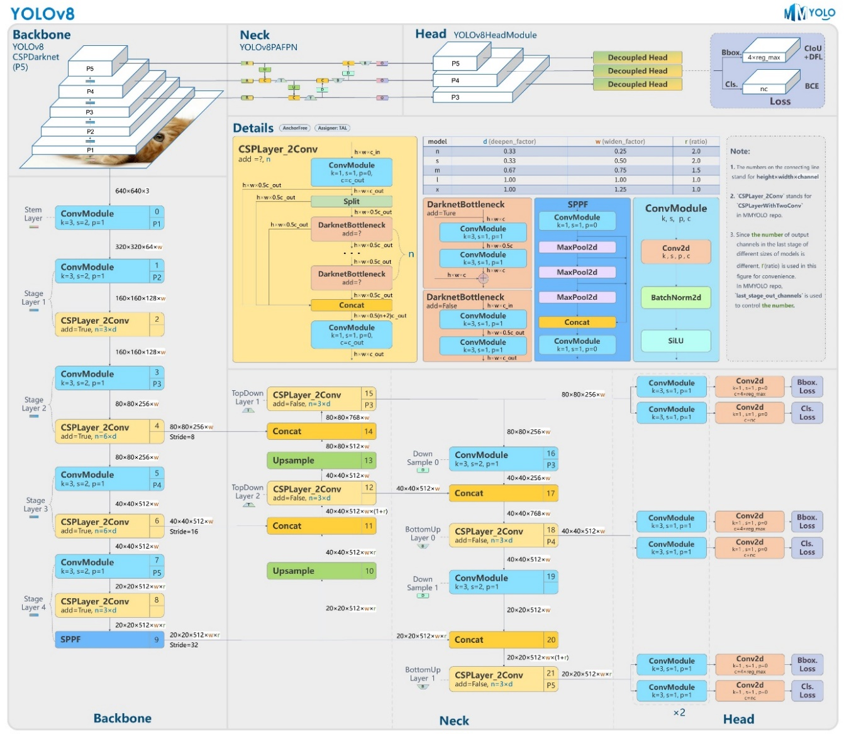
Architecture

Slide 6
Proposed Methodology /Technique
Data Collection :
famous datasets within the domain of Handgun detection and other similar objects such as cold steel weapons (knives) are available for free use.
2) Preprocessing:
Resizing
Enhancing the image
Auto Align
3) YOLOv8 : modifications to CSP called as C2f module

Slide 7
Implementation Details
Trained using Google Collab with a Tesla T4 GPU over around 2 hours
Proposed Model: YoloV8
Tested Models :
Systems | Model | Precision % | Recall % | F1 Score | Dataset Size
Proposed Model | YoloV8 | 93.6 | 87.8 | 90.65 | 12000 images
Saponara | Yolov2 | 97 | 97 | 95.4 | 400
Saponara | Yolov5 | 94.99 | 78.28 | 0.858 | 20000
Norkobil Saydirasulovich | Yolov6 | 93.48 | 28.29 | 0.9 | 4000

Slide 8
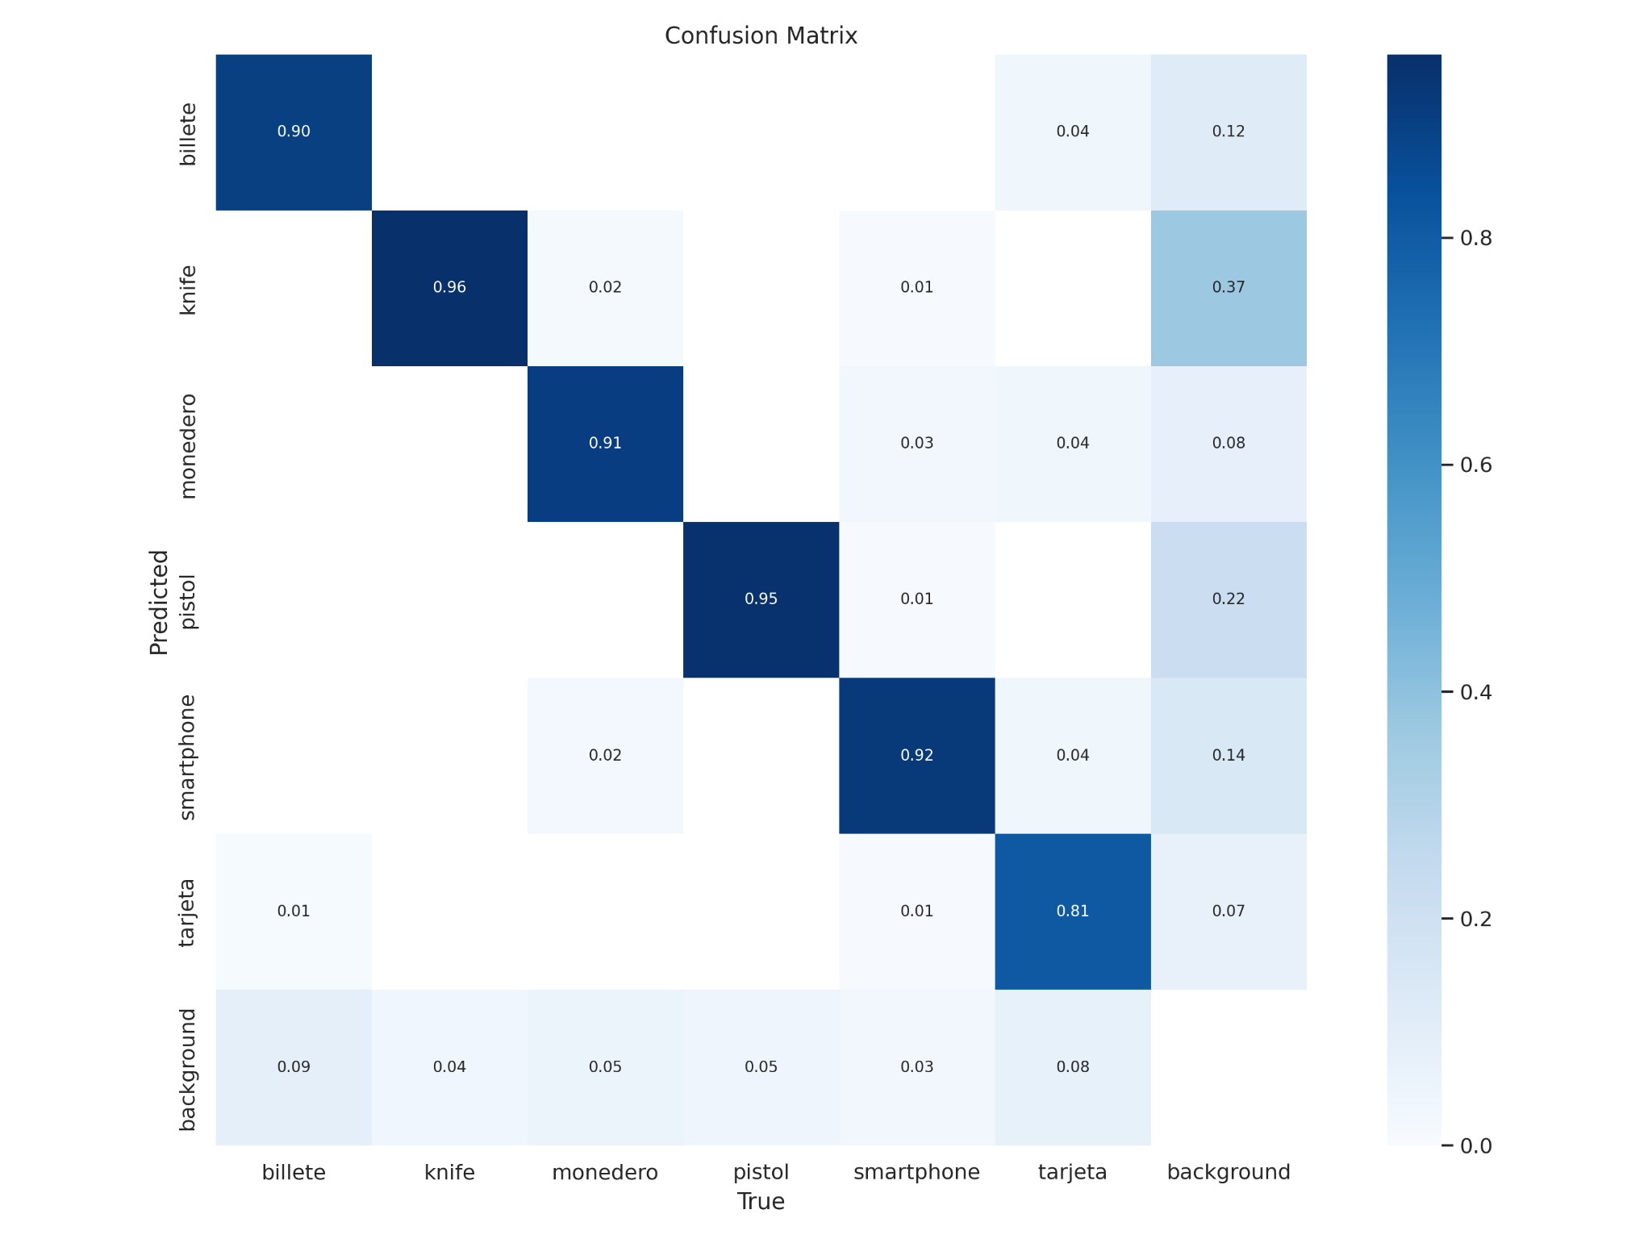
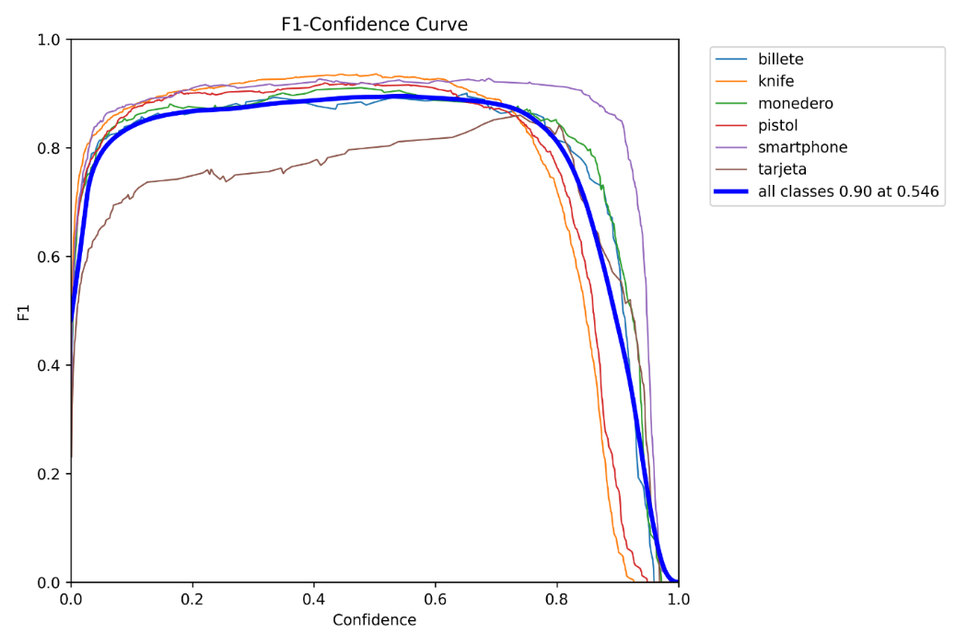
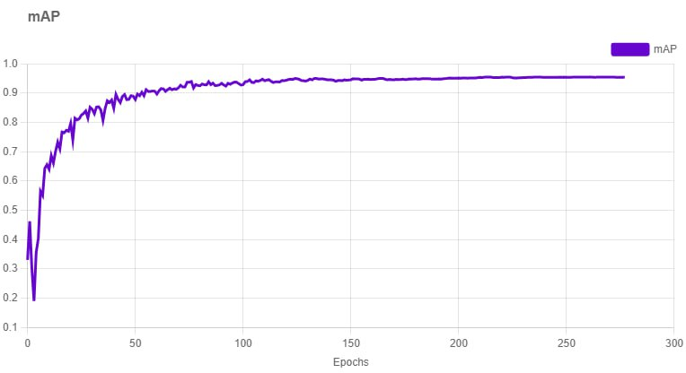
Results
Precision of 93.6% in detecting firearms while maintaining an overall
mean average precision (mAP) of 95.3%, along with
Recall rate of 87.8 %. The box loss is recorded at 0.762 while class loss stands at 0.439.

Slide 9
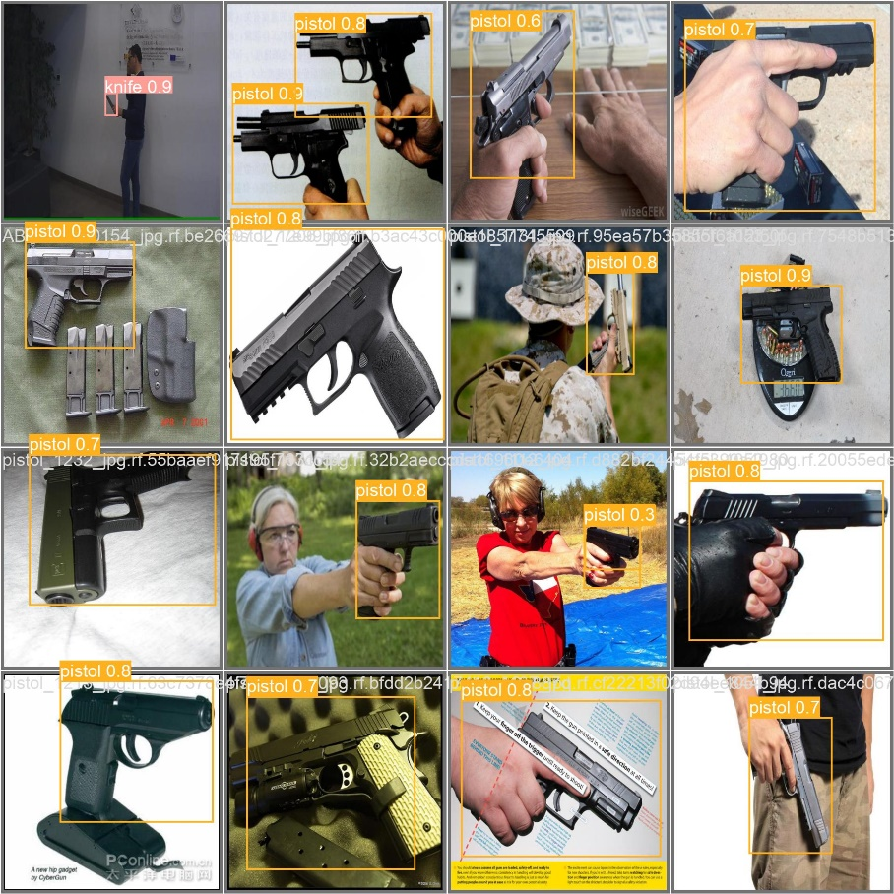
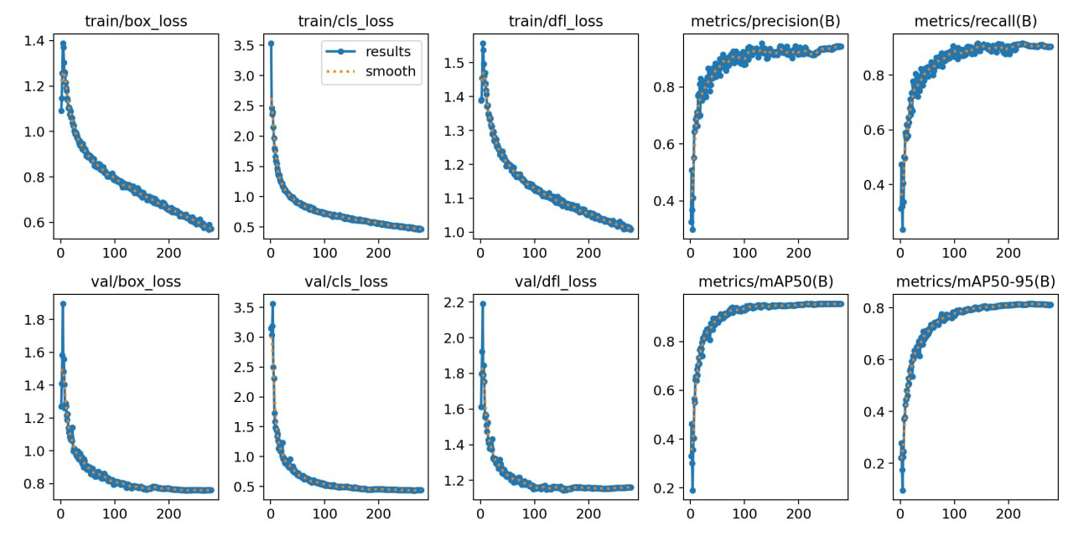

Slide 10
Thank you and Any Queries

Slide 11
Ultralytics. “Ultralytics/Ultralytics: NEW - YOLOv8 🚀 in PyTorch > ONNX > OpenVINO > CoreML > TFLite.” GitHub, github.com/ultralytics/ultralytics. Accessed 22 Nov. 2023.
(https://github.com/ultralytics/ultralytics)
that was used for the training of our model.
(read about yolov8 from paper)->
Terven, J. and Cordova-Esparza, D.
Terven, Juan, and Diana Cordova-Esparza. “A Comprehensive Review of YOLO: From YOLOv1 and Beyond.” arXiv.Org, 8 Oct. 2023, arxiv.org/abs/2304.00501. Accessed 22 Nov. 2023.

