Slide 1

AI-Driven Cloud Platform for Personalized Drug Response Prediction
Multi-omics data · Graph neural network + Transformer · Deployed on AWS
Abhijeet Sinha
Sarthak Pathak
Shriyans Pratihari
23BIT0157
23BIT0187
23BIT0219
BITE412L Cloud Computing · Guide: Dr. Priya V · SCOPE, VIT Vellore · 16/10/2026
Notes:
Introduce the team and the one-line idea: we took a deep-learning drug response model and turned it into a secure, explainable cloud service on AWS, built entirely within the free plan.

Slide 2




Good drug-response models rarely become usable services
Research code, not services
61
No login, storage, audit trail or monitoring, so a team cannot use them safely
Partial use of the data
deep-learning drug response models catalogued in one review (Partin et al., 2023)
One or two omics layers; drugs as strings; missing data not handled
Limited explanations
Deep models are hard to trust in a clinical setting
19
Optimistic evaluation
studies found that actually ran an MLOps pipeline in health care (Li et al., 2025)
Random splits leak cell lines; accuracy drops on unseen data
Notes:
Many models exist, but very few are deployed with security, monitoring and explanations. That gap is what this project addresses.

Slide 3



15 papers (2023–2026) point to one combined gap
Models (8)
Reviews (4)
Cloud & MLOps (3)
P2, P6–P10, P12, P13
P1, P3, P14, P15
P4, P5, P11
Graph drug encoders (GPDRP, TransCDR)
Attention / Transformer fusion (PASO, PharmaFormer)
Cell line → patient transfer (PANCDR)
Big accuracy drops on unseen datasets
Simple models often match complex ones
Need validation on new patients and drugs
Serverless cuts RNA-seq runtime by up to 96%
Security and performance are open issues
Deployment and monitoring rarely done
Gap: no reviewed work delivers an explainable multi-omics model as a secure, monitored, low-cost cloud service evaluated for both accuracy and service quality.
Notes:
Each student analysed five papers. Abhijeet: model papers; Sarthak: reviews, benchmark and cloud; Shriyans: explainability and clinical translation. All citations are verified in the report's reference list.

Slide 4
Six measurable objectives
O1
O2
O3
Leakage-free preprocessing
Multimodal GNN + Transformer
Explainable predictions
Statistics fitted on training cell lines only
Pearson ≥ 0.80, ROC-AUC ≥ 0.85 on unseen cell lines
Modality + gene attributions with every result
O4
O5
O6
Secure deployment as code
Performance & observability
Cost control
One CloudFormation stack; access tests pass
Median latency ≤ 2 s; metrics and alarms live
AWS Free plan; ≤ US$50/month on-demand equivalent
Notes:
These criteria are revisited on the results slides: O1, O3, O5 and O6 met; O4 met with one finding; O2 partly met because a per-drug linear baseline does better on the synthetic data.

Slide 5
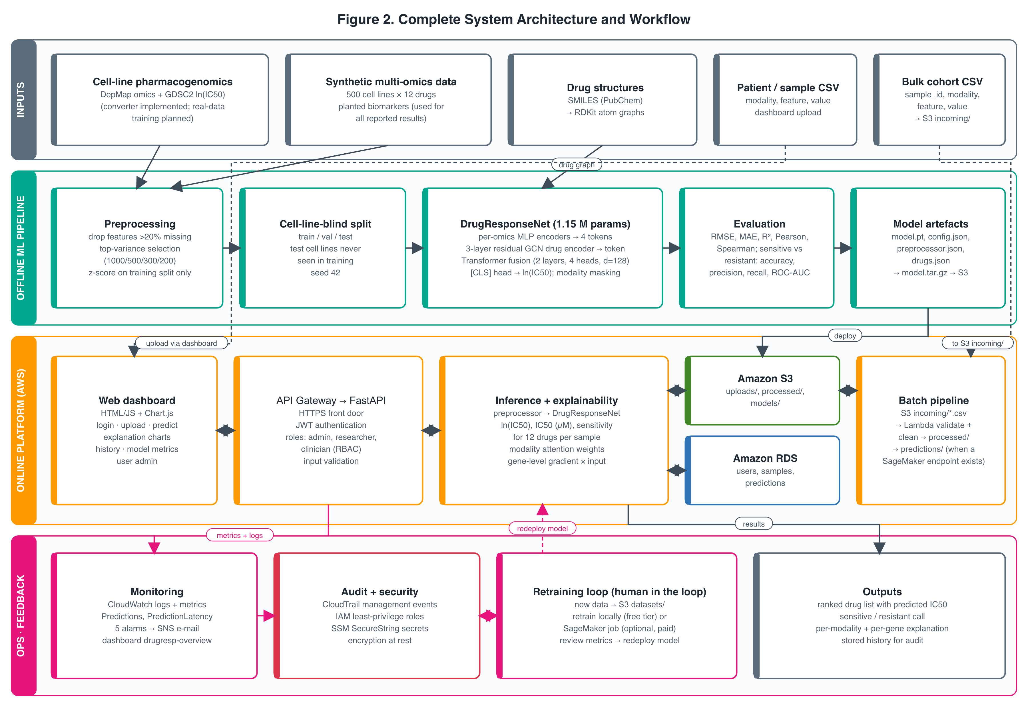
From multi-omics profile to explained prediction
1
Upload a profile in the dashboard
2
API authenticates and stores it in S3
3
Model predicts ln IC50 for 12 drugs
4
Explanations + results saved to RDS
5
CloudWatch tracks every prediction
Notes:
Four layers: inputs, the offline ML pipeline, the online platform on AWS, and operations/feedback. The full-size figure is Figure 2 in the report.

Slide 6

DrugResponseNet: one token per data type
Expression
Transformer fusion
Output
1,000 genes
ln IC50 and IC50 (µM) per drug; sensitive vs resistant against the drug's training median
[CLS] token attends to all tokens
2 layers · 4 heads · d = 128
Missing modalities masked out
Modality dropout 0.15 in training
Copy number
500 genes
Mutation
300 genes
Explanations
Proteomics
Attention weights show which data type mattered; gradient × input ranks the top genes
200 proteins
Drug graph
1.15 M parameters
RDKit atoms → 3-layer GCN
Notes:
Each omics layer becomes one token, and the drug's molecular graph becomes another. The Transformer's attention gives a per-modality explanation for free; gradient times input gives gene-level attribution.

Slide 7
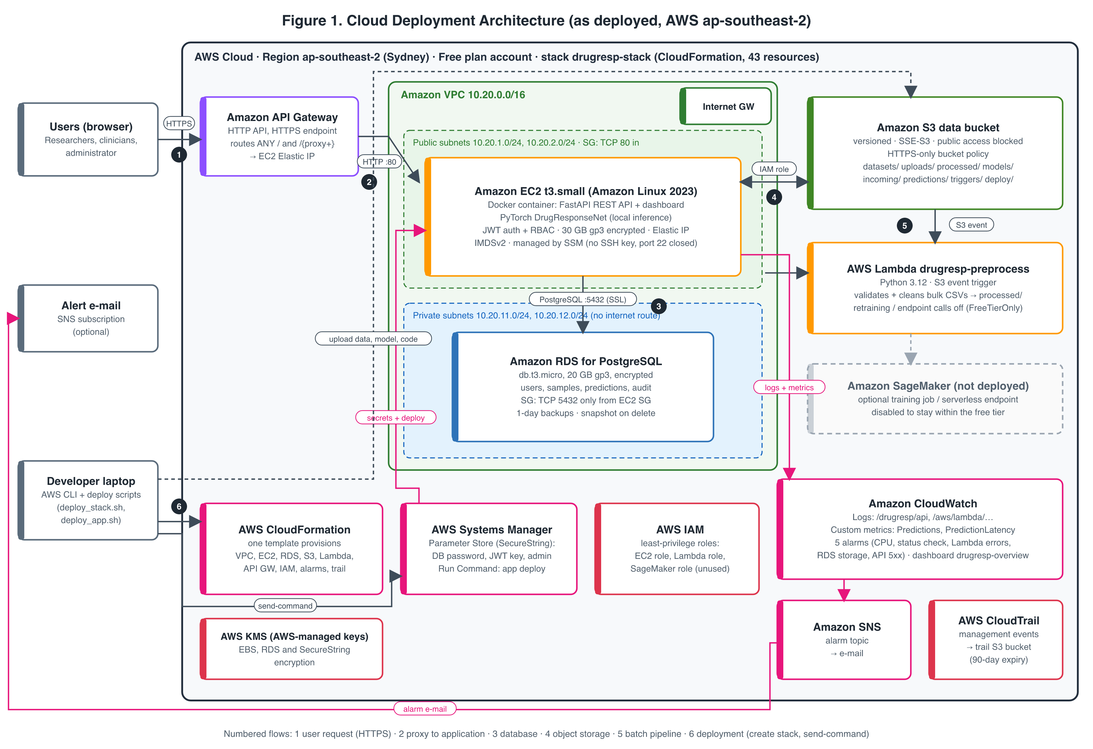
Deployed on AWS from one CloudFormation template
43
resources in stack drugresp-stack
11
AWS services in use
3
commands to deploy
Notes:
Region ap-southeast-2 (Sydney), because the AWS project only allows one home region. Flow: users → API Gateway (HTTPS) → EC2 container → RDS in private subnets; S3 for data; Lambda for bulk files; SSM for secrets and deployment; CloudWatch, SNS and CloudTrail for operations.

Slide 8






Security is built into the stack
Private database
Login and roles
RDS in private subnets; port 5432 only from the app
HTTPS, JWT, admin / researcher / clinician, sample ownership
No secrets in code
No SSH
SecureString parameters in SSM Parameter Store
Managed through SSM Run Command; IMDSv2 enforced
Encrypted everywhere
Audit and alarms
S3 SSE + HTTPS-only policy; encrypted EBS and RDS
CloudTrail events; 5 CloudWatch alarms → SNS
Notes:
Each control was tested on the live site; see the testing slide. One finding: port 80 on the EC2 instance is reachable directly, bypassing HTTPS (test T12).

Slide 9
Data: synthetic benchmark with planted biology
500
12
5,101
2,000
cell lines, 8 lineages
GDSC drugs
response pairs
selected omics features
Cell-line-blind split: 3,566 / 763 / 772 pairs; test cell lines never seen in training
Leakage-free: feature selection and z-scores fitted on training cell lines only
Planted effects: EGFR → erlotinib, BRCA1 → olaparib, ABCB1 → doxorubicin resistance
Real data next: DepMap + GDSC converter and TCGA validation are implemented but not yet run
Notes:
Because the data are synthetic, the results prove the pipeline works, not that the biology is right. Real-data validation is the clear next step.

Slide 10
Beats global baselines; a per-drug linear model scores higher
Test Pearson r on 772 pairs from unseen cell lines
0.837
0.866
1.077
Per-drug mean
0.434
Pearson r
ROC-AUC
RMSE (ln IC50)
Ridge (global)
0.516
Why the per-drug ridge wins
Random forest
0.772
The synthetic data plant mostly linear, drug-specific effects, which a separate linear model per drug captures exactly. Our single model must also handle all drugs, missing data and new drugs from structure. Real DepMap/GDSC data and an unseen-drug test will decide.
DrugResponseNet
0.837
Ridge (per drug)
0.908
Same split, features and thresholds for every model
Notes:
Same split, same features, same thresholds for every model. We report the per-drug ridge result openly; it is the main limitation of the current evaluation.

Slide 11
Live deployment: 13 of 14 tests passed
Area | Tests | What was checked | Pass
Functional | T01–T04 | 12 unit tests; stack created; health OK; end-to-end prediction | 4/4
Security | T05–T08, T11 | No token, forged token, wrong password → 401; sign-up → 403; SSH closed | 5/5
Access control | T09–T10 | Researcher blocked from user admin (403) and others' samples (404) | 2/2
Performance | T13–T14 | Latency and 10-client concurrency within targets | 2/2
HTTPS bypass | T12 | EC2 answers plain HTTP on its public IP; fix: restrict port 80 | 0/1
1.07 s
median end-to-end, 12 drugs + explanations
0.18 s
average server-side inference (CloudWatch)
6.6 / s
predictions with 10 concurrent users, 0 errors
Notes:
Tests ran on 16/10/2026 from a laptop in India against the Sydney deployment. About 0.85 s of each request is network round trip, so a Mumbai deployment would be faster.

Slide 12
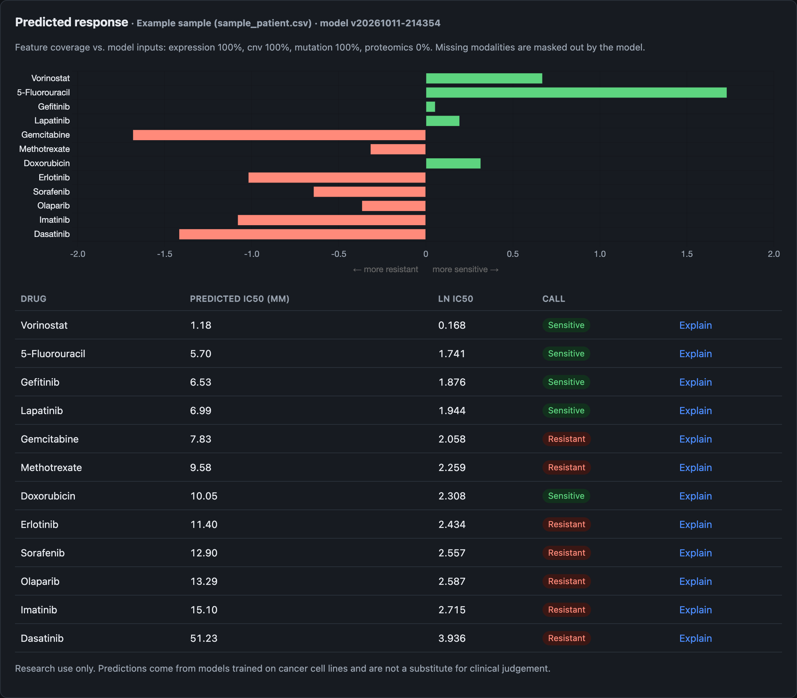
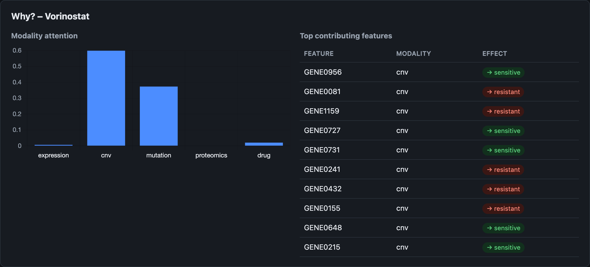
The dashboard: ranked drugs with explanations
Left: predicted sensitivity for 12 drugs with IC50 and sensitive/resistant calls. Right: why vorinostat was predicted sensitive, by data type and top genes.
Notes:
Live demo point: sign in, upload datasets/sample_patient.csv, predict, then click Explain on any drug. Then show the Model, History and Users tabs, and sign in as a researcher to show role-based access.

Slide 13
Runs on the AWS Free plan: no card charges
Estimated on-demand cost, ap-southeast-2 (USD per month)
≈ $49
RDS db.t3.micro
$20.44
per month if billed on demand (AWS price lists, 16/10/2026); everything else < $0.10
EC2 t3.small
$19.27
Public IPv4
$3.65
Cost controls
Free plan: usage comes from credits
SageMaker switched off (FreeTierOnly)
No NAT gateway; Parameter Store, not Secrets Manager
Stop EC2/RDS between sessions; delete stack after
EBS 30 GB
$2.88
RDS storage 20 GB
$2.76
Notes:
These are estimates, not actual spend: the free plan had not yet recorded any credit use on 16/10/2026, with $140 of credits available.

Slide 14


Limitations and next steps
Current limitations
Next steps
Synthetic data only; one training run
Per-drug ridge beats the model here
Port 80 reachable without HTTPS (T12)
Single EC2 instance, Single-AZ RDS
Region fixed to Sydney (extra latency)
Train on DepMap + GDSC; test unseen drugs; run TCGA validation
Repeat runs with several seeds; report confidence intervals
Restrict port 80 to API Gateway or use a private VPC link
Auto Scaling across two AZs; Multi-AZ RDS
Move to Mumbai; add CI/CD and SNS e-mail alerts
Notes:
Each limitation on the left is matched by the next step on the right.

Slide 15

Team contributions
Abhijeet Sinha
Sarthak Pathak
Shriyans Pratihari
23BIT0157
23BIT0187
23BIT0219
Data, preprocessing and DrugResponseNet
Training, metrics and baselines
Papers P2, P7, P10, P12, P13
CloudFormation, IAM, VPC, SSM
FastAPI backend, RBAC, PostgreSQL
Papers P1, P4, P5, P11, P14
Dashboard and API integration
End-to-end and UI testing
Papers P3, P6, P8, P9, P15
Notes:
Code: github.com/Vegeta290/AIDrugResponsePrediction_AWS_Cloud_Project_2026.

Slide 16
An explainable drug-response model, delivered as a secure cloud service for $0
O1, O3, O5, O6 met · O4 met with one finding · O2 partly met
Code: github.com/Vegeta290/AIDrugResponsePrediction_AWS_Cloud_Project_2026
Live: q6oovdd9rc.execute-api.ap-southeast-2.amazonaws.com
Thank you · Questions?
Notes:
Summarise: a working, secure, monitored platform; honest model results; clear next steps with real data.

