Slide 1
Mood Tracker
Francesco Malagrinò

Slide 2
Intro to the Mood Tracker
MoodTracker is a tool to track your daily mood. It can be used to track changing your mood but could also easily be adapted to serve as a means to evaluate a visit to a restaurant, follow the evolution of a patient or any other context that asks for feedback and history.

Slide 3
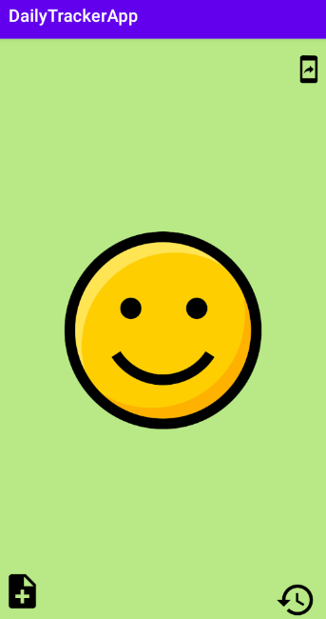
This is the homepage :
There are 5 moods from very happy to sad, you can change the mood just swiping with the finger up or down or left to right and as well changing mood will make a sound.
The mood will be saved as soon as you save a comment and the comment will be saved in the history.

Slide 4
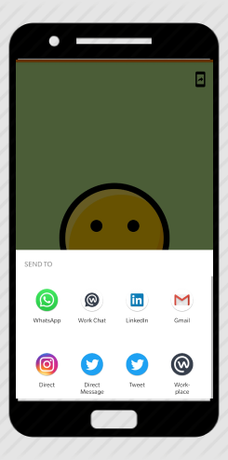
Share feature :
The app have the share option on right top , if you click on the share will appear the image on the right :
You can share your mood with your friends using whatapp or email or twitter or any social media app.

Slide 5
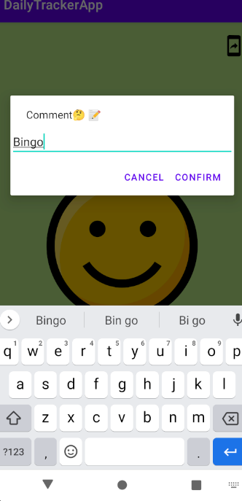
Comments feature :
You can click the button on the bottom left to leave a comment like in the picture on the right :
If you click cancel will be cancel the comment and will appear a Toast notification on the bottom of the screen telling that the comment as been cancel
If you instead click confirm the comment will be saved in the history and as well will appear on the bottom of the screen a Toas notification saying that the comment has been saved

Slide 6
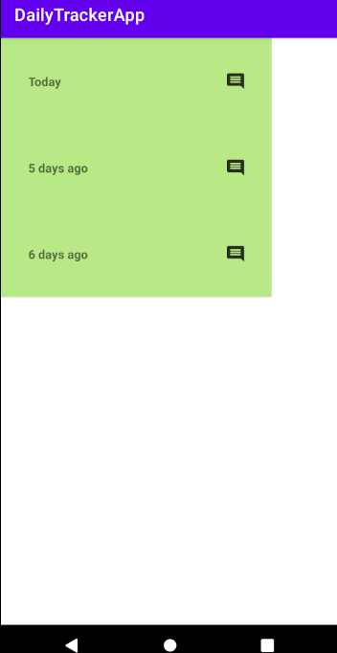
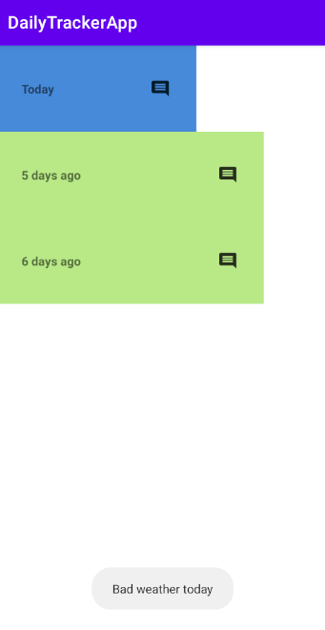
History feature
This is the history page as the picture first picture on the right.
The data will be saved for every single mood daily up maximum seven days :
If somebody could ask what will happens at the eight day? The oldest day will be ovveride and will become the today day
If you press the messagge icon will appear the comment saved as in the second picture

