Slide 1
DoorDash
The future of delivery food
Product Owner: Francesco Malagrino
© 2019 Udacity. All rights reserved.

Slide 2
Background
Why Are We Here?
We need to reduce operations cost
We need to provide more reliable delivery times
That’s why we will introduce a new revolutionary system
© 2019 Udacity. All rights reserved.

Slide 3
Business Case
© 2019 Udacity. All rights reserved.
Notes:
[ALL PARTICIPATION]

Slide 4
Initial Focus
Where are we starting?
Why did I choose this focus?
Because this matches the company goals.
© 2019 Udacity. All rights reserved.

Slide 5
Opportunity
What’s the problem?
We need to reduce operations cost and as well we need to provide more reliable delivery times
We was losing money and customer for this reason I needed to create a new product that will help us to optimise cost and attract more customer
To do this we will start to delivery to 2 meter as start the food using robots
Total Addressable market for food delivery in USA is $ 325 Bilions this year and in the next 5 years can increase until $470 bilions.
The market share can become 27% more in the 2022 .
We have 6 competitors. 2 big competitors and 4 little competitors.
© 2019 Udacity. All rights reserved.

Slide 6
Proposal
What’s Our Solution?
We need to build a software that will track and make sure that the robot is Delivering correctly the food and can’t be neither stole.
We will put camera at 365 grades and we will send a message to the customer and only the customer can unlock the robot.
© 2019 Udacity. All rights reserved.

Slide 7
Return On Investment
What can we do?
The cost won’t be too much and the return as investment will be very high.
Good-quality robots are predictable and offer peace of mind for financial returns. As manufacturers consider investing in robots for productivity
We will keep the 25% of current labor cost.
My Estimation is that reducing the labor budget can be very impressive , $37,350 per years or $150 000/4.
© 2019 Udacity. All rights reserved.

Slide 8
Measurement
How will we know if we’re successful?
Our first year we want to use 3 maximum 4 robots that will delivery the food in time to the first 5 miles. We will start with 2 miles to arrives to 5 miles in the first year.
© 2019 Udacity. All rights reserved.

Slide 9
Competitors
© 2019 Udacity. All rights reserved.
Notes:
[ALL PARTICIPATION]

Slide 10
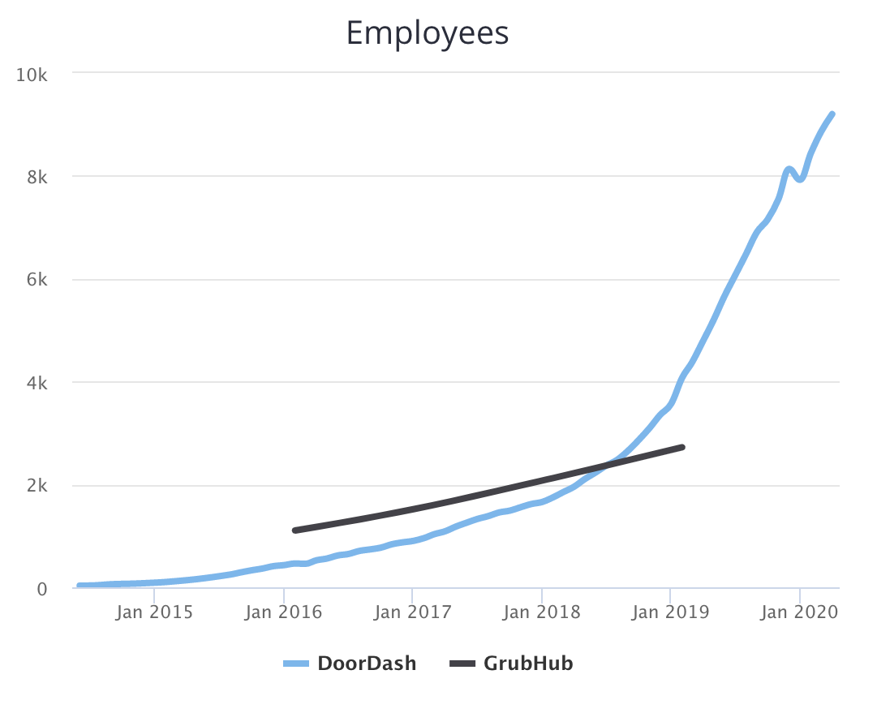
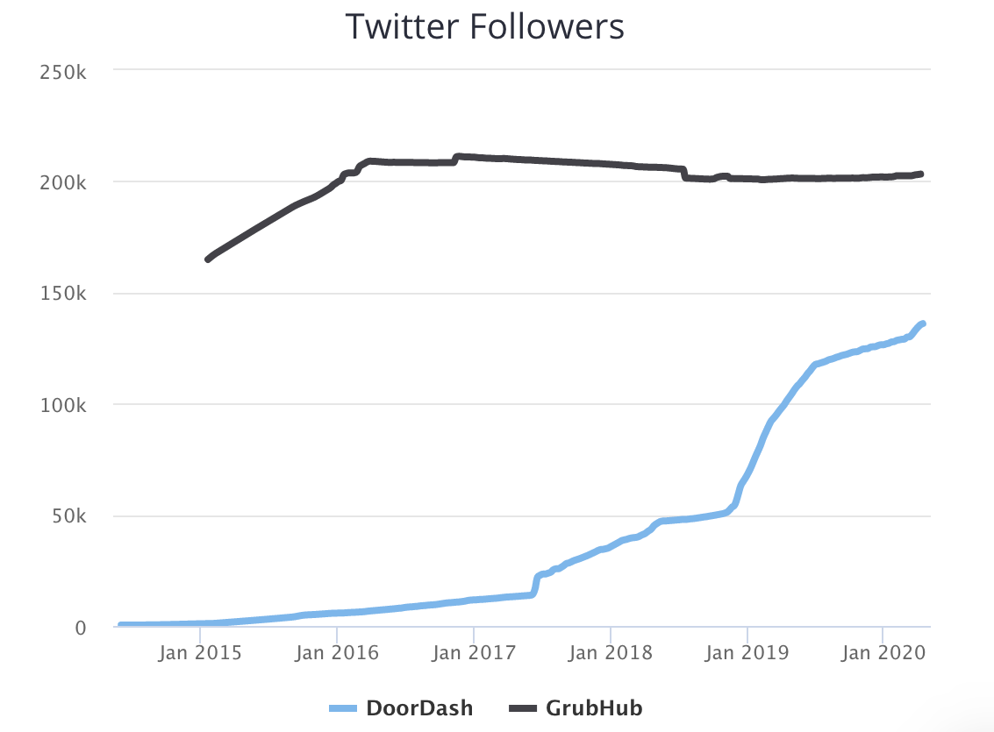
GrubHuB
GrubHub provides an online and mobile platform for restaurant pick-up and delivery orders.
They are a public company specialize in
Food & beverage Technology,
Delivery mobile app and Platform restaurant
Some important facts :
They are increase the employee,
They operates at the moment only at
Chicago and New York
They Have 4,1B ($) of valutation
They have 203,2 K followers on twitters,
They revenue is of $1,3 Billions and Net income is (18,6m)
© 2019 Udacity. All rights reserved.

Slide 11
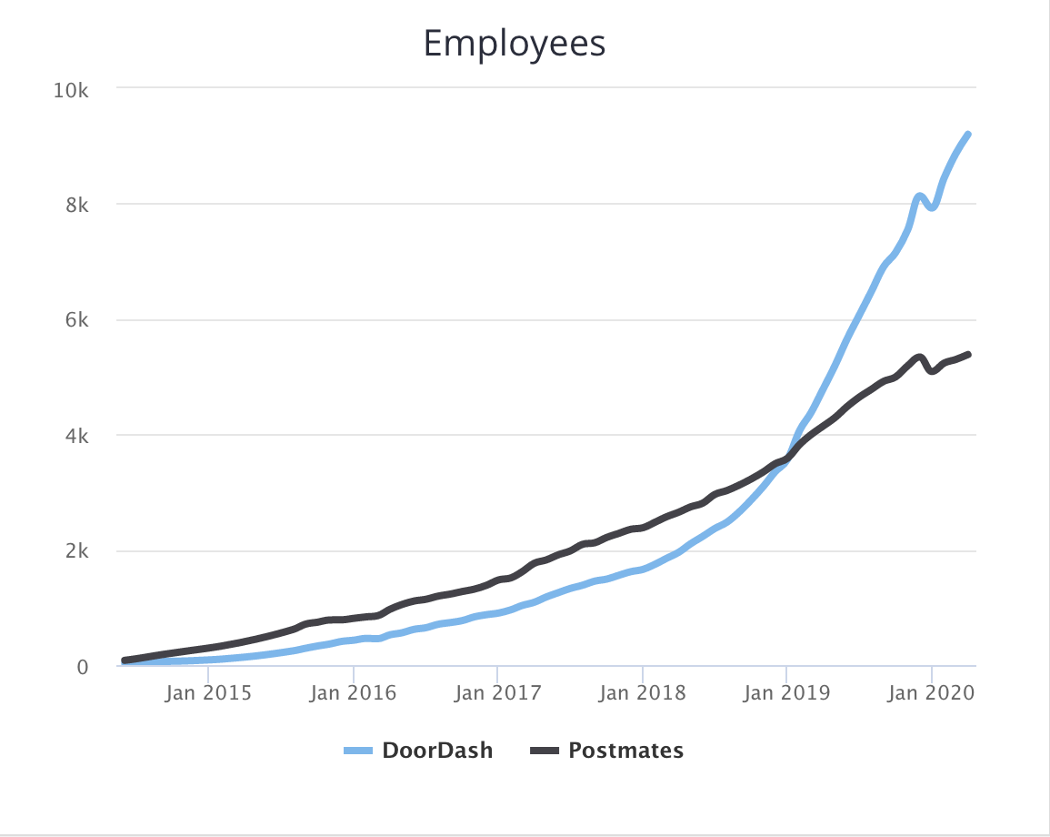
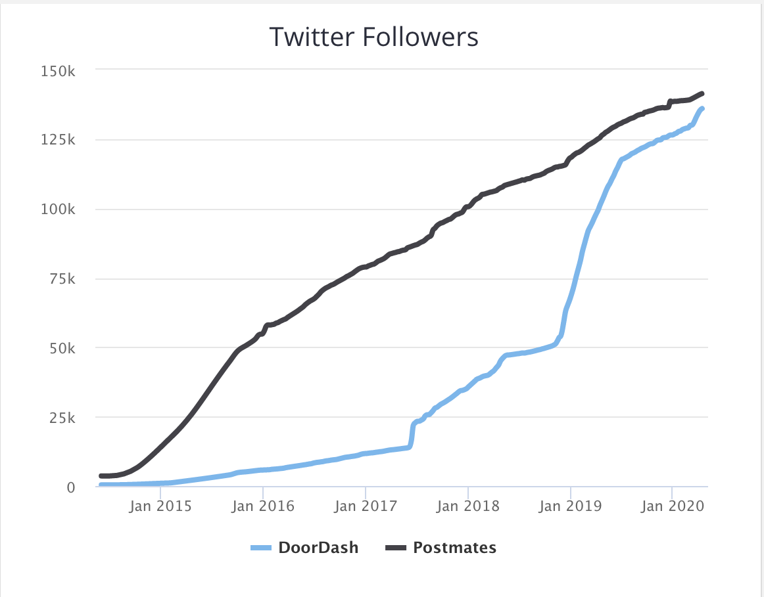
PostMates
Postmates is a company developing an urban logistics and on-demand delivery platform.
They are a private company specialize in :
Technology Delivery
Logistics
Platform Shipping
Some important facts :
They are increase the employee
They have 141.3 k of twitter followers
Revenue is 1 billions and
cost goods is £739,9m
They Pay 170K every years per drivers
They operate in multiples cities
© 2019 Udacity. All rights reserved.

Slide 12
Our Advantages
Why are we better?
why us?
Why should buyers choose your product and not that of the competitors you just mentioned?
Because we are the best we have the best technology we will not allow anymore any late delivery and we have as well a nutrition software and diet software
© 2019 Udacity. All rights reserved.

Slide 13
Roadmap and Vision
© 2019 Udacity. All rights reserved.
Notes:
[ALL PARTICIPATION]

Slide 14
Roadmap Pillars
Where do we go from here?
My vision is that we will become the number one company in the USA for delivery foods and we will open in all the USA.
GPS Tracker
Anti Theft mode
Customer oriented
© 2019 Udacity. All rights reserved.

Slide 15
GPS Tracker
GPS tracker for customer to see where the robot it is and see how long until arrive the food.
DoorDash GPS tracker
© 2019 Udacity. All rights reserved.

Slide 16
Anti Theft Mode
Camera software tracker and SMS to open and lock the robot
Will be more than one camera, we want to have a 365 grade visualization to check everything if somebody will try to steal and open the robot the robot won’t open it will make a picture of the person and send it to the police.Only the customer will receive an SMS with a link that will permits to open the robot.
© 2019 Udacity. All rights reserved.

Slide 17
Customer Oriented
The customer will personalize the delivery. They can buy with an extra discount a menu of nutrition, we want our customer that eat with us and healthy.
The Customer can personalize our delivery
© 2019 Udacity. All rights reserved.

Slide 18
Where do we go from here?
Widening the scope
Our next product will be an innovative food delivery, we will collect all the data and we will create a software with AI that will help our customer on the diet and as well nutrition , we will suggest what is better to eat based on weight and height
© 2019 Udacity. All rights reserved.

