Slide 1
DoorDash
The future of delivery food
Product Owner: Francesco Malagrino
© 2019 Udacity. All rights reserved.

Slide 2
Background
Why Are We Here?
We are a company expert in food delivery and we want to have more customer.
We are wasting billions in operation cost and we need to reduce it.
We need to provide more reliable delivery times at least we want to be at a rate of 90% of reliable delivery.
That’s why we will introduce a new revolutionary system
© 2019 Udacity. All rights reserved.

Slide 3
Business Case
© 2019 Udacity. All rights reserved.
Notes:
[ALL PARTICIPATION]

Slide 4
Initial Focus
Where are we starting?
Why did I choose this focus?
Because this matches the company goals.
© 2019 Udacity. All rights reserved.

Slide 5
Opportunity
What’s the problem?
We need to reduce operations cost and as well we need to provide more reliable delivery times
We was losing money and customer for this reason I needed to create a new product that will help us to optimise cost and attract more customer
To do this we will start to delivery to 2 meter as start the food using robots
Total Addressable market for food delivery in USA is $ 325 Bilions this year and in the next 5 years can increase until $470 bilions.
The market share can become 27% more in the 2022 .
We have 6 competitors. 2 big competitors and 4 little competitors.
© 2019 Udacity. All rights reserved.

Slide 6
Proposal
What’s Our Solution?
We have a problem with the reliable of the delivery, especially if are in 2 / 5 meters and we have as well lots of driver that we need to pay even for 2/5 meters so mine proposal is to use a robot that will delivery the food in the first 2 meters and then 5 meters in this way we will safe cost and we will crease the reliable of the delivery at 90%
© 2019 Udacity. All rights reserved.

Slide 7
Return On Investment
What can we do?
We will invest 200 000 dollars the first years to create robots that will send food to the customer.
We will keep at least 25% of the current labor cost for the first 5 mile s/8 miles
We will have 4 developer cost to create a software on Android and 4 on Apple store and 4 engineering to build the robot.
We want have at least 50% more of new customer and an 80% of comeback customer
We Will have 15% of ROI
© 2019 Udacity. All rights reserved.

Slide 8
Measurement
How will we know if we’re successful?
our goal is to reduce delivery time so the metric for this goal will be average delivery time.
We will as well check how many new customer we will have and comeback customer
Feedback from the customer based on the app. We want at least 4.5 on 5 on review on our app that will be on apple and android devices
© 2019 Udacity. All rights reserved.

Slide 9
Competitors
© 2019 Udacity. All rights reserved.
Notes:
[ALL PARTICIPATION]

Slide 10
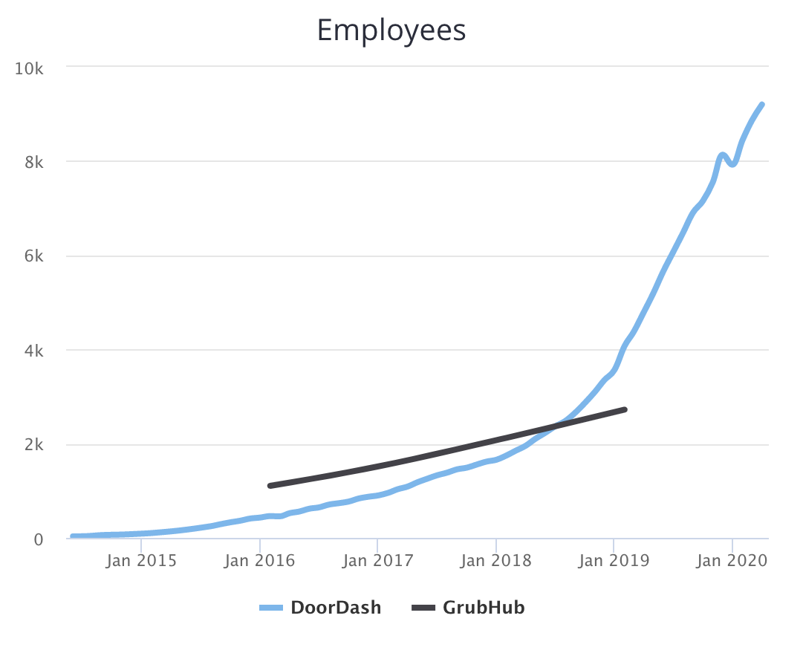
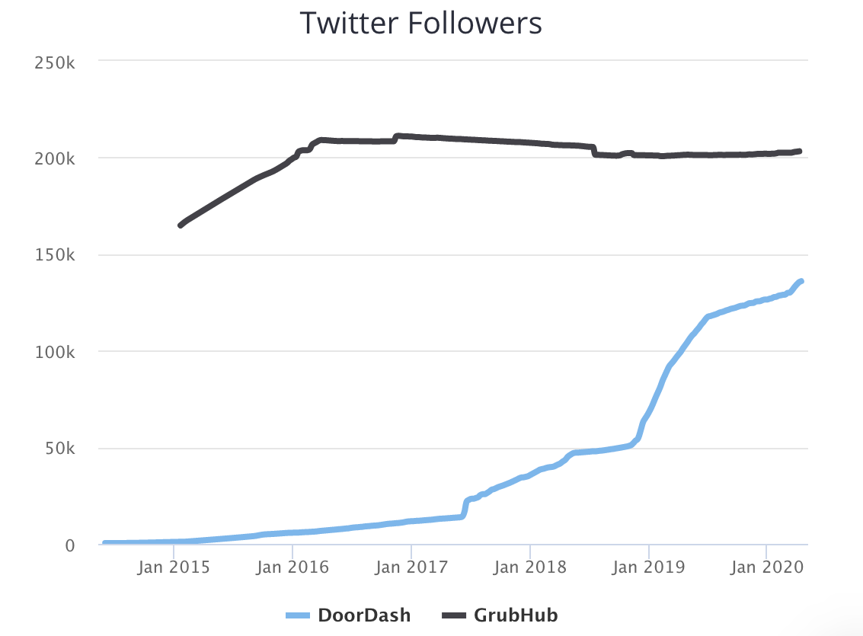
GrubHuB
https://www.grubhub.com/
GrubHub provides an online and mobile platform for restaurant pick-up and delivery orders.
They are a public company specialize in
They have an app that provide deals with restaurant
New customer have free delivery
Some important facts :
They are increase the employee,
They operates at the moment only at Chicago and NY
They Have 4,1B ($) of valutation
They have 203,2 K followers on twitters,
They revenue is of $1,3 Billions and Net income is (18,6m)
© 2019 Udacity. All rights reserved.

Slide 11
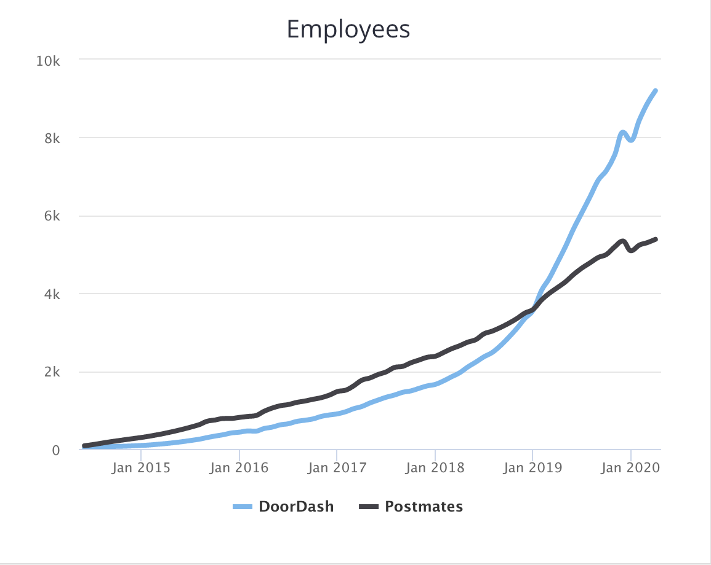
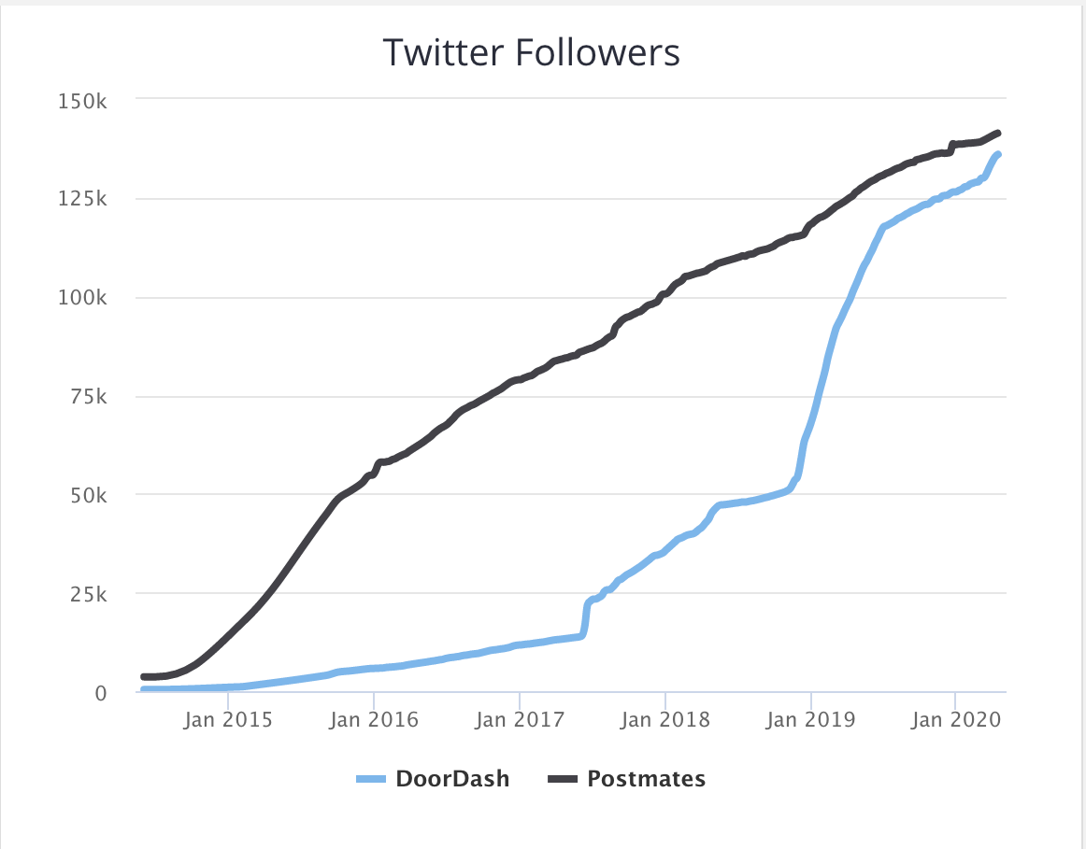
PostMates
https://postmates.com/
Postmates is a company developing an urban logistics and on-demand delivery platform.
Their app that will locate a restaurant near you
They give you a free unlimited 7 days of the app
And if you have this every 12 $ spent you have
A free delivery
Some important facts :
They are increase the employee
They have 141.3 k of twitter followers
Revenue is 1 billions and cost goods is £739,9m
They Pay 170K every years per drivers
They operate in multiples cities
© 2019 Udacity. All rights reserved.

Slide 12
Our Advantages
Why are we better?
Why choice us? The answer is very simple we will give you the best food in the zone in a faster way respect anybody else. We will use the robot to send food fast in the first 2/5 meters
We will have as well unique business partnerships, and unique content that our competitor doesn’t have
© 2019 Udacity. All rights reserved.

Slide 13
Roadmap and Vision
© 2019 Udacity. All rights reserved.
Notes:
[ALL PARTICIPATION]

Slide 14
Roadmap Pillars
Where do we go from here?
My vision is that we will become the number one company in the USA for delivery foods and we will open in all the USA.
GPS Tracker
Anti Theft mode
Customer oriented
© 2019 Udacity. All rights reserved.

Slide 15
GPS Tracker
This feature will be able to the customer check where is the food and how long to wait
To us to check if there is any issue or obstacles and use a remote controller to make sure that the robot will pass the obstacles and arrive in perfect time
DoorDash GPS tracker
© 2019 Udacity. All rights reserved.

Slide 16
Anti Theft Mode
Camera software tracker and SMS to open and lock the robot
Will be more than one camera, we want to have a 365 grade visualization to check everything if somebody will try to steal and open the robot the robot won’t open it will make a picture of the person and send it to the police.
Only the customer will receive an SMS with a link that will permits to open the robot.
© 2019 Udacity. All rights reserved.

Slide 17
Customer Oriented
The customer will personalize the delivery like weekly, monthly , every day different order or same order.
They can buy with an extra discount a menu of nutrition, we want our customer that eat with us and healthy.
We will as well give extra discount to our assiduous customer
The Customer can personalize our delivery
© 2019 Udacity. All rights reserved.

Slide 18
Where do we go from here?
Widening the scope
Our next product will be an innovative food delivery, we will collect all the data and we will create a software with AI that will help our customer on the diet and as well nutrition , we will suggest what is better to eat based on weight and height
Our AI will as well recommend based on the past order order similar or the same typical order.
© 2019 Udacity. All rights reserved.

