Slide 1
Analysis of A/B Test Results
Data Scientist: Francesco Malagrino
© 2024 Udacity.

Slide 2
Agenda
Findings of A/B test analysis
Experiment Setup
Conversion Rates
Experiment Results

Slide 3
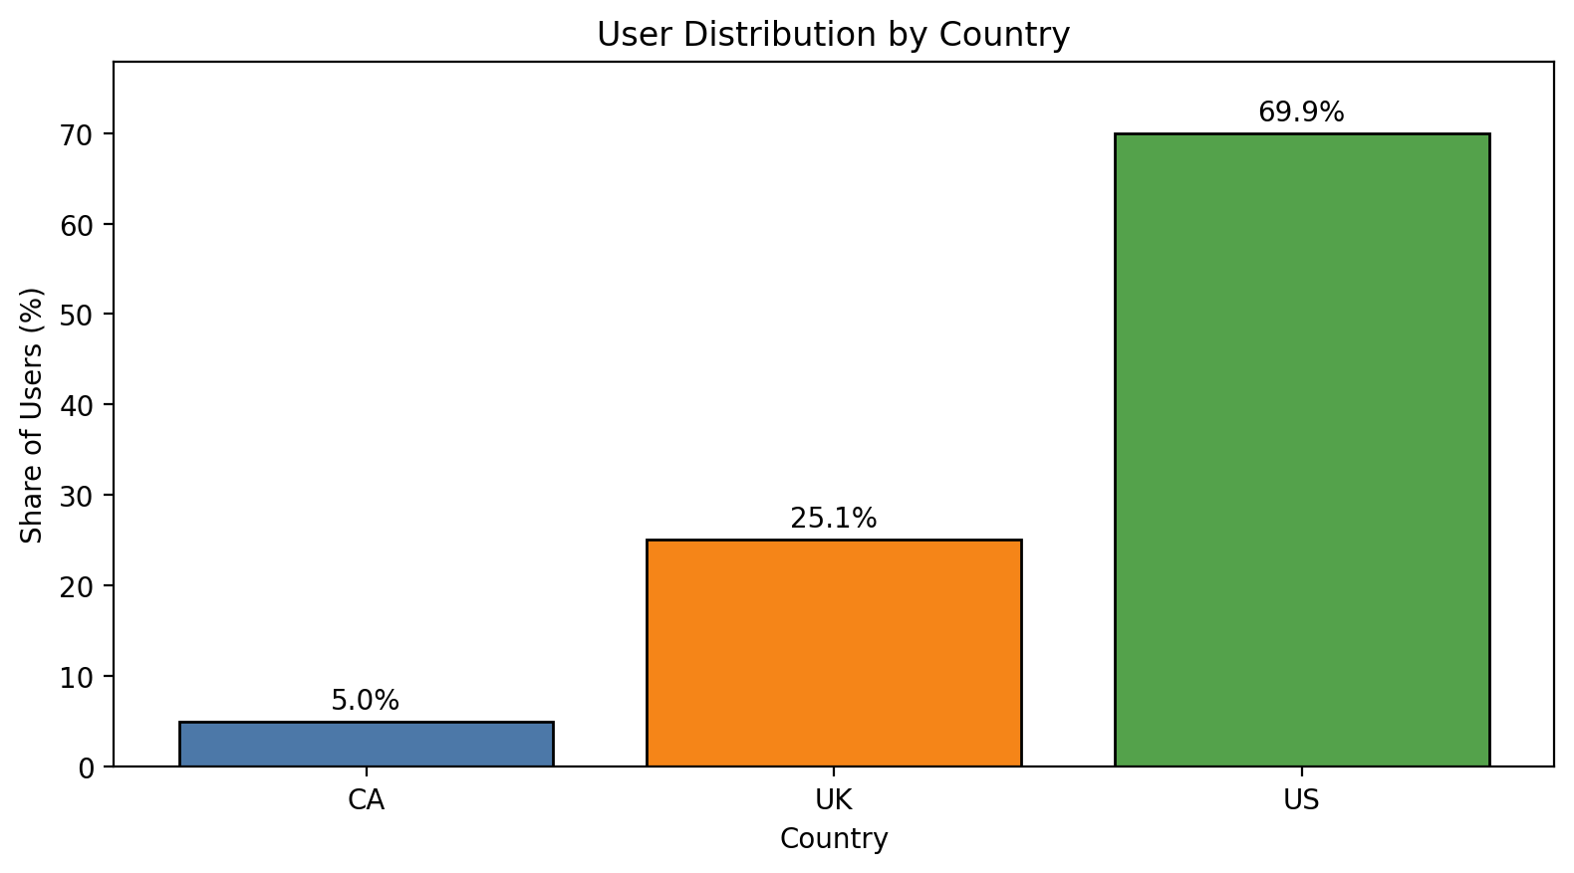
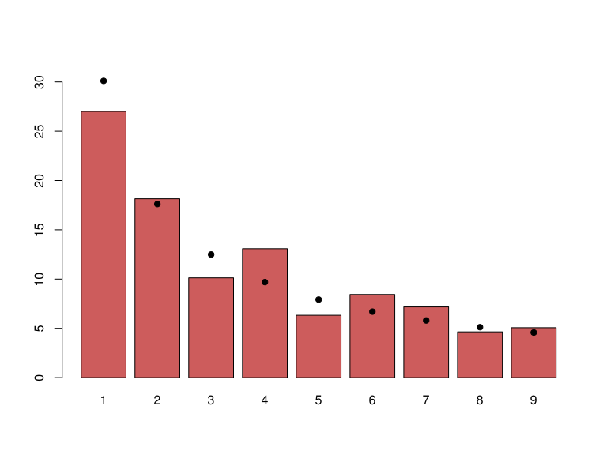
How Was the Experiment Implemented?
Total Variant Visitors: 35,211
Total Control Participants: 34,678
Users from: US (69.9%), UK (25.1%), CA (5.0%)

Slide 4
Conversion Rates
 | U.S. | U.K. | CA
Control | 10.73% | 10.16% | 9.45%
Treatment | 15.78% | 14.87% | 15.40%
Executive Summary: Treatment is associated with higher conversion rates than control overall and within each country. The treatment conversion rate is 15.53% versus 10.53% for control, and the treatment lift appears in the US, UK, and CA. Country-level conversion rates differ somewhat, but the treatment effect is consistently positive.

Slide 5
Experiment Results
Treatment Conversion Rate: 15.53%
Control Conversion Rate:​ 10.53%
Delta in Treatment vs. Control Conversion Rate:​ +5.01 percentage points
p-value:​ 0.00 (simulation-based; 0 of 500 null differences exceeded observed)
Conclusion:
​We reject H0 at the 0.05 level. The treatment page performs significantly better than the control page, so the company should implement the new page.

