Slide 1


ConnectOne
Jayakumar Vegi, Shankar, Satyaveni, Aruna
https://github.com/Vegi-Jayakumar/Hackathon_DataCrusaders_ConnectOne

Slide 2
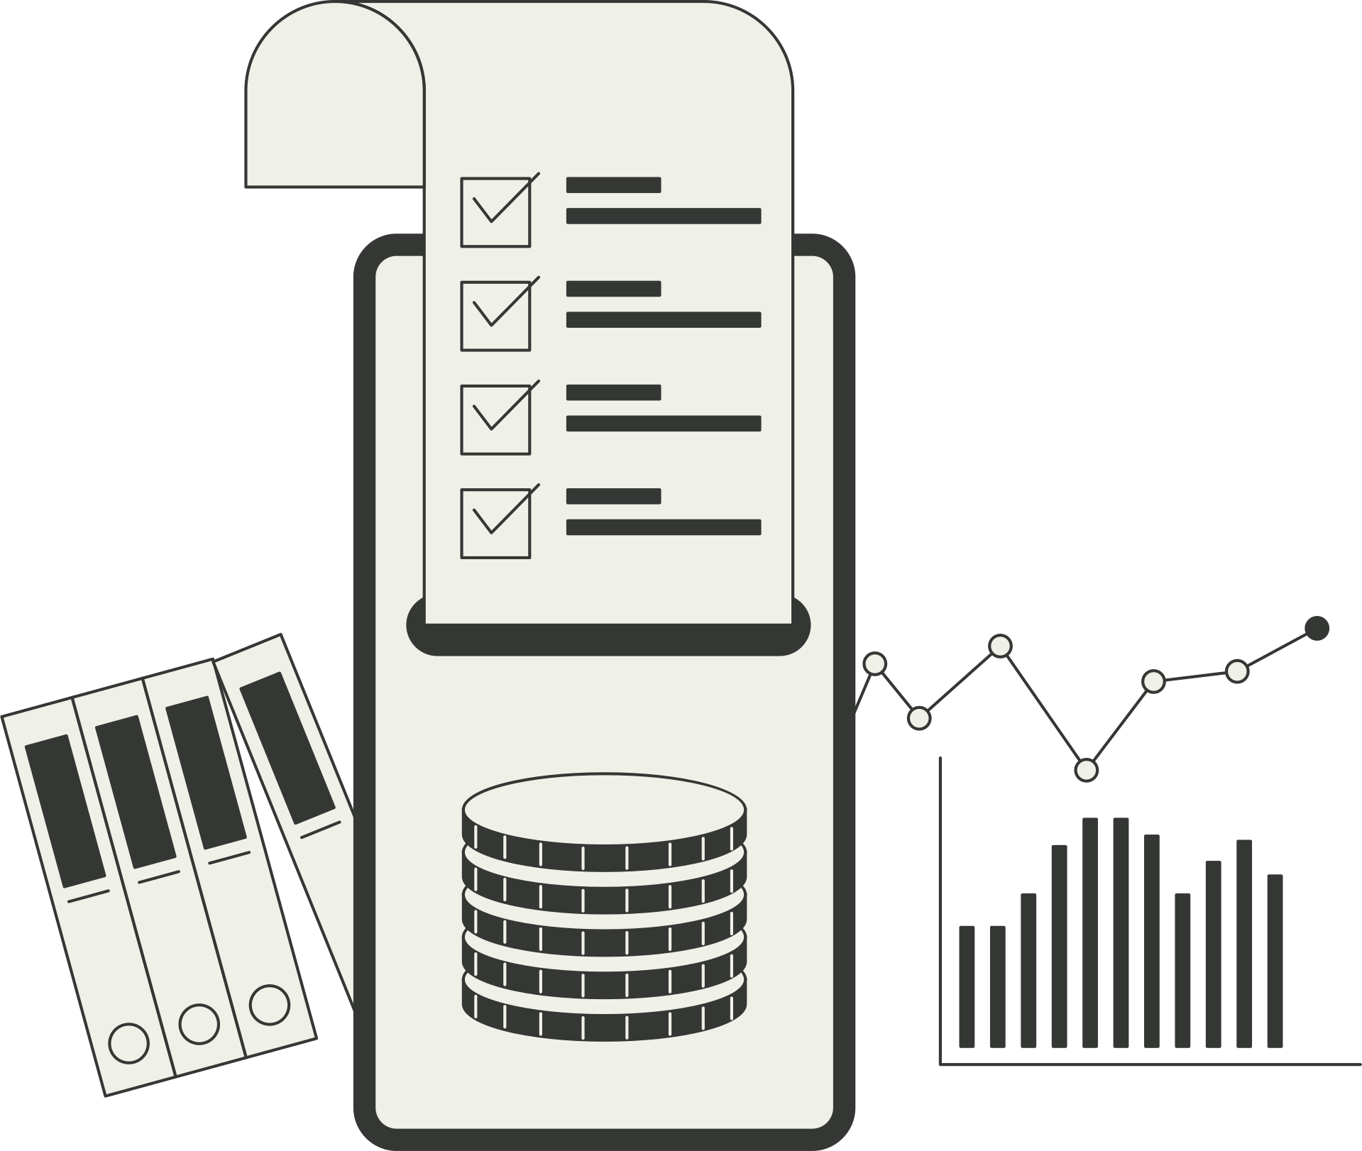
Problem Statement
ConnectOne is a regional telecom operator with 8 lakh prepaid and postpaid subscribers in Andhra Pradesh and Telangana. Every month thousands of subscribers move to other networks, and the company is not sure which plans or areas are losing the most customers.
Network complaints are rising in some towns, and many subscribers are on plans that are not profitable. Leadership wants to understand churn, usage and plan performance before revising plans and network investments.

Slide 3

Primary Responsibilities
Collect Data
Validate
Analyze
Report
Recommend

Slide 4
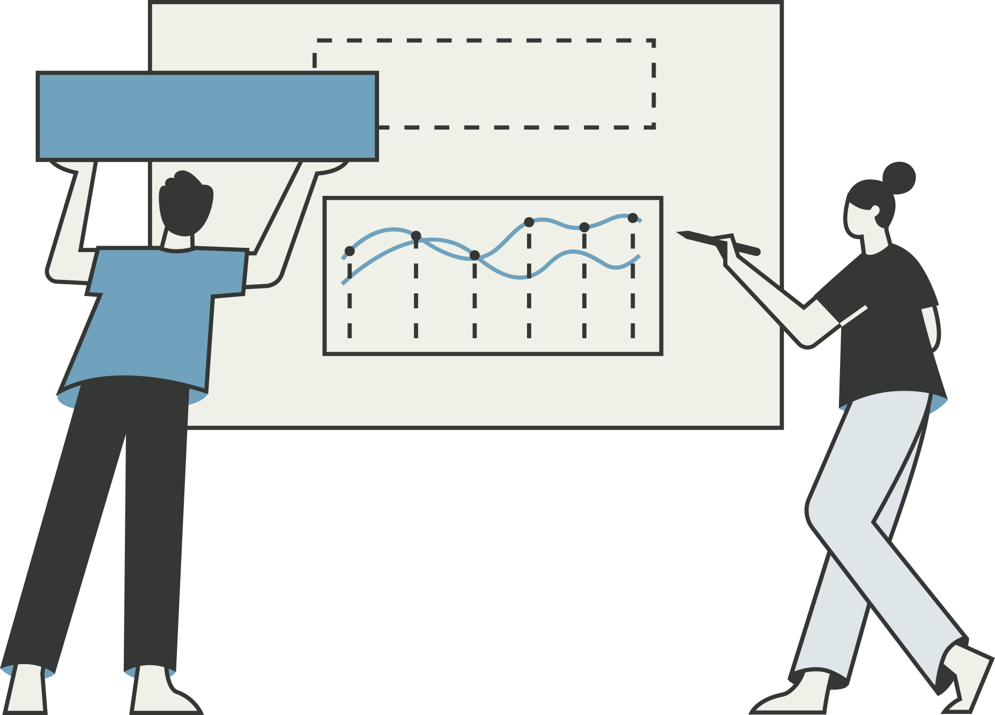
Objective
1
Measure churn by plan, area and subscriber type
Their analysis provides clarity in situations where uncertainty previously existed
2
Find the usage and complaint patterns seen before subscribers leave
3
Identify profitable and loss-making plans
4
Find areas with poor network experience
5
Turn the findings into a dashboard and retention recommendations

Slide 5

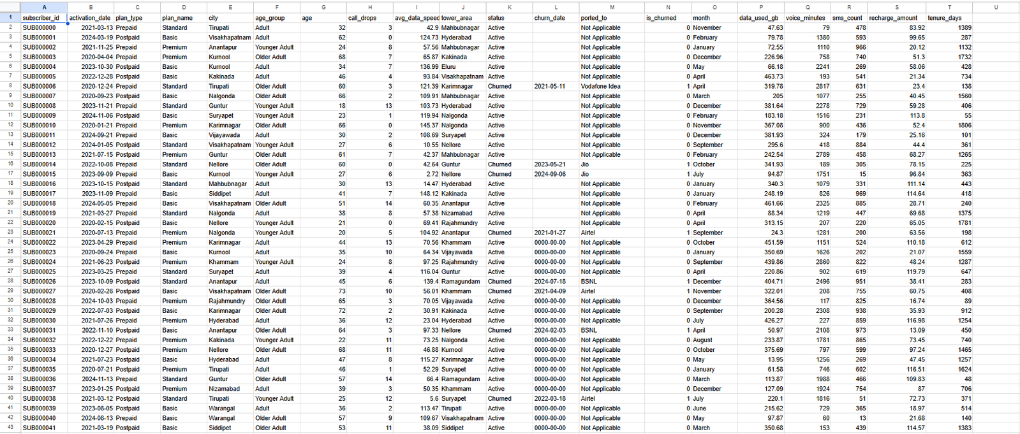

Data Collection

Slide 6
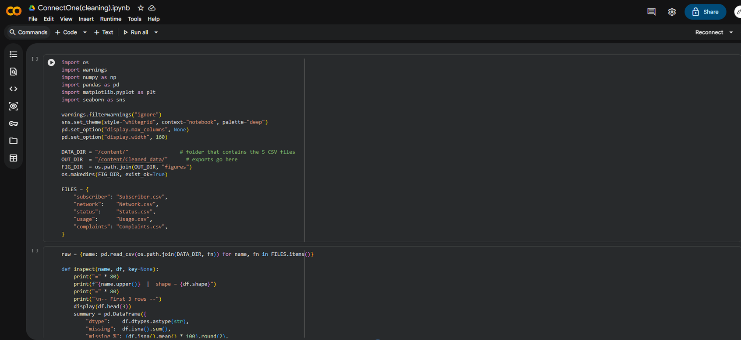

Data Cleaning

Slide 7
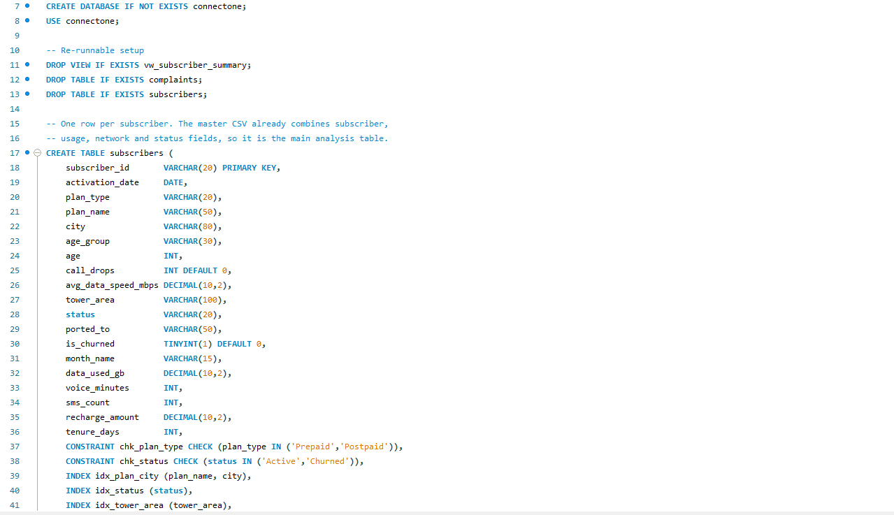
SQL Operations

Slide 8
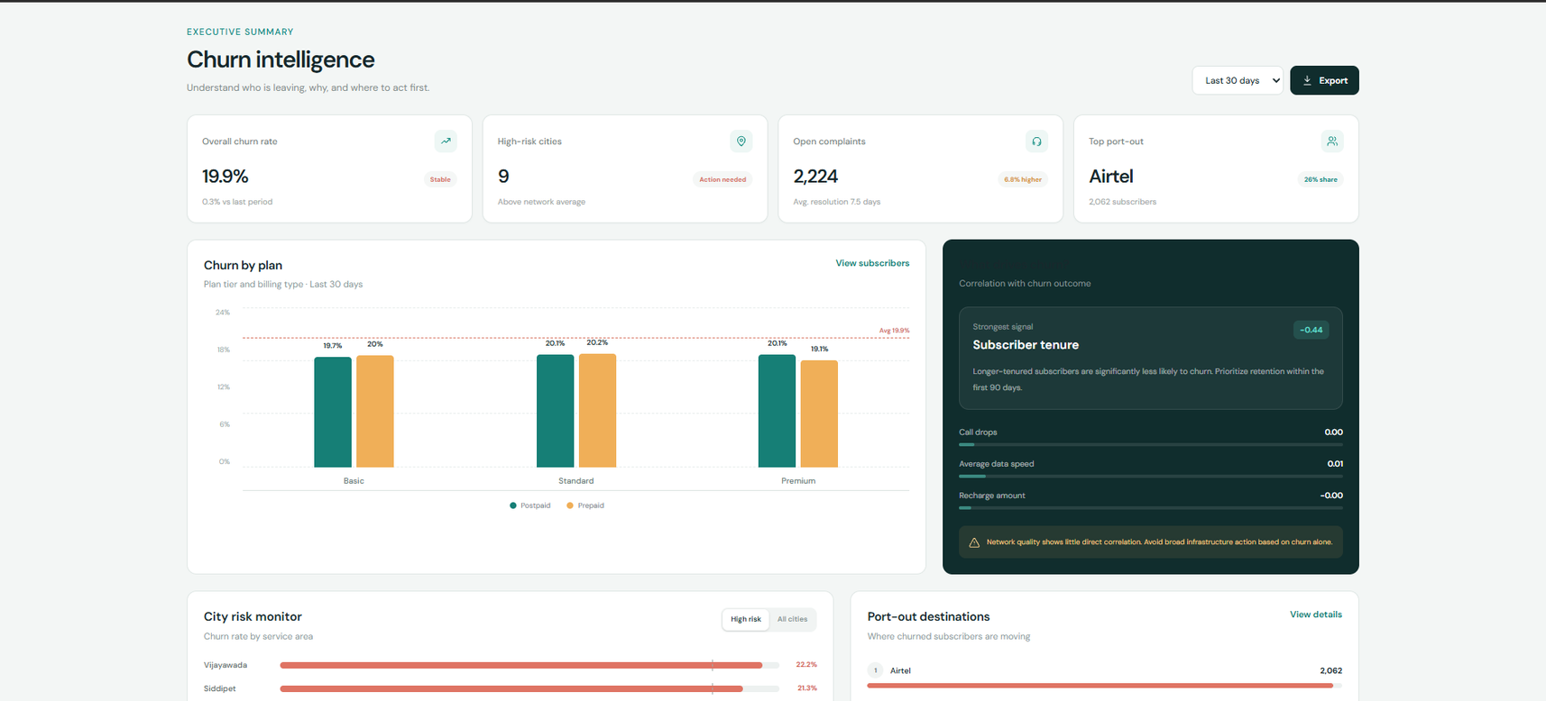
Dashboard

Slide 9
Insights
Longer-tenured subscribers are significantly less likely to churn. Prioritize retention within the first 90 days.
Network quality shows little direct correlation.
Avoid broad infrastructure action based on churn alone.
Most Churn occurs due to VAS related Complaints.
Focus on improving the customer support on that front.

Slide 10
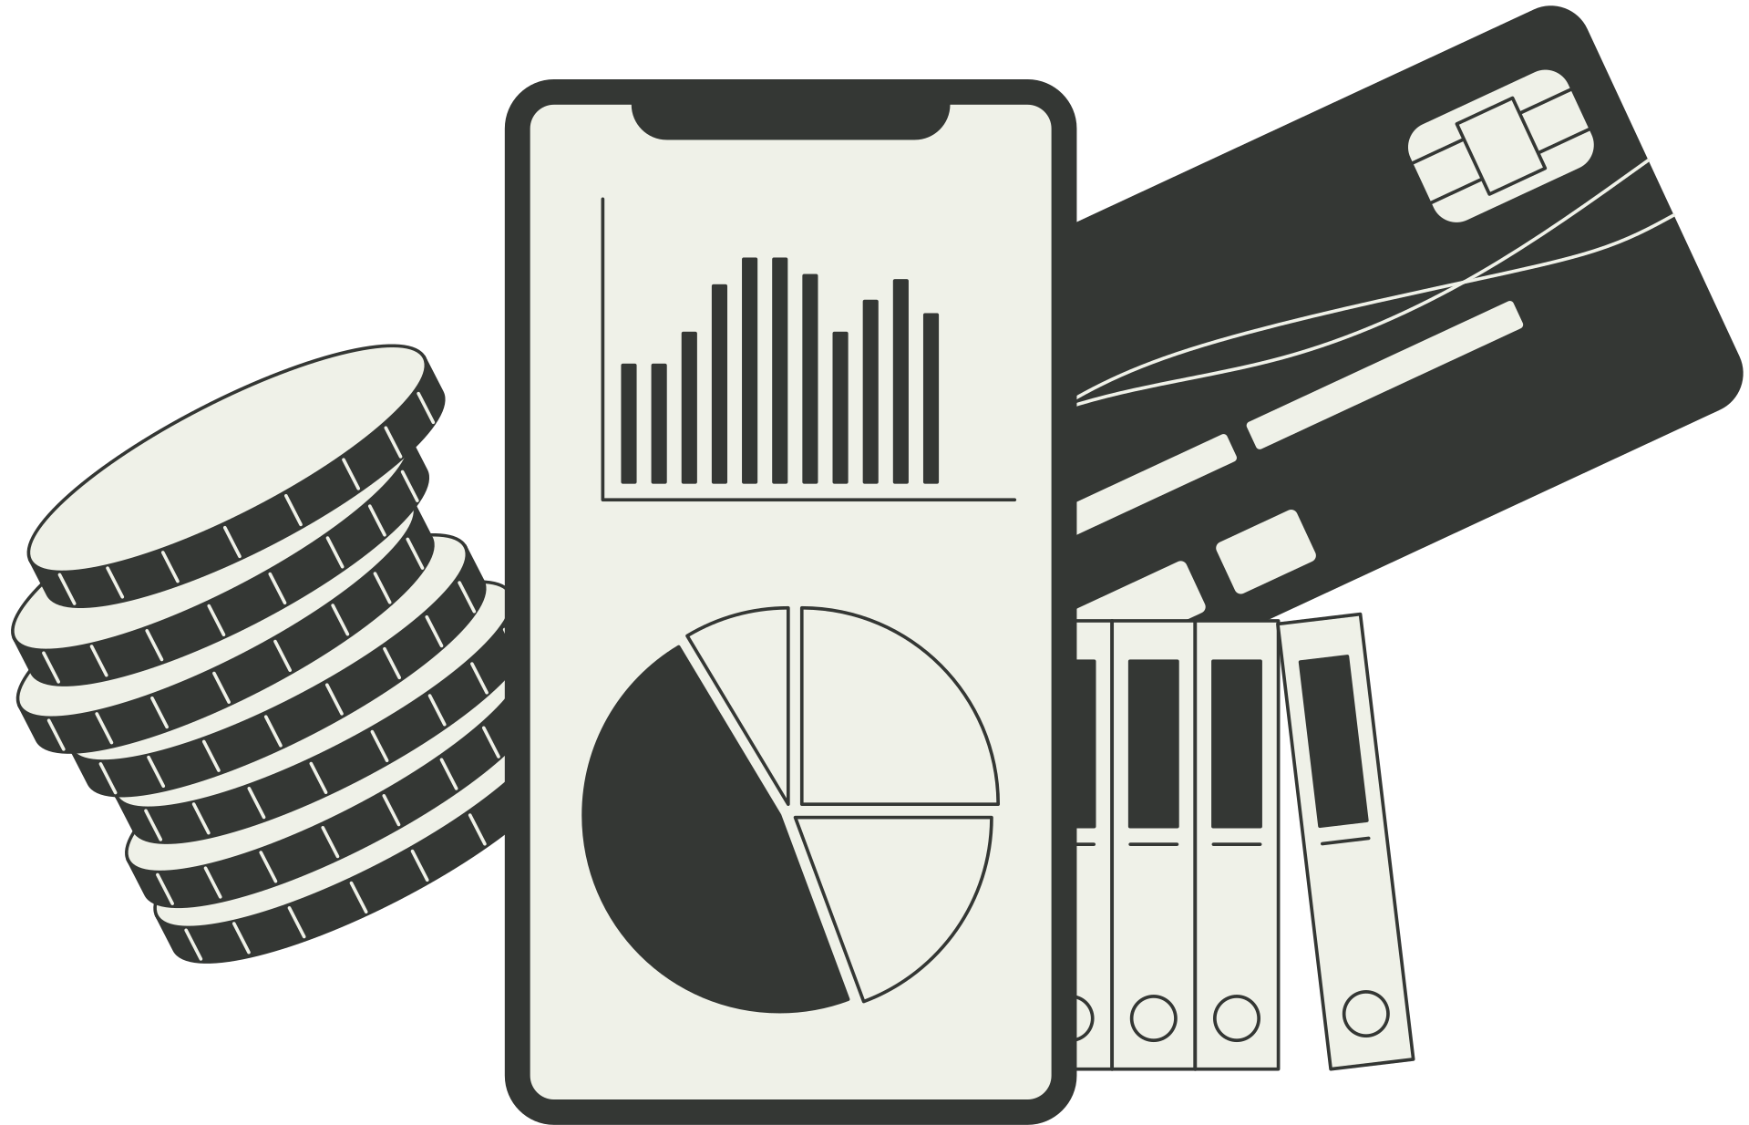
Thank You
Thank you for your attention

