Slide 1
Selenium Design Patterns: Beyond the Page Object Selenium Conference 2014 Sept. 5, 2014 Derrick Kearney Purdue University telldsk@gmail.com
Notes:
Work for hubzero.org at Purdue University
Our group creates and manages about 15 – 20 web sites that support scientific research and education.
A few years ago I started building automation scripts to check features of our websites. I read about the Page Object design pattern and tried to use it in my automation scripts. While learning the Page Object design pattern, I've developed some best practices of my own that have helped me tackle representing different types of web pages as page objects.
There are a lot of people talking about the basics of how to build page objects, but not many people talking about their own best practices for creating tackling the harder problems.

Slide 2
Agenda
WebForm Pattern
ItemList Pattern
IframeWrap Pattern
Notes:
So today I'd like to present to you some of my best practices for building page objects in situations where the simple approach may not be good enough. Along our way through these three patterns we will check out how to incorporate some old school design patterns to make our life easier.

Slide 3
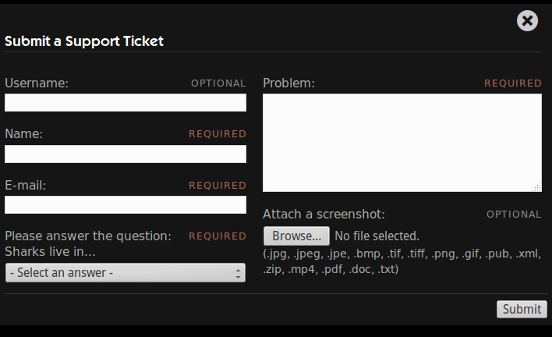
Working with Web Forms
Notes:
Part of the way HUBzero based websites grow is by encouraging users to upload new material from their research onto the website.
To automate the process of uploading and posting new resources, many of the website components use web forms to gather information from the user and generate web pages for the resources.
Web forms are probably the most common way, that I know of, to ask the user a question and retrieve the response. On websites across the internet, you see them being used, most notably, for website registration, login, or on contact us pages.
I never realized just how prevalent web forms were until I started writing automation scripts for them. On my journey of building automation scripts that interacted with web forms, I accumulated a few best practices that have helped make building page objects for web forms a breeze for me. These best practices make up the WebForm Pattern.

Slide 4
WebForm Pattern
Standardize the interface for filling out a web form.
Usual Interface
Proposed Interface
po = TroubleReportForm()
po.set_name('testuser')
po.set_email('tu@hubzero.org')
po.set_problem('test problem')
po.set_upload('myscreen.png')
po.submit.click()
po = TroubleReportForm()
data = {
'name' : 'testuser',
'email' : 'tu@hubzero.org',
'problem' : 'test problem',
'upload' : 'myscreenshot.png',
}
po.populate_form(data)
po.submit_form()
Notes:
Purpose of the web form pattern is to help standardize the interface for filling out web forms.
The usual interface makes the script writer work hard to remember all of the accessor methods for the various inputs on the form.
The proposed interface encourages the user to simply list out what values they want in which widgets and send that information to a standard page service, the populate_form() method. Later the user can submit the form using the submit_form() method. These two services are standard for all forms. We'll see how we can we can build an abstract base class that form based page objects can be derived from.

Slide 5
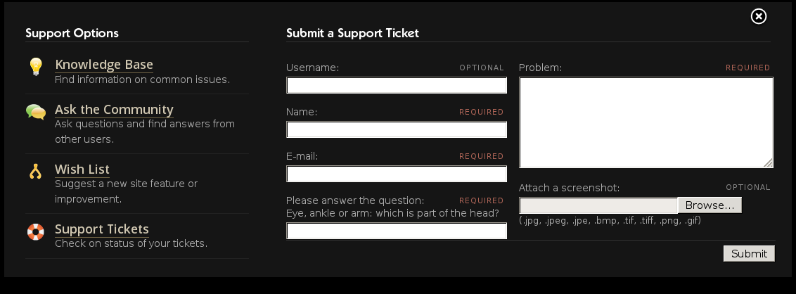
1. Give page objects a 'value'
test problem
testuser
tu@hubzero.org
myscreenshot.png
...
e = browser.find_element_by_id('trName')
e.clear()
e.send_keys(“testuser”)
...
…
name = Text('#trName')
name.value = 'testuser'
...
Notes:
The WebForm Pattern relies on page objects knowing how to retrieve and set the value of the HTML element it represents.
The Page Object design pattern teaches us to avoid directly interacting with HTML elements from within our automation scripts. We should push that type of interaction down a level into our page objects. A lot of people end up putting it in their member functions that are providing an interface to the web page's services. I've found it more helpful to push it down even further into a set of page objects that represent a few of the popular HTML elements like text inputs, buttons, checkboxes, radio buttons, and textareas.

Slide 6
Setting the value of a Checkbox
Usual Interface
Proposed Interface
# get the value
e = browser.find_element_by_id('ckbox')
e.is_selected()
# set the value
e = browser.find_element_by_id('ckbox')
If e.is_selected() is not val:
e.click()
# get the value
e = Checkbox('#ckbox')
x = e.value
# set the value
e = Checkbox('#ckbox')
e.value = True
Notes:
Value methods gives page objects a standard interface for accessors.
We just want to get or set the value in scripts, usually not concerned with the details of the type of widget it is, and certainly don't want to have to repeat or update the code in scripts.
In a way, our value methods are creating a facade for interacting with Selenium Webdriver.

Slide 7
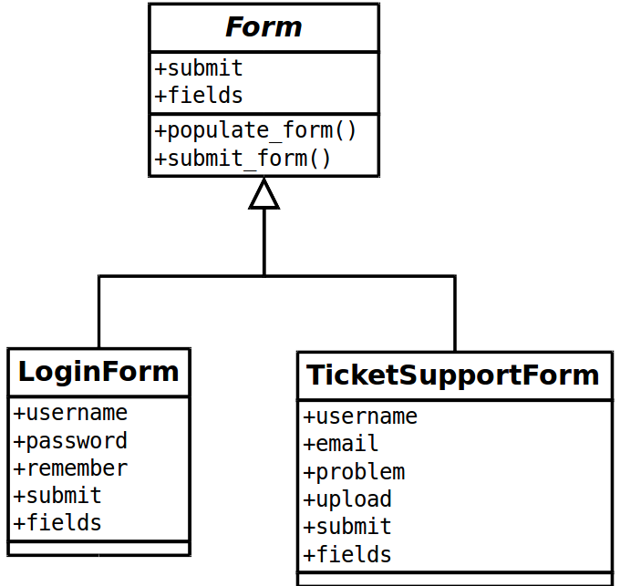
2. Use an abstract Form base class
Notes:
The second thing needed to implement the Web Form Pattern is to create a base class, named Form here, that all other web form page objects can be derived from.
The only notable thing about the Form base class is that it implements two method that sum up what you would be interested in doing on a web form:
Populating the form and submitting the form.

Slide 8
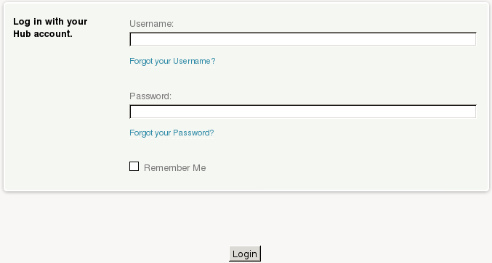
2. Use an abstract Form base class
class LoginForm(object):
def __init__(self):
…
def set_username(self,username):
…
def set_password(self,username):
…
def login_as(self,username,passwd):
…
Notes:
Some form interfaces create getter and setter methods for each individual fields on the form, but if we followed the suggestion from #1, we wouldn't need these.

Slide 9
2. Use an abstract Form base class
class TroubleReportForm(object):
def __init__(self):
…
def set_username(self,username):
…
def set_name(self,name):
…
def set_email(self,address):
…
def submit_ticket(self,username,name,...):
…
Notes:
Sometimes we also see methods that take one argument for each field in the form. These are ok, but on big forms, they can leave your code a little difficult to read, Trying to match positional arguments.

Slide 10
Proposed Interface: Form class
class Form(object):
…
def populate_form(self, data):
for (k,v) in data:
# find the widget in the object's
# dictionary and set its value
widget = getattr(self,k)
widget.value = v
def submit_form(self,data={}):
self.populate_form(data)
result = self.submit.click()
return result
Notes:
A different approach is to give all forms a common interface
with the populate_form() and submit_form() methods. These methods accept a dictionary of inputs that should be used to populate the form.
The populate_form() method iterates through the dictionary and matches keys with data members of the Form object. The values of the dictionary are then assigned to the data member's value accessor, setting the value of the underlying HTML element in the form.

Slide 11
LoginForm subclasses Form
class LoginForm(Form):
def __init__ (self):
self.username = Text('#userame')
self.password = Text('#password')
self.remember = Checkbox('#rmbr')
self.submit = Button('#submit')
Notes:
Now, when we come across a new page with a form on it, all we need to do is subclass the Form base class, and describe the fields in the form.
Here we do it for a HUBzero login page. The page contains username and password fields, a remember me checkbox and a form submission button.

Slide 12
TicketSupportForm subclasses Form
class TicketSupportForm(Form):
def __init__ (self):
self.name = Text('#trName')
self.email = Text('#trEmail')
self.problem = Text('#trProblem')
self.upload = Text('#trUpload')
self.submit = Button('#submit')
Notes:
Similarly, a page object for the HUBzero support ticket form would include data members for all of the fields on the form.
After describing the form in the constructor or initialization method, the page services are inherited from the Form base class, populate_form() and submit_form().

Slide 13
3. Organize form data into dictionaries
test problem
testuser
tu@hubzero.org
myscreenshot.png
po = TroubleReportForm()
po.submit_ticket(
'testuser',
'tu@hubzero.org',
'test problem',
'myscreenshot.png'
)
po = TroubleReportForm()
data = {
'name' : 'testuser',
'email' : 'tu@hubzero.org',
'problem' : 'test problem',
'upload' : 'myscreenshot.png',
}
po.populate_form(data)
po.submit_form()
Notes:
And in the automation script, the user would instantiate the page object as before, but instead of passing the arguments into a “submit_ticket” method, they would throw their arguments into a dictionary and pass the dictionary of arguments to the populate_form() method.

Slide 14
3. Organize form data into dictionaries
test problem
testuser
myscreenshot.png
po = TroubleReportForm()
po.submit_ticket(
'testuser',
'tu@hubzero.org',
'test problem',
'myscreenshot.png'
)
po = TroubleReportForm()
data = {
'name' : 'testuser',
'problem' : 'test problem',
'upload' : 'myscreenshot.png',
}
po.populate_form(data)
po.submit_form()
Notes:
This method makes it super easy to not populate one or more of the inputs as well, by just leaving them out of the dictionary.

Slide 15
3. Organize form data into dictionaries
test problem
testuser
po = TroubleReportForm()
po.submit_ticket(
'testuser',
'tu@hubzero.org',
'test problem',
'myscreenshot.png'
)
po = TroubleReportForm()
data = {
'name' : 'testuser',
'problem' : 'test problem',
}
po.populate_form(data)
po.submit_form()

Slide 16
Extending the Web Form Pattern
Many types of Forms can extend the base class
Simple Forms : fill-in order is ambiguous
Ordered Forms : fill-in order matters
Multi-Button Forms: forms with cancel, back, previous button
Preview Forms : forms with a preview button
Notes:
Wait, you're probably saying to yourself, “Hey Derrick, you solved the simple case, but not all web forms have just a submit button, or fill-in order doesn't matter”
This is true, but the Form base class can be extended to cover these cases as well. Some forms include a cancel or back button. Additional buttons and methods can be added to derived classes.
Some forms need to be filled out in a specific order. These forms can't use a dictionary. I've had luck using a populate_form() method that parsed lists of tuples instead of dictionaries. You might also be able to get away with an ordered dictionary that provides list like access to its items.
Forms with preview buttons may take a little more work because the page loaded by the preview probably has an additional page object that needs to be created, that may reside in an iframe.

Slide 17
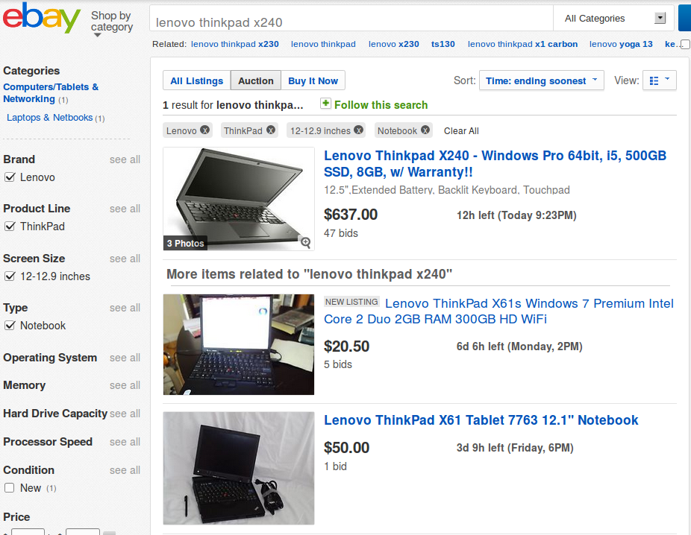
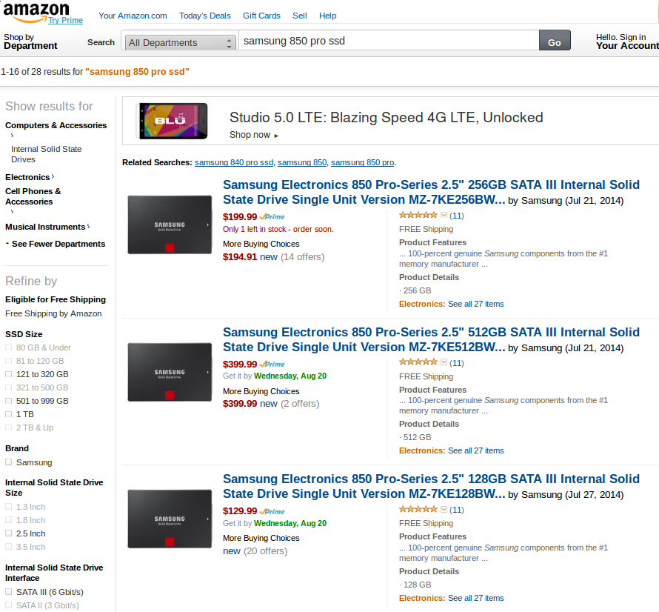
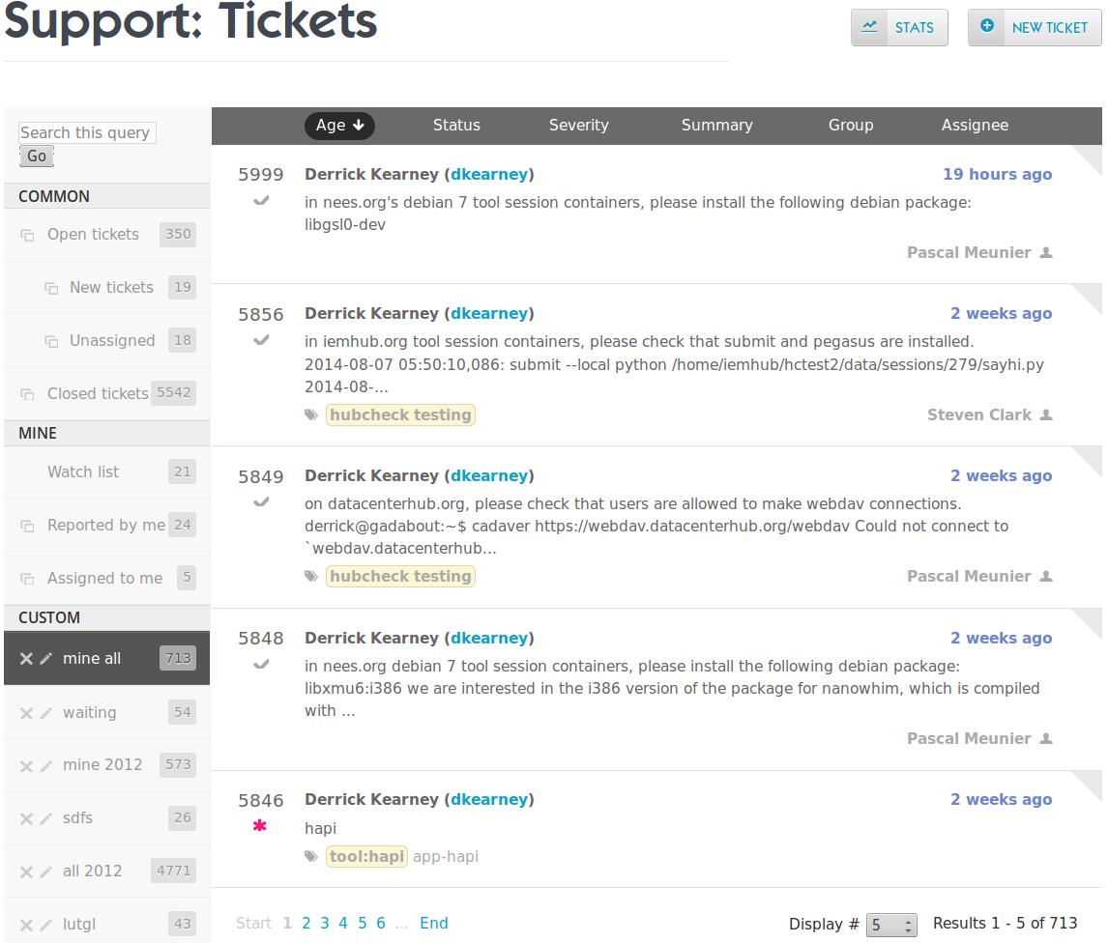
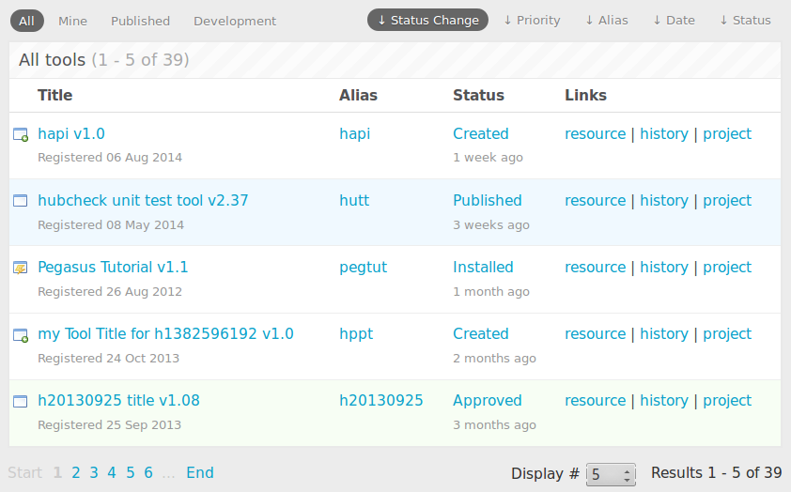
Interacting with lists of items
Notes:
We see lists everywhere
1. when we do a search on ebay, we are provided back a list of results
2. looking up items on amazon gives up back a list of matched items
3. Even on the hub, we find lists when reviewing support tickets
4. Or when interacting with Contribtool, the tool contribution process, we are presented with a list of items.
But how do you build page objects for lists. List pose a couple of problems.

Slide 18
Problems representing lists
1. Can't hard code locators
2. Don't want to pre-allocate items
3. Easy access to items
4. Sequential access to items
5. Searching for items
Notes:
1. Don't want to manually create object
2. Don't know how many items to allocate, slow automation scripts
3.
4. Two non standard ways to access page objects: sequentially
5. and non-sequentially

Slide 19
How are lists used?
1. Interact with list meta-data
2. Present enumerable data
3. Query list item value
4. Interact with list item
Header counts
Column titles
Notes:
We can think about good ways to create page objects for lists by first investigating how we use lists.
Lists are a good way to present a countable number of results back to the user.
Lists typically have some kind of meta-data to help the user interpret the data and give them hints about how many items are available to view.

Slide 20
How are lists used?
1. Interact with list meta-data
2. Present enumerable data
3. Query list item value
4. Interact with list item
Sequential
1
2
3
Notes:
Lists present similarly organized items back to the user. There is a countable number of items in the list. Sometimes we know ahead of time how many items will show up on the page, but often we don't.
Not knowing how many items to expect means we can't prebuild the page object. Even if we could, the number of objects we need to make could be unmanageable.
In order to find the item we are interested in, we probably have to evaluate each item until we find our target.

Slide 21
How are lists used?
1. Interact with list meta-data
2. Present enumerable data
3. Query list item values
4. Interact with list item
Readable item detail
Notes:
The items tend to be structured similarly with data that summarizes the entry. In this sense, each item has a “value”.

Slide 22
How are lists used?
1. Interact with list meta-data
2. Present enumerable data
3. Query list item value
4. Interact with list item
Links to more detail
Notes:
Items may allow the user to interact with them. This is seen in situations where items summarize a result, and if the item is interesting, we can click links to access more detail about that result.
Ahead of time, we know the parts of the item we may want to interact with, but we don't know which item in the list we will be interested in.

Slide 23
Proposed Interface
ItemList Pattern
Participants:
Container class
Item class
Iterator Pattern to enumerate items
Template Locators solve item count problem.
Factory Method Pattern to create item objects on demand

Slide 24
ItemList Pattern Participants
Container Class:
Provides access to list meta-data
num_items()
Can iterate through items
next()
Search for list items
get_item_by_position()
get_item_by_property()
Item Class:
Represents single item in list
Query value of item
value()
Can reference another item
update_item_number()
Notes:
The main participants for the pattern are its two base classes.
The container class represents the meta-data of the list. Users should be able to ask the container things like “how many items are there?” or other questions about the list in general. The container class can't answer questions about specific elements in the list, but should provide access to list elements, either sequentially, or through a limited search capability.

Slide 25
ItemList Pattern Participants
Container Class:
Provides access to list meta-data
num_items()
Can iterate through items
next()
Search for list items
get_item_by_position()
get_item_by_property()
Item Class:
Represents single item in list
Query value of item
value()
Can reference another item
update_item_number()
Notes:
The Item class represents a single item in the list. Users should be able to query it for information about the item it represents. Additionally, it is convenient if it can be updated on the fly to point to another item from the list.

Slide 26
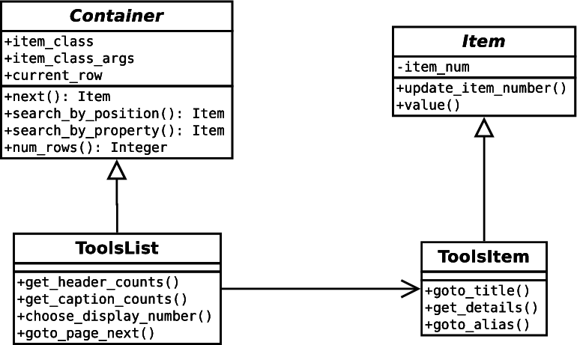
ItemList Pattern Participants
Notes:
In the end we will be able to create objects that implement the Container and Item interfaces and can be used to represent many types of lists, tables, and general collections of items.

Slide 27
Container Class Overview
class Container(object):
def __init__(self, locatordict, item_class, *args):
...
def num_items(self):
...
def __iter__(self):
...
def next(self):
...
def get_item_by_position(self,item_number):
...
def get_item_by_property(self,prop,val):
...
Access list
meta-data
Notes:
Lets take a closer look at how we can implement a Container class.
We mentioned earlier that the container class should provide access to the list meta-data. One of the most common things I am interested in asking the list is “how many items are there in the list?” Usually there are other hints on the web page, around the list, that tell me how many items are in the list and comparing that data with the number of items my container thinks is in the list is an easy test that sometimes fails.

Slide 28
Container Class Overview
class Container(object):
def __init__(self, locatordict, item_class, *args):
...
def num_items(self):
...
def __iter__(self):
...
def next(self):
...
def get_item_by_position(self,item_number):
...
def get_item_by_property(self,prop,val):
...
Iterate over
items
Notes:
Next we can implement a way of accessing list element sequentially by using an iterator.

Slide 29
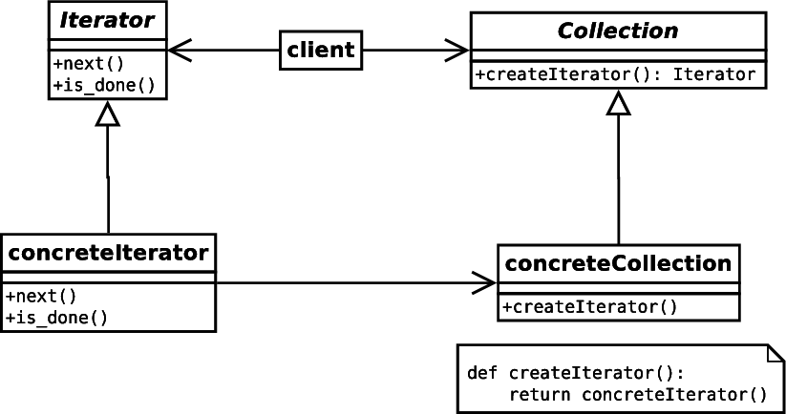
Iterator Pattern
Sequentially access each element in a collection.
Notes:
I think everyone is probably familiar with the Iterator pattern, but we'll briefly review it.
The goal of the Iterator Pattern is to allow users to sequentially access elements of the collection without know anything about the underlying structure of the elements or the collection. This is usually associated with collections with elements of different types, but works equally well in our situation.
Essentially, we just keep asking for the next element and our container keeps giving us elements until there are no more to give.

Slide 30
Container Class Iterator
class Container(object):
def __iter__(self):
self.__current_item = 0
return self
def next(self):
...
self.__current_item += 1
if self.__current_item >= self__num_items:
# reset our counter, stop iterating
self.__current_item = 0
raise StopIteration
return self.get_item_by_position(self.__current_item)
Notes:
Python helps us create iterator objects by providing an Iterator protocol. In Python, user can define the __iter__ method, which returns in iterator object. The Iterator object just needs to define the next() method which provides the caller an element from the collection being iterated over.
I like to make my Container classes iterators. It restrict the use a little bit, but makes them easy to write.
In this example, our container object keeps track of the current row. When we ask for the next element, we update the current row, and call our object's get_row_by_position() method.

Slide 31
Container Class Overview
class Container(object):
def __init__(self, locatordict, item_class, *args):
...
def num_items(self):
...
def __iter__(self):
...
def next(self):
...
def get_item_by_position(self,item_number):
...
def get_item_by_property(self,prop,val):
...
Search for
list items
Notes:
The last thing we would like our container to be able to do is to retrieve an item from the list that matches some criteria

Slide 32
Searching for items: by position
def get_item_by_position(self,item_number):
…
return Item(...)
1
2
3
Notes:
Either retrieve the item by position, where we hand it a specific item number...

Slide 33
Searching for items: by property
def get_item_by_property(self,prop,val):
…
return Item(...)
Properties
Notes:
Or retrieve the item by matching a property. In this case we would tell the container object which property we would like to search against and give it a value to match.
Our properties are associated with the “values” of our Item object.
The thing to note about these two searching methods is that we are asking the container to create and return an object that represents an item in the list.
Our general container class doesn't know any thing about the items in the list. So far, we have only told it that there are these things called “Item”s but what the item object looks like depends on the list we are working with.

Slide 34
Container Defines Item Class
Notes:
The types of Item objects that should be returned are determined by the specific Container class.
So an Ebay search list container would return an ebay search list item.
An Amazon search list container would return an amazon search list item.
A HUB Support Ticket list container would return a HUB Support Ticket list item.
And a HUB Contribtool list container would return a HUB Contribtool list item.
The type of item returned is tied to the container returning it. Because of this, our searching functions end up being Item object factories

Slide 35
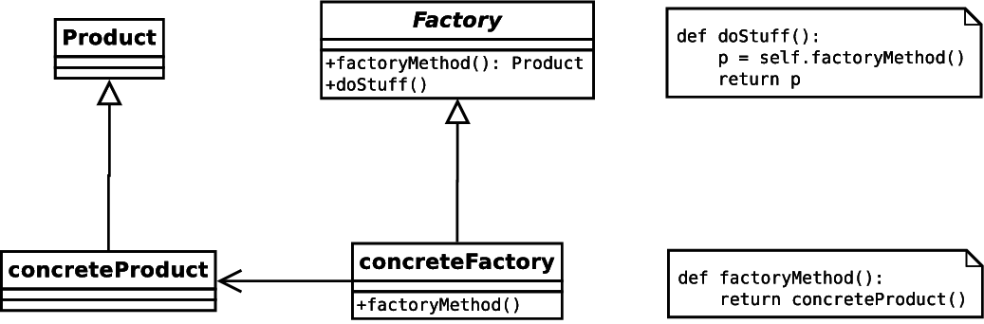
Factory Method Pattern
Define an interface for creating an object, but let subclasses define which class to instantiate.
Notes:
This is a situation where we should be thinking about using the Factory Method Pattern.
The Factory Method Pattern is used when we want to define an interface for creating an object, but don't know which class to instantiate. Instead of always instantiating the same class, we delegate the responsibility to a subclass.

Slide 36
Searching for items
class Container(object):
def __init__(self, locatordict):
...
self.item_class = None
self.item_class_args = None
…
def get_item_by_position(self,item_number):
...
result = self.item_class(
*self.item_class_args,
item_number=item_number )
...
return result
Notes:
We store the Item class and its arguments inside of the container object, and use them in the get_item_by_position() and get_item_by_property() methods.
The get_item_by_position class instantiates an Item object, and returns it to the caller.
The get_item_by_position() and get_item_by_property() methods are Factory Methods for Item objects.

Slide 37
ToolsList implements Container
class Container(object):
def __init__(self, locatordict):
…
self.item_class = None
self.item_class_args = None
…
class ToolsList(Container):
def __init__(self, locatordict):
...
self.item_class = ToolsItem
self.item_class_args = [{...}]
class ToolsItem(Item):
def __init__(self, locator_templates):
...
Notes:
And we let the subclasses of the Container object determine what kinds of Item objects need to be instantiated.

Slide 38
ItemList Pattern Participants
Notes:
We've talked about the Container class. Lets take a look at the Item class.

Slide 39
Item Class Overview
class Item (object):
def __init__ (self, locatordict, item_number):
…
def update_item_number (self, item_number):
…
def value (self):
…
Notes:
Earlier we mentioned four qualities we would like Item objects to have:

Slide 40
Items represent a single item
class Item (object):
def __init__ (self, locatordict, item_number):
self.locators = locatorsdict
self.__item_number = item_number
…
Notes:
The first is that an Item should represent a single item in the list.
We achieve the first feature by associating a numeric value with the item.

Slide 41
Items can be updated
class Item (object):
def __init__ (self, locatordict, item_number):
self.locators = locatorsdict
self.__item_number = item_number
…
def update_item_number (self, item_number):
…
locators = {
'title' : "tr:nth-of-type(1) .title",
'details' : "tr:nth-of-type(1) .details",
'alias' : "tr:nth-of-type(1) .alias",
'status' : "tr:nth-of-type(1) .status",
'time' : "tr:nth-of-type(1) .time",
'resource' : "tr:nth-of-type(1) .page",
'history' : "tr:nth-of-type(1) .history",
'wiki' : "tr:nth-of-type(1) .wiki",
}
Notes:
The second feature requires us to be able to update the item represented by the object.
This causes us a little trouble because in the past, we have hard coded our element locators, only updating them if the underlying web page changed.

Slide 42
Interacting with ItemLists
tr:nth-of-type(1) .title
tr:nth-of-type(1) .alias
tr:nth-of-type(1) .status
tr:nth-of-type(1) .page
tr:nth-of-type(1) .history
tr:nth-of-type(1) .wiki
Notes:
For example, if we wanted to create an object referencing the first row in a list of items, we would use a positional locator, with the '1' hard coded in the the locator.

Slide 43
Interacting with ItemLists
tr:nth-of-type(2) .title
tr:nth-of-type(2) .alias
tr:nth-of-type(2) .status
tr:nth-of-type(2) .page
tr:nth-of-type(2) .history
tr:nth-of-type(2) .wiki
Notes:
And if we wanted to reference the second row in a list of items, we would again use a positional locator, with the number '2' hard coded in the locator.
But this approach doesn't fit with our original goals. We didn't want to be forced into manually creating classes to represent all possible items that could show up in a list. It is wasteful of system resources and makes our automation scripts slow.

Slide 44
Interacting with ItemLists
tr:nth-of-type(n) .title
tr:nth-of-type(n) .alias
tr:nth-of-type(n) .status
tr:nth-of-type(n) .page
tr:nth-of-type(n) .history
tr:nth-of-type(n) .wiki
Notes:
What we need is a way to dynamically update the locators in our object. We could substitute the 'n' in our locators with a number that references which row we are interested in representing.
Well, we can do just that. This is the idea behind Template Locators.

Slide 45
Template Locators
>>> locator = "tr:nth-of-type({item_num}) .title"
>>>
>>> locator.format(item_num=3)
tr:nth-of-type(3) .title
Notes:
The Template Locator is an idea I first heard about from Adam Goucher of Element34 (@adamgoucher).
The idea is that you give your page object strings with templates in them. These are of course invalid locators. As part of the object instantiation process, the templates are substituted with legitimate values, making the locators valid.
In this example, we show how the substitution can be done in Python. Most programming languages allow for substituting values into strings.

Slide 46
Items can be updated
class Item (object):
def __init__ (self, locatordict, item_number):
self.locators = locatordict
self.__item_number = item_number
…
def update_item_number (self, item_number):
…
locators = {
'title' : "tr:nth-of-type(1) .title",
'details' : "tr:nth-of-type(1) .details",
'alias' : "tr:nth-of-type(1) .alias",
'status' : "tr:nth-of-type(1) .status",
'time' : "tr:nth-of-type(1) .time",
'resource' : "tr:nth-of-type(1) .page",
'history' : "tr:nth-of-type(1) .history",
'wiki' : "tr:nth-of-type(1) .wiki",
}
Notes:
Going back to our Item class, instead of accepting a locator dictionary from the caller...

Slide 47
Items can be updated
class Item (object):
def __init__ (self, locator_templates, item_number):
self.locators = {}
self.locator_templates = locator_templates
self.__item_number = item_number
self.update_item_number(item_number)
…
def update_item_number (self, item_number):
self.__item_number = item_number
for k,v in self.locators_templates.items():
self.locators[k] = v.format(item_num=self.__item_number)
…
locators = {
'title' : "tr:nth-of-type({item_num}) .title",
'details' : "tr:nth-of-type({item_num}) .details",
'alias' : "tr:nth-of-type({item_num}) .alias",
...
}
Notes:
We should accept a dictionary of locator templates. In our object initialization, or any time we want to update the item that our object represents, we can call the update_item_number() method and it will use the template locators to generate updated, valid locators.

Slide 48
ItemList Pattern Participants
Notes:
The last two features must be implemented in the subclasses of the Item class because they are specific to the types of items they represent.

Slide 49
Items have a value
class ToolsItem (Item):
def __init__ (self, locator_templates, item_number):
...
self.title = Link(...)
self.details = Text(...)
self.alias = Link(...)
...
def value(self):
properties = {
'title' : self.title.text(),
'details' : self.details.value,
'alias' : self.alias.text(),
...
}
return properties
...
Properties
value() method returns
a dictionary of properties
from the item.
Notes:
Each item object should be able to return a dictionary of properties that make up its “value”. In the Item class and its subclasses this is done in the value() method.
The value method returns a dictionary of properties. These properties are usually the readable elements of the list item represented by the object.
The value() method is used by the Container class's get_item_by_property() method to retrieve an item from the list that has a matching property.

Slide 50
Items can be interacted with
class ToolsItem (object):
def __init__ (self, locator_templates, item_number):
...
self.title = Link(...)
self.details = Text(...)
self.alias = Link(...)
...
def goto_title(self):
self.title.click()
def get_details(self):
return self.details.value
def goto_alias(self):
self.alias.click()
...
Web page services are
implemented as methods
of the page object.
Notes:
The last feature of the item class is that it can be interacted with. This should be no surprise, as one of the main goals of a page object is to provide an interface to the services available on the page.
This too is specific to the item being represented so it must be done in the subclass, not the base class.

Slide 51
ItemList Pattern
Problem
1. Can't hard code locators
2. Don't want to pre-allocate
3. Easy access to items
4. Sequential access to items
5. Searching for items
Solution
1. Template Locators
2. Factory Method Pattern
3. Item objects are updatable
4. Iterator Pattern
5. Item objects have a value

Slide 52
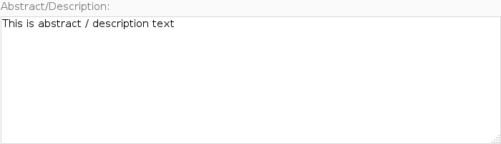
Interacting with Iframes
<label for="field-fulltxt">
Abstract/Description:
<textarea id="field-fulltxt">This is abstract / description text</textarea>
</label>
Notes:
Iframes are another area where we run into problems building page objects. When users upload resources to a HUBzero website, they are asked to describe the resource they are contributing.
The resource contribution form's description field used to be an HTML <textarea>. The field handled both plain text descriptions, but also allowed users to use a wiki-like markup language to include rich text descriptions. Building a page object with a textarea is pretty rudimentary.

Slide 53
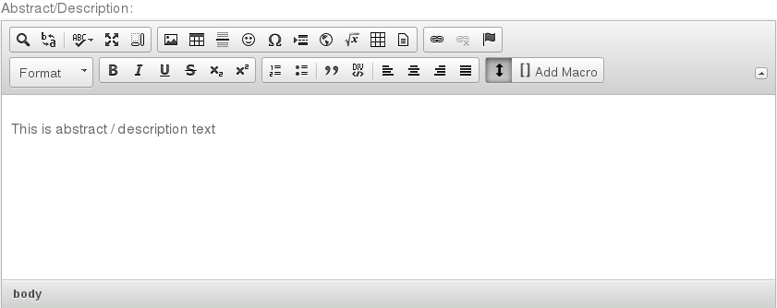
Interacting with Iframes
<iframe class="cke_wysiwg_frame">
<html>
<body class="ckeditor-body">
<p>This is abstract / description text </p>
</body>
</html>
</iframe>
Notes:
A few months ago, our web developers started incorporating a new editor for the description field. It looks like this and incorporates better functionality for handling rich text. So instead of writing out the wiki syntax to make words bold, for example, they would just press the “B” bold button in the editor and type the text they wanted to be bold. This is a great step forward for usability. And it meant we had to update our page objects. When I took a look at the new web page, I noticed the previously simple <textarea> field was replaced with an iframe and embedded web page.
Playing around with the iframe widget, I figured out that once I entered the Iframe, writing text to the <body> tag was just like writing text to the <textarea> tag.

Slide 54
Question:
Do I need to write a new page object for a widget embedded in an <iframe>, if I already have a class that works except for entering and exiting the <iframe>?
Notes:
So started asking myself, this question:
Do I need to write a whole new page object to deal with this widget that acts like a textarea page object that I already have, except that I have to enter a exit an iframe before and after I use it?

Slide 55
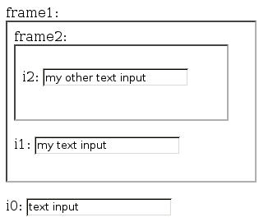
How do Iframes work
Notes:
Lets back up a little bit and start by explaining how iframes work.
Here is an example web page with some input fields embedded in different levels of iframes.

Slide 56
How do Iframes work
Default Context
i0 input in Default Context
<html>
<body>
<label for="frame1">frame1: </label>
<iframe id="frame1" src="inner_page.html"></iframe>
<br/><br/>
<label for="i0">i0: </label>
<input type="text" id="i0" value="text input"></input>
</body>
</html>
Notes:
The first input field, i0, is located in the default context. This is the level of the web page we generally work in when iframes are not involved.
Along with the input field i0, this web page also has an iframe, frame1.
In the HTML iframes just hold the location of another web page which will be embedded in the frame. In our example, frame1 is going to load up the web page inner_page.html.

Slide 57
How do Iframes work
Frame1 Context
i1 input in Frame1 Context
<html>
<body>
<label for="frame2">frame2: </label>
<iframe id="frame2" src="another_page.html"></iframe>
<br/><br/>
<label for="i1">i1: </label>
<input type="text" id="i1" value="my text input"></input>
</body>
</html>
Notes:
This is the HTML for inner_page.html. It makes up what we refer to as the Frame1 Context. The Frame1 context has an input field i1, and another iframe, frame2.
Again, the iframe frame2 holds the location of a web page, and in our case it points to another_page.html

Slide 58
How do Iframes work
i2 input in Frame2 Context
Frame2 Context
<html>
<body>
<label for="i2">i2: </label>
<input type="text" id="i2" value="my other text input"></input>
</body>
</html>
Notes:
And this is the HTML for the file another_page.html, that makes up the Frame2 Context. It contains an input field i2 that resides within the Frame2 context.

Slide 59
Page Object for i0
class Text(BasePageWidget):
def __init__(self, locator):
…
# getter
def value(self):
e = self.find_element(self.locator)
return e.get_attribute('value')
# setter
def value(self, text):
e = self.find_element(self.locator)
e.clear()
e.send_keys(text)
def append(self, text):
e = self.find_element(self.locator)
e.send_keys(text)
Default Context
Notes:
If we wanted to build a page object for the i0 input field, that resides in the Default Context, it would look something like this. There would probably be a getter method to retrieve the value of the input, a setter method to set the value of the input, and maybe an append method that just appended text to whatever was already in the field.
Since the i0 field resides in the default context, there is no need to do anything special, our methods will find the i0 input element in the HTML DOM, and perform actions on it.

Slide 60
Page Object for i1
class Text1Frame(BasePageWidget):
def __init__(self, locator):
…
# getter
def value(self):
…
# setter
def value(self, text):
frame = self.find_element('#frame1')
self._browser.switch_to_frame(frame)
e = self.find_element(self.locator)
e.clear()
e.send_keys(text)
self._browser.switch_to_default_content()
def append(self, text):
…
Frame1 Context
Notes:
If we wanted to build a page object for the i1 input field, we would have to do a little more work.
The page object is almost the same as the one for the i0 input field, but because i1 is located inside of the Frame1 context, we have to instruct the web browser to traverse the frame1 iframe to get to it.
So inside each of our methods we add a few lines of code to traverse the iframe, then we search for the element in the HTML DOM, perform our actions on the element, and lastly, we have to return back to the default context.

Slide 61
Page Object for i2
class Text2Frame(BasePageWidget):
def __init__(self, locator):
…
# getter
def value(self):
…
# setter
def value(self, text):
frame1 = self.find_element('#frame1')
self._browser.switch_to_frame(frame1)
frame2 = self.find_element('#frame2')
self._browser.switch_to_frame(frame2)
e = self.find_element(self.locator)
e.clear()
e.send_keys(text)
self._browser.switch_to_default_content()
def append(self, text):
…
Frame2 Context
Notes:
If we wanted to build a page object for the i2 input field, located inside of Frame2 context, which is located inside of the Frame1 context, we could start by using the Text or Text2Frame page objects, but we have to update our methods to traverse two iframe contexts.
We have to first go from the the Default context to the Frame1 context, then we have to go from the Frame1 context to the Frame2 context. Next, we can search for the i2 input field in the HTML DOM, perform our actions on the field, and finally, switch back to the default context.

Slide 62
Dealing with Iframes
Enter / Exit frames to interact with elements
Must update all methods of page object.
Create new page objects for Iframes?!?
Default Context
Frame1 Context
Frame2 Context
Notes:
So just to sum it up, when building page objects for the i0, i1 and i2 input fields, we have to be cognoscente of the frame level we are in.
All of the page objects started off with the same code, but for input i1, we had to update all methods to enter and exit the Frame1 context. And for input i2, we had to update all methods to enter and exit the Frame1 and Frame2 contexts.
Is there a way we can handle the entering and exiting of iframes outside of the page object so we could reuse our original page object that represents a Text field on a web page?

Slide 63
Page object's value: No Iframes
value()
Perform core actions
Notes:
Some way where we can write the methods of our page object once,

Slide 64
Page object's value: One Iframe
Enter Frame1
value()
Perform core actions
Exit Frame1
Notes:
And if we want to use that page object inside of an iframe, we can wrap the methods of the page object with code to enter and exit the iframe

Slide 65
Page object's value: Two Iframes
Enter Frame1
Enter Frame2
value()
Perform core actions
Exit Frame2
Exit Frame1
Notes:
And if we wanted to use the page object in two or more iframes, we could just keep wrapping the methods?

Slide 66
IframeWrap Design Pattern
Use Decorator Pattern to wrap attributes of a page object with Enter / Exit iframe calls.
value()
value()
value()
0 Iframes
1 Iframe
2 Iframes
Notes:
This is the idea behind the IframeWrap Design Pattern. It uses the Decorator Pattern to “decorate” or wrap the attributes of a page object with code to:
1. Enter an iframe context.
2. Call the original page object method.
3. Exit the iframe context.
It also supports the case where the original page object method could have been a previously wrapped method.

Slide 67
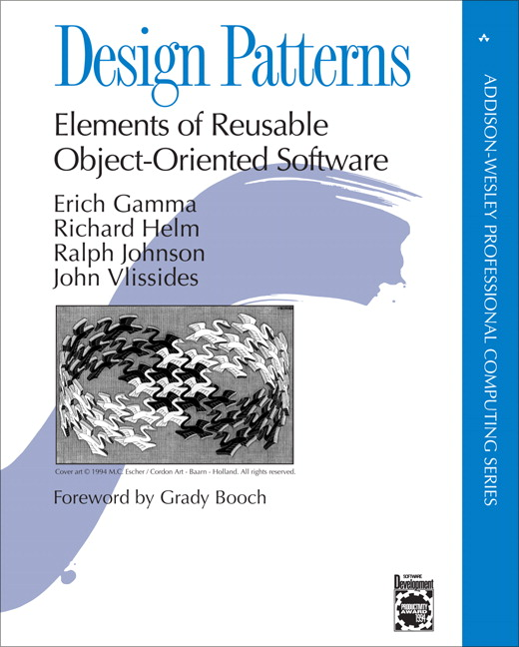
Decorator Pattern
Attach additional responsibilities to an object dynamically and transparently.
class A (object):
def f (self):
do_some_stuff()
a = A()
a
a
f
function
f
wrapper
function
Before Decoration
After Decoration
Notes:
Let's take a second to review how the decorator pattern works. The purpose of the decorator pattern is to extend functionality of an object without necessarily changing the interface. It is most notably seen used when you want to change a specific object at runtime, without changing all objects of a class. It does this by wrapping the original functionality of the object's attribute with code to do extra stuff.
For example, if we had an object 'a', which was an instance of class 'A', with a method 'f', we could add functionality to 'f' by first pointing a.f to our wrapper method, and then in our wrapper method, we would add the extra code to extend a.f, and call a.f

Slide 68
Applying the Decorator Pattern
class Text(BasePageWidget):
# setter
def value(self, text):
e = self.find_element(self.locator)
e.clear()
e.send_keys(text)
i1 = Text('#i1')
i1.value('new i1 text')
Frame1 Context
i1
i1
value
function
value
wrapper
function
Before Decoration
After Decoration
Notes:
We can apply this same idea to our Text page object. The page object has a method named value() that performs the core actions of adjusting the underlying HTML element.
In Python, the object's value attribute points to a function object, so we can represent it like this.
We would like to decorate this function object to add our enter and exit iframe commands.
After decorating the function object, the value attribute will point to our wrapper function, and our wrapper function will call our original function object.

Slide 69
Create decorated page objects
class FramedInputs(BasePageObject):
def __init__(self):
self.i0 = Text('#i0')
self.i1 = IframeWrap( Text('#i1'), ['#frame1'] )
self.i2 = IframeWrap( Text('#i2'), ['#frame2', '#frame1'] )
HTML element's
page object
List of frames
to traverse
Notes:
We can implement the IframeWrap pattern by first creating a page object we would like to wrap and passing it to a function like IframeWrap along with the locators for frames that need to be traversed to interact with the page object's HTML elements.
In this example, we create a Text page objects for all three of our inputs. For the inputs i1 and i2, we call the IframeWrap function and give it the page object and a list of frames.

Slide 70
Find callable attributes
class IframeTracker(object):
...
def wrap_callable_attributes(self,o):
for attr, item in o.__class__.__dict__.items():
if callable(item):
item = getattr(o,attr)
setattr(o,attr,self.wrap_attribute(item))
i1
i1
value
function
value
wrapper
function
Before Decoration
After Decoration
Notes:
Internally, my implementation of the IframeWrap method creates an object I call IframeTracker. It is used to keep track of and assist with navigation between iframes.
The most interesting part of the IframeTracker object is when the page object gets decorated, so we'll skip to the fun stuff.
First the IframeWrap method calls the wrap_callable_attributes method, which identifies callable attributes from the class object.
Next we call the wrap_attributes method on the callable attributes.

Slide 71
Wrap attributes with iframe calls
class IframeTracker(object):
...
def wrap_callable_attributes(self,o):
for attr, item in o.__class__.__dict__.items():
if callable(item):
item = getattr(o,attr)
setattr(o,attr,self.wrap_attribute(item))
def wrap_attribute(self,item):
def wrapper(*args, **kwargs):
...
switched = self._switch_to_iframe_context(final_framelevel)
result = item(*args, **kwargs)
self._switch_to_iframe_context(initial_framelevel)
return result
return wrapper
frame = self.find_element('#frame1')
self._browser.switch_to_frame(frame)
e = self.find_element(self.locator)
e.clear()
e.send_keys(text)
self._browser.switch_to_default_content()
Notes:
The wrap_attribute() method wraps the callable attributes with calls to enter an iframe context, and exit an iframe context. The method returns a reference to the new wrapper function.
For the i1 input, you can already see the similarity between what we used to have to do manually, and what the IframeWrap pattern provides.

Slide 72
Store the wrapped attribute
class IframeTracker(object):
...
def wrap_callable_attributes(self,o):
for attr, item in o.__class__.__dict__.items():
if callable(item):
item = getattr(o,attr)
setattr(o,attr,self.wrap_attribute(item))
i1
i1
value
function
value
wrapper
function
Before Decoration
After Decoration
Notes:
Lastly, we set the name of our old callable attribute to reference the new wrapper function in the object we are trying to wrap.
With that, the attribute wrapping process is complete and we are ready to use our new IframeWrap'd page object.

Slide 73
Using an IframeWrap'd page object
class FramedInputs(BasePageObject):
def __init__(self):
self.i0 = Text('#i0')
self.i1 = IframeWrap( Text('#i1'), ['#frame1'] )
self.i2 = IframeWrap( Text('#i2'), ['#frame2', '#frame1'] )
po = FramedInputs()
# print out the current text in the widgets
print "i0.value = %s" % (po.i0.value)
print "i1.value = %s" % (po.i1.value)
print "i2.value = %s" % (po.i2.value)
# update the text in the widgets
po.i0.value = 'i0 text'
po.i1.value = 'new i1 text'
po.i2.value = 'new i2 text too'
Notes:
When we use the new IframeWrap'd page object, we don't see any difference in the interface. Page objects that traverse iframes work the same as elements that don't. The difference is mainly see in how we declare our page objects that need to traverse iframes.

Slide 74
IframeWrap Pattern Summary
Use IframeWrap Pattern when you have page objects for HTML elements that work the same inside or outside of an iframe
Uses Decorator Pattern to wrap page object attributes with calls to enter and exit iframe
value()
value()
value()

Slide 75
IframeWrap Pattern Gotchas
Not all page object attributes need to be wrapped.
Keep a list of specific methods not to wrap.
Wrapping Python properties can be tricky
Create a new class object from old class.
Decorate the property functions of new class.
Associate new class with page object.

Slide 76
More Info
Design Patterns Book
Websites
http://www.oodesign.com
http://sourcemaking.com
Special Thanks
HUBzero Team
Sam Midkiff, Advisor

