Slide 1
Efficient Encoder/Decoder

Slide 2
In DSRC vehicle-to-X (including vehicle-to-vehicle) communication, there are four standards of messages to be shared, which are:
Basic safety message (BSM)
Traveler information message (TIM)
MAP Message
Signal phase and timing message (SPAT)

Slide 3
Basic safety message (BSM): The BSM is a representative message type of V2V communication. It contains the core data elements such as vehicle size(we currently assume all vehicles are same size), position, heading, acceleration, and brake system status. In addition, it contains such information as vehicle type, description, and identification. It is transmitted at approximately 10 Hz.
This is the standard that includes all our shared data currently

Slide 4
Traveler information message (TIM): The TIM is used to convey information regarding different traffic conditions. It is the means to inform the public about both incidents (traffic accidents) and pre-planned roadwork events such as road construction. It is transmitted at approximately 1 Hz.
More into V2X grade
May be implemented later (future plan)

Slide 5
MAP Message: The MAP message is used to provide geometric data on intersections and roadway lanes. This message is used to number and describe lane-level details for each lane at an intersection. It is transmitted at approximately 1 Hz.
Signal phase and timing message (SPAT): The SPAT message is used to provide signal and phase-timing data for one or more intersections. All SPAT messages are linked to MAP messages to convey road details and link signal-controller steps to the correct set of lanes. It is transmitted at approximately 1 Hz.
NOT implemented

Slide 6
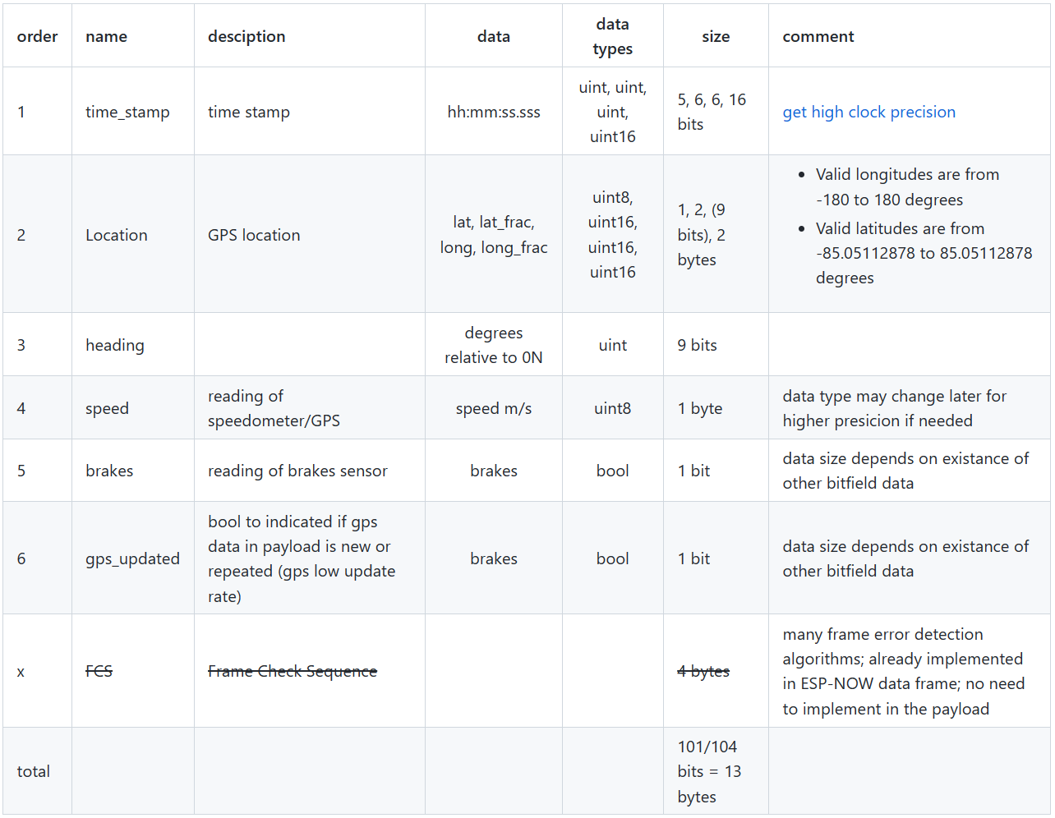
Vehicle-Telematics-Control-Unit/Efficent-encoder-decoder (github.com)

Slide 7
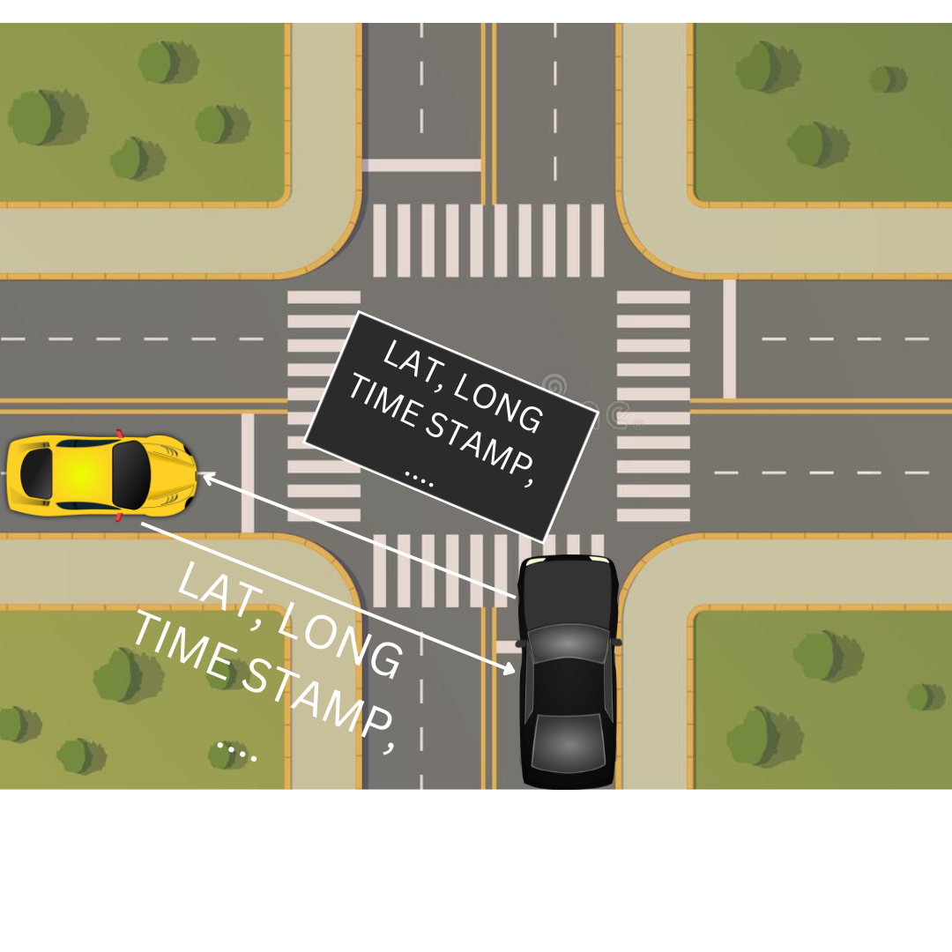
We used two approaches to send data through DSRC:
Send a payload with all vehicle’s data every time interval
During a specific interval, data gathered from ready sensors, at the end of the time interval only newly gathered data is sent (in progress)

Slide 8
In the first approach, we gather data from sensors then we place the data in one payload and wait for a specific time. Even if the data is not updated the old values will be placed in the payload because we need to send all data in this approach.
In the second approach, we don’t need to wait until all sensor data is ready, but we send only the data that arrived in the buffer after a specific time without waiting for the rest of the data.
We took in consider that if a brakes sensor signal arrived, we don’t wait until the specific time is finished, we immediately start sending the payload.

