Slide 1
STM32 with Sensors

Slide 2
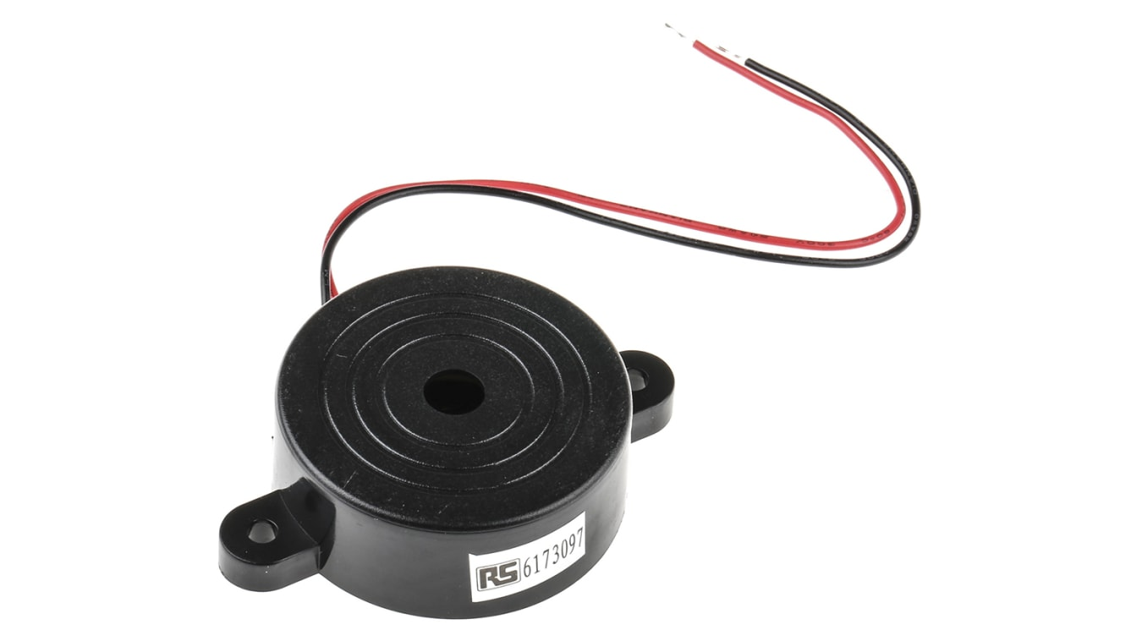
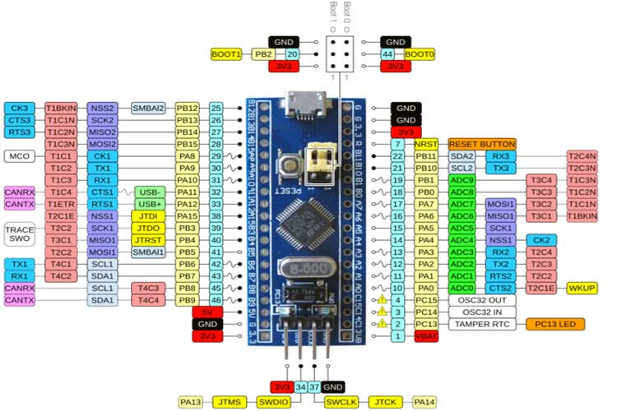
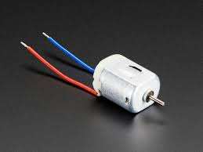
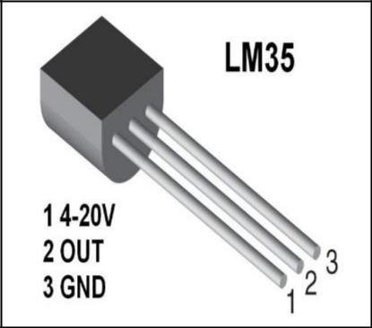
Components
Buzzer
STM32
LM35
DC motor

Slide 3
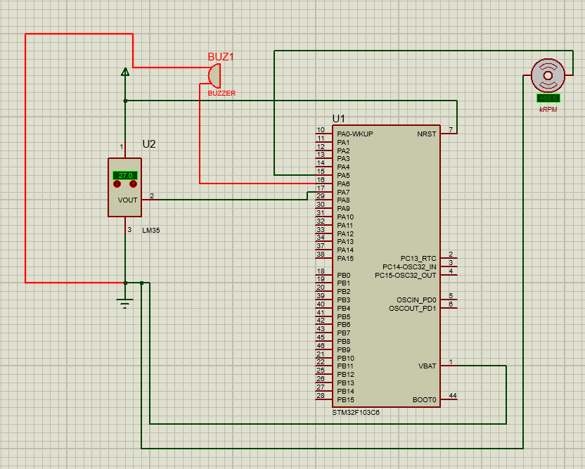
STM32 connected with Sensors
For LM35(pin2 connected PA7) with pin1(power)and pin3(ground)
For Buzzer(two pins: First pin connect to ground and second pin connect to PA6)
For Fan DC(two pins: first pin connect to ground and second pin connect to PA5)

Slide 4
How it works?
When temperature(LM35) increased, the fan dc stop then buzzer rings as this signal for user to check for car engine or thermostat of car

Slide 5
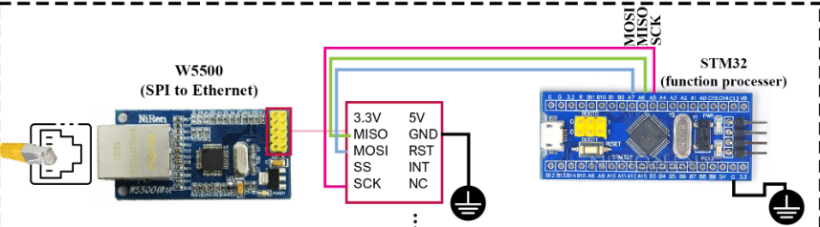
Prototype
After we connect STM32 with sensors, we need to connect SPI to Ethernet(W5500) as STM32 doesn’t has Ethernet port to take signal data from STM32, so W5500 in order to make communication between STM32, Raspberry pi.

