Slide 1
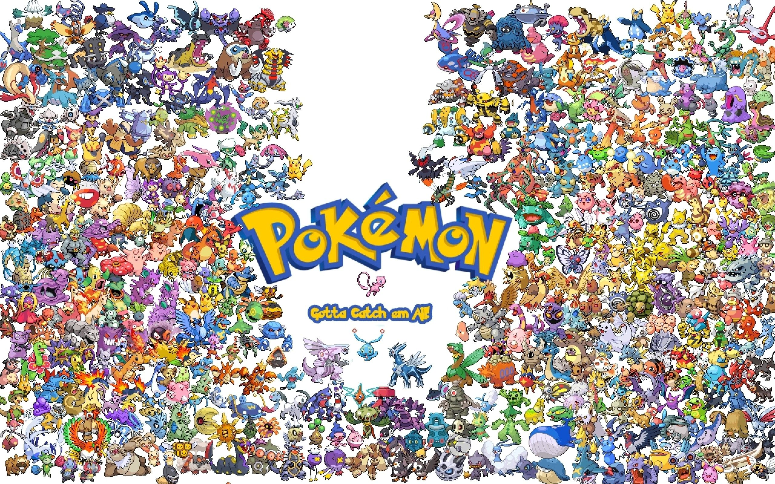
Pokémon
Ethan Heavey
CSCI 527
Nov. 28, 2022

Slide 2
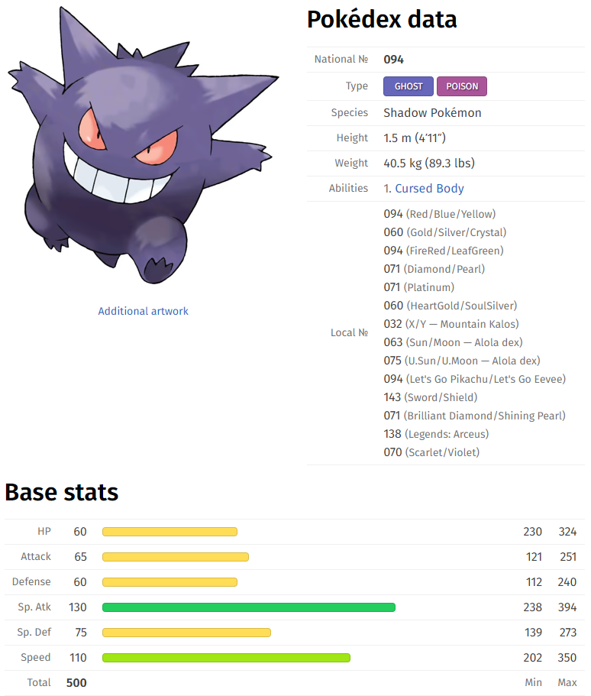

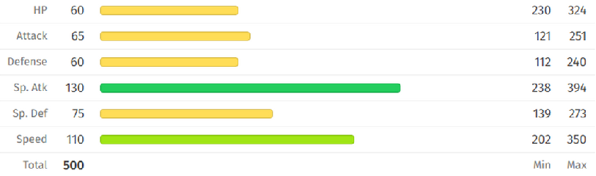
What is a Pokémon?
Some cute... some not so cute
As of Nov 18, 9 generations
1008 unique species
Six stats
Up to two types
Unique interactions
Type chart
Gen 9
1

Slide 3
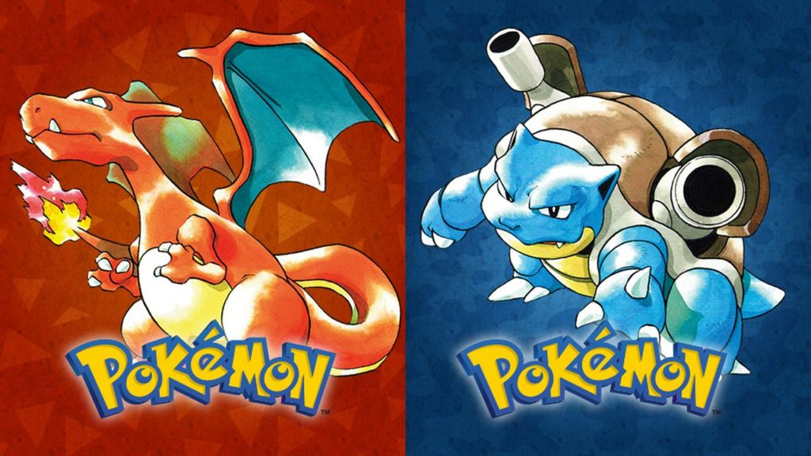

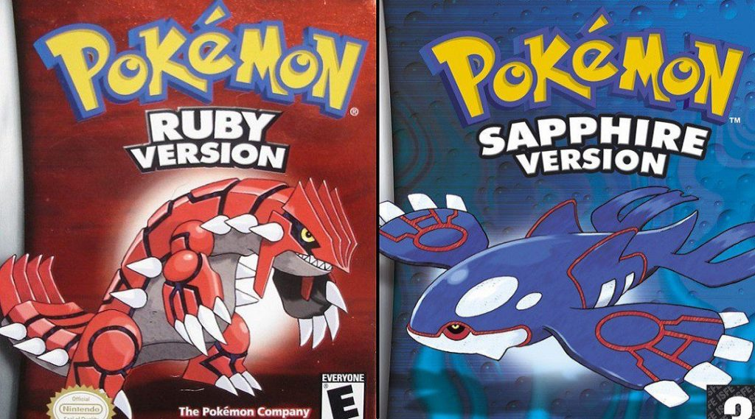

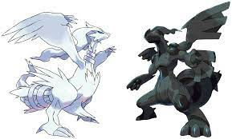
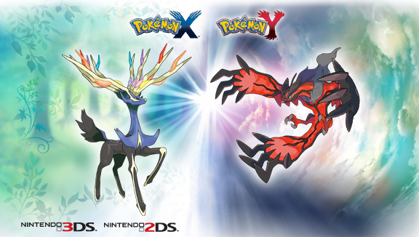


Dataset
Taken from Kaggle
905 Pokémon across 8 generations
55 attributes
English/Japanese name
Is Legendary?
Generation
Lots of data types!
2

Slide 4
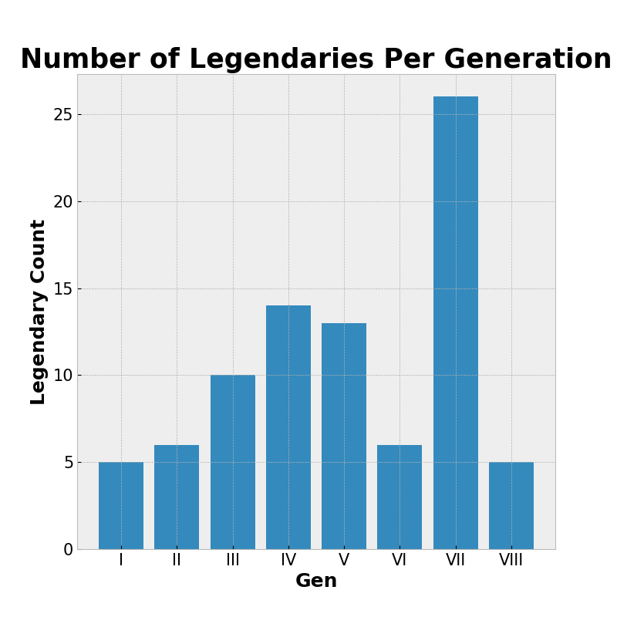
Observations
See which generations have the most legendaries
Generation 7..?
3

Slide 5
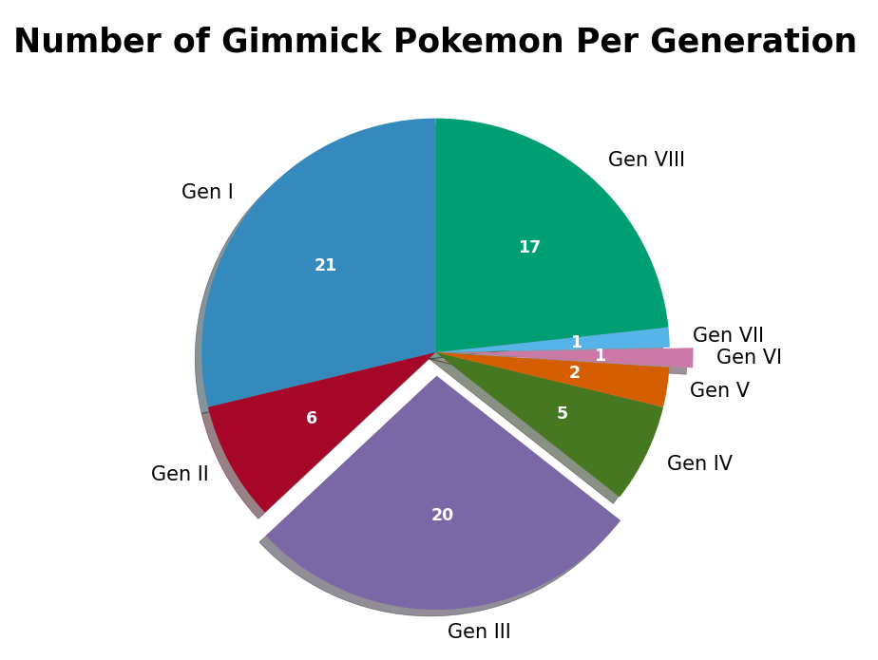
Observations
What is a “gimmick”?
First generation to appear!
Even though Charizard can dynamax,it is only counted once
4

Slide 6
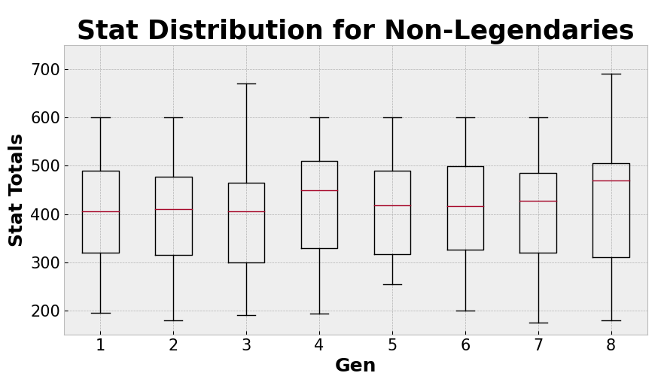
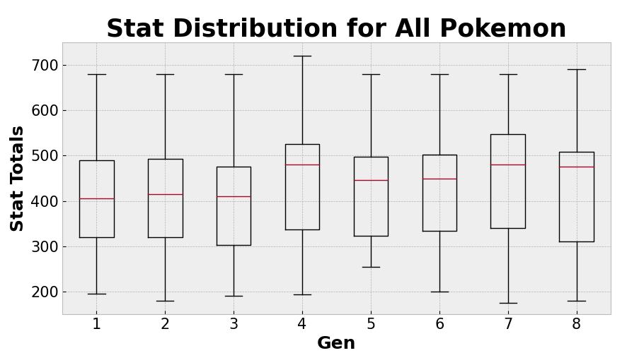
Observations
“Total” attribute
Sum of all six stats
5

Slide 7
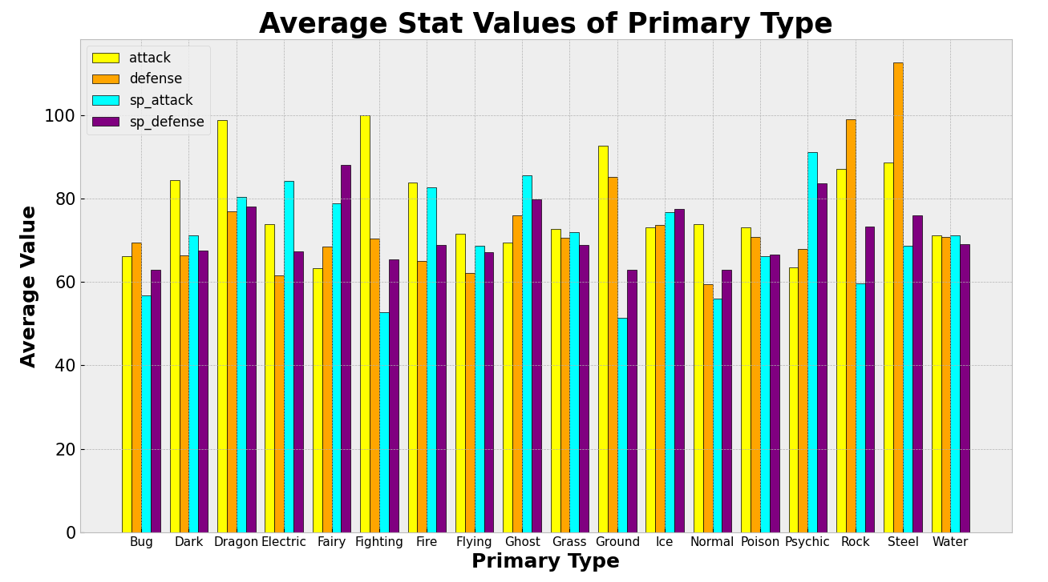
Observations
What types have the highest average;
Attack?
Defense?
Special Attack?
Special Defense?
6

Slide 8
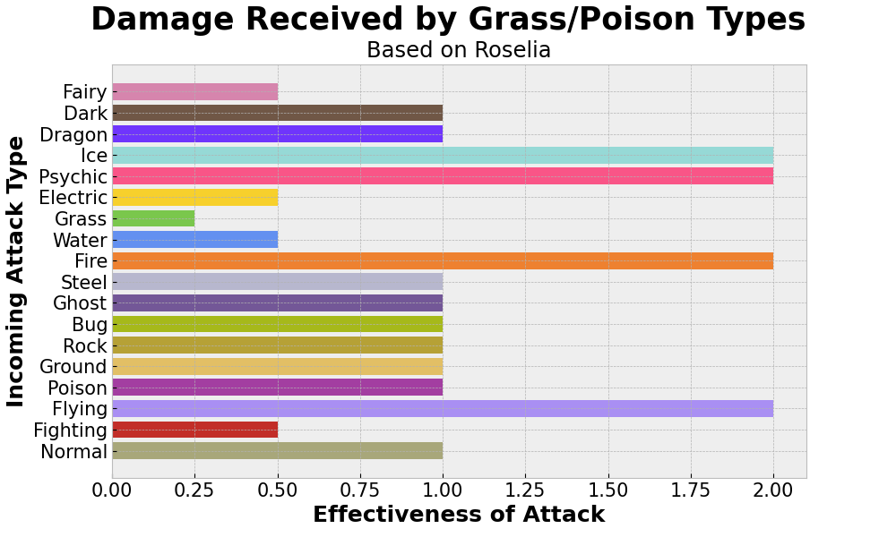
Observations
Effectiveness..?
Next version...
7

Slide 9
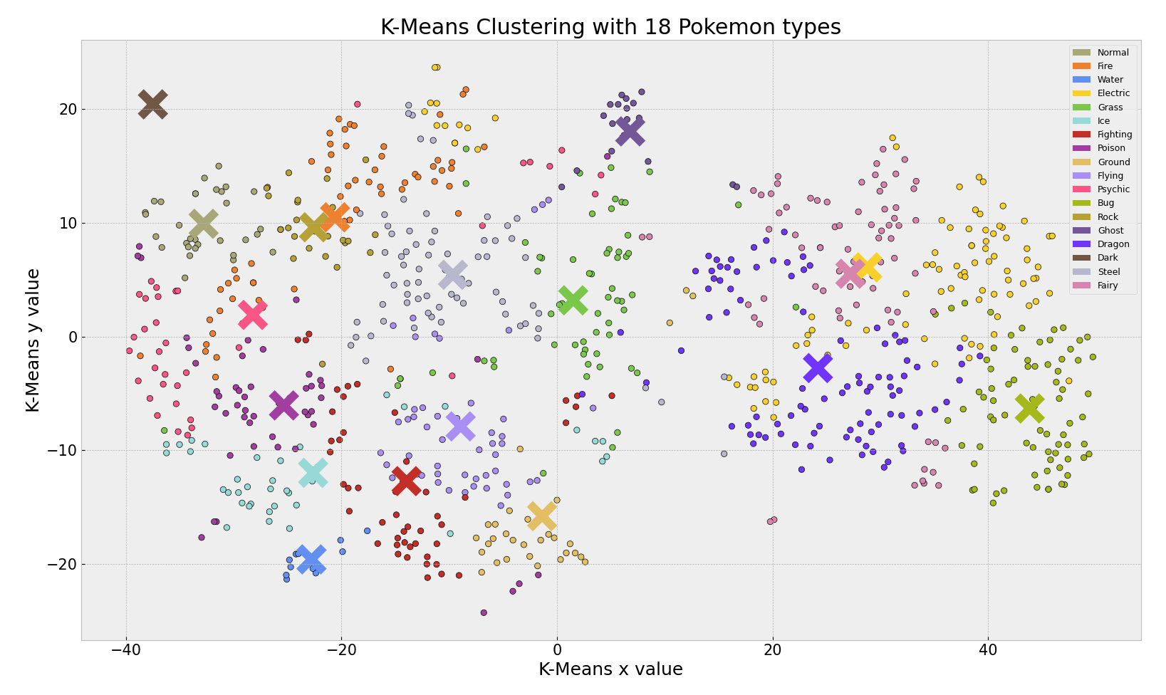
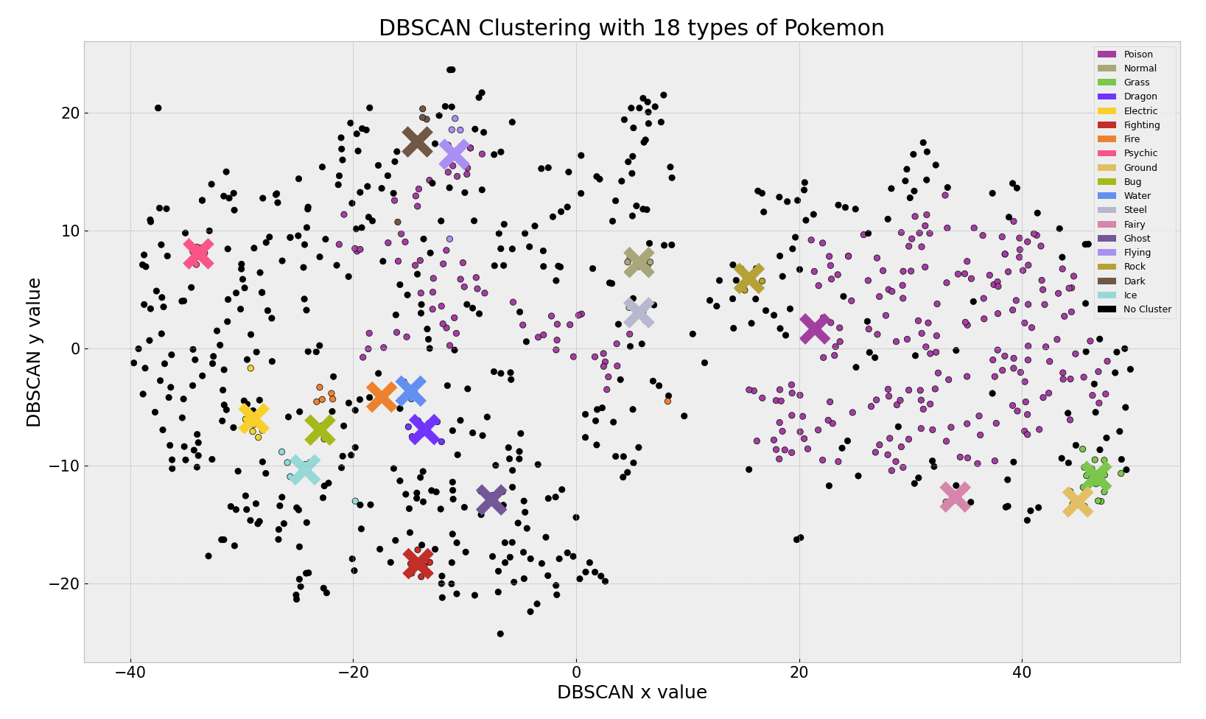
Task
Cluster Pok_mon by type
Compare K-Means and DBSCAN
But... labels...
8

Slide 10
Thank you
Questions?
9

