Slide 1
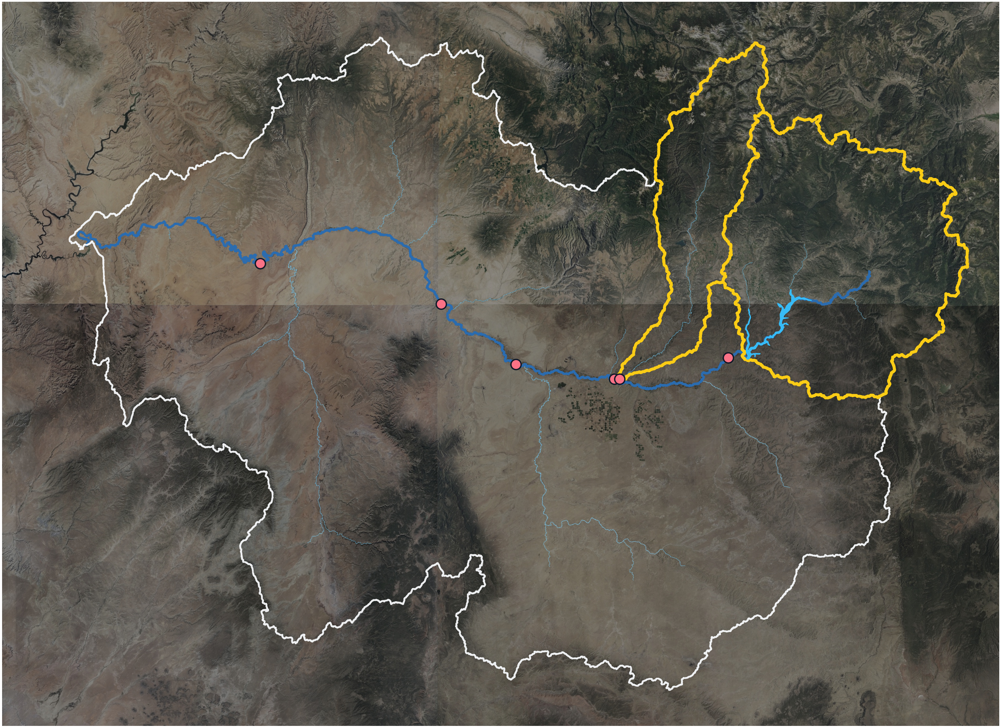
Animas + Navajo basins
San Juan basin
San Juan mainstem
USGS gage
Animas River basin
Navajo Reservoir basin
San Juan
Lake Powell
River
SJ near Bluff
Animas at Farmington
SJ at Four Corners
Navajo Reservoir
SJ at Shiprock
SJ at Archuleta
SJ at Farmington
Disproportionate contributing areas
Animas + Navajo
Rest of San Juan basin
18.6%
accounts for
96.2%
100 km
San Juan Basin
drainage area
Contribution to discharge at SJ nr Bluff
Imagery: USDA, USGS The National Map

