Slide 1
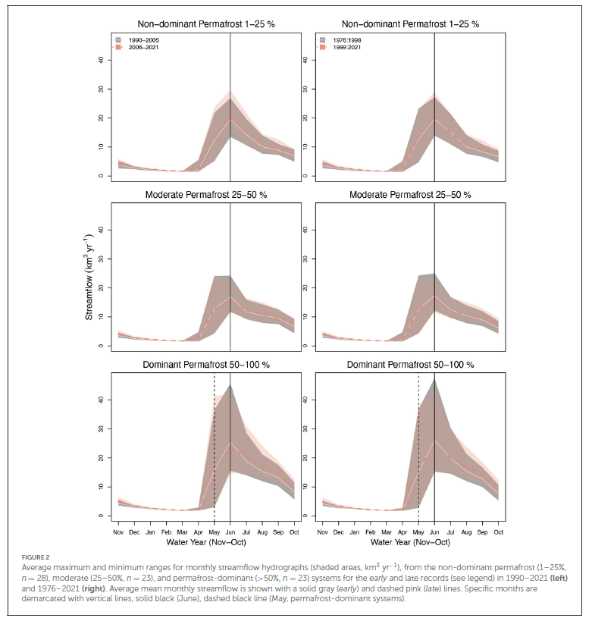
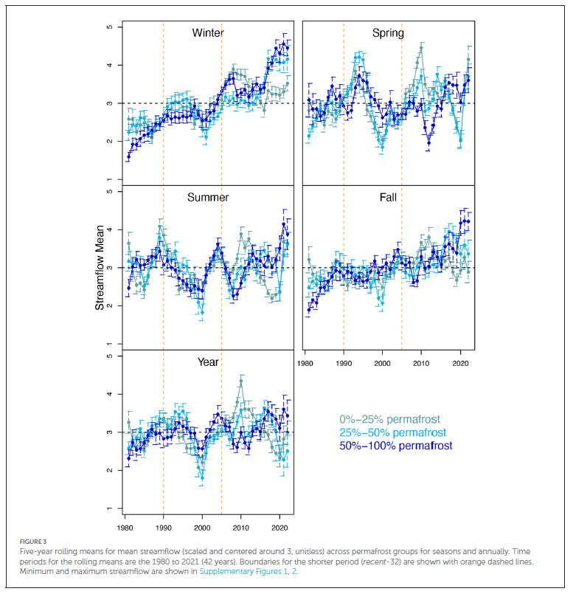
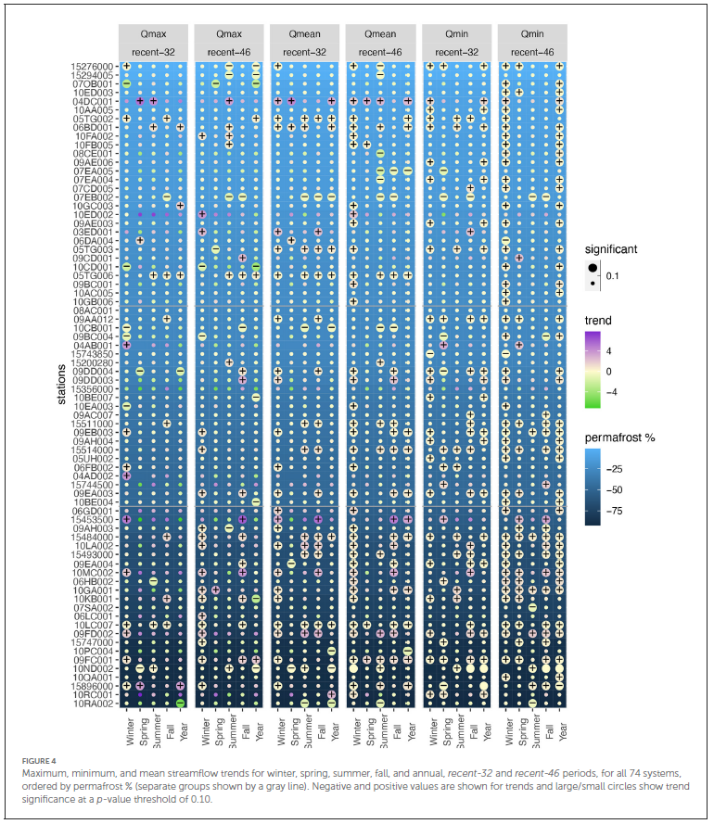
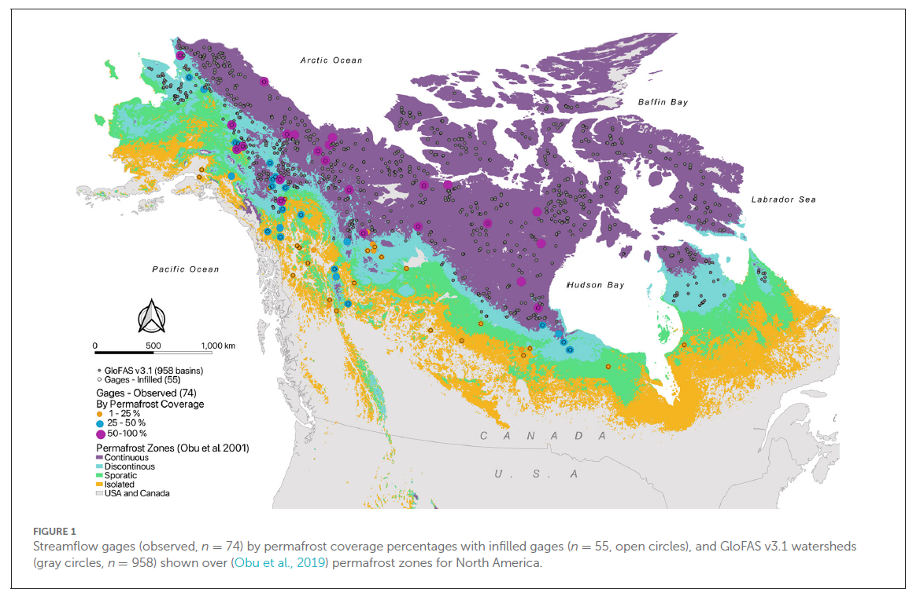
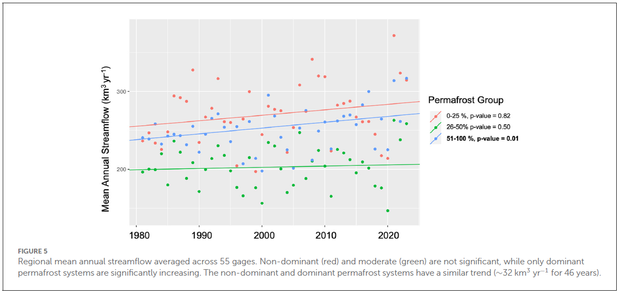
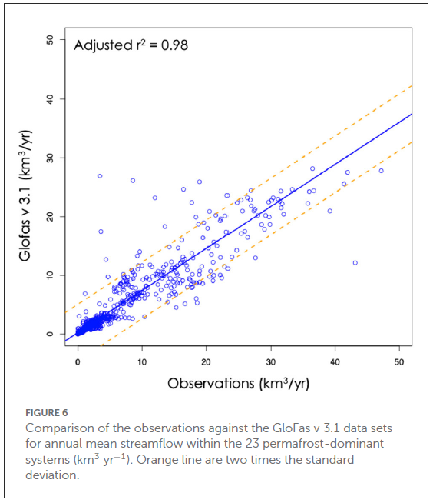
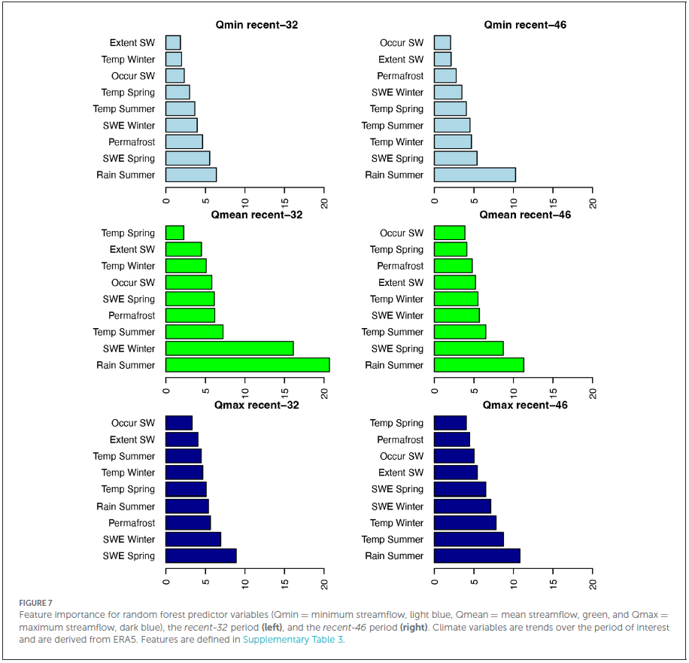
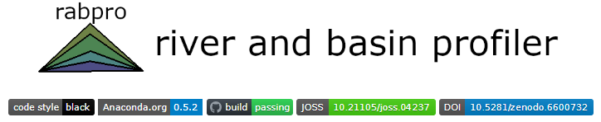
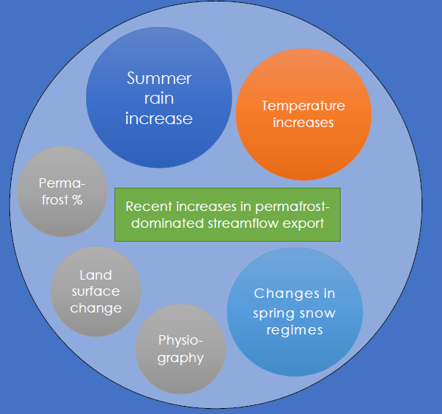
Recent streamflow trends across permafrost basins of North America
Katrina Bennett¹, Jon Schwenk¹, Claire Bachand¹, Eve Gasarch¹, Jemma Stachelek¹, William R. Bolton², Joel C. Rowland¹
¹ Los Alamos National Laboratory
² International Arctic Research Center, University of Alaska, Fairbanks
Contact information: kbennett@lanl.gov
Motivation
Results
Climate change impacts, including changing temperatures, precipitation, and vegetation, are widely anticipated to cause major shifts to permafrost with resulting impacts to hydro-ecosystems across the high latitudes of the globe. However, it is challenging to examine streamflow shifts in these regions owing to a paucity of data, discontinuity of records, and other issues related to data consistency and accuracy. A first step toward understanding how climate impacts permafrost hydrology is understanding how it already has.
Objectives
identify a high quality set of observed streamflow gages on which to perform our analysis
►
determine the key drivers of streamflow change by utilizing novel datasets and traditional and new methods to identify important influences of observed trends
Trends
Analysis
►
►
carry out studies to estimate trends for seasonal and annual timescales over the recent past for each streamflow system
Explain-
ability
Methods
Conclusions
We used gages from the USGS and HYDAT streamflow databases, downselected for multiple criteria to improve quality (n=77). We computed watersheds and their characteristics (e.g., glacier presence, permafrost %, climate stats) using our RabPro software tool. We divided the systems into permafrost-dominant (>50%, n=23), -moderate (26-50%n=23), and -unimpacted (1-25%, n=31) systems. We looked at the entire recent record (1990-2019), and the 1st (1990-2004), and the 2nd (2005-2019) 15 years of the recent record. We calculated trends and significance using Mann-Kendal, Sens slope approaches, along with simple difference metrics with a focus on maximum and minimum streamflow at seasonal and annual time scales. For machine learning methods, we randomly selected 991 basins from GloFAS v 3.14 as a proxy for the permafrost-affected sites and computed trends. We tested 24 machine learning methods; the top models are presented here. To investigate the climatic drivers of streamflow changes, we extracted temperature, precipitation, rainfall, snowfall, and snow water equivalent from ERA5-Land Reanalysis products.
The changes in streamflow trends observed in this study are reflective of deepening active layers and thawing permafrost, indicating that the entire hydrograph is undergoing change within permafrost-dominant streamflow systems as the Arctic moves towards a warmer future under climate change.
►
Overall trend of increasing minimum streamflow for permafrost-containing watersheds across the seasons and annual periods considered.
Climatic factors (precipitation and temperature) are primarily driving trends, but permafrost coverage shows importance for the most recent 32-year period.
►
►
References
Bennett et al. (2023) Frontiers in Water. doi: 10.3389/frwa.2023.1099660
Bennett et al. (2023) Dataset. ESS-DIVE. doi: 10.15485/1985921
Schwenk et al., (2022) Journal of Open Source Software. doi: 10.21105/joss.04237
Schwenk et al., (2022) AGU Fall Meeting. doi: 10.1002/essoar.10509913.2

