Slide 1
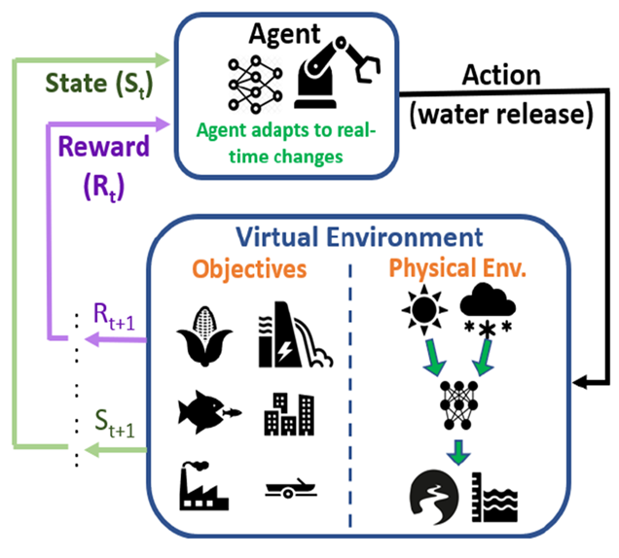
AI-Driven, faster, more robust solutions to resource optimization problems
What science problem are you solving ? Why is AI/ML the right technology ? How to optimally allocate water from the Navajo Reservoir considering many constraints (water supply, hydropower, ecology). AI allows the use of novel data streams, incorporation of uncertain forecasts, and intuitive “rulesets” to provide adaptive, maximally-optimal solutions.
What AI/ML method(s) are you using ? Reinforcement Learning (PPO, TD3) for reservoir control, LSTM for digitally representing the environment.
What is the impact/breakthrough? Very few studies have attempted to use reinforcement learning for reservoir optimization, and none in the context of a completely digital environment.
(improved optimization) Initial results show great potential to provide solutions that meet objectives more often (e.g. maximize hydropower production while maintaining safe reservoir levels).
(speed) The speed of the digital testbed allows managers to explore many more scenarios intuitively and rapidly without hardcoding rulesets.
What infrastructure are you using/would ideally like to use ? Currently using HPC for training RL models; ideally would scale to more powerful GPU/cloud infrastructure to handle future multi-objective, multi-agent systems more efficiently—e.g. when connecting reservoirs
Who is funding the work? If you are funded by LDRD and Artimis, what is your transition plan to programmatic funding?
The work is solely funded by an LDRD ER. We are targeting the DOE WPTO for more sustainable support of the immediate research, and considering how to deploy reinforcement learning for other LANL/DOE-relevant optimization problems such as power grids (DOE OE) and sampling strategies (DOE OSc)
POC: Jon Schwenk, A-1; Presenter: Shubhendu Singh, CCS-3

