Slide 1
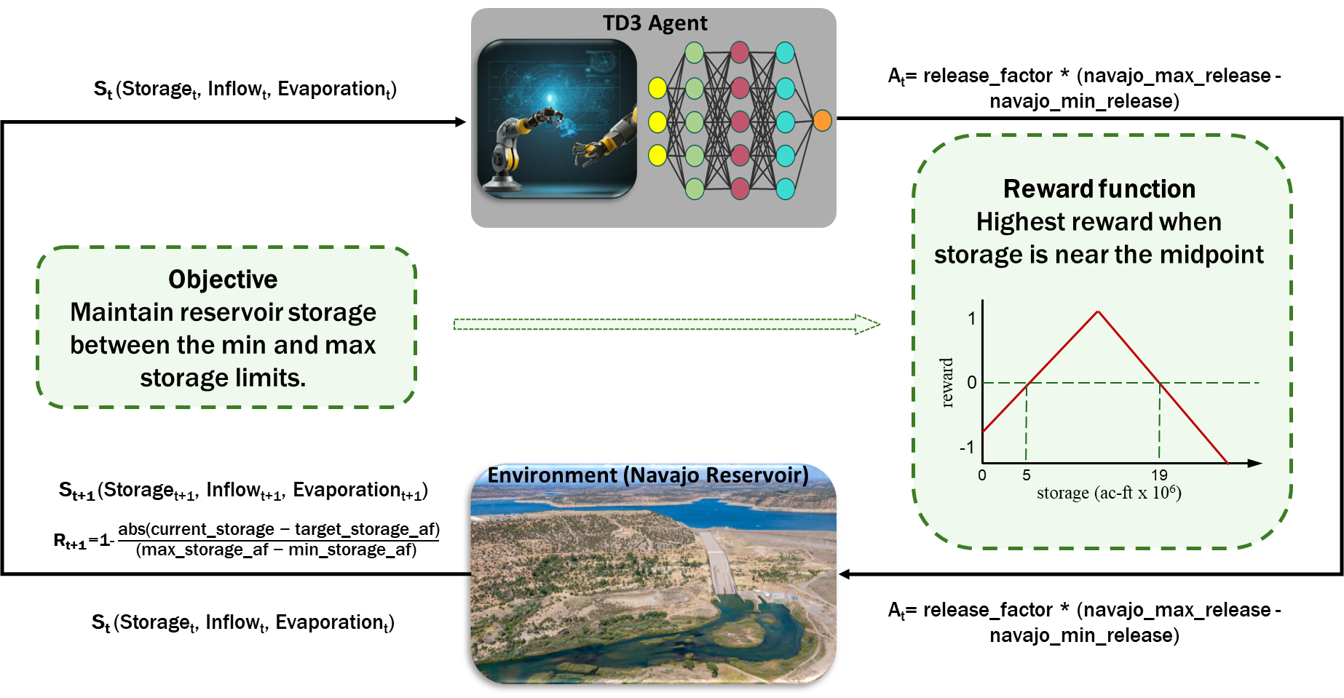
Optimizing: Simpler Case
Project Execution

Slide 2
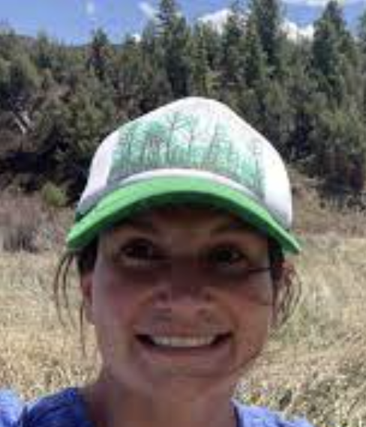

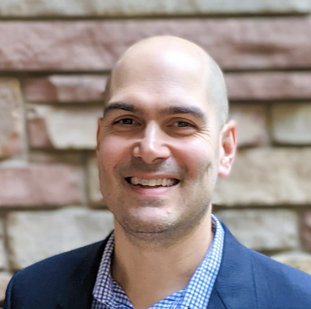
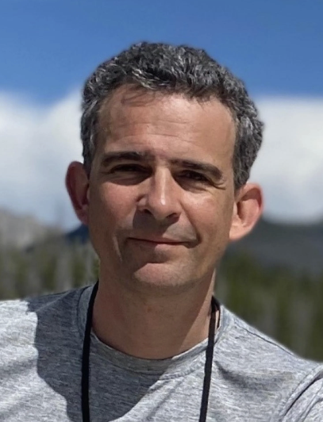
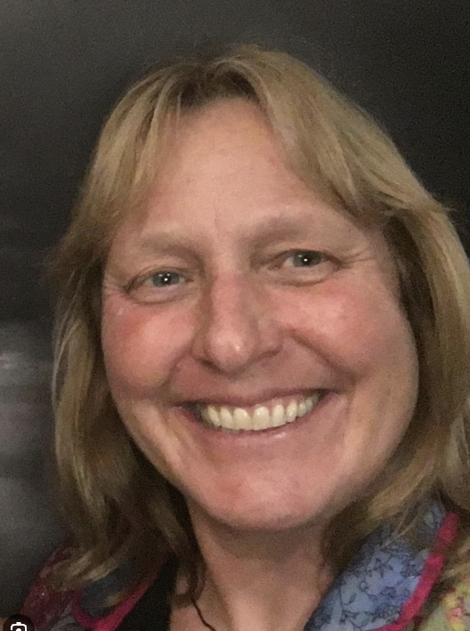
Continued Engagement with Stakeholders
Ben Livneh
Director, Western Water Assessment
Professor, UC Boulder
Engagement with stakeholders
Workshop 1: Spring, 2025 (small team)
Workshop 2: Spring, 2026 (broader engagement)
Aims
Sharing information
Building partnerships for future engagement and proposals
Ensuring our work is impactful and has adoptability
Susan Behery
Navajo Dam Operator
Reclamation
Jim Prairie
Research and Modeling Group Chief
Reclamation’s Upper Colorado Basin Region
Dagmar Llewellyn
Senior Hydrology and Branch Chief
Reclamation’s Colorado Basin Region
Workforce Development, Mission Agility, Project Execution

Slide 3
Optimizing Release: Simplest Case
1
1
0
reward
0
reward
-1
0
5
19
-1
storage (ac-ft x 10⁶)
0
5
19
storage (ac-ft x 10⁶)

