Slide 1
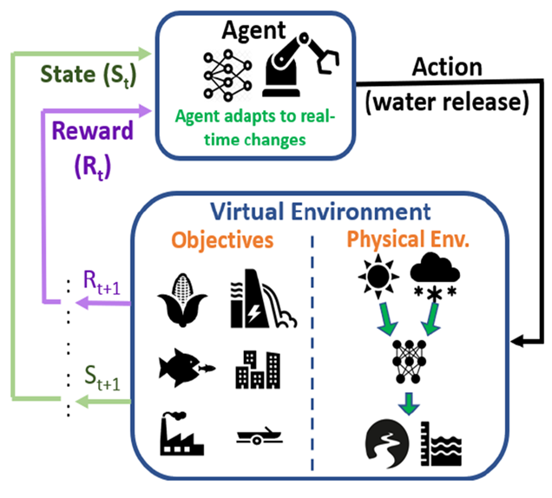
AI-[Enhanced, Driven], ready for [Domain: Material Science, Drug Discovery, etc.] [rest of the title states the breakthrough or speed up in the domain science problem solved]
What science problem are you solving ?
why is AI/ML the right technology ?
Solving optimal reservoir operation (balancing water supply, hydropower, ecology)
AI/ML (RL) is ideal as it learns adaptive, multi-objective strategies under uncertainty
What AI/ML method(s) are you using ?
Using Reinforcement Learning (PPO, TD3) for reservoir control
What is the impact/breakthrough ?
Speed up (gain over non AI approach) ? Breakthrough ? Better physics models ? Design Optimization ? other ?
Breakthrough: Adaptive reservoir operation under uncertainty
Gain: Learns faster than manual rule-based approaches
Impact: Enables multi-objective water management and design optimization
What infrastructure are you using/would ideally like to use ?
Currently using HPC for training RL models; ideally would scale to more powerful GPU/cloud infrastructure to handle future multi-objective, multi-agent systems more efficiently.
Who is funding the work ? (current sponsors )
if you are funded by LDRD and Artimis, what is your transition plan to programmatic funding ?
ASC, DOD, ASCR, BES, etc
POC: Name, group

