Slide 1

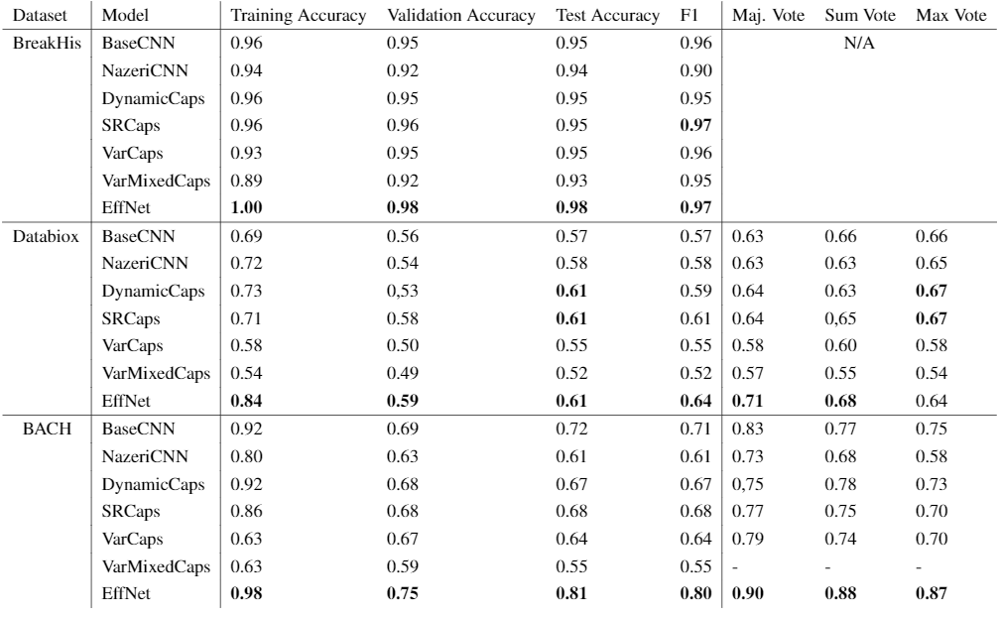
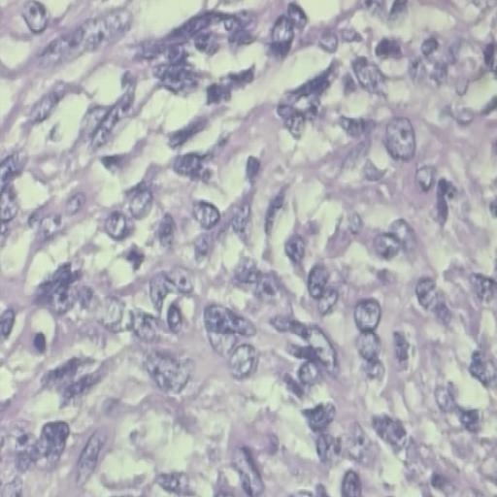
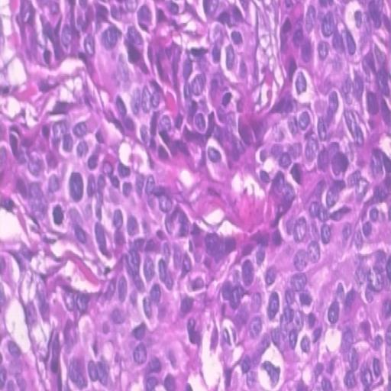

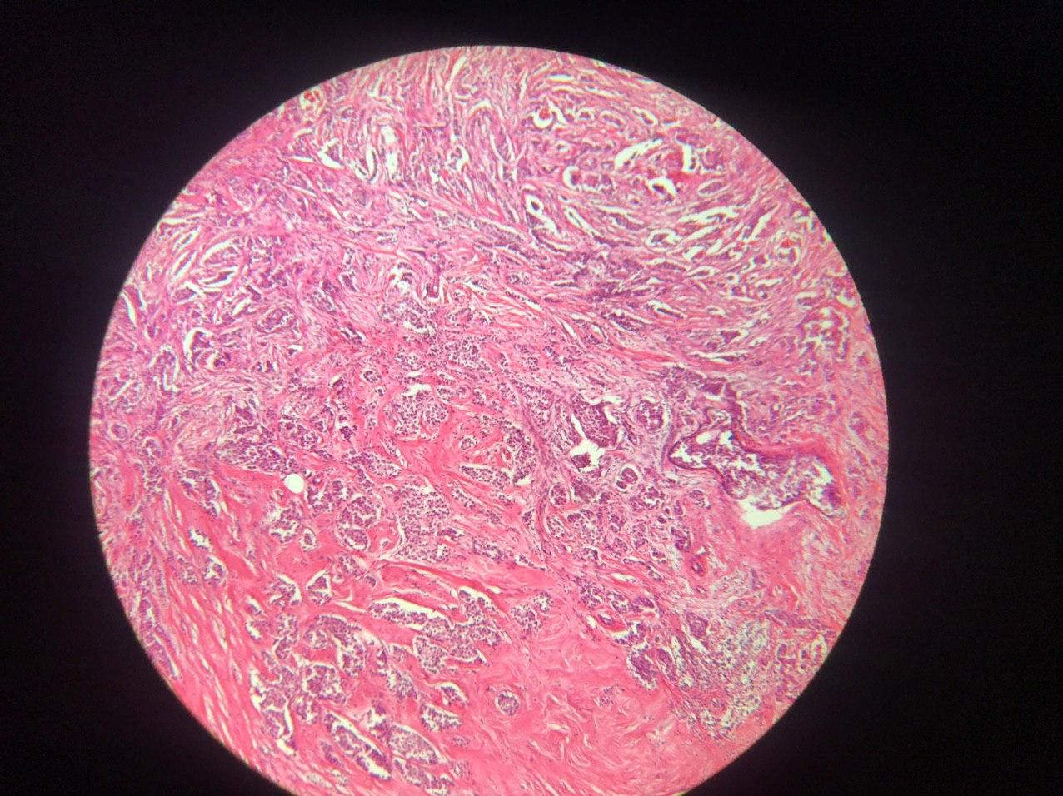
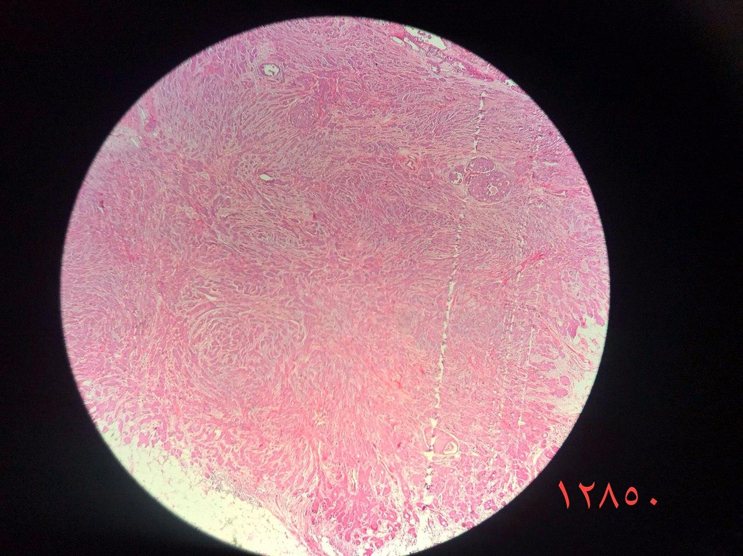
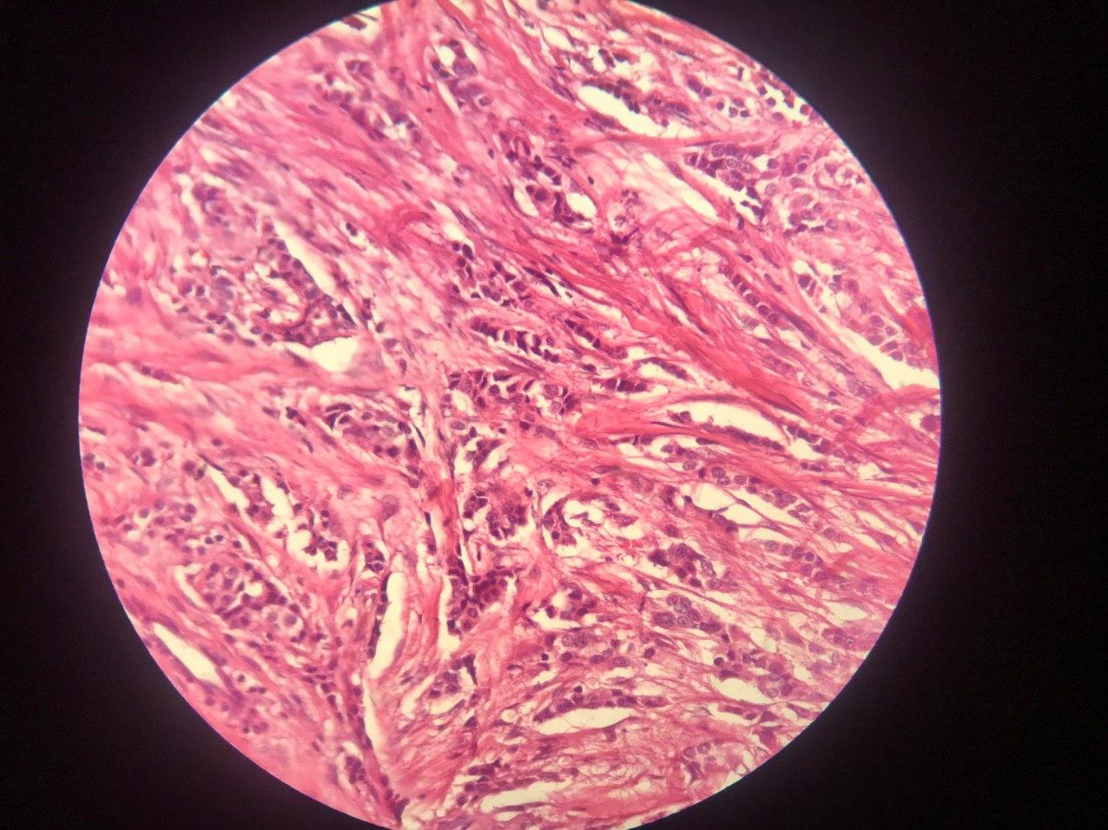
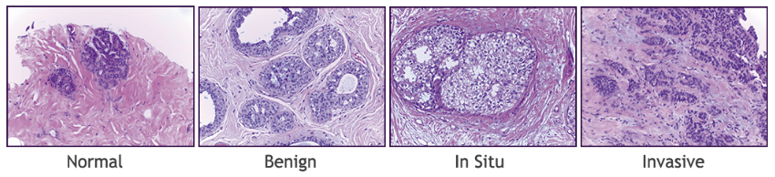
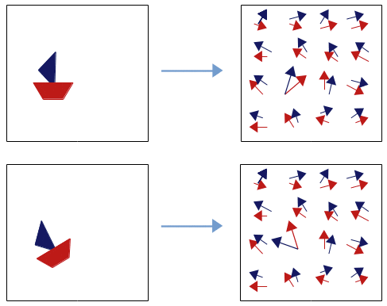
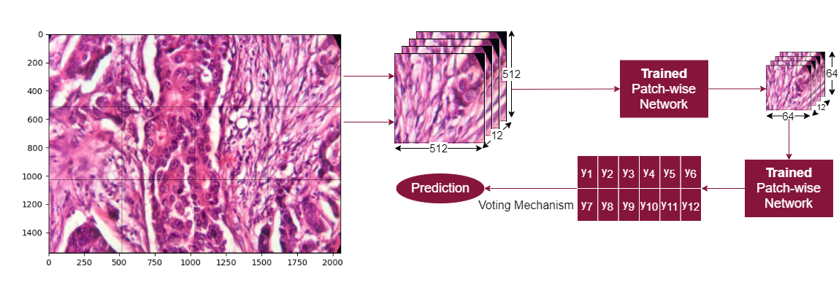

Breast Cancer Classification with Capsules and Convolutional Neural Nets
Marcell Veiner
University of Aberdeen: Department of Computing Science
Introduction
Datasets
Results
Breast cancer is one of the most common type of cancer in the UK.
1 out of every 8 females are diagnosed with it at some point.
4th most common cause of cancer death in the UK.
3 datasets, patched to 512 x 512 using 2 different strides.
Table 1: Overall Performance.
Figure 1: Breast Cancer Statistics in the UK.
Figure 3: Examples of the BreakHis dataset (Benign & Malignant) [8].
Diagnosis often set up with the help of computer aided techniques.
Current approaches (CNNs), discard valuable low-level in-formation.
New approach: Capsule Networks.
Capsule Networks
Figure 4: Examples of the Databiox dataset (Grade I – III) [2].
Novel deep learning approach proposed to address the flaws of CNNs.
Its first version appeared in [6], which has been refined several times since.
Learning process similar to inverse graphics.
Recognise not only objects but their attributes (orientation, size, skew…)
Conclusion
Figure 5: Examples of the BACH dataset [1].
BreakHis: competing with published results.
Databiox: Poor overall performance, models stuck.
BACH: EffNet competing performance.
Architecture
Two-staged approach: Capsules outperforming baseline CNNs.
Overall: Transfer Learning superior.
Two stage architecture as in [5].
First model (Patch-wise network) downscales patches.
Second model (Image-wise network) uses patch-voting to establish label.
References
[1] Guilherme Aresta, et al. Bach: Grand challenge on breast cancer histology images. Medical image analysis, 56:122–139, 2019.
[2] Hamidreza Bolhasani, et al. Informaticsin Medicine Unlocked, 19:100341, 2020.
[3] Charlotte Burmeister. Capsule networks - better cnns?, Jan 2020.
[4] Geoffrey E Hinton, Sara Sabour, and Nicholas Frosst. Matrix capsules with em routing. InInternational conference on learning representations, 2018.
[5] Kamyar Nazeri, Azad Aminpour, and Mehran Ebrahimi. Two-stage convolutional neural network for breast cancer histology image classification. International Conference Image Analysis and Recognition, pages 717–726. Springer, 2018.
[6] Sara Sabour, Nicholas Frosst, and Geoffrey E Hinton. Dynamic routing between capsules. arXiv preprint arXiv:1710.09829, 2017.
[7] Sara Sabour, et al. Unsupervised part representation by flow capsules. arXiv preprint arXiv:2011.13920, 2020.
[8] Fabio A Spanhol, et al. A dataset for breast cancer histopathological image classification. Ieee transactions on biomedical engineering, 63(7):1455–1462, 2015
Figure 6: Image-wise Phase of Training.
Contact Information
Figure 2: Capsules Finding Parts of Objects [3].
Patch-wise network fixed.
Image-wise network: BaseCNN, NazeriCNN, DynamicCapsules, SRCapsules, VariationalCapsules.
Mixed Networks: EfficientNet, VariationalMixedCapsules.
Capsules are more robust to adversarial attacks [4].
Viewpoint changes have linear effects on part-whole relationships [4].
Capsules are equivariant to translation and affine transformations [6].
Capsules do not discard information about the position of an entity [6].
Marcell Veiner
m.veiner.17@adbn.ac.uk
BSc. Computing Science & Mathematics

