Slide 1
Breast Cancer Classification with Capsule Networks
Author: Marcell Veiner
Supervisor: Dr Georgios Leontidis
Notes:
Be specific and direct in the title. Use the subtitle to give the specific context of the speech.
-The goal should be to capture the audience’s attention which can be done with a quote, a startling statistic, or fact. It is not necessary to include this attention getter on the slide.

Slide 2

Introduction
Breast Cancer Statistics
Breast cancer is one of the most common type of cancer in the UK.
1 out of every 8 females are diagnosed with it at some point [].
4th most common cause of cancer death in the UK.
Diagnosis
Diagnosis often set up with the help of computer aided techniques.
Current approaches (CNNs), discard valuable low-level in-formation.
New approach: Capsule Networks.
Figure 1: Breast Cancer Statistics in the UK.
Notes:
Use the background points to post details that are not common knowledge, or that the audience will need to understand the context of the speech.
-Do not read these main points from the PowerPoint, instead elaborate on these points during the speech.

Slide 3
Can Capsule Networks outperform CNNs in medical imaging?
Notes:
Dedicate this entire slide to the thesis statement. It is the reason the speech is being given. Use this time to reveal the three main points of the speech (slides 4,5,6) as an overview for the direction of the speech:
-[type main point #1 here]
-[type main point #2 here]
-[type main point #3 here]
Be sure to transition to the first main point and the next slide.

Slide 4
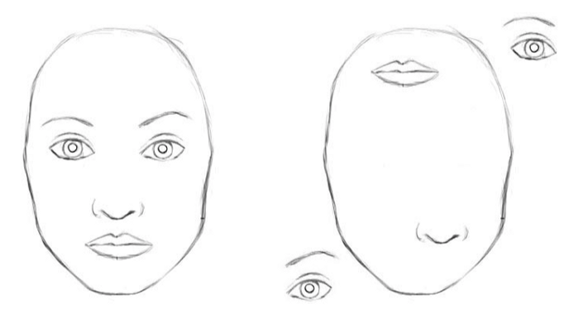
Convolutional Neural Networks
Good if large amounts of data is available.
Vulnerability to adversarial attacks.
Inability to handle the nonlinearity of viewpoint changes without data engineering.
Transformation invariance.
Max pooling looses local information.
G. Hinton: “The pooling operation used in convolutional neural networks is a big mistake and the fact that it works so well is a disaster.”
Figure 2: CNNs Recognising a Face [].
Notes:
The title of main point #2 should be clear and concise. Each piece of evidence should be summarized for clarity and cited correctly. Do not simply read the pieces of evidence, but elaborate where needed.
[type notes for elaboration here]
Be sure to transition to main point #3 and the next slide.

Slide 5
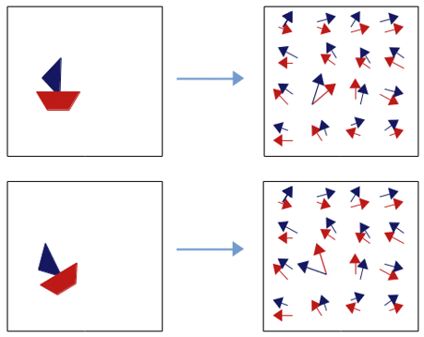
Capsule Networks
Novel deep learning approach proposed to address the flaws of CNNs.
Recognise not only objects but their attributes (orientation, size, skew…).
Learning process similar to inverse graphics.
Viewpoint changes have linear effects on part-whole relationships [].
Capsules do not discard information about the position of an entity [].
Figure 3: Capsules Finding Parts of Objects [].
Notes:
The title of main point #1 should be clear and concise. Each piece of evidence should be summarized for clarity and cited correctly. Do not simply read the pieces of evidence, but elaborate where needed.
[type notes for elaboration here]
Be sure to transition to main point #2 and the next slide.

Slide 6
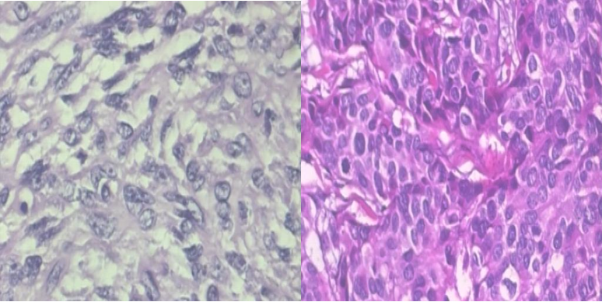
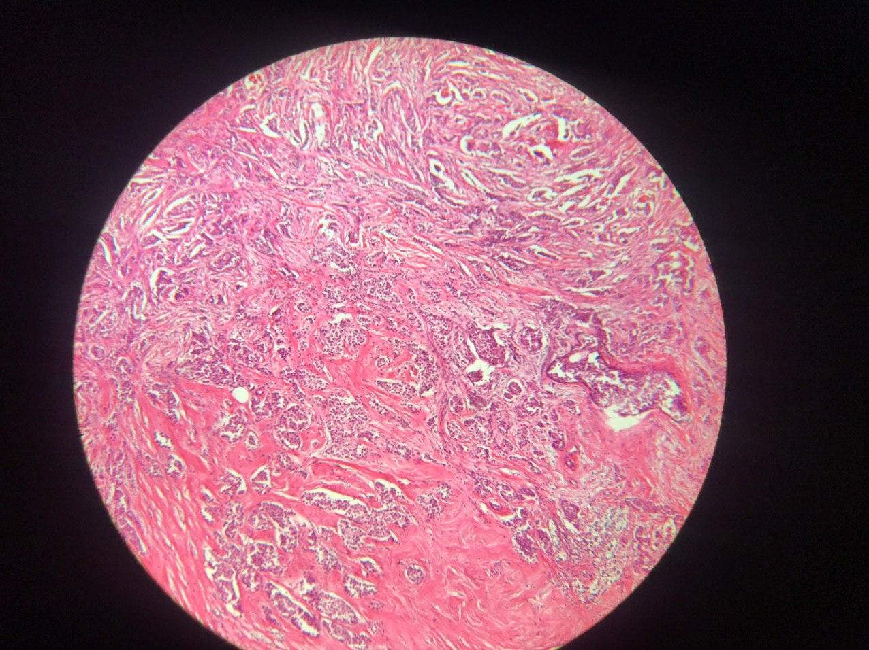
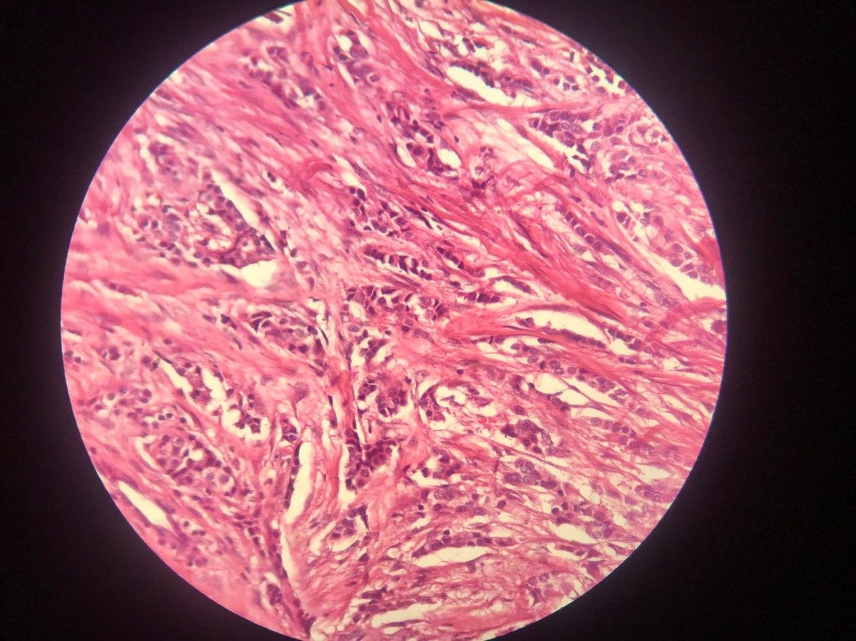
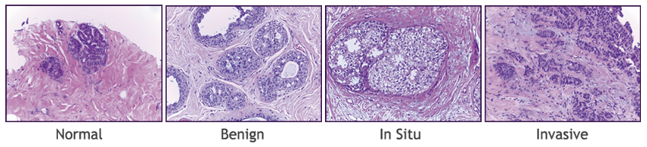
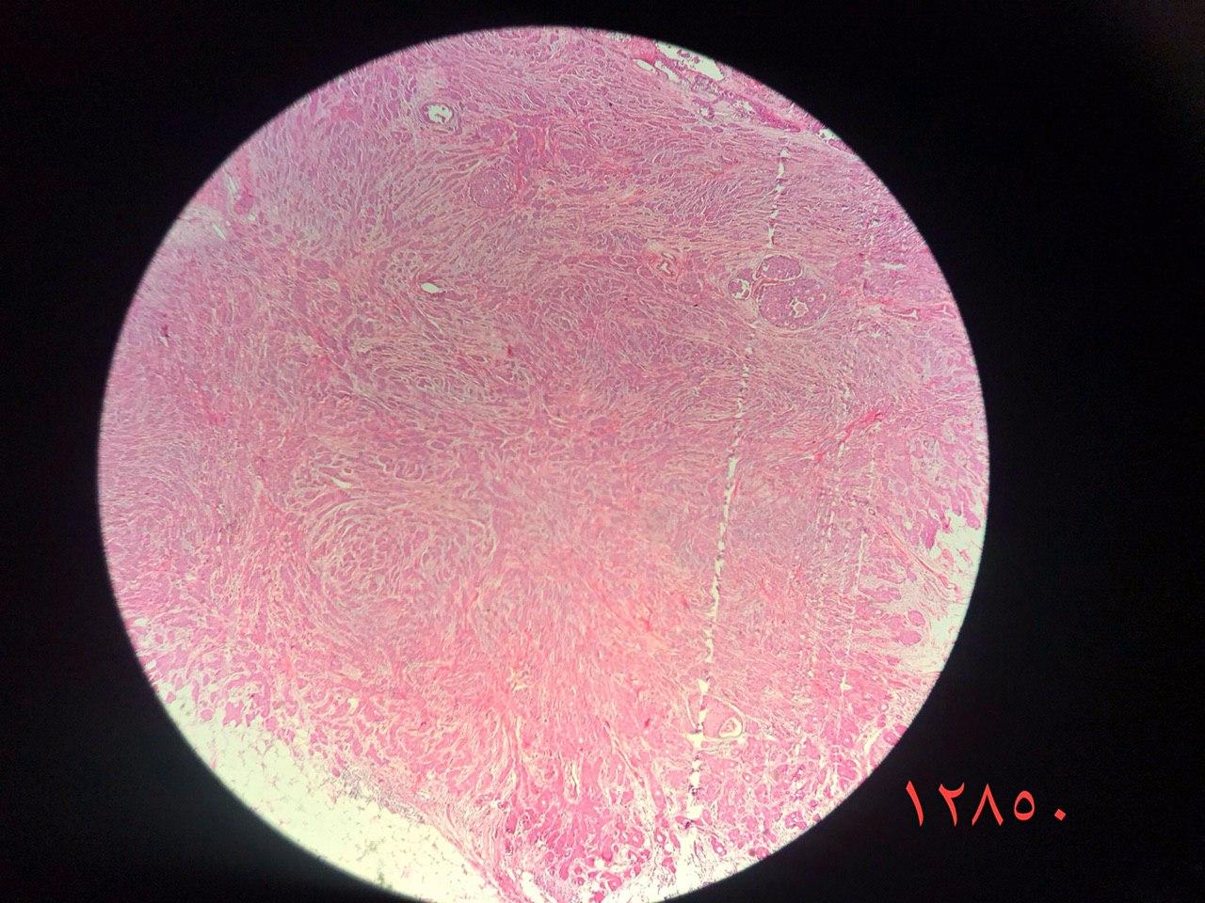
Datasets
Large Resolution Images.
Create Patches of 512x512.
Downscale with CNNs to 64x64.
BreakHis
Databiox
BACH
Figure 6: Examples of BACH [].
Figure 5: Examples of Databiox [].
Figure 4: Examples of BreakHis [].
Notes:
The title of main point #3 should be clear and concise. Each piece of evidence should be summarized for clarity and cited correctly. Do not simply read the pieces of evidence, but elaborate where needed.
[type notes for elaboration here]
Be sure to transition to the counterargument and the next slide.

Slide 7
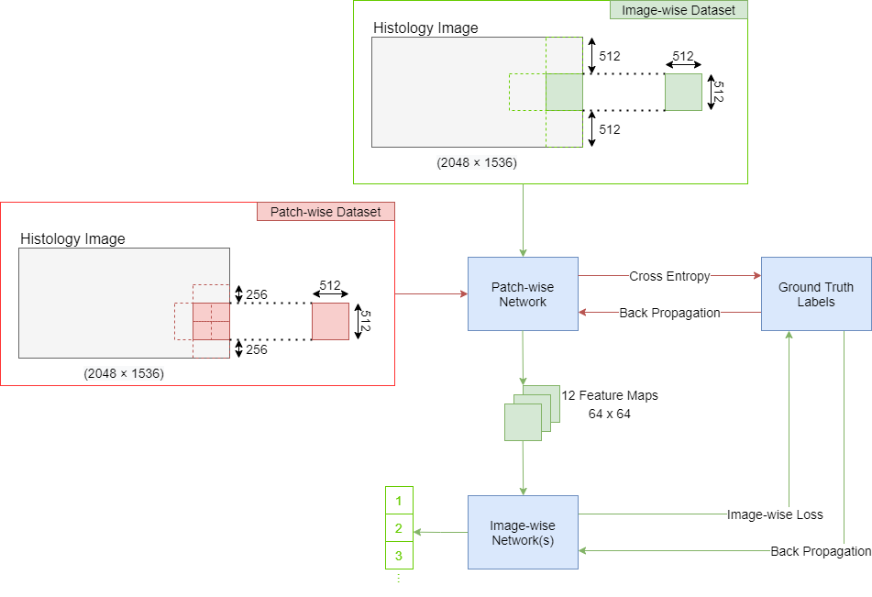
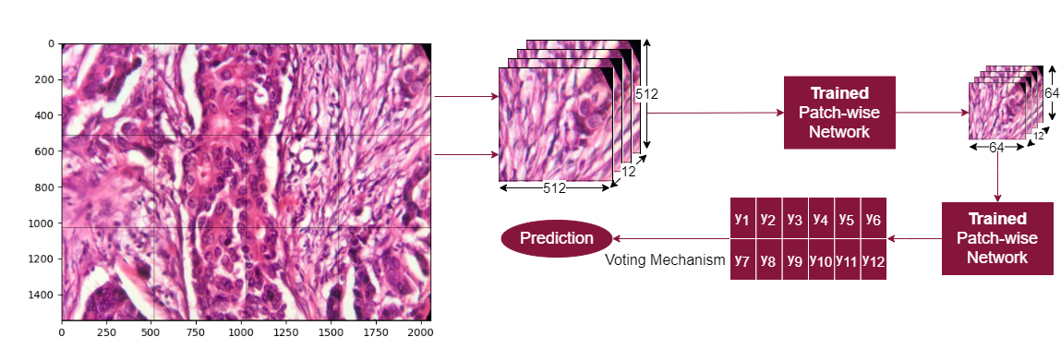
Architecture
Two stage architecture as in [].
First model (Patch-wise network) downscales patches.
Second model (Image-wise network) uses patch-voting to establish label.
Patch-wise network fixed.
Image-wise network:
BaseCNN,
NazeriCNN,
DynamicCapsules,
SRCapsules,
VariationalCapsules.
Mixed Networks: EfficientNet, VariationalMixedCapsules.
Figure 6: Overall Architecture
Figure 7: Image-wise Phase of Training
Notes:
The title of main point #3 should be clear and concise. Each piece of evidence should be summarized for clarity and cited correctly. Do not simply read the pieces of evidence, but elaborate where needed.
[type notes for elaboration here]
Be sure to transition to the counterargument and the next slide.

Slide 8
Architecture
Figure 8: Overall Architecture
Notes:
The title of main point #3 should be clear and concise. Each piece of evidence should be summarized for clarity and cited correctly. Do not simply read the pieces of evidence, but elaborate where needed.
[type notes for elaboration here]
Be sure to transition to the counterargument and the next slide.

Slide 9
Results
[Type evidence against the topic here]
[Type evidence against the topic here]
[Type evidence against the topic here]
Go to Colab
Notes:
The counterargument should be the most common argument against the topic. The goal for this slide is to address the counterargument in such a way as to actually strengthen the original topic. Be sure to address each piece of evidence against the topic. As you address each piece of evidence elaborate on the text found on the slide. Remember to transition to the final slide, the action step.

Slide 10
Yes and No. Competing Results.
Can Capsule Networks outperform CNNs in medical imaging?
Notes:
The action step is what the audience is supposed to do or think about the topic. It should be one sentence that is written clearly and with much thought. It may also be the thesis statement restated as an action. The goal of this slide is to leave the audience with a clear message as to what they are to do or think at the end of the speech. It may be a good idea to end with a powerful quote or image.

Slide 11
References
[Type evidence against the topic here]
[Type evidence against the topic here]
[Type evidence against the topic here]

Slide 12
Thank you!
Notes:
Dedicate this entire slide to the thesis statement. It is the reason the speech is being given. Use this time to reveal the three main points of the speech (slides 4,5,6) as an overview for the direction of the speech:
-[type main point #1 here]
-[type main point #2 here]
-[type main point #3 here]
Be sure to transition to the first main point and the next slide.

