Slide 1

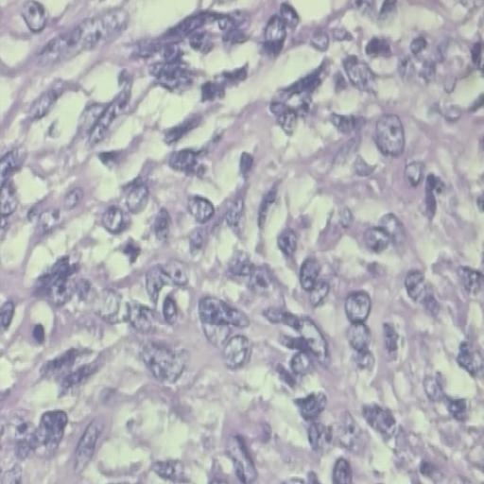
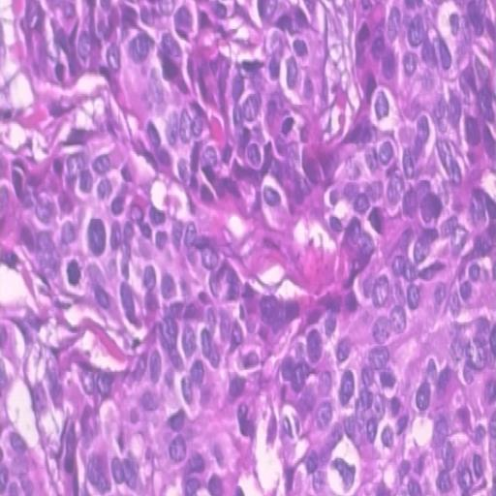

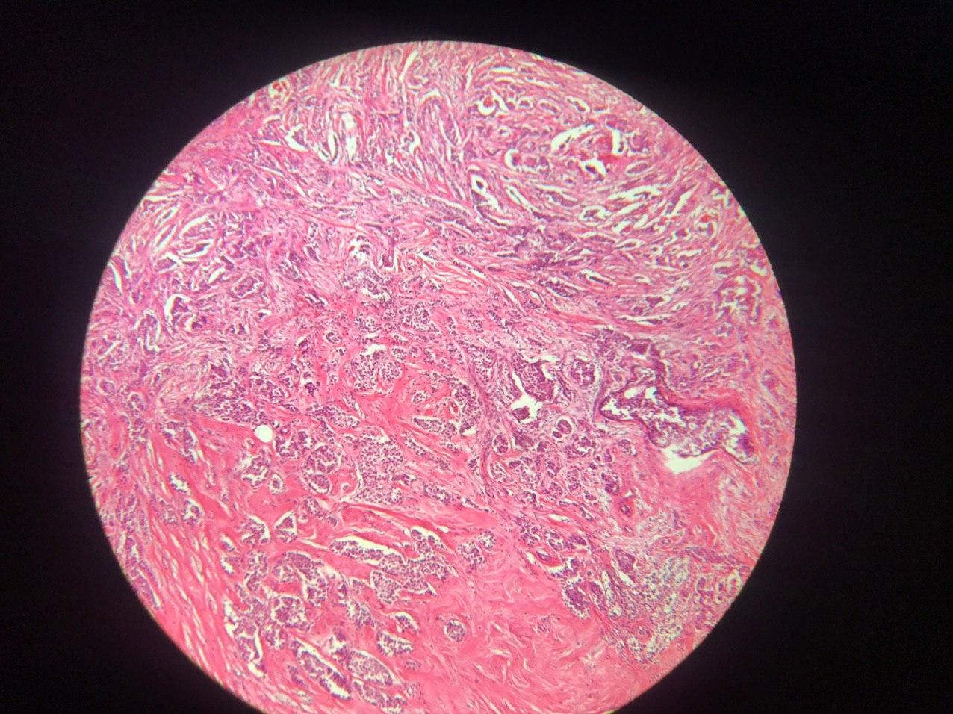
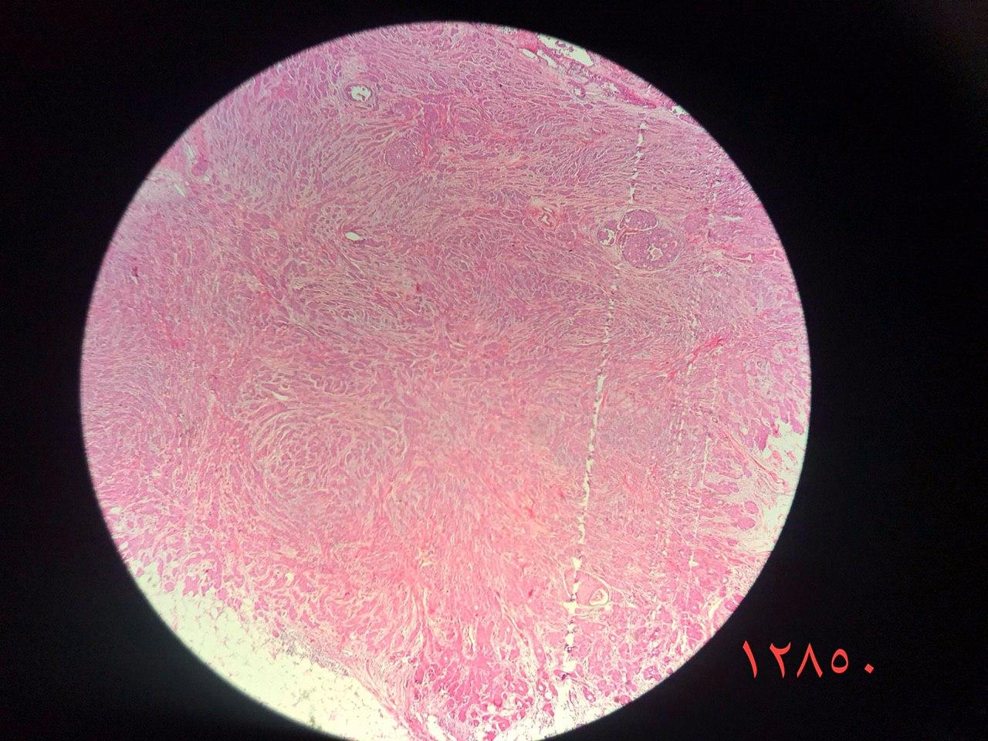
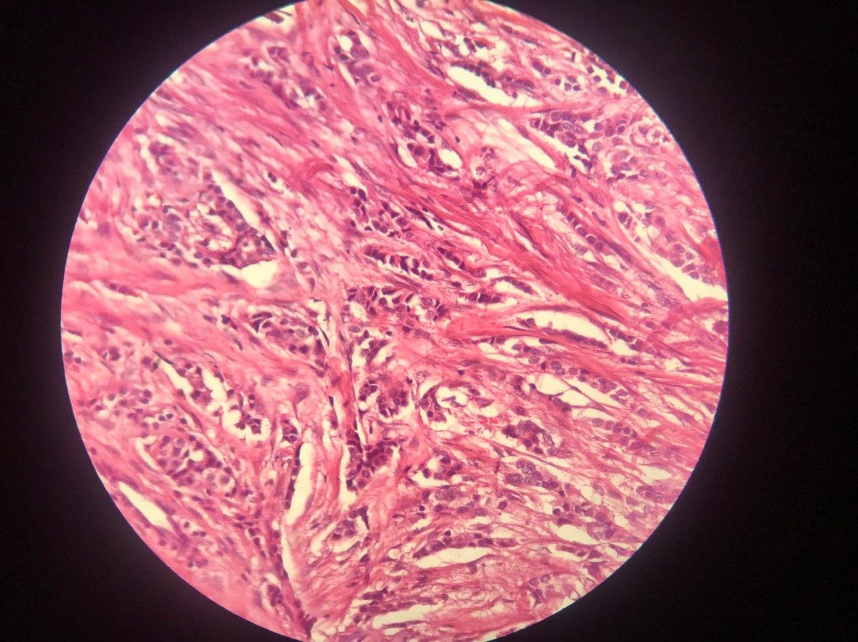
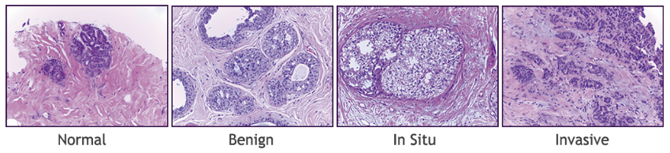
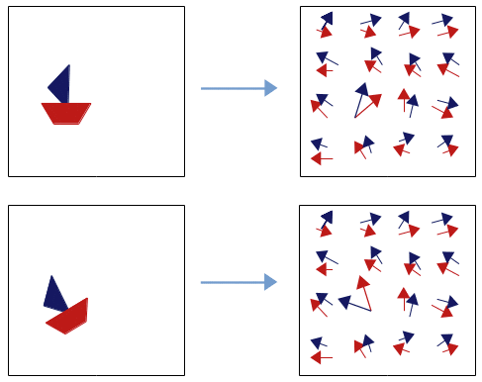
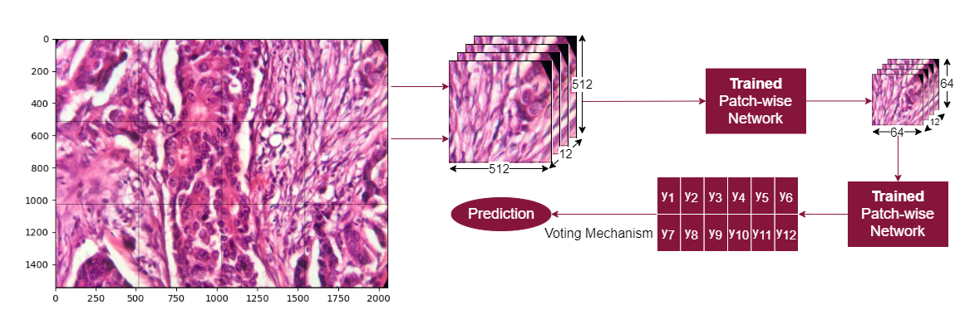

Breast Cancer Classification with Capsule Networks
Marcell Veiner
University of Aberdeen: Department of Computing Science
Introduction
Datasets
Results
Breast cancer is one of the most common type of cancer in the UK.
1 out of every 8 females are diagnosed with it at some point [].
4th most common cause of cancer death in the UK.
3 datasets, patched to 512 x 512 using 2 different strides.
Figure 1: Breast Cancer Statistics in the UK.
Figure 3: Examples of the BreakHis dataset (Benign & Malignant) [].
Diagnosis often set up with the help of computer aided techniques.
Current approaches (CNNs), discard valuable low-level in-formation.
New approach: Capsule Networks.
Conclusion
Capsule Networks
Figure 4: Examples of the Databiox dataset (Grade I – III) [].
Novel deep learning approach proposed to address the flaws of CNNs.
Its first version appeared in [], which has been refined several times since.
Learning process similar to inverse graphics.
Recognise not only objects but their attributes (orientation, size, skew…)
Figure 5: Examples of the BACH dataset [].
Architecture
References
Two stage architecture as in [].
First model (Patch-wise network) downscales patches.
Second model (Image-wise network) uses patch-voting to establish label.
Figure 6: Image-wise Phase of Training.
Contact Information
Figure 2: Capsules Finding Parts of Objects [].
Patch-wise network fixed.
Image-wise network: BaseCNN, NazeriCNN, DynamicCapsules, SRCapsules, VariationalCapsules.
Mixed Networks: EfficientNet, VariationalMixedCapsules.
Capsules are more robust to adversarial attacks [].
Viewpoint changes have linear effects on part-whole relationships [].
Capsules are equivariant to translation and affine transformations [].
Capsules do not discard information about the position of an entity [].
Marcell Veiner
m.veiner.17@adbn.ac.uk
BSc. Computing Science & Mathematics

