Slide 1
Mortgage Process Revamp — Sequential vs Parallel
Current
Process
Document collection
→
IGF
→
Docket Login
→
DM
Preparation
→
DM under approval
→
E-Sign
→
FCPG
→
Credit Ops check
→
Ops NDC check
→
FinnOne Maker-Checker
→
OTC/PDD
Proposed
Process
Document collection
→
DM
Preparation
→
DM under approval
→
E-Sign
→
FCPG
→
Ops NDC check
→
FinnOne Maker-Checker
→
OTC/PDD
Current TAT = 13.27 Hrs | Median TAT = 9.28 Hrs (From DM Prep. Till Disbursement)
The above is calculated for 95 percentile cases excluding outliers
Key Bottlenecks: Waiting dominates cycle time | Redundant Verification | Sequential Blocking | Low Customer Visibility
PRoblem
New TAT ≈ MAX(T₁, T₂, ... Parallel Validation) — Wait time converts into execution time
Stages → Tasks
System assigns tasks to relevant stakeholder as per dependency
Partial Progression
9/10 docs correct → Progress. 1 incorrect → query only that task. No full-case freeze
Parallel Distribution
As per dependency, multiple stakeholders work on same case at a time
Dependency Engine
Only dependent/ Mandatory tasks will act as blocker
1

Slide 2
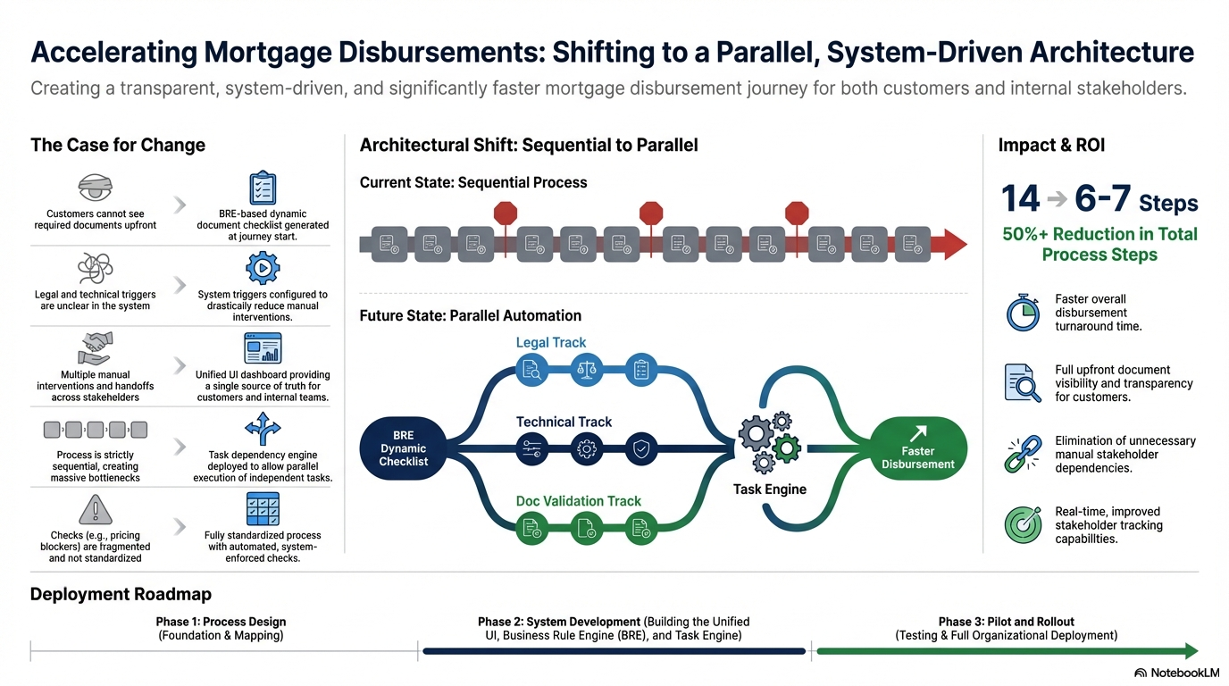















Accelerating Mortgage Disbursement Process
Creating a transparent, system-driven, and significantly faster mortgage disbursement journey for both customer and internal stakeholders.
Impact
Key Challenges & Recommended Solutions
Architectural Shift: Sequential to Parallel
Impact
Architectural Shift : Sequential to Parallel
11 8 Steps
Current State : Sequential Process
Customer cannot see required documents upfront.
BRE based dynamic document checklist generated at journey start.
Current State : Sequential Process
30% + Reduction in Total Process Steps
Faster overall disbursement turnaround time.
Legal, technical, pricing & FinnOne service triggers are unclear in the system
System triggers configured to reduce manual interventions
Future State : Parallel Automation
Future State : Parallel Automation
Legal Track
Full upfront document visibility and transparency for customers.
Legal Track
Multiple manual interventions & handoffs across stakeholders
Unified UI dashboard providing a single source of truth for customers and internal teams
BRE Dynamic Checklist
Technical Track
Faster Disbursement
BRE Dynamic Checklist
Technical Track
Faster Disbursement
Elimination of unnecessary manual stakeholder dependencies
Process is strictly sequential, creating massive bottlenecks
Task dependency engine deployed to allow parallel execution of independent tasks
Task Engine
Doc Validation Track
Task Engine
Doc Validation Track
Real-time improved stakeholder tracking capabilities.
Checks (e.g., pricing blockers) are fragmented and not standardized
Fully standardized process with automated, system-enforced checks
Deployment Roadmap
Phase 1 : Process Design
Phase 2 : System Development
Phase 3 : Pilot and Rollout
Stakeholder's consent
Changes in BRE and system logics
Testing & Deployment

Slide 3
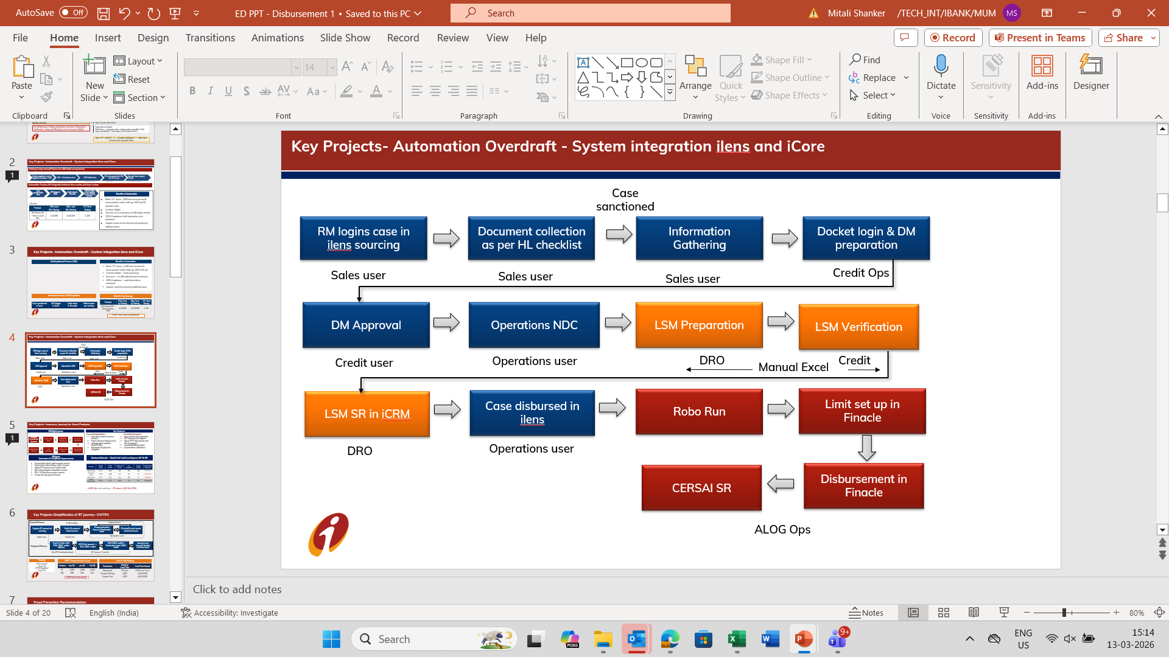
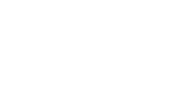
Key Projects- Automation Overdraft - System integration ilens and iCore
Existing Manual Process (LSM)
Benefits of Automation
z
Better TAT: Saves > 5,500 man hours/month across product, credit, credit ops, DRO & OD ops
Customer delight — faster processing
Zero error — no LSM maker/checker involvement
100% Compliance — audit observations minimised
Capacity saved for processing additional cases
Automated Process (API Integration)
Monthly Cost Savings
Case sanctioned
in iLens
→
API trigger
in iLens
→
Limit setup
in Finnacle
→
Fallout cases
per existing
Product | Print Cost (₹) Saving | Man Cost (₹) Saving | TAT (hrs) Saving
OD (Home OD + Money Saver OD) | 2,40,000 | 12,20,000 | 5,400
→
→
→
5,500+ man hours saved/month

Slide 4
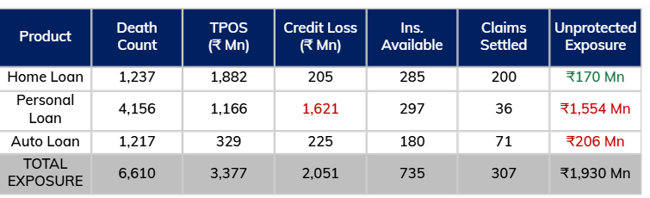
Charter
Key Projects- Insurance Journey for Asset Products
Credit Cards : Bounce Tend
Business Rationale — Death Trail Credit Loss Exposure (FY 24-25)
Key Features and Controls
Journey Standardization
Automation Introduced
Post-disbursement insurance initiation
Parent LAN auto-linking in iLens
Unified product workflow
Customer consent capture for Data Sharing and Policy issuance
Funding options
Self-funded
Bank funded
Auto customer data population
OTP-based consent capture
Secure SFTP data transfer with API development
Automated MIS generation
System-driven notifications
₹2,051 Mn total credit loss - PL alone: ₹1,621 Mn (79%)
E2E Digital Journey
Proposed Business Growth
Initiate Insurance Journey
iLens Data entry
Customer consent on TMA (OTP)
MIS auto-generated
Ops booking in FinnOne
Parent LAN linked
LAN generated
Policy issued digitally
Sr. No. | Loan Product | Total Premium, Cr. | Expected comission (Cr.)
1 | PL-BIL | 116.35 | 5.81
2 | AL | 49.22 | 2.461
3 | EL | 7.74 | 0.387
Assumptions: - Loan Tenure: 60 months, 45 yrs age - Avg. Premium is 1% of total loan sanctioned amount
Project Roadmap
1: FinnOne MIS Automation
2: Self-funding logic, MIS setup & New LOBs journey
3: Lead capture & PDD communication development
4. Insurance journey upgrade (iLens)
5. Complete API integration
Live
April 1st week
April 1st week
TBC
TBC

Slide 5
Key Projects-Simplification of BT Journey- OWTEN
Current Process
Underwriting
Disbursement
Capture BT amount at sourcing
Verify O/s amount basis bureau
Cheque printed in favour of destination bank
Physical/Courier based check hand over
Sales user
Credit user
Operations user
Fetch & Verify LAN, POS, CBDC wallet address
ICICI Pool account -> ICICI CBDC wallet
ICICI CBDC wallet-> Destination bank CBDC wallet
Accounts are closed & Settled real time basis
Proposed Process
BT Amount Transfer
Via API-Destination bank
Timeline
EXBT Cheque Issuance Count
Cost & Time Savings
Pilot Launch
April '26
API Integration
Sept '26
Product | Dec'25 | Jan'26 | Feb'26
PL | 4,658 | 5,198 | 5,159
BIL | 108 | 110 | 124
Particulars | Existing Cost/Time | Cost/Time Saved
Manpower | 30 mins | 2,600 man hours
Cheque Printing | ₹200 | ₹10,50,000
Courier Cost | ₹200 | ₹10,50,000
2,600 man hours saved

Slide 6

Fraud Prevention Recommendation
FD Lien Marking Automation
Currently FD Details are manually entered from c360
Auto populating FD details using API in ilens
Lien marking of FD at IGF submission
Validation at disbursement stage for mandatory lien marking
FD Lien marking cases
Product | Dec-25 | Jan-26 | Feb-26
EL | 29 | 34 | 25
BIL | 1 | 0 | 3
Digitization of society NOC verification via iLens
Sales user to visit property location
Capture photo(selfie) of Society Office/Name board
Capture Latitude & Longitude
Upload NOC document in iLens
Noc Verification completed with Lat &Long, date, time stamp
Reduction in fraud:
No cases reported post Oct'25

Slide 7
Fraud Prevention Recommendation- Seller Verification
C360 — Seller Verification via Bank Relationship
Previous Process flow- c360 Green
Add Seller and enter basic details of seller​
Select KYC mode- EKYC & Physical
Seller to share OTP
KYC Completed
Sales user
Sales user
Seller
System
Operational Challenges
RM to visit seller for verification — Increase in TAT
Seller refuses to share OTP — ZH approval needed
Revised Process flow
Add Seller and enter basic details of seller​
Select KYC mode- EKYC & Physical, C360
KYC mode c360
PAN + DOB match → Auto-verified ✔
Sales user
Additional KYC mode-c360 added
KYC Completed
160 C360 cases processed in Feb’26 — Faster: No OTP, no ZH approval required

Slide 8
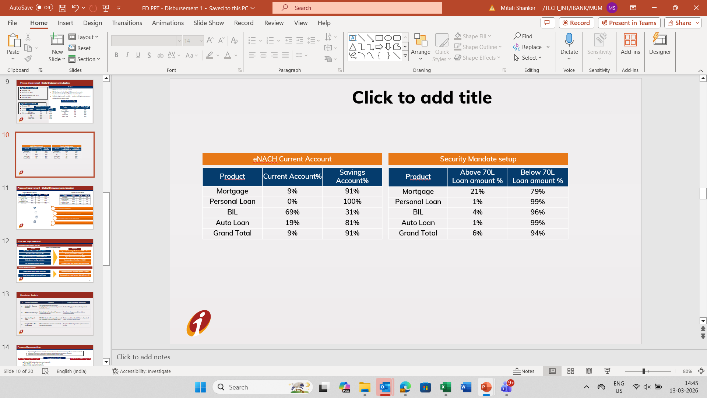
Process Improvement- Digital Disbursement Adoption
Digital Mandate Setup Feb’26
Enablers
Personal Loan 99%
Mortgage 97%
Business Instalment Loan 87%
Auto Loan 91%
ENACH for current accounts enabled
MIS development to track digital disbursement zone-wise
Security mandate for above ₹1Cr loan amount enabled
Collection tag in security mandate — enables debiting borrower account multiple times in case of default
Digital Disbursement Feb’26
Personal Loan 97%
Mortgage 78%
Business Instalment Loan 70%
Auto Loan 61%

Slide 9
Process Improvement
Auto Loan Disbursement Journey​
Current
Proposed
Manual entry of Repayment & Beneficiary details
Auto population basis logic — reduced FTNR & errors
Manual entry of Fees & Charges by RM
System generated Fees and Charges
Digital disbursement for Salaried & SEP only
Digital Journey Extended to SENP profiles, 8,459 cases(Feb'26)
eSign + eNACH Clubbed journey
Standalone journey for eSign and eNACH, 31% cases physical(Feb'26)
PSL Tagging sanction loan amount
PSL Tagging Basis asset cost & luxury asset criteria
Cheque Handover Process
Current
Proposed
Cheque Handover pending for more than 40 days
Cancellation process for cheques >40 days
Cheque date Manual update in Finnone
Auto updation of cheque handover date via finnone API

Slide 10
Process Decongestion – Delegation of Manual Approvals
Empowering the business center to take discretionary calls basis customer profile on case-to-case basis
Smoother processing of cases at a local level and bring about operational efficiency
Approvals have been removed and others delegated to local teams
Delegated to Zonal Heads
Delegated to Regional Heads
Physical NACH and physical disbursement approvals 33,792 cases from Dec'25-Feb'26
15th EMI Date for self employed profile
Physical Seller Verification for Mortgage: Count 645 cases (Feb’26)
Deduction of processing fees from loan disbursement amount
OD limit setup and Cheque / DD issuance
Manual SR for CERSAI report generation
Mortgage E-sign Deactivation access delegated to sales hierarchy : Avg. 23 deactivations per day (Jan’26)
Auto loan-Discontinuation of 10th /15th EMI cycle for North East, Odisha, Chhattisgarh, Nagpur, ROMG
Alternate MICR incase of mismatch from statement and system

Slide 11
Regulatory Projects
# | Regulatory Requirement | Description | System Development Implemented
01 | Section 20 — Common Directors | RBI guidelines prohibit banks from granting loans to own directors to prevent conflicts of interest | Section 20 tagging in Finnone for all products
02 | KFS Document Changes | Revised logic for Foreclosure/Prepayment as per RBI guidelines | Foreclosure charges moved from static to dynamic calculation
03 | Appraised Property Value | RBI 2014 circular: LTV computation should use 'Realisable Value' not 'Market Value' | Field renamed from 'Market Value' → 'Appraised Value' in Finnone Neo & Finacle
04 | Exception MIS — End Use of Funds | RBI mandates loan proceeds used strictly for sanctioned purpose | Exception MIS development to capture instances of error

