Slide 1
Image Classification with Feature Extraction Techniques
Machine Learning in Cyber Security (20CYS215)
R.Vekeshhari (ch.sc.u4cys23051)
Yeshwanth Raj (ch.sc.u4cys23052)

Slide 2
Introduction
Objective: Analyze different feature extraction techniques for image classification.
Dataset: MNIST and EMNIST for digit classification.
Feature extraction methods
- Histogram of Oriented Gradients (HOG)
- Local Binary Pattern (LBP)
- Edge Detection (Canny)
- Deep Learning (VGG16)

Slide 3
Datasets
MNIST Dataset: 60,000 training images and 10,000 test images of handwritten digits (0-9).
EMNIST Dataset: Extended version of MNIST that includes extra handwritten digits, used for evaluating model generalization.

Slide 4
Preprocessing
Conversion of images to NumPy arrays.
Feature extraction using HOG, LBP, Edge Detection, and Deep Learning (VGG).
Normalization of features using StandardScaler.

Slide 5
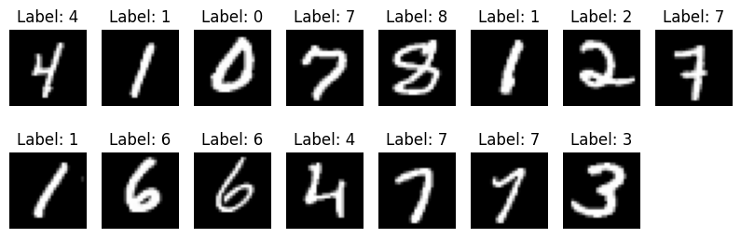
Sample Images from the Dataset

Slide 6
Feature Extraction Techniques
1. HOG (Histogram of Oriented Gradients):
- Captures edge and texture information.
- Used with Logistic Regression.
- Visualization of features.
2. LBP (Local Binary Pattern):
- Texture-based feature.
- Applied with KNN classifier.
- Visualization of features.
3. Edge Detection (Canny):
- Detects object boundaries.
- Used with Decision Tree Classifier.
- Visualization of edges.
4. Deep Learning (VGG16):
- Pre-trained CNN for feature extraction.
- Used with Random Forest Classifier.

Slide 7
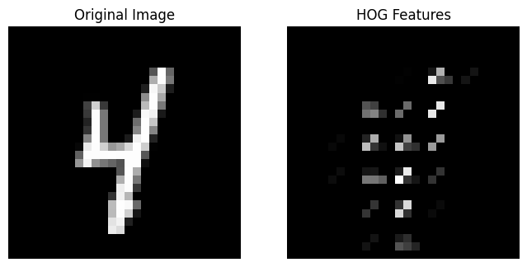
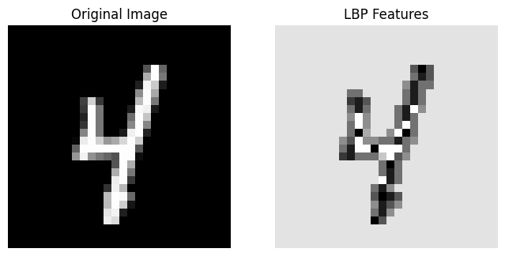
Sample Images after Feature Extraction
1. HOG (Histogram of Oriented Gradients):
2. LBP (Local Binary Pattern):

Slide 8
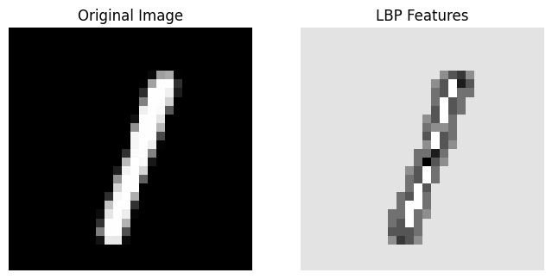
Sample Images after Feature Extraction
3. Edge Detection (Canny):

Slide 9
Model Training & Evaluation
Classifiers Used:
- Logistic Regression (HOG)
- K-Nearest Neighbors (LBP)
- Decision Tree (Edge Detection)
- Random Forest (Deep Learning)
Metrics:
-Accuracy
- Precision
- Recall
- F1-Score

Slide 10
Robustness Testing
Added noise (image becomes slightly blurry or grainy).
Rotated images by 15 degree.
Blur the images.
Extracted the features using HOG, LBP, Edge Detection, and VGG after applying robustness.

Slide 11
Feature Extraction & Training Time Analysis
HOG had the second-highest feature extraction time (60.20s) but delivered the highest accuracy (97.23%).
LBP was the fastest feature extraction method (19.72s) but resulted in a moderate accuracy (83.26%).
Edge Detection (Canny) was poor in both accuracy and time taken for future extraction.
Deep Learning (VGG16) had the longest feature extraction time (858.24s) but performed well with 92.07% accuracy.
Training times for Random Forest on Deep Learning features taking the longest (116.07s) due to complex feature extraction and high-dimensional data.
Training times for KNN on LBP being the fastest (0.14s) because it requires
no explicit training, only storing and comparing feature vectors.

Slide 12
Robustness Analysis: Impact of Noise, Rotation and Blur
Deep Learning (VGG16) takes significantly longer time (386.93s) compared to HOG (26.85s), LBP (9.81s), and Edge Detection (9.73s).
HOG is the most robust traditional feature extractor but struggles significantly under distortions.
LBP is computationally efficient but performs poorly under all transformations

Slide 13
Key Insights
1. Baseline Performance on MNIST
HOG features achieved the highest accuracy (97.23%), indicating strong discriminative capability for handwritten digit classification.
Deep Learning features (VGG16) followed closely with 92.07% accuracy, demonstrating effective feature representation despite the model's complexity.
LBP (83.26%) and Edge Detection (74.81%) lagged behind, suggesting that these traditional methods capture less distinctive information for MNIST.

Slide 14
2. Generalization to EMNIST
All methods experienced a significant drop in accuracy on the EMNIST dataset, indicating challenges in generalizing beyond the MNIST dataset.
Deep Learning features performed best on EMNIST (20.67%), hinting at their potential for capturing more transferable features, although overall performance remained low.
HOG, LBP, and Edge Detection features resulted in near-random performance on EMNIST, emphasizing the difficulty in transferring learned features from one dataset to another with different character distributions.

Slide 15
3. Overfitting, Underfitting, and Model Complexity
Deep Learning exhibits signs of overfitting: While it performs well on MNIST, its poor generalization to EMNIST and sensitivity to distortions suggest that it may have learned dataset-specific features.
HOG features, despite their high baseline performance, struggle with robustness and generalization, indicating a potential over-reliance on features specific to MNIST.
LBP and Edge Detection, while less complex, appear to underfit the data, failing to capture enough nuanced information for robust performance across varying conditions.

Slide 16
Conclusion
HOG stands out on MNIST for its high accuracy but lacks resilience under image distortions and generalization to different datasets.
Deep Learning (VGG16) provides powerful feature extraction, yet its tendency to overfit and inconsistent robustness underlines the need for strategies that improve generalizability.
LBP and Edge Detection offer limited performance, with Edge Detection showing marginally better robustness despite lower baseline accuracy.
Overall, no single method is optimal across all scenarios—there is a clear trade-off between accuracy, robustness, and generalization

