Slide 1
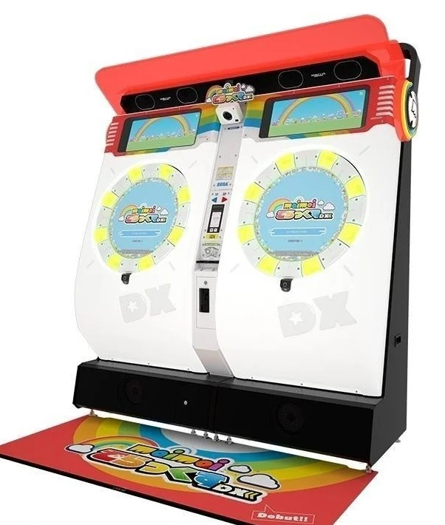
Maimai

Slide 2
1.History(Version)
Maimai(2012)
GreeN
PiNK
Maimai DX(2019)
Splash
Milk
MURASAKi
Universe
Festival(2022)
ORANGE
FiNALE(2018)
In China
DX2021
DX2022

Slide 3
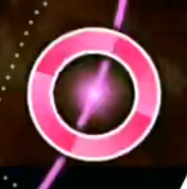
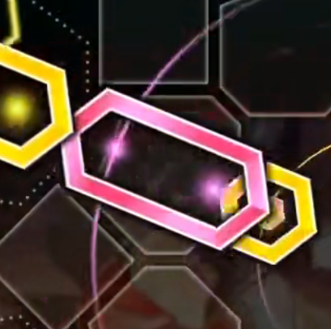
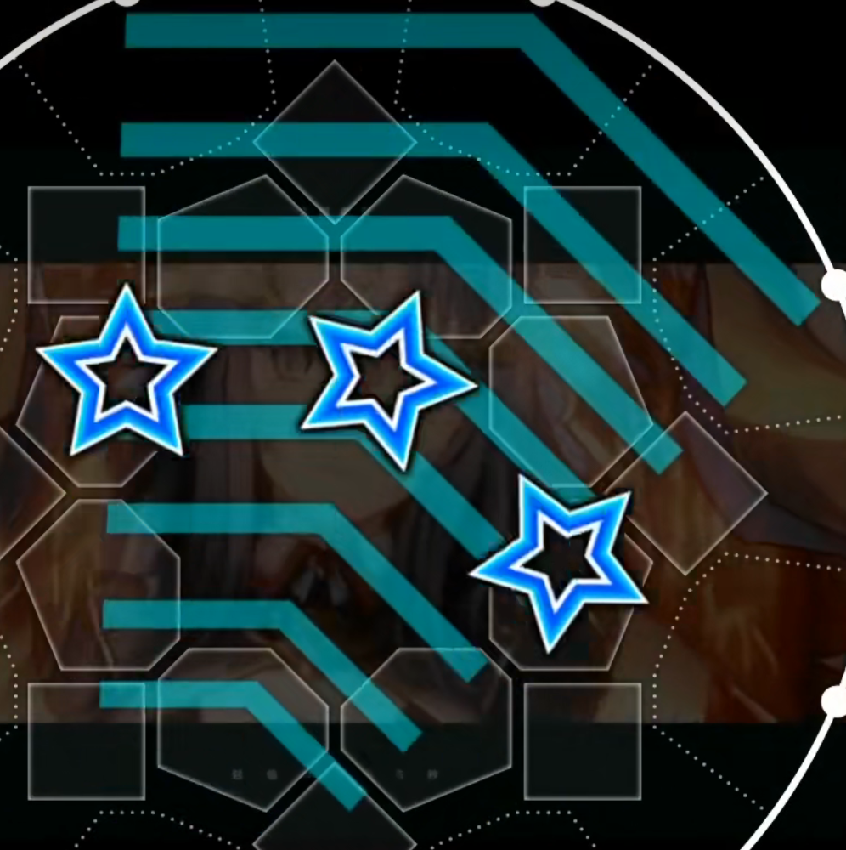
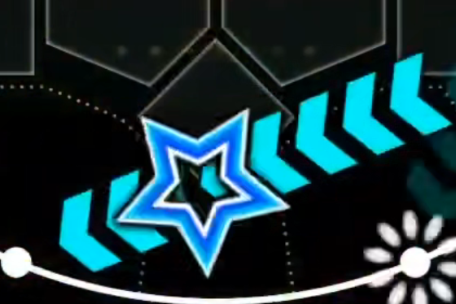
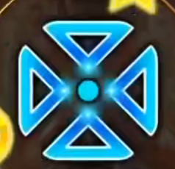
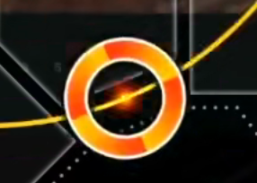
2.Notes:
1.TAP
2.HOLD
3.SLIDE
4.TOUCH
5.BREAK

Slide 4
3.Frame
1.key
2.screen
3.card reader
4.earphone hole

Slide 5
4.Chart
difficulites
Basic(Green)
Expert(Red)
levels
1
15
Advance(Yellow)
Master(Purple)
Re:Master(White)

Slide 6
5.Kinds of songs
Pop’n
Vocaloid and niconico
Original(3)
VARIETY
Touhou Project

Slide 7
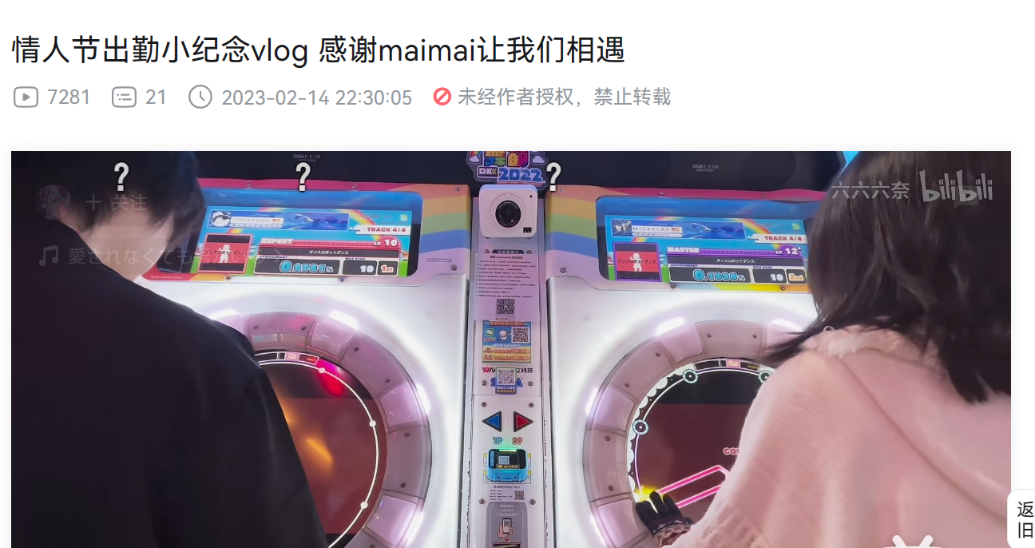
6.Social
My story
Others’ stories

