Slide 1

Algorithms of Oppression: How Search Engines Reinforce Racism
Author: Safiya Umoja Noble
Presentation by: Richmond Yevudza
Notes:
Hello, everyone. Today, I'm excited to share with you a very thought-provoking book titled "Algorithms of Oppression: How Search Engines Reinforce Racism" by Safiya Umoja Noble, a scholar who specializes in digital media and the intersection of race, gender, and technology.

Slide 2
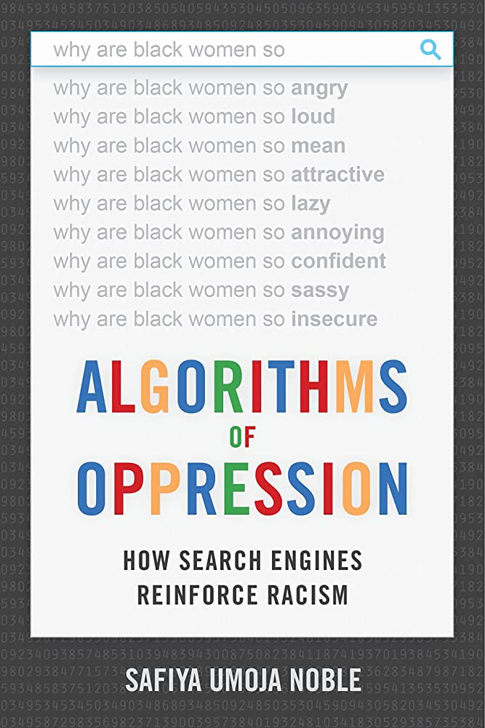
Introduction
Algorithmic biases in search engines
Importance of addressing biases
Notes:
"Algorithms of Oppression" is a groundbreaking book that takes a deep dive into the world of search engines, exploring how algorithmic biases shape our understanding of information and contribute to the reinforcement of systemic racism and sexism. The book emphasizes the importance of addressing these biases to create a more equitable and inclusive digital environment.

Slide 3

The Problem with Search Engines
Shaping our worldview
Biases and consequences
Racist and sexist search results
Notes:
Search engines are powerful tools that have become an integral part of our lives, acting as the primary source of information. However, the algorithms behind these platforms are not as objective as we might believe. Biases within search algorithms can lead to harmful consequences, such as racist and sexist search results, misrepresenting marginalized communities, and maintaining stereotypes.

Slide 4


How Algorithms Reinforce Racism and Sexism
Role of data in biases
Commercialization of search engines
Myth of neutrality
Notes:
You might wonder how algorithms can reinforce racism and sexism. The answer lies in the data that algorithms rely on to make decisions. If the data is biased, the algorithms will produce biased results. Additionally, the commercialization of search engines, driven by advertising revenue, can further skew results towards sensationalism and stereotypes. The myth of technological neutrality, which suggests that algorithms are inherently unbiased, worsens these issues, as it prevents us from critically examining the systems we use daily.

Slide 5
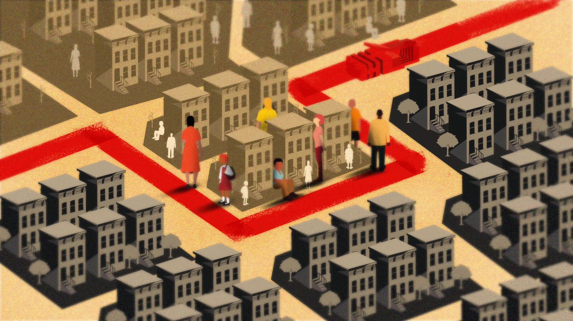
Digital Redlining & Algorithmic Discrimination Cycle
Definition and historical context
Search engines' role
Impact on marginalized communities
Reinforcing stereotypes
Feedback loop of discrimination
User behavior's role
Notes:
Digital redlining is the online counterpart to historical redlining practices, where marginalized communities experience limited access to information, services, and opportunities. Search engines play a significant role in this phenomenon by maintaining biases and reinforcing stereotypes. This creates a feedback loop of discrimination, where biased algorithms generate biased results, which in turn influence user behavior, further reinforcing the biases and worsening inequalities.

Slide 6

Case Studies
"Black girls" search results
Biased auto-complete suggestions
Real-world consequences
Notes:
Noble provides several case studies to illustrate the real-world consequences of algorithmic bias. For instance, she highlights how searching for "black girls" can yield inappropriate and objectifying results, perpetuating harmful stereotypes. Another example is the biased auto-complete suggestions, which often reflect and reinforce existing prejudices. In one case, a search for "why do black women" yielded offensive suggestions, demonstrating how biases in algorithms can have significant consequences on people's perceptions.

Slide 7

Possible Solutions & Noble's Recommendations
Policy changes and regulation
Diversity in tech
Media literacy and critical thinking
Breaking up tech monopolies
Public interest search engines
Algorithmic transparency
Notes:
To address algorithmic bias, Noble offers a range of recommendations. These include advocating for policy changes and regulation to hold tech companies accountable, promoting diversity and inclusion within the tech industry to create more representative algorithms, fostering media literacy and critical thinking skills to empower users to question and challenge biased search results, breaking up tech monopolies to encourage a more diverse and competitive market, developing public interest search engines that prioritize accuracy and relevance over commercial interests, and increasing algorithmic transparency to help users better understand how search results are generated.

Slide 8

The Role of Education and Community
Digital literacy in schools
Community discussions
Reporting biased search results
Public debates
Notes:
Noble also emphasizes the importance of education and community involvement in addressing algorithmic bias. By teaching digital literacy in schools and organizing community discussions, we can raise awareness and promote a more critical approach to our engagement with search engines. Encouraging users to report biased search results and engaging in public debates can also help drive change in the tech industry.

Slide 9

Implications and Future Directions
Equitable and inclusive digital tools
Broader impact on AI technologies
Call to action
Notes:
The insights presented in "Algorithms of Oppression" have far-reaching implications for the development and use of search engines, as well as other AI-powered technologies. By understanding the biases embedded in these systems, we can work towards creating more equitable and inclusive digital tools that serve everyone fairly. Furthermore, this book serves as a call to action for individuals, communities, and policymakers to actively engage in addressing algorithmic biases and their consequences.

Slide 10
Reasons to Read and Not to Read
Read: Awareness, case studies, critical thinking, recommendations, diversity
Not read: Background knowledge, criticism vs. solutions, technical focus
Notes:
In summary, there are several reasons why you should consider reading this book: it raises awareness of the biases in search engines, provides insightful case studies, fosters critical thinking skills, presents actionable recommendations, and highlights the importance of diversity in tech.
However, there are also reasons why you might decide not to read this book. First, it may require some background knowledge in the field to fully grasp the concepts discussed. Additionally, the book tends to focus more on criticism of the current state of search engines and their inherent biases, rather than extensively exploring potential solutions. As a result, some readers may find it less solution-oriented than they would prefer.

Slide 11

Conclusion
Recap of key points
Significance of addressing biases
Notes:
Thank you for your attention. I hope this presentation has provided you with a comprehensive overview of "Algorithms of Oppression" and helped you decide whether or not it's a book you'd like to explore further. By understanding the biases and inequalities that exist within the digital tools we rely on, we can work together to create a more just and inclusive society.

