Slide 1
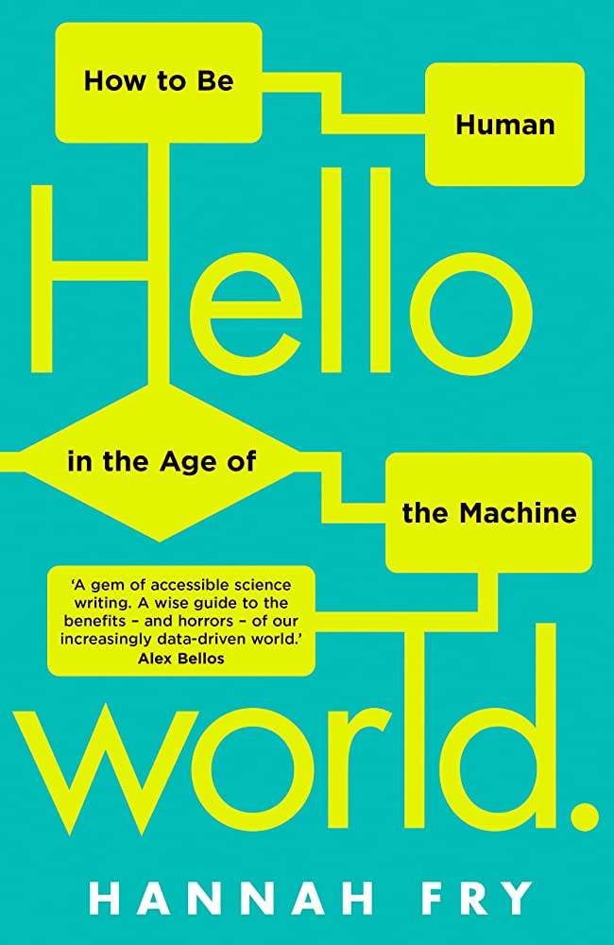
Data 303 Presentation
Presented by Yuqian Wang
Hello World:
How to be Human in the Age of the Machine
By Hannah Fry

Slide 2
Summary of the Big Ideas
The relationship between humans and machines is evolving, and it is important to consider how we can work together to achieve human goals
The nature of prediction is built on mathematical models, and justice is not part of prediction
Using AI and algorithms means having to give answers to historical debates about morality and philosophy

Slide 3
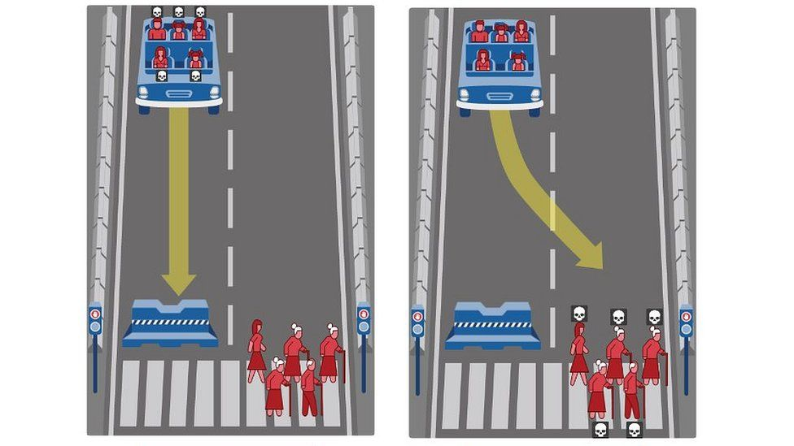
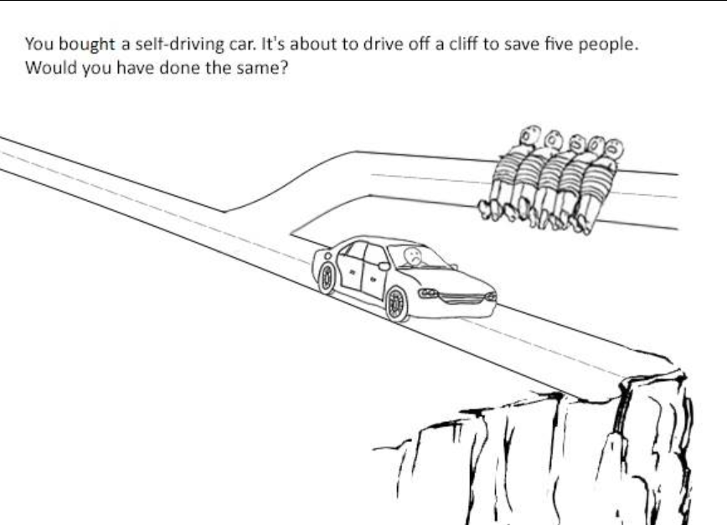
Trolley Problem in Self-Driving Cars
Notes:
The "trolley problem" scenario for a self-driving car is, in the event of an accident, whether the car will prioritize protecting the occupants and hitting pedestrians, or prioritize protecting pedestrians on the road and putting the occupants in danger.

Slide 4
Response to Trolley Problem
This question directly challenges our view of algorithms making value judgments about our own lives and the lives of others, because algorithms will prioritize protecting their own users when there is no better solution.
Notes:
Fry argues that if manufacturers do devise an algorithm that sacrifices themselves to save others, they could be heavily liable for it, since it is illegal to harm consumers.
Therefore, Fry suggests that since each individual has his or her own moral considerations, allowing people to develop their own individualized ethical solutions for algorithms to practice may help certain groups in real life.

Slide 5
Algorithms Biases
“Try searching ‘math professor’ in Google … 94 per cent of math professors are male. But however accurate the results might be, you could argue that using algorithms as a mirror to reflect the real world isn’t always helpful, especially when the mirror is reflecting a present reality that only exists because of centuries of bias. Now, if it so chose, Google could subtly tweak its algorithm to prioritize images of female or non-white professors over others, to even out the balance a little and reflect the society we’re aiming for, rather than the one we live in.”

Slide 6
Interesting Points
What we should be more worried about is not machines becoming people, but people becoming machines
Artificial intelligence is all about old algorithms running on high-speed computers

Slide 7
Recommendation
But… Great for Data 101 student

