Slide 1

Algorithms of Oppression: How Search Engines Reinforce Racism
Author: Safiya Umoja Noble
Presentation by: Richmond Yevudza

Slide 2
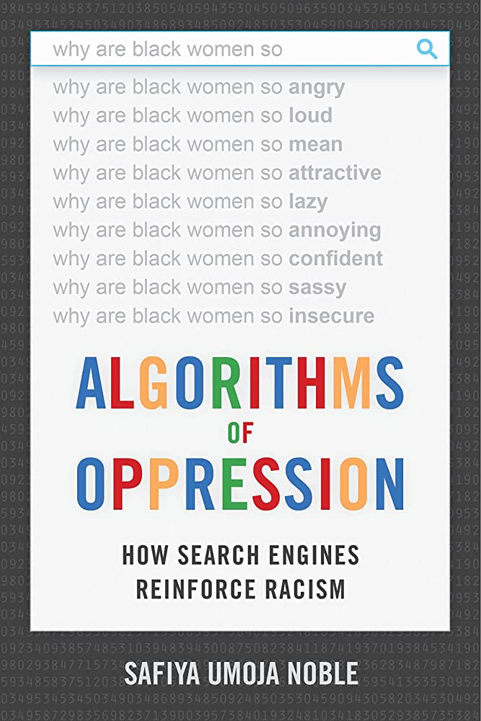
Introduction
Algorithmic biases in search engines
Importance of addressing biases

Slide 3

The Problem with Search Engines
Shaping our worldview
Biases and consequences
Racist and sexist search results

Slide 4


How Algorithms Reinforce Racism and Sexism
Role of data in biases
Commercialization of search engines
Myth of neutrality

Slide 5
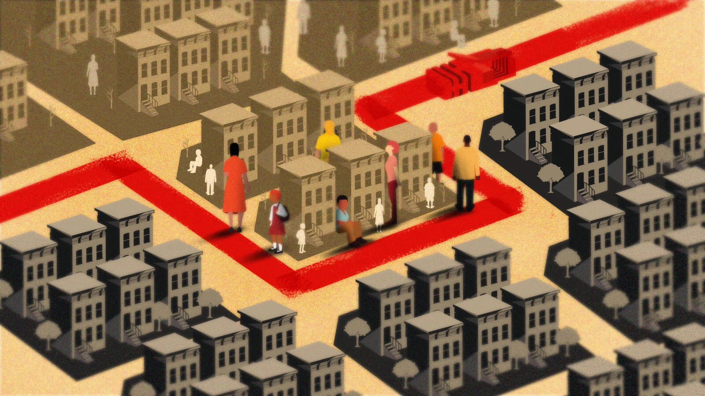
Digital Redlining & Algorithmic Discrimination Cycle
Definition and historical context
Search engines' role
Impact on marginalized communities
Reinforcing stereotypes
Feedback loop of discrimination
User behavior's role

Slide 6

Case Studies
"Black girls" search results
Biased auto-complete suggestions
Real-world consequences

Slide 7

Possible Solutions & Noble's Recommendations
Policy changes and regulation
Diversity in tech
Media literacy and critical thinking
Breaking up tech monopolies
Public interest search engines
Algorithmic transparency

Slide 8

Conclusion
Recap of key points
Significance of addressing biases
Call to action

Slide 9
Reasons to Read and Not to Read
Read: Awareness, case studies, critical thinking, recommendations, diversity
Not read: Background knowledge, criticism vs. solutions, technical focus

