Slide 1
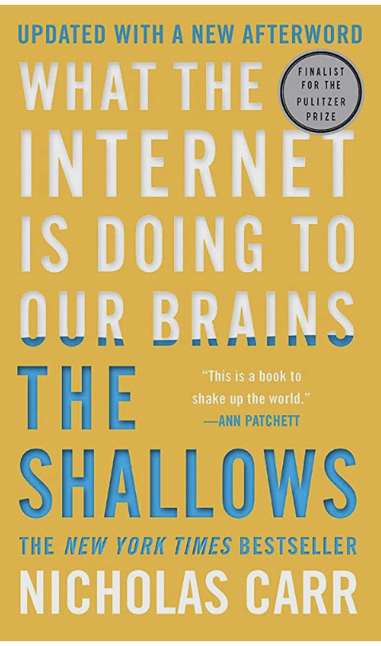
“The Shallows”
Nicholas Carr

Slide 2
Introduction
Early Life
Adulting with technology
Notes:
Began in life with no technology
Went to Dartmouth and was introduced with on of the first computers, ever now and then he would play games in there
He became an early adopter of technology, buying the first Macintosh and spending lots of money keeping up with the newest technology
Realized in the early 2000s that there were effects that he hadn’t noticed before such as loss of concentration and impatience

Slide 3
Neuroplasticity
“Our ways of thinking, perceiving, and acting, we know now, are not entirely determined by our genes. Nor are they entirely determined by our childhood experiences. We change them through the way we live – and, as Nietzsche sensed, through the tools we use” (38).
“Every technology is an expression of human will through our tools, we seek to expand our power and control over our circumstances” (49).
Notes:
The old view of our brains is that from birth, our brains are set in stone and do not change much
Nietzsche was ahead of his time thinking that the way our brain functions changes with the tools we use.
A few studies were cited to prove the neuroplasticity
Repeated action help require out brain. A famous quote “Cells that fire together wire together”
Carr then talks about the different tools used throughout history sch as compasses and maps and the evolution of these over time

Slide 4
Loss of Brain Dependency and Memory
Since mankind began writing down their thoughts, we have slowly lost our dependency on our brain and memory
Knowing where we stored information may serve us better, and allows access to much more information quicker
Notes:
People became accustomed wot writing down their thoughts, so they did not to have memorize as much as they used to. Stories used to be carried by word of mouth, then books and writings, and now a new medium: technology
Push back of using our brain more as a table of contents, we have to change with the time and we have access o more information more quickly

Slide 5
Technology and Humanity
We are creating technology to become more like us
We are in a feedback loop with technology
“what makes us most human, is what is least computable about us” and our “emotion and empathy” (182)
Notes:
The lines between us are becoming more blurred and we are encouraging this technological process
“We program Computers and therefore they program us” (187)

Slide 6
Call to Action
Do not go easy into this new technological age
01
Ask questions
02
Be conscious of what we might lose
03
Notes:
We are not yet aware of the effects of this new age we are entering
There are some bigger questions that need to be asked such as how much influence do computer programmers have on us today, how we think, and how we get our information
The potential loss of our humanity, free will, and brain functionality
As a Christian, we need to have discernment in how we use technology and how we let it affect our thinking and our brains. The internet has a way of subtly influencing you, so being aware of this is crucial

Slide 7
Recommendation
For those who are interested in the effect of technology on our brains and the way we think
Great thought-provoking topics and concepts
Well researched yet does not feel like a research paper
Notes:
For those that feel that technology is affecting their brains and the way they think.
Had a lot of through-provoking concepts and provided a broad overview of how we got here
This was a very easy read for the most part. It was well researched yet did not feel like you were reading a research paper
It did have a few interruptions or digressions from the author but other than that, it flowed well

Slide 8
Questions?

