Slide 1
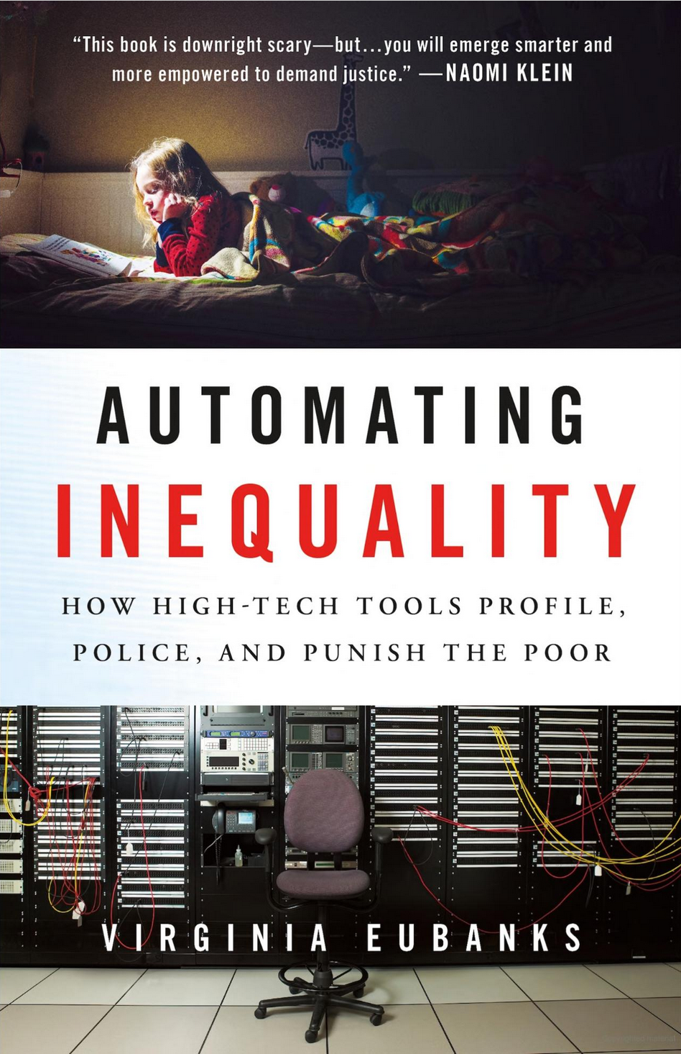
Automating Inequality by Virginia Eubanks
Andrew Hill

Slide 2
From Poorhouse to Database
Since the birth of the US, systems have been in place to discriminate against the poor and those less fortunate.
Although poorhouses have since closed, negative attitudes towards poverty have persisted
Discrimination is now hidden within computer systems.

Slide 3
Automating Public Services in Indiana
Indiana instituted an automated social program eligibility system in the late 2000s
Even the smallest mistake led to a “failure to cooperate”
Thousands of people lost aid that they desperately needed
The state refused to listen to their complaints
The system became a means of discrimination against poor and working-class Americans, with their fundamental human rights denied by authorities that refused to listen to them
Data scientists need to consider all potential harm that technological systems may cause
Data scientists need to constantly be analyzing how their systems are affecting its users

Slide 4
High-Tech Homelessness in Skid Row
The city uses the Vulnerability Index-Service Prioritization Decision Assistance Tool (VI-SPDAT)
Determines who needs housing the most
To use the program, consent is needed to share data with other agencies, including the police department
It is unclear why individuals are scored the way they are
Prison stays count as recent housing
This system does the opposite of its intent, instead trapping individuals in their situation
Data scientists need to be transparent on how their models make decisions
Data scientists need to be responsible with the data they collect

Slide 5
Child Abuse in Alleghany County
A screening tool is used to predict instances of child abuse
Validated using historical data
The system is trained on historical data which is sources from agencies that serve low-income and working-class families
Since the tool’s validation is based on historical data, it tends to flag more cases of abuse and neglect among low-income families, leading to a disproportionate number of investigations.
These results go back into the system, creating a feedback loop
There is worry that indicators of child abuse in professional middle class families will not show up
Data scientists must treat all equally

Slide 6
Recommendation
Automating Inequality is a must read for data scientists or anyone interested in the intersection of technology and social justice
Eubanks visited all the locations that she wrote about, so the book consists of lots of mini stories, which keeps it interesting.
She does let her political beliefs bleed through, but it doesn’t detract from its purpose and conclusions

