Slide 1
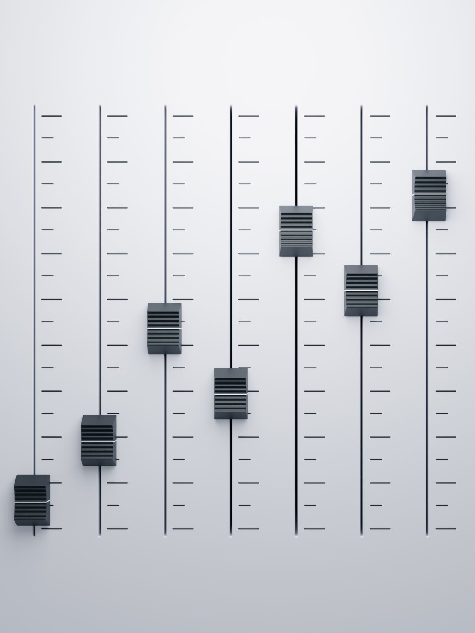
Task Vectors as semantic sliders for text generation
Department of Linguistics and Philology
Master Programme in Language Technology
Supervisors:
Fredrik Wahlberg, Uppsala University
Hillevi Hägglöf, Avega Group AB.

Slide 2
Introduction
Research Questions
Can we control the level of toxicity in a text generated by a GPT-2 small model using a single task vector?
How can we navigate a generated vector space defined by one gender- and one race-task vector, and what constraints limit movement within this space?

Slide 3
Background
Current Techniques
Prompt engineering: Requires manual tuning
Adapters & LoRA: Need retraining and architectural changes

Slide 4
Background
Task Vectors: A Lightweight Alternative
Directly operate in the model’s parameter space
Represent directional shifts in learned behavior
Do not require retraining or architecture changes
Offer an interpretable, modular way to guide model outputs

Slide 5
Data
Replication experiment
- 2000 civil comments
Second experiment
- 2000 civil comments categorized as female
- 2000 civil comments categorized as black

Slide 6
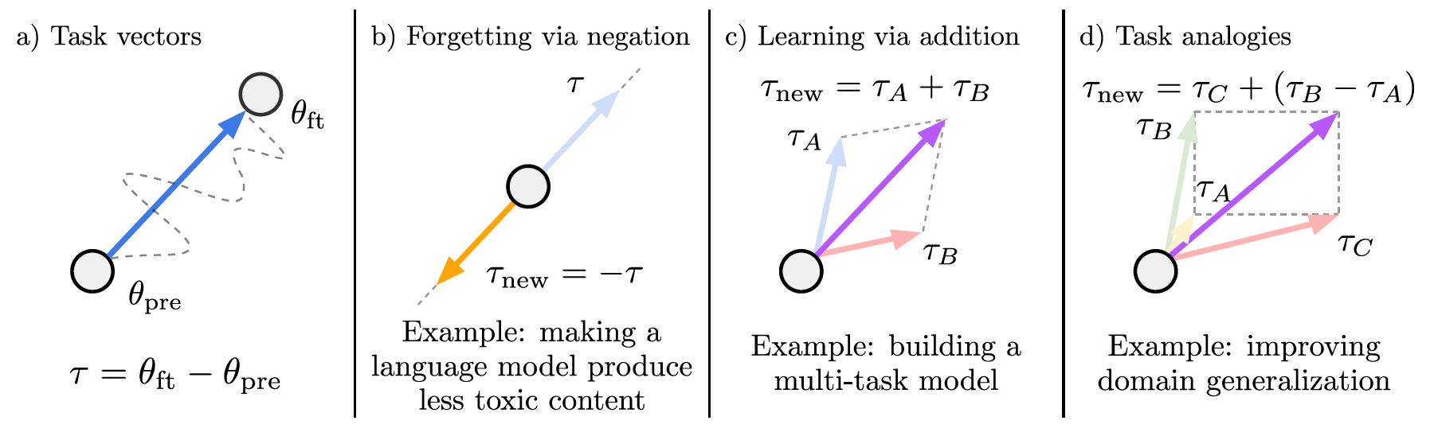
Methodology
One Vector: 𝜃𝑛𝑒𝑤 = 𝜃𝑝𝑟𝑒 + 𝜆 ・ 𝑇
Two combined Vectors: 𝑇𝑛𝑒𝑤 = 𝑇A + 𝑇B

Slide 7
Base-model
GPT-2
Trained on ~8M web pages, 117M parameters
Decoder-only model
Strong benchmark performance despite size
Used in this study for finetuning, generation and evaluation

Slide 8
Experimental setup
GPT-2 small and toxic data for finetuning
Saved pretrained & finetuned weights
Created task vectors by scaling differences (-1 to 1, step 0.1 → 20 models)
Generate text with prompt ”you’re a real”.

Slide 9
Evaluation metrics
Perplexity
Detoxify
LLM-as-a-judge

Slide 10
Expected results
Near-linear changes in toxicity
Predictable semantic shifts
Additive and composable effects

Slide 11
Results, Replication

Slide 12
Results, Further experiments
Left: Gender, Right: Race

Slide 13
Results, Further experiments
Proportion of 1,000 samples that include at least one matched term using a case-insensitive regular expression.

Slide 14
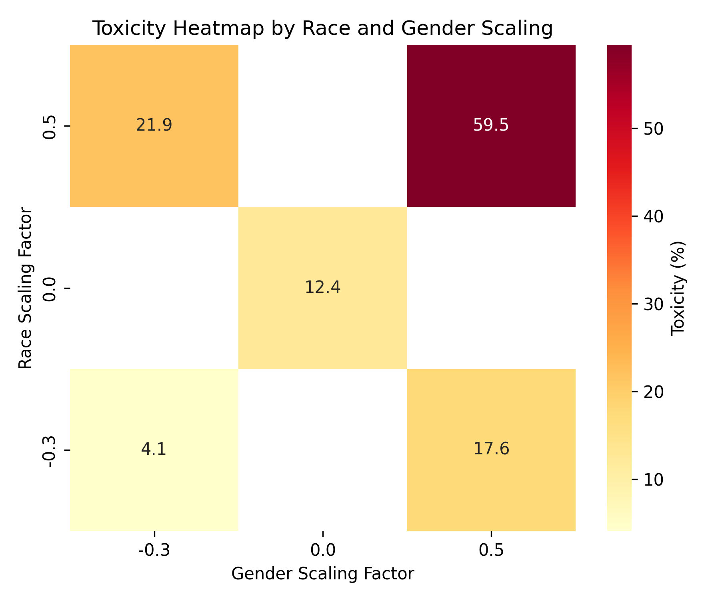
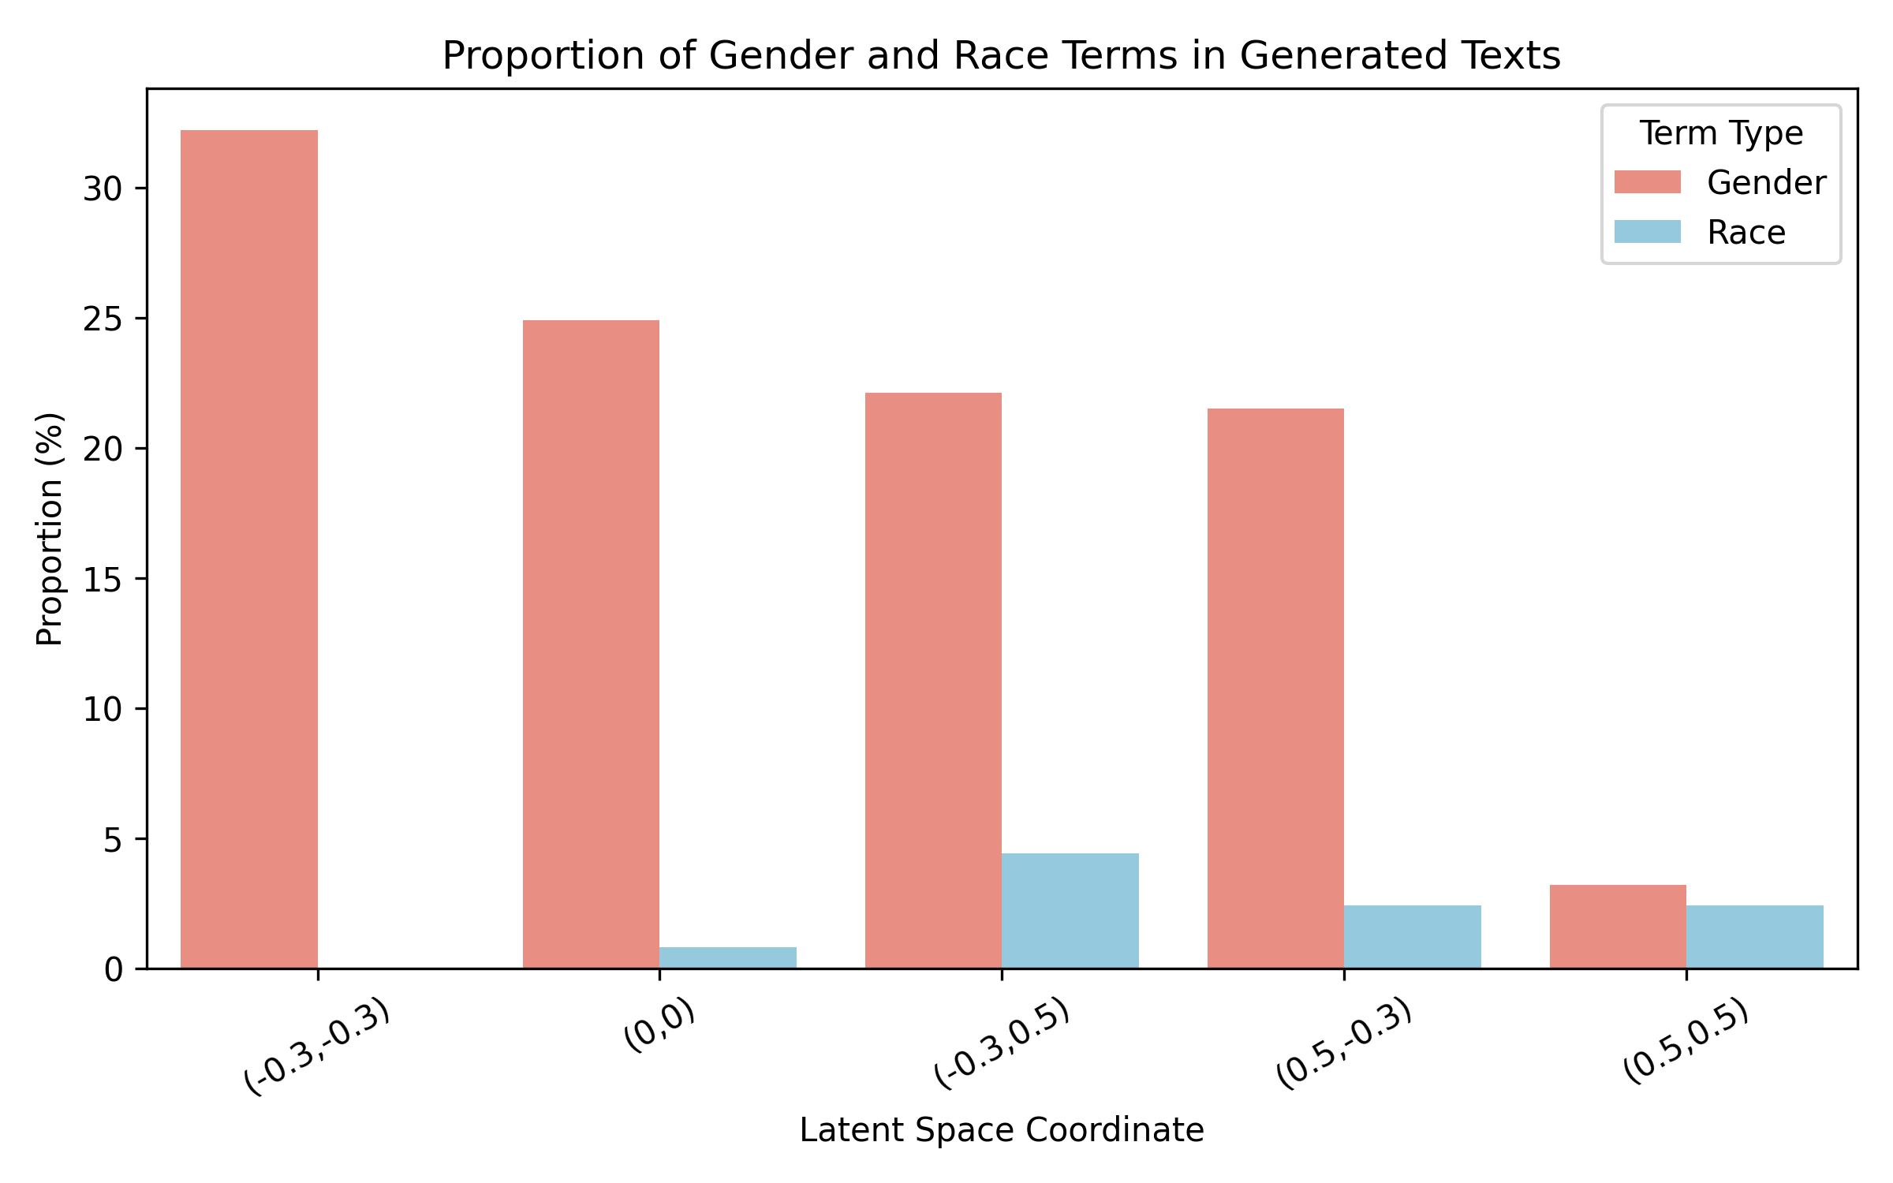
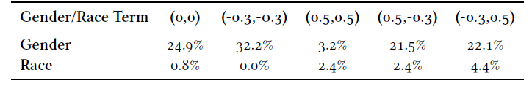
Results, Further experiments

Slide 15
Conclusions
Research Question 1
Can we control toxicity using a single task vector? → Yes. Increasing the scaling factor raised toxicity levels in GPT-2 small outputs.
The effect was non-linear, plateauing at higher values.
Perplexity remained stable at moderate scales — suggesting a “sweet spot” for control without sacrificing fluency.
Research Question 2
How do gender and race task vectors interact in vector space? → Partially additive effects.
Combining vectors enabled dual control across identity axes.
Interactions were not always linear or symmetric, with some combinations producing unexpected effects.
Suggests a navigable but constrained vector space with complex dynamics.
Key Takeaways
Task vectors allow meaningful, interpretable control over LLM output.
Compositionality is possible, but subject to model-specific constraints.
Future work should explore:
More granular control dimensions
Generalization across tasks, datasets, and architectures.

Slide 16
Thank you!

