Slide 1
Predicting Video Game Success Using Machine Learning
Abeil Tedla
CIS 3715 - Principles of Data Science

Slide 2
Topic and Objective
Predict whether a game is a hit
Hit is ≥ 1 million global sales
Identify key factors driving success

Slide 3
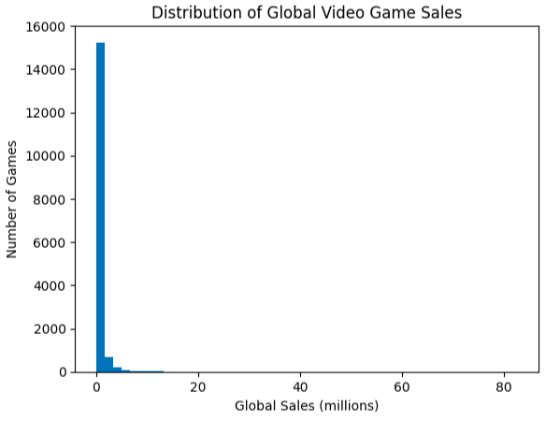
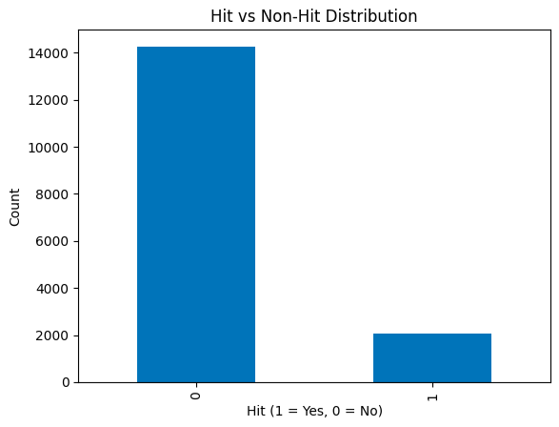
Description of Data
Video Game Sales Dataset from Kaggle
16,598 games → 16,327 after cleaning
11,493 uniques
Features
Name, Platform, Genre, Publisher, Year
Regional sales (removed for modeling)
Target
Hit vs. Non-Hit
12.6% are Hits

Slide 4
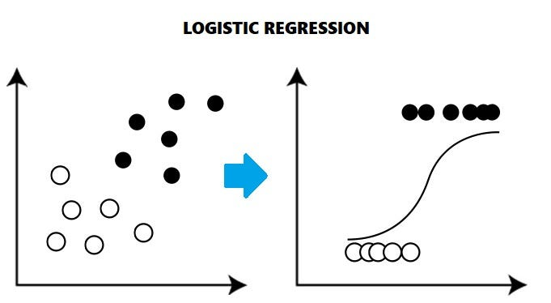

Description of Model
Models used
Logistic Regression
Decision Tree
Model Pipeline
Reduced publishers → Top 10 + “Other”
One-hot encoding (Platform, Genre, Publisher)
Created MultiPlatform features
Removed sales features to prevent leakage
Techniques
Train/test split (80/20)
Feature scaling for Logistic Regression
Class weighting

Slide 5
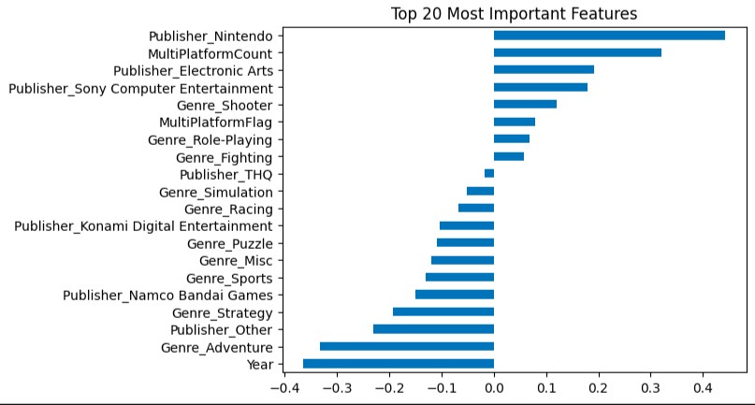

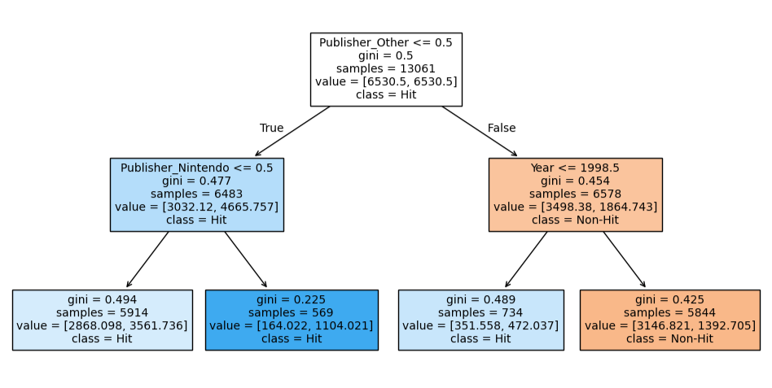
Results
Logistic Regression Performance
Accuracy: 71.3%
Recall: 70.6%
F1-Score: 0.36
The most important factor in predicting game success is whether the game is published by a major publisher. Among major publishers, Nintendo stands out as a unique case, reflecting its strong ecosystem of exclusive titles. For smaller publishers, success is strongly influenced by release year, with older games having a higher likelihood of becoming hits.

Slide 6


