Slide 1
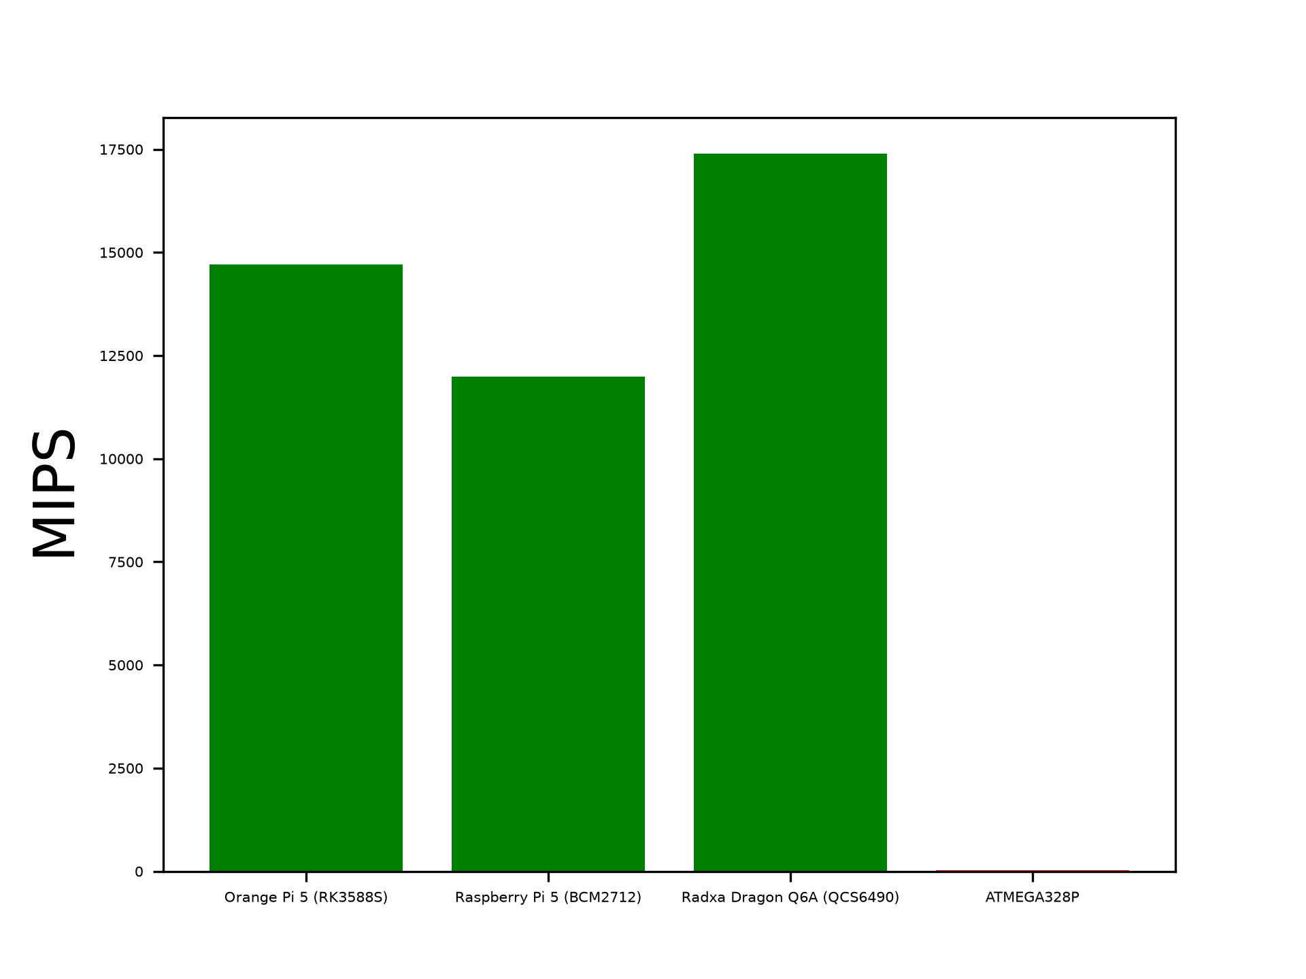
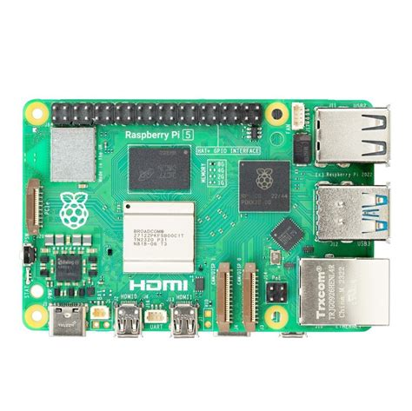
Micro computing
Why Not A Micro controller?
While micro controllers are incredibly power efficient, inexpensive and easy to use, there is many reasons why we decided against their usage in this project. Firstly, they’re rather weak, as demonstrated in fig. 1.0, when comparing MIPS (Million Instructions Per Second) even a fairly weak micro computer easily beats out the ATMEGA328P, which is a fairly weak micro controller, but the point still stands.
https://sbc.compare/rockchip-rk3588s
https://sbc.compare/raspberry-pi-5?runs=2:168
Real scaled raspberry Pi for scale.

