Slide 1


REVOLUTIONIZING student ACCOMMODATIONS WITH

Slide 2


Welcome to The future
Welcome to the culmination of StudentSmart Rentals . What began as a concept to streamline student life has now become a reality, revolutionizing how students at Indiana University Bloomington access rental services.

Slide 3
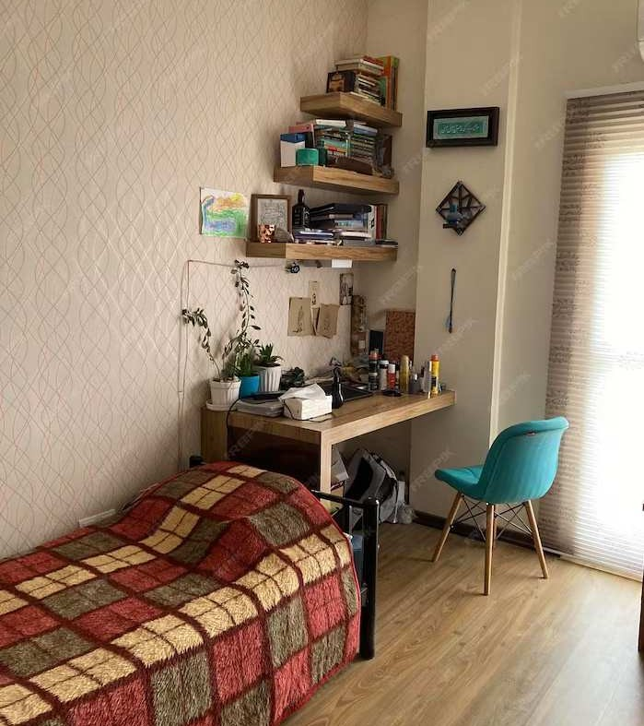
service overview
Our platform now boasts a wide array of features, meticulously designed to carter to the diverse needs of students. From detailed property listings with multimedia support to interactive map views and user evaluations, we’ve created a user-friendly experience. The integration of essential moving-in services is a testament to our commitment to providing a holistic rental solution

Slide 4

TECHNICAL ADVANCEMENTS
At the core of StudentSmart Rentals is our robust MERN Stack, enhanced with Firebase for superior security and data handling.
This technical foundation has allowed us to build a responsive and scalable platform

Slide 5

SERVICE IMPLEMENTATION
DEMO

Slide 6

CONCLUSION AND FUTURE OUTLOOK
As we look forward, StudentSmart Rentals stands as a testament to our dedication to improving student life. Our journey has set the stage for future expansion and continued innovation in the student rental market.

Slide 7
Thanks!
Do you have any questions?

