Slide 1
Introduction to Azure Logic Apps
Velin Georgiev

Slide 2




Who’s this guy?
Senior SharePoint Developer at
Tech Junkie
Blogs:
velingeorgiev.pro
sharepoint.bg
Twitter: @velingeorgiev
Contributor

Slide 3
Agenda
Introduction
Demo 1 – Logic Apps from scratch and the designer
Logic App menus (blades) overview
Demo 2 – Business approval workflow
Demo 3 – Custom API and real time reporting
Q & A

Slide 4
What are Logic Apps
Automate common tasks
Connect existing apps to SaaS providers
Nothing to install
Drag and drop designer. No coding
Can extend with your custom API apps (hybrid)
Exposes many BizTalk APIs for expert integration scenarios

Slide 5
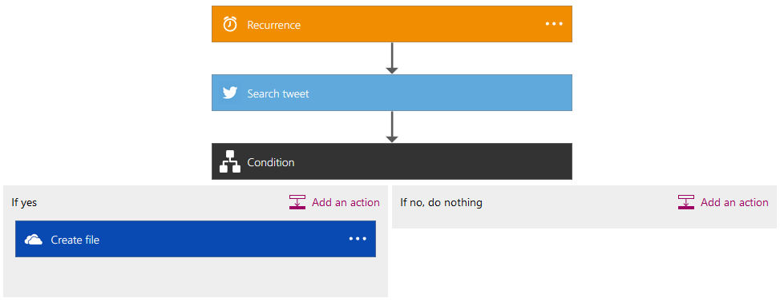
Demo: The Logic Apps Designer
Search for Tweets once per hour
Save Tweets to OneDrive

Slide 6
Workflow Definition Language
{
"parameters": { ... },
"triggers": {
...
},
"actions": {
...
},
"outputs": { … }
}
https://msdn.microsoft.com/en-us/library/azure/mt662474.aspx
JSON as native language
Rich expression language

Slide 7
Parameters
Re-using values or objects
Separate out config from the definition itself
"parameters": {
"<parameterName>": {
"type": "<type-of-parameter-value>",
"defaultValue": "<optional-default-value-of-parameter>",
"allowedValues": [ "<optional-array-of-allowed-values>" ]
}
}

Slide 8
Triggers
Evaluated at recurring intervals
State maintained across executions
"<name-of-the-trigger>": {
"type": "Http|ApiApp|Recurrence",
"inputs": { "<trigger-specific-inputs>" },
"recurrence": {
"frequency": "Second|Minute|Hour|Week|Month|Year",
"interval": "<recurrence interval in units of frequency>"
},
"conditions": [ "<array-of-post-conditions>" ]
}

Slide 9
Actions
Order of execution determinate by dependencies
State maintained across executions
"<name-of-the-action>": {
"type": "Http|ApiApp|Workflow",
"conditions": [ "<array-of-pre-conditions>" ],
"repeat": "<array-to-repeat-over>",
"inputs": { "<action-specific-inputs>" }
}

Slide 10
Two main aspects
API Connectors
Connect to Slack…
Logic
Control flow or expression
Send Slack message if…then

Slide 11
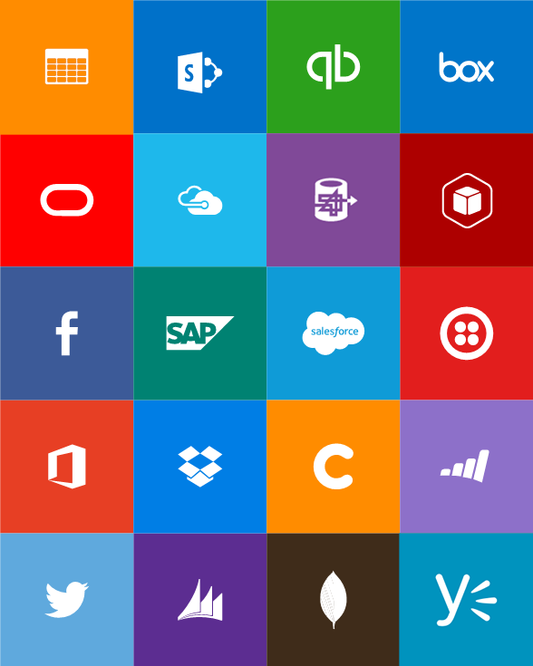
API Connectors & Protocols
Connectors
Box
Chatter
Delay
Dropbox
Azure HD Insight
Marketo
Azure Media Services
OneDrive
SharePoint
SQL Server
Office 365
Oracle
QuickBooks
SalesForce
Sugar CRM
SAP
Azure Service Bus
Azure Storage
Timer / Recurrence
Twilio
Twitter
IBM DB2
Informix
Websphere MQ
Azure Web Jobs
Yammer
Dynamics CRM
Dynamics AX
Hybrid Connectivity
Protocols
BizTalk Services
HTTP, HTTPS
File
Flat File
FTP, SFTP
POP3/IMAP
SMTP
SOAP + WCF
Batching / Debatching
Validate
Extract (XPath)
Transform (+Mapper)
Convert (XML-JSON)
Convert (XML-FF)
X12
EDIFACT
AS2
TPMOM
Rules Engine

Slide 12
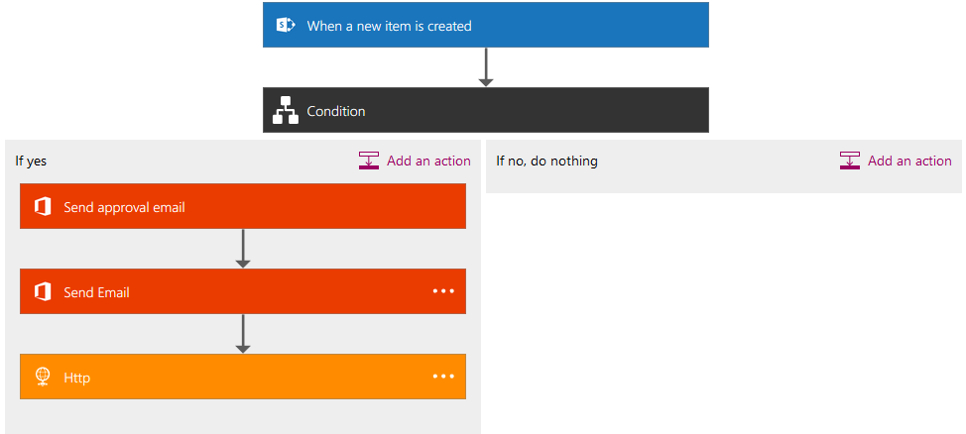
Demo: Business approval workflow

Slide 13
Visual Studio Support
Azure SDK 2.8+
New -> Project ->Templates -> Visual C# ->Cloud -> Azure Resource Group -> Logic App

Slide 14
Expert scenarios customization
Logic Apps Github Repository
BizTalk APIs
Function Apps
Full rest PowerShell support (Workflow Management API)

Slide 15
Expert scenarios customization
Custom API Apps
Swagger
TRex – Logic Apps metadata generation
Swashbuckle - Swagger generator

Slide 16
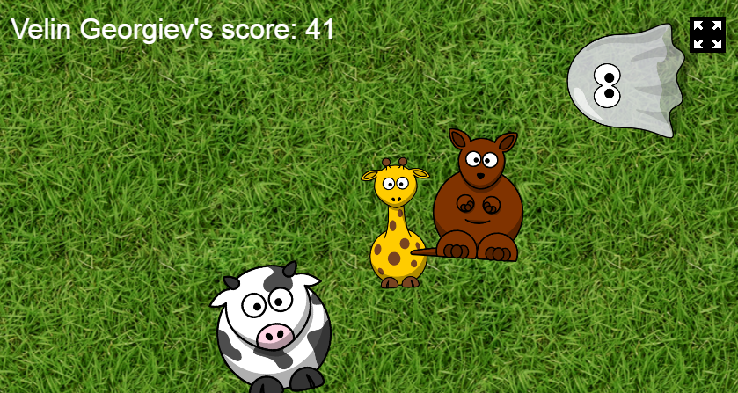
Demo: Custom API Apps
Blame //build/ 2016 for so many games sessions

Slide 17
The challenge
Http json data from the game:
{ “data” : “velin#;100#;200” }
Http json data to be send to the PowerBI dashboard:
{ “score”: 100, “name”: “velin” }
How the DataConvertor API converts the data:
{ “score”: 100, “name”: “velin”, “totalScore”: 200 }

Slide 18
Action required
bit.do/tkzs

Slide 19
Call to action
Azure portal (public preview)
Get started
http://aka.ms/logicappsquickstart
https://github.com/logicappsio
Comunnity links:
Webcast: http://aka.ms/logicappslive
Twitter: @logicappsio
Blog: https://blogs.msdn.microsoft.com/logicapps/
Channel 9 (many enterprise examples)
User voice: https://feedback.azure.com/forums/287593-logic-apps?filter=top&page=1

Slide 20
Introduction to Logic Apps
Q & A

Slide 21

Upcoming events
SQLSaturday #519 in may!
http://www.sqlsaturday.com/519/
bit.do/svote

Slide 22













Thanks to our Sponsors:
Global Sponsor:
Platinum Sponsors:
With the support of:
bit.do/svote
Swag Sponsors:
Media Partners:

Slide 23
Feedback
bit.do/svote

Slide 24
Common Q&A
How to secure http trigger?
Jeff Hollan: Authentication exists today in the form of a “Shared Access Signature” - https://azure.microsoft.com/en-us/documentation/articles/storage-dotnet-shared-access-signature-part-1/
How to clean connection you use from the resource group?
Jeff Hollan: only possible via the REST API https://blogs.msdn.microsoft.com/logicapps/2016/03/18/using-powershell-to-manage-api-connections/
How to deploy logic app via the rest API?
https://blogs.msdn.microsoft.com/logicapps/2016/02/23/deploying-in-the-logic-apps-preview-refresh/
Source control? – cannot deploy via Git (continuous integration)
Cancel all instances? – Yes, on disable.
Limitations?
https://azure.microsoft.com/en-us/documentation/articles/azure-subscription-service-limits/#app-service-limits
https://azure.microsoft.com/en-us/documentation/articles/azure-web-sites-web-hosting-plans-in-depth-overview/
Marketplace and Monetization?
https://azure.microsoft.com/en-us/marketplace
Scaling? – Scales with resource group.

Slide 25
The initial logic app blade
Summary
Quick Start
All Triggers
All Runs
Trigger History
Debugging

Slide 26

Azure App Service
Web Apps
Mobile Apps
Logic Apps
API Apps

Slide 27
What is important?
Build in navigation and auto discovery APIs
Conditions
Repeating discovery
Auto recognision of fields
Easy flow of the data trouth the app (Swagger)
Smart authentication
Code view
Use search for more options (only recomended are shown)

Slide 28
Democratize
Integration
Vision
iPaaS
Leader
Rich
Ecosystem

Slide 29
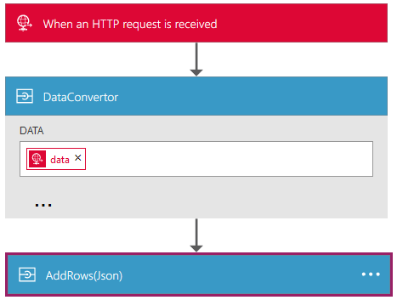
https://github.com/Azure/azure-quickstart-templates/tree/master/app-service-environment-serviceplan-logicapp

Slide 30
Title Goes Here, 36pt
Main Text / Bullets Here, Gray, 28 pt.
Main Text / Bullets Here, Gray, 28 pt.
Bullets Points, Line 2, 24 pt.
Bullets Points, Line 3, 20 pt.
Bullets Points, Line 4, 24 pt.

Slide 31
Title Goes Here, 36pt
Content
Content

