Slide 1
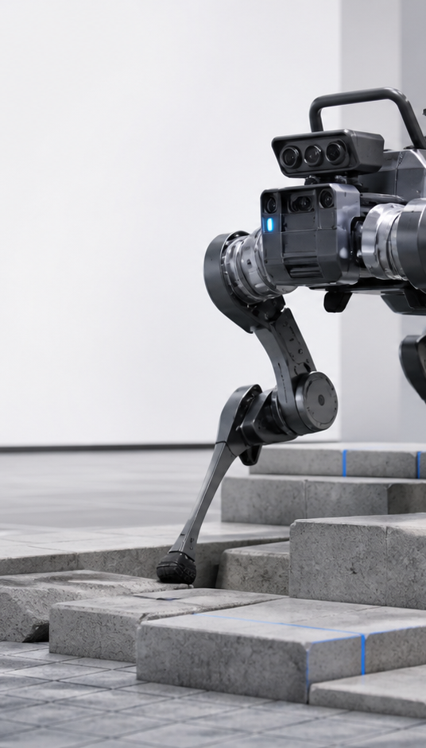
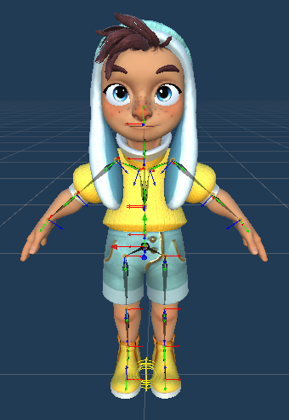
INTERVIEW PROJECT WALKTHROUGH
Two approaches to
believable locomotion
Runtime character animation and reinforcement-learning control
Project 1 · Master thesis
Project 2 · Isaac Lab locomotion
Notes:
Frame the presentation as two different locomotion problems solved with the same engineering mindset: define the desired behavior, build progressively, and validate the result under realistic constraints.
[Sources]
- User-provided MIG Presentation.pptx
- Local ANYmal project report: DOMAIN_RANDOMIZATION_REPORT.md
- Generated ANYmal cover visual
[/Sources]

Slide 2
TWO PROJECTS · ONE THROUGHLINE
The projects differ in technique, but share the same engineering question
How do we turn a desired motion into a system that is controllable, natural, and reliable?
01
Precise character locomotion
02
Robust robot locomotion
Adapt a small motion-capture library at runtime so a character can reach nearby targets precisely without foot sliding.
Train a quadruped policy that follows commands, traverses rough terrain, and remains useful when the physics changes.
02
Notes:
This is the portfolio map. Spend only enough time to distinguish the two projects, then move directly into the thesis story.
[Sources]
- User-provided MIG Presentation.pptx
- Local ANYmal project README and DOMAIN_RANDOMIZATION_REPORT.md
[/Sources]

Slide 3
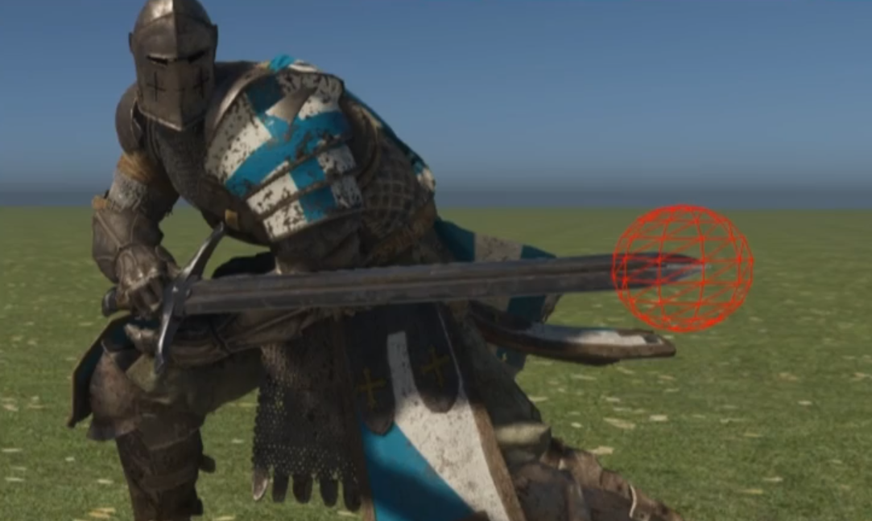
PROJECT 1 · MASTER THESIS
Small repositioning exposed a gap in real-time character locomotion
The problem
An interactive character often needs to move only a few steps—toward an object, another person, or an exact interaction point.
Existing approaches traded off precision, natural motion, runtime cost, or dependence on large datasets.
Design target
Natural motion · exact goal pose · low latency · limited data
03
Notes:
Use a concrete example: moving a hand to an interaction target requires the feet and body to arrive in the right place, not merely look plausible from far away.
[Sources]
- User-provided MIG Presentation.pptx, slides 2–9 and embedded image22.png
[/Sources]

Slide 4
PROJECT 1 · METHOD
The method reused real motion, then adapted only what the goal required
Select
Adapt
Repair
1
2
3
Search a compact database for a short sequence aimed near the target.
Transform the root and feet so the sequence lands on the requested pose.
Apply constraints, blending, and inertialization to preserve visual quality.
Core decision: preserve the captured performance and make targeted geometric corrections instead of synthesizing motion from scratch.
04
Notes:
Keep this nontechnical. The method is a select–adapt–repair pipeline. The important decision was to preserve authored motion quality while changing only the pieces needed for spatial precision.
[Sources]
- User-provided MIG Presentation.pptx, slides 10–26
[/Sources]

Slide 5
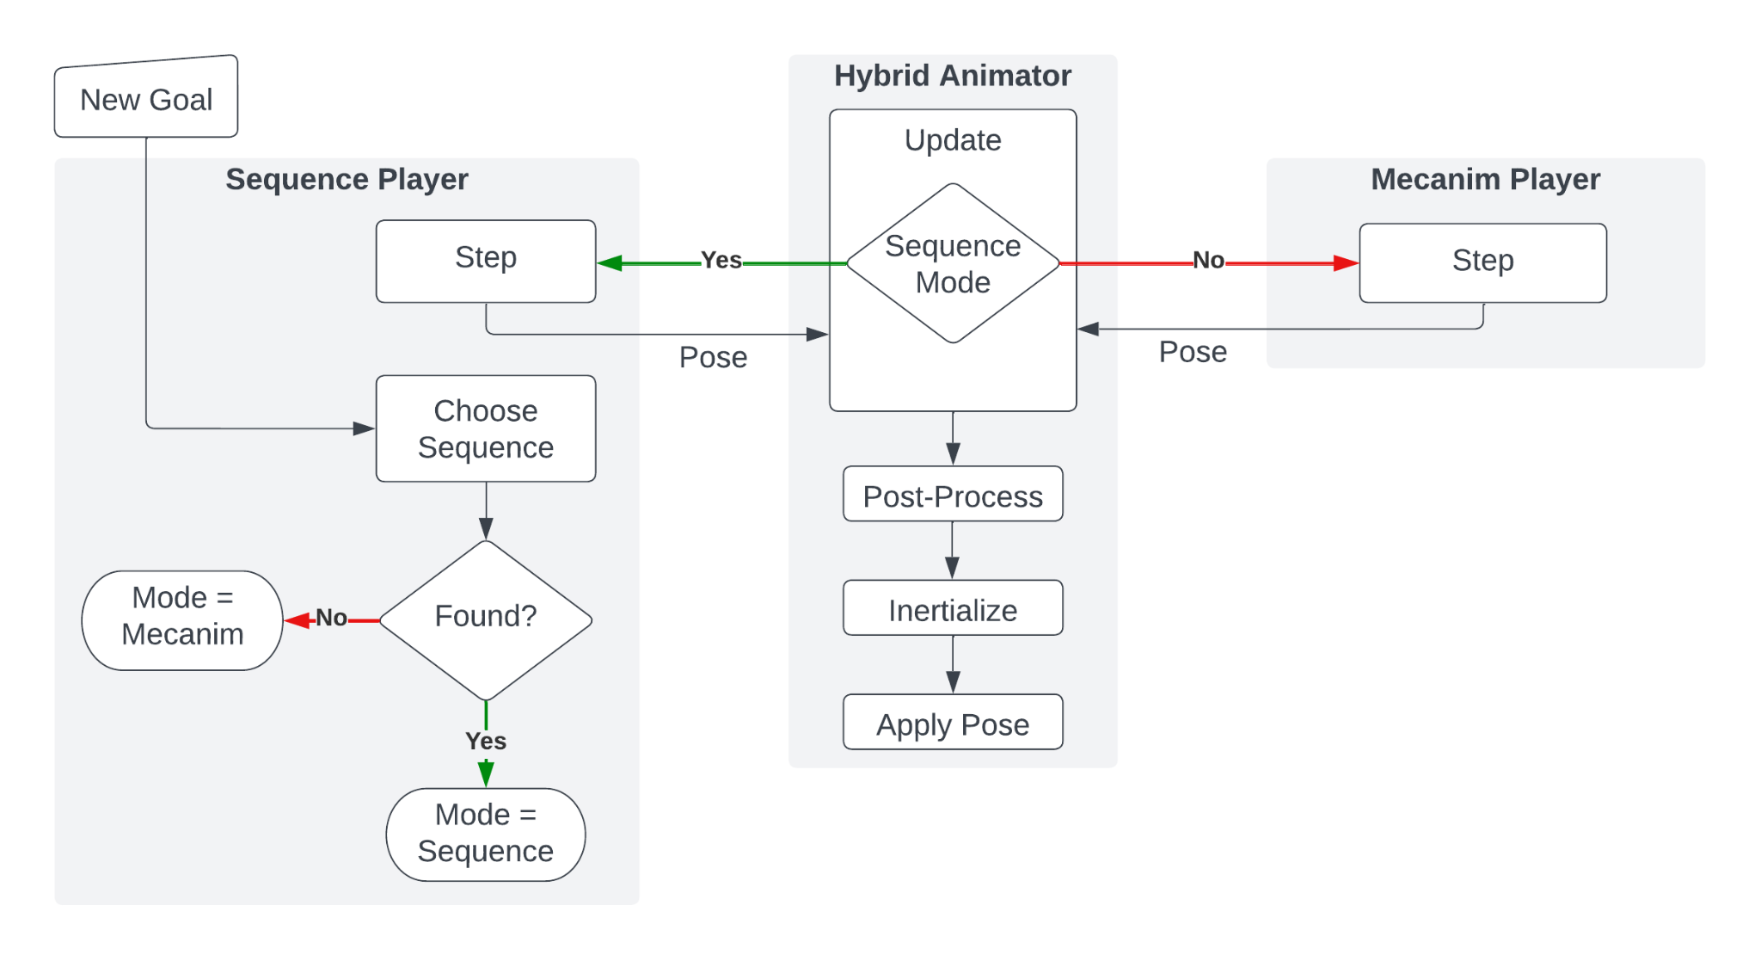
PROJECT 1 · WHAT SHIPPED
A hybrid runtime made precise motion usable inside an interactive system
Runtime behavior
Target arrives
A goal position and orientation enter the system.
Best sequence found
The captured clip is adapted and post-processed.
No valid sequence
The standard locomotion controller remains available as fallback.
05
Notes:
Emphasize what shipped: not an offline algorithm, but a hybrid runtime component that could accept goals repeatedly, adapt sequences, and gracefully fall back when needed.
[Sources]
- User-provided MIG Presentation.pptx, slide 36 and embedded image37.png
[/Sources]

Slide 6
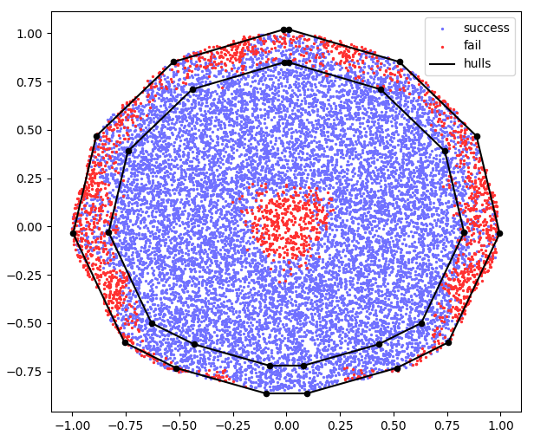
PROJECT 1 · RESULTS
The system covered most nearby goals while staying within a real-time budget
≈ 4.6 ms
successful sequence selection
≈ 0.15 ms
pose adaptation + post-processing
The main limitation was geometric: failures concentrated very close to the origin and near the edge of the reachable region.
06
Notes:
Translate the plot rather than explaining its axes. Blue targets succeeded across most of the reachable area; red clusters show where the available clips could not be adapted convincingly. State that these timings came from the thesis measurements.
[Sources]
- User-provided MIG Presentation.pptx, slides 29–34 and embedded image31.png/image33.png
[/Sources]

Slide 7
FROM ANIMATION TO CONTROL
The thesis taught me to treat locomotion as a system problem—not just an algorithm
01
Specify the outcome
02
Design for failure
03
Validate the whole loop
Define what valid behavior looks like.
Use fallback paths and measurable limits.
Measure runtime behavior, not isolated components.
I applied the same mindset to a very different problem: learning a controller for a physical robot.
Notes:
This transition is important. It makes the second project feel like a progression in engineering judgment rather than an unrelated hobby project.
[Sources]
- Synthesis based on user-provided MIG Presentation.pptx and local ANYmal project history
[/Sources]

Slide 8
PROJECT 2 · ISAAC LAB LOCOMOTION
In reinforcement learning, the robot exploited every ambiguity in the objective
A policy can maximize reward without learning the behavior we intended.
The desired controller
Controllable
Early policies found locally safe shortcuts: kneeling instead of standing, walking in place, or turning on stairs to make climbing easier.
Follow forward, lateral, and turning commands
Terrain-aware
Adapt gait to stairs, slopes, blocks, and rough ground
Robust
Remain stable when physics and disturbances change
08
Notes:
Explain reward hacking in plain language: the robot did exactly what the incentives allowed. The work became behavior specification and diagnosis, not merely parameter tuning.
[Sources]
- Local ANYmal project report: DOMAIN_RANDOMIZATION_REPORT.md
[/Sources]

Slide 9
PROJECT 2 · PROGRESSIVE TRAINING
I trained one capability at a time, then combined them on rough terrain
Stand
Recover
Resist
Track
Turn
Traverse
Balance
Random starts
Pushes
Velocity
Yaw
Rough + DR
1
2
3
4
5
6
Each stage exposed a different failure mode, so the next reward, curriculum, or observation change was driven by evidence.
09
Notes:
Walk through this quickly as an engineering progression. Each stage was validated before adding the next source of complexity.
[Sources]
- Local ANYmal project history and DOMAIN_RANDOMIZATION_REPORT.md
[/Sources]

Slide 10
PROJECT 2 · WHAT SHIPPED
The result was a controllable experimentation system—not only a checkpoint
4,096
50 Hz
6 × 10
parallel training environments
closed-loop policy control
terrain families × levels
Policy experience
Engineering workflow
• Keyboard command control
• Direction markers and follow camera
• Live terrain switching
• Named, reproducible training runs
• Resume from explicit checkpoints
• CSV + JSON evaluation reports
10
Notes:
Describe what another engineer could actually use: interactive control, terrain inspection, reproducible runs, checkpoint management, and evaluation artifacts.
[Sources]
- Local ANYmal project README.md and source configuration
[/Sources]

Slide 11
PROJECT 2 · OBJECTIVE
The reward function balanced tracking, stability, and gait quality
FINAL ROUGH-TERRAIN OBJECTIVE
rₜ = 2e⁻⁽‖v*ₓᵧ−vₓᵧ‖²⁄⁰·²⁵⁾ + e⁻⁽ω*𝓏−ω𝓏⁾²⁄⁰·²⁵ + 0.5r_air + 0.35r_trot + 0.75𝟙_straight r_phase
− v𝓏² − 0.2‖ωₓᵧ‖² − 0.05‖aₜ−aₜ₋₁‖² − 2×10⁻⁵ mean(τ²) − 2.5×10⁻⁷Σq̈² − N_bad-contact
Every term except the fall penalty is multiplied by Δt = 0.02 s. A fall adds −2.
Tracking
Stability
Efficiency
Gait structure
Match planar velocity and yaw commands.
Suppress vertical motion, roll, pitch, and bad contacts.
Limit abrupt actions, torque, and joint acceleration.
Encourage air time, trot consistency, and phase scheduling.
Design choice: the phase term activates only for straight forward commands, so standing, turning, and lateral motion keep their adaptive behavior.
11
Notes:
Explain the objective as a hierarchy. Tracking produces the task behavior. Stability and efficiency keep the solution physically plausible. The gait terms remove degenerate solutions. The phase reward remains gated so it does not prescribe a trot during standing or turning.
[Sources]
- anymaltraining_env_cfg.py
- anymaltraining_env.py
- PHASE_CLOCK_GAIT_REPORT.md
[/Sources]

Slide 12
PROJECT 2 · MEASUREMENT
A controlled gait test converted visual concerns into measurable errors
TOUCHDOWN PHASE MAE
COMPOSITE TROT DEVIATION
LF defines each stride cycle
TDI = phase MAE + 0.25 × duty-factor CV + 0.25 × stride-period CV
Targets: RF = 0.5 LH = 0.5 RH = 0.0 cycles
eᵢⱼ = min(|Δφᵢⱼ − δᵢⱼ|, 1 − |Δφᵢⱼ − δᵢⱼ|)
Phase MAE
Inter-leg touchdown timing
Phase MAE = mean(eᵢⱼ)
Duty-factor CV
Unequal time spent on each foot
Lower values mean touchdowns occur closer to an ideal trot schedule.
Stride-period CV
Irregular stride duration
Protocol: 64 paired trials · seed 42 · 1.0 m/s · 2 s warm-up · 10 s measurement
12
Notes:
The gait evaluation uses LF touchdowns to delimit stride cycles. It measures where the other three feet touch down within each cycle and uses circular distance to avoid a discontinuity at zero. TDI combines phase accuracy with load balance and stride regularity. The controlled protocol fixes the terrain, command, seed, warm-up, and measurement duration.
[Sources]
- scripts/rsl_rl/evaluate_gait.py
- gait_evaluation/scale035_error020/summary.json
[/Sources]

Slide 13
PROJECT 2 · FAILED ABLATION
An event-only phase reward made the measured gait worse
Hypothesis
Metric | Reference | Event reward | Result
Phase MAE ↓ | 0.0288 | 0.0437 | 51.5% worse
Trot deviation ↓ | 0.0606 | 0.0801 | 32.3% worse
Duty CV ↓ | 0.1013 | 0.1211 | 19.6% worse
Opposition ↑ | 0.9854 | 0.9600 | 2.5 pts lower
Velocity error ↓ | 0.0323 | 0.0315 | slightly better
Reward each touchdown according to its phase error relative to the latest measured stride.
What failed
Feedback arrived only at sparse touchdown events. The policy had no phase reference in its observations, so improving one leg pair shifted errors into another.
Decision: stop adjusting scalar kernels and give the policy an explicit, observable cyclic reference.
13
Notes:
This negative result is central to the engineering story. The event reward directly referenced touchdown error, but the signal remained sparse and partially observable. The controlled evaluation showed a statistically clear regression, so the code was reverted and the experiment retained as an ablation.
[Sources]
- gait_evaluation/explicit_touchdown_phase/summary.json
- gait_evaluation/comparison_best_vs_explicit_phase.json
- PHASE_CLOCK_GAIT_REPORT.md
[/Sources]

Slide 14
PROJECT 2 · PHASE CLOCK
The phase clock made the desired contact schedule observable
CLOCK AND OBSERVATION
DESIRED TROT SCHEDULE
φₜ = (2.5t) mod 1
LF
z_phase = [sin(2πφₜ), cos(2πφₜ)]
RF
Sine and cosine encode a continuous cycle without a jump between phase 1 and phase 0.
LH
RH
0
0.5
1 cycle
r_phase = 1 − ¼ Σᵢ |cᵢ − c*ᵢ(φₜ)|
Gate: vx* > 0.3 m/s, |vy*| < 0.1 m/s, and |ωz*| < 0.1 rad/s
14
Notes:
The clock runs at 2.5 Hz, close to the baseline policy's measured 0.39 second stride. LF and RH share one stance window. RF and LH use the same window shifted by half a cycle. The dense reward compares desired and actual contact at every policy step. The gate limits the schedule to straight forward motion.
[Sources]
- anymaltraining_env.py
- anymaltraining_env_cfg.py
- PHASE_CLOCK_GAIT_REPORT.md
[/Sources]

Slide 15
PROJECT 2 · CONTROLLED CHANGE
Checkpoint migration isolated the effect of the two new observations
01
02
03
04
Reference policy
›
Expand input
›
Fine-tune
›
Select by metric
235 observations
model_2996.pt
Add sin/cos phase
Zero new weights
4,096 environments
24-step PPO rollout
Evaluate every 50
updates
W′ = [ W₍₅₁₂×₂₃₅₎ 0₍₅₁₂×₂₎ ]
The migrated policy initially behaves exactly like the reference because the new phase inputs have zero influence.
Early stopping selected model_3100.pt after the first decisive improvement, rather than treating 500 iterations as a goal.
15
Notes:
The architecture changed from 235 to 237 inputs. The migration utility appended zero columns to the actor and critic first layers and to the Adam moments. All other parameters remained unchanged. This makes the experiment a clean fine-tune rather than a new training run. The first strong result appeared around 100 updates, so training stopped there.
[Sources]
- scripts/rsl_rl/migrate_phase_clock_checkpoint.py
- PHASE_CLOCK_GAIT_REPORT.md
[/Sources]

Slide 16
PROJECT 2 · GAIT RESULT
The phase-clock policy reduced touchdown error by 41.7%
Metric | Reference | Phase clock | Change
Touchdown phase MAE ↓ | 0.02881 cycles | 0.01680 cycles | 41.7% lower
Trot deviation index ↓ | 0.06056 | 0.03774 | 37.7% lower
Stride-period CV ↓ | 0.02573 | 0.00116 | 95.5% lower
Duty-factor CV ↓ | 0.10127 | 0.08262 | 18.4% lower
Diagonal opposition ↑ | 0.98541 | 0.99913 | +1.37 points
Velocity tracking MAE ↓ | 0.03231 m/s | 0.03251 m/s | +0.00020 m/s
Fall rate ↓ | 0% | 0% | unchanged
64 paired trials · 20,000 bootstrap resamples
Phase-MAE change 95% CI: [−0.01221, −0.01182] cycles
All primary gait metrics improved; controlled tracking and survival stayed effectively unchanged.
16
Notes:
Lead with phase MAE because it was the stated defect. The paired confidence interval excludes zero. TDI, duty balance, stride consistency, diagonal agreement, and opposition all moved in the desired direction. Velocity error changed by only 0.00020 metres per second and no robot fell in the controlled trials.
[Sources]
- gait_evaluation/comparison_best_vs_phase_clock_3100.json
- gait_evaluation/phase_clock_3100/summary.json
[/Sources]

Slide 17
PROJECT 2 · TRADEOFF
A more regular gait cost a small amount of rough-terrain adaptability
GENERATED ROUGH TERRAIN · 256 EPISODES
Metric | Reference | Phase clock | Change
Completion ↑ | 98.4% | 97.7% | −0.7 points
Fall rate ↓ | 1.6% | 2.3% | +0.7 points
Planar error ↓ | 0.062 m/s | 0.070 m/s | +0.008 m/s
Yaw error ↓ | 0.065 rad/s | 0.065 rad/s | unchanged
Interpretation
The clock strongly regularized timing on controlled ground. Difficult terrain sometimes benefits from delaying a foot or breaking the nominal rhythm.
Next step
Adapt clock strength or phase speed using terrain difficulty.
Defensible result: a targeted architectural change fixed the measured gait defect and revealed a quantifiable regularity–adaptability tradeoff.
17
Notes:
Do not present the phase clock as an unconditional improvement. On generated rough terrain, completion decreased by two episodes out of 256 and planar tracking error rose by eight millimetres per second. This suggests that rigid periodicity can conflict with adaptive foot placement. A terrain-conditioned phase weight or adaptive oscillator would be the next experiment.
[Sources]
- evaluations/baseline_model_2996_rough_matched/summary.json
- evaluations/phase_clock_3100_rough/summary.json
- PHASE_CLOCK_GAIT_REPORT.md
[/Sources]

Slide 18
PROJECT 2 · EVALUATION
Held-out physics tests showed where domain randomization actually helped
+3.9 pts
OOD completion improvement
Where it helped
Straight walking
70.3% → 79.7%
Combined motion
71.9% → 85.9%
Tradeoff: OOD in-place turning fell from 98.4% to 90.6%.
18
Notes:
Lead with the matched experimental design: both policies started from the same checkpoint and trained for the same additional budget. Then state the result honestly—randomization improved difficult translational survival but did not improve every behavior.
[Sources]
- Local ANYmal DOMAIN_RANDOMIZATION_REPORT.md and evaluation summary JSON files
[/Sources]

Slide 19
PROJECT 2 · INTERPRETATION
OOD robustness improved, but precise planar tracking became harder
Held-out physics
Metric | Control | DR | Change
Completion | 85.2% | 89.1% | +3.9 points
Planar velocity error | 0.155 m/s | 0.175 m/s | 12.9% worse
Yaw-rate error | 0.131 rad/s | 0.126 rad/s | 3.8% lower error
The defensible conclusion
Nominally, DR improved both survival and tracking. Under held-out physics, it survived more often but accepted larger planar tracking errors—the expected robustness–precision tradeoff.
19
Notes:
Use this slide to qualify the previous result. The DR policy did not simply become more accurate everywhere: under unseen physics it traded some planar command precision for a higher probability of finishing the episode. Yaw tracking still improved slightly.
[Sources]
- Local ANYmal DOMAIN_RANDOMIZATION_REPORT.md — primary matched comparison
[/Sources]

Slide 20
WHAT THE TWO PROJECTS DEMONSTRATE
Different locomotion problems, one repeatable engineering approach
Define behavior
Build progressively
Evaluate honestly
Translate intent into measurable outcomes.
Isolate capabilities before combining them.
Test the shipped loop and report tradeoffs.
Project 1 shipped precise, low-latency character repositioning. Project 2 shipped controllable, measurable rough-terrain robot locomotion.
Notes:
Close by connecting the work to the role: you can formulate locomotion problems, make system-level tradeoffs, implement the full loop, and evaluate claims critically.
[Sources]
- User-provided MIG Presentation.pptx
- Local ANYmal project report: DOMAIN_RANDOMIZATION_REPORT.md
[/Sources]

