Slide 1
Admin Dashboard
MERNSTACK PROJECT
FINAL REVIEW
Velmurugan S
22EC184

Slide 2
Introduction
This MERN stack admin dashboard project is meticulously crafted to provide a comprehensive platform for efficient management and visualization of data. Built upon MongoDB, Express.js, React, and Node.js, our dashboard offers a seamless integration of front-end and back-end technologies, ensuring scalability and real-time data handling.
With a user-friendly interface and intuitive navigation, our dashboard empowers administrators to oversee and manage various aspects of their systems with ease. From user management and analytics to content administration and system configurations, our dashboard facilitates streamlined operations and informed decision-making.
This main objective of this project is to deliver a robust and scalable solution that meets the dynamic needs of modern businesses, fostering productivity, insight, and collaboration.

Slide 3
Existing System
1. Salesforce CRM:
Salesforce CRM is a versatile platform for managing sales, marketing, and customer service operations. It centralizes customer data, supports lead management, opportunity tracking, and automates workflows. With customizable dashboards and seamless integration capabilities, it scales to meet diverse business needs across industries. Salesforce CRM enhances customer engagement, streamlines sales processes, and drives revenue growth effectively.
2. SAP ERP:
SAP ERP integrates business management modules for real-time core process management across finance, HR, procurement, manufacturing, and supply chain. It offers unified data management, advanced analytics, and supports decision-making. With modules like SAP S/4HANA, it utilizes AI and machine learning for actionable insights, fostering innovation. SAP ERP optimizes resources, enhances operational efficiency, and is essential for large enterprises aiming to reduce costs and maintain competitiveness.

Slide 4
Proposed System
The proposed MERN stack admin dashboard will leverage MongoDB, Express.js, React, and Node.js to create a robust platform for managing organizational operations. It will offer dynamic data visualization tools powered by React components, allowing administrators to monitor and analyze key metrics in real-time.
The backend, built with Node.js and Express.js, will ensure efficient data processing and seamless API integration with existing systems. MongoDB will serve as the database for scalable and flexible data storage. The dashboard will feature customizable widgets, interactive charts, and comprehensive reporting capabilities to support data-driven decision-making.
Security will be a priority, with authentication and authorization mechanisms implemented using industry best practices. The goal is to enhance operational efficiency, streamline workflows, and empower administrators with actionable insights for strategic planning and business growth.

Slide 5
Tech Stack
FRONTEND
DATABASE
BACKEND
React.js
HTML
CSS
MongoDB
Express.js
Node.js

Slide 6
Key Features
User Management:
Allows administrators to manage user accounts, including adding, editing, and deleting users. It also provides functionalities for assigning roles and permissions to control access levels within the application.
Real-time Analytics:
Provides real-time data visualization through interactive charts and graphs. Administrators can monitor key metrics, track performance indicators, and generate customizable reports to gain insights into business operations.
Content Management:
Facilitates the creation, editing, and organization of various types of content, such as blog posts, articles, and media files. This feature ensures that content is easily manageable and accessible.

Slide 7
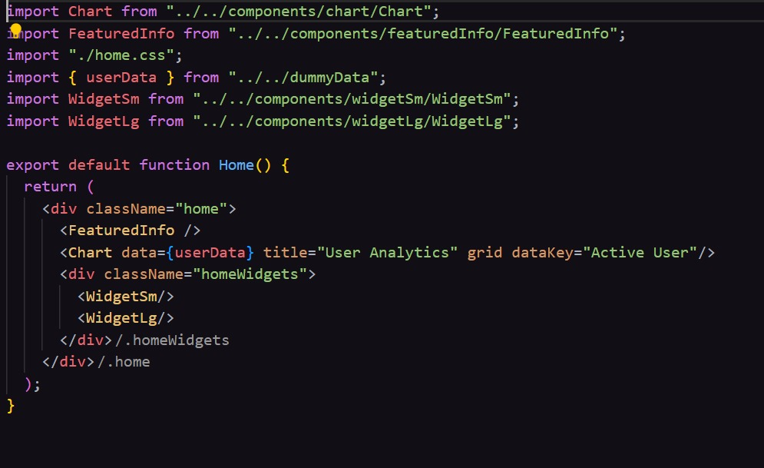
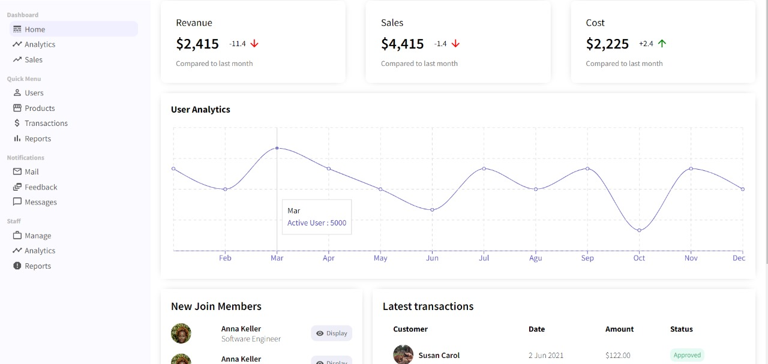
OUTPUT SCREENSHOTS
HOME PAGE

Slide 8
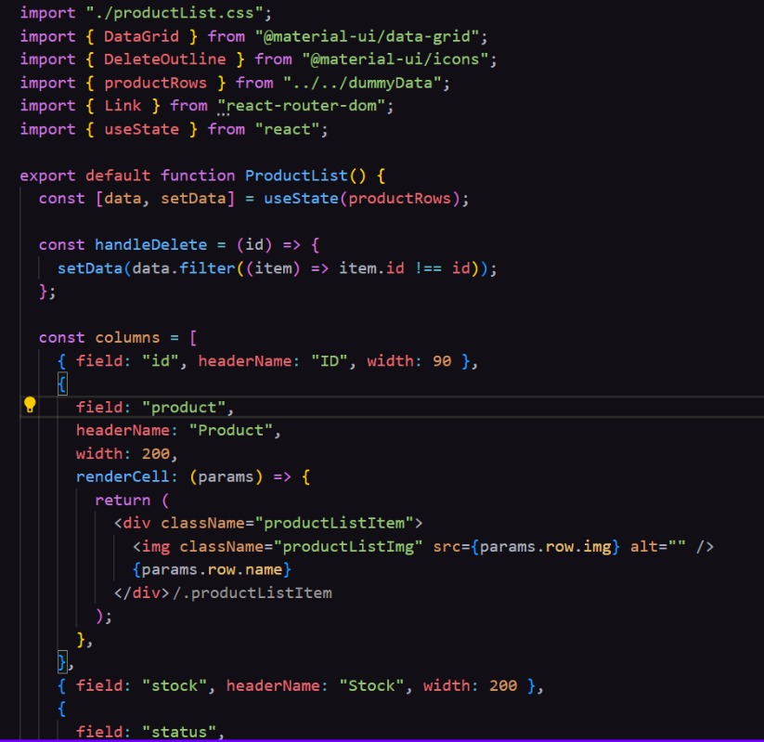
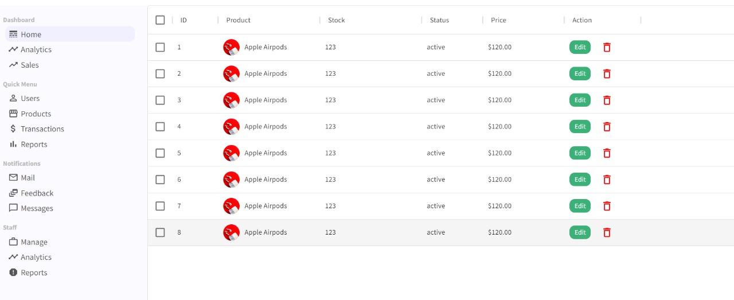
OUTPUT SCREENSHOTS
PRODUCTS PAGE

Slide 9
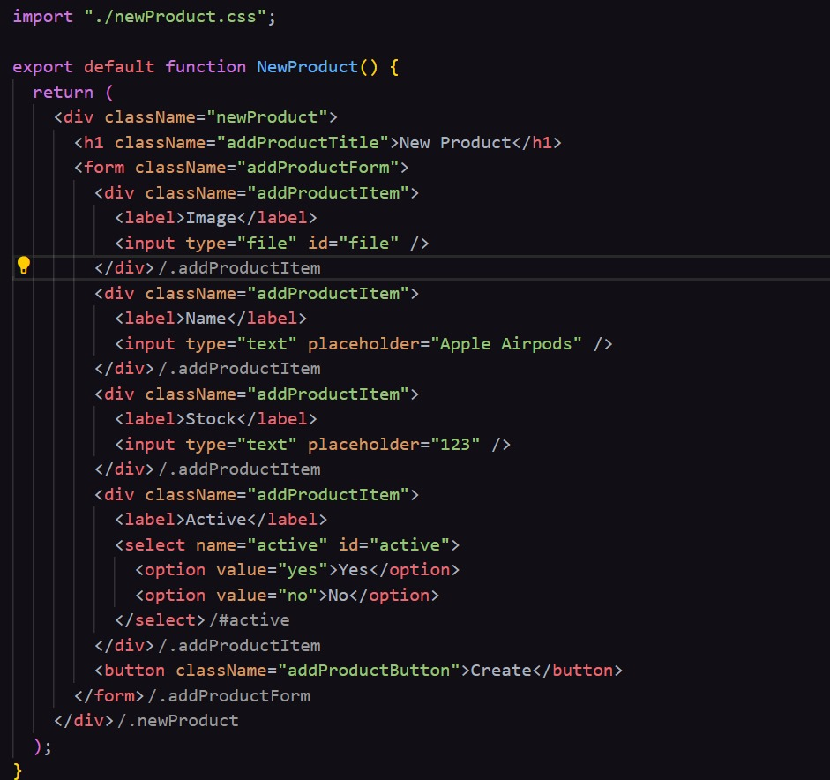
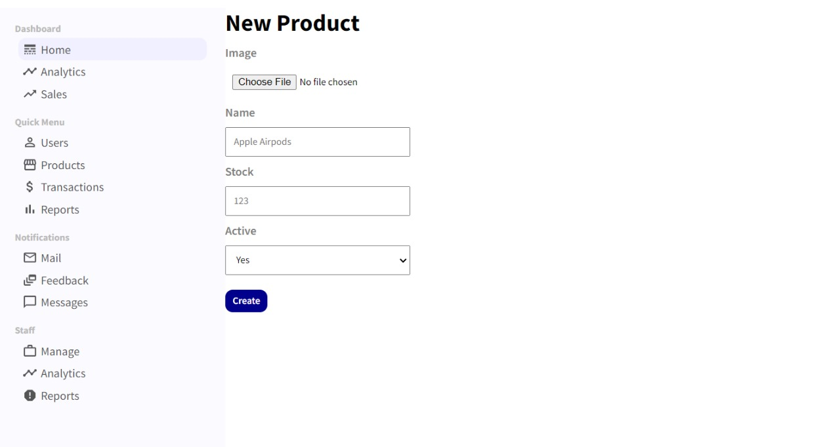
OUTPUT SCREENSHOTS
CREATING NEW PRODUCT PAGE

Slide 10
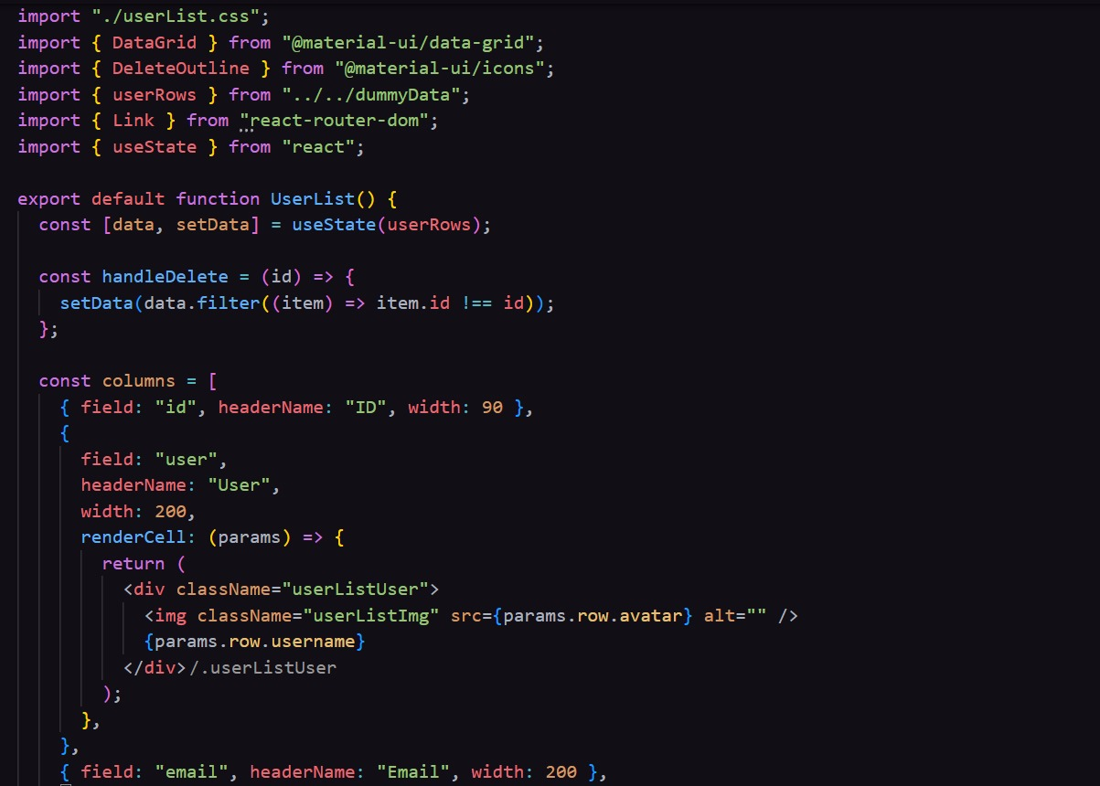
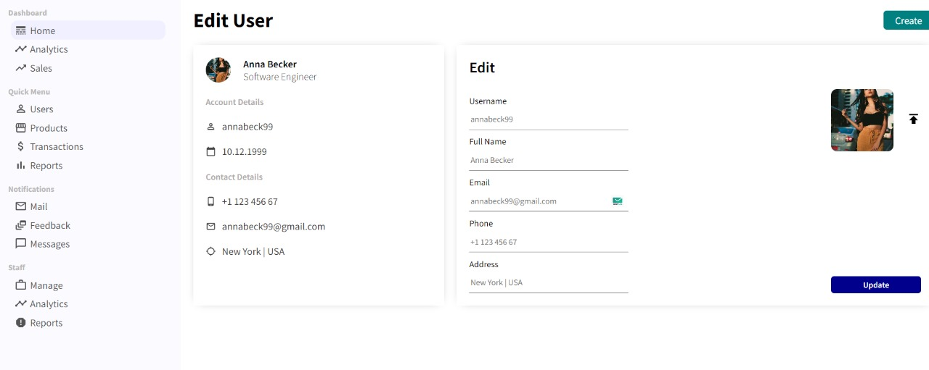
OUTPUT SCREENSHOTS
UPDATING EXISTING USER PAGE

Slide 11
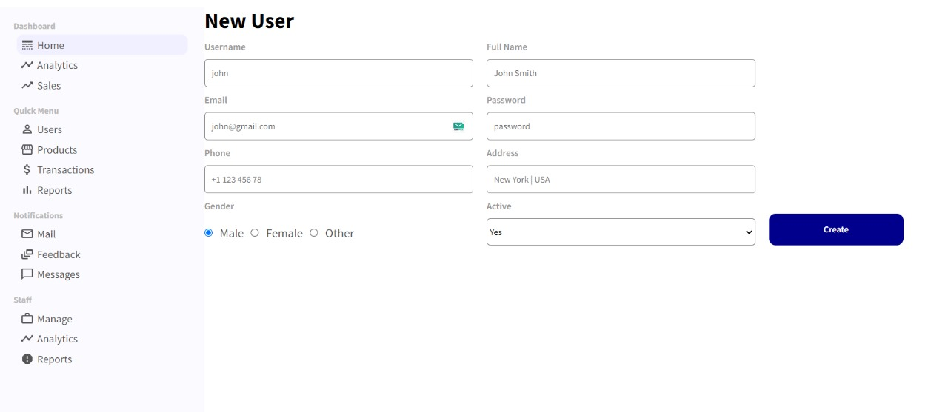
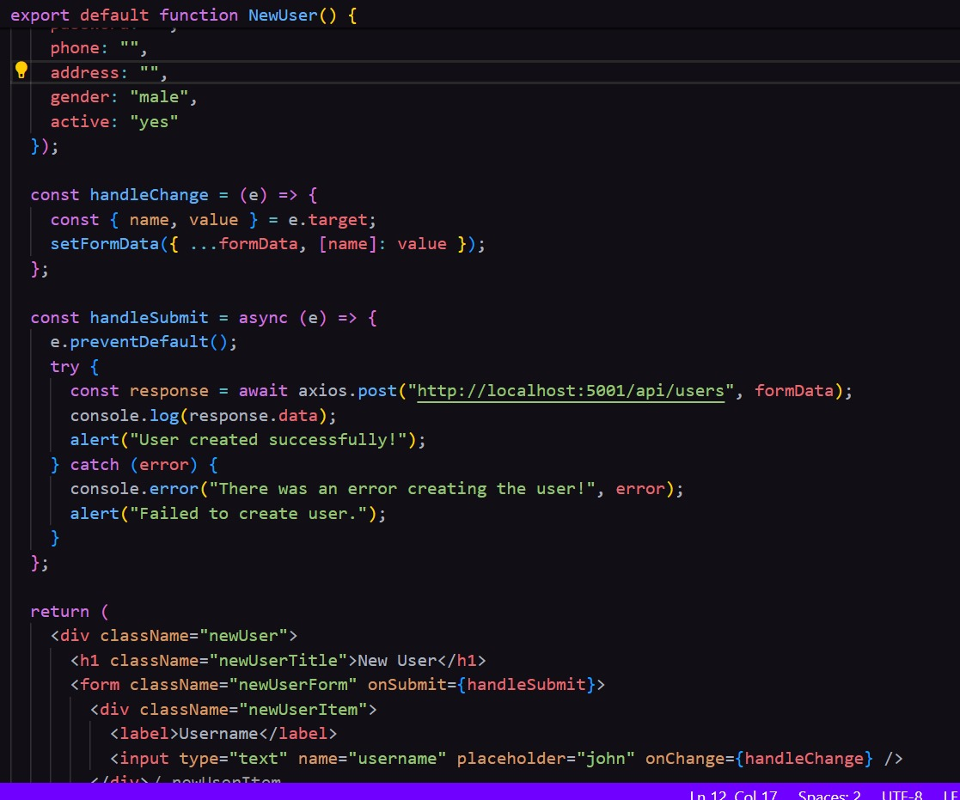
OUTPUT SCREENSHOTS
CREATING NEW USER PAGE

Slide 12
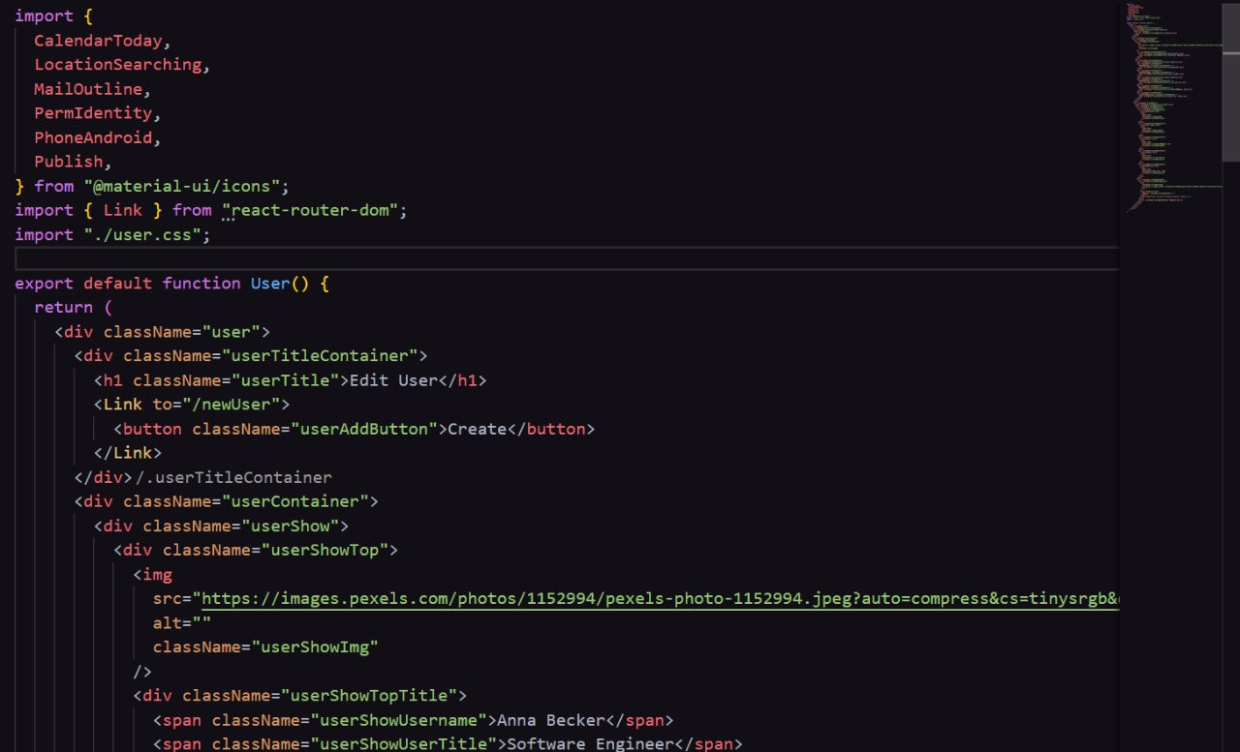
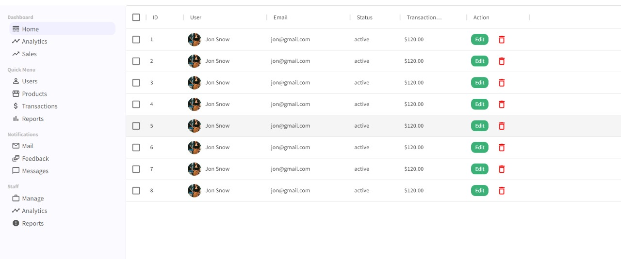
OUTPUT SCREENSHOTS
USERS PAGE

Slide 13
Conclusion
The showcased full-stack blog application exemplifies the fusion of MongoDB, Express.js, React.js, and Node.js to forge a dynamic and engaging web platform.
Facilitating functionalities such as creating, reading, updating, and deleting blog posts, this app offers a seamless experience for content management and dissemination.
Leveraging the MERN stack, the development process was characterized by efficiency and agility, empowering swift prototyping and iteration.

Slide 14
THANK YOU

