Slide 1
Should you use Lua?
Christopher Leonard

Slide 2
Slides are online
Email me I guess
  chris.j.leonard@gmx.com
Twitter, @VeltasV

Slide 3
Part I: the language

Slide 4
“There are only two kinds of languages:
the ones people complain about
and the ones nobody uses”
-Bjarne Stroustrup
creator of a language people complain about

Slide 5
Lua
made by
  Roberto Ierusalimschy
  Waldemar Celes
  Luiz Henrique de Figueiredo
Pontifical Catholic University of Rio de Janeiro

Slide 6
Lua
popular
embeddable
easy
portable
small
fast

Slide 7
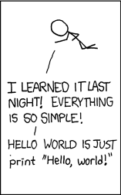
Simple
print "Hello, world!"
Entire syntax listing fits on back of a napkin

Slide 8
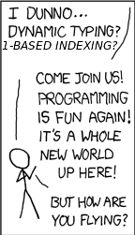
Some odd conventions
1-based indexing
~= is the inequality operator
.. is the concatenation operator
object:method()

Slide 9
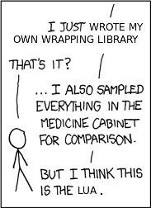
Immature ecosystem
No import antigravity
Many Lua users prophesize Lua dominating the scripting world
Lua community has lots of dedicated members pushing for this
Long way to go

Slide 10
Example
function factorial(n)
if n == 0 then
return 1
else
return n * factorial(n - 1)
end
end

Slide 11
Paradigm Agnostic
OOP is hinted at by the language
Supported by
  Flexibility of tables
  Syntactic sugar
  Metatables
Language ultimately quite flexible
  Inheritance, constness, properties, etc. with metatables
  Useful for many domains
  Semi-DSL

Slide 12
Syntactic sugar
object.field = 5
object["field"] = 5

Slide 13
Syntactic sugar
object:method(1, 2)
object.method(object, 1, 2)

Slide 14
Syntactic sugar
fn({1, 2, 3})
fn{1, 2, 3}

Slide 15
Metatables
Allow you to handle different conundrums for the Lua VM
  Non-existant index
  Calling a table value
  more

Slide 16
Flexibility of tables
Main data type
Syntax for constructing lists and records
  {1, 2.5, "hi", 4, 5}
  {name = "Nod", occupation = "sod"}
Any type (other than nil) can be index
Any type can be field
Any combination of indices

Slide 17
Pick a convention
And document it
Löve
Use OOP? Tell us how

Slide 18
Library object compatibility
Need to know what an object is
In any OOP system we can always assume an object is:
  Copy by reference
  Accessible by standard indexing
  May or may not have a metatable
Modifying metatables?, be careful

Slide 19
Metables inheritance/instancing
MyClass = {value = 5} -- New class: MyClass, value has default
function MyClass:New(obj) -- Define constructor for class
setmetatable(obj, {__index = self}) -- fallback lookup
return obj
end
function MyClass:DoSomething() -- Define method for class
print(self.value)
end
Derived = MyClass:New{} -- Define class inheriting from MyClass
derivedObj = Derived:New{} -- Create object of Derived type
derivedObj:DoSomething() -- Use method on object

Slide 20
Part II: libraries for Lua

Slide 21
Standard library
Insanely fast to load
Useful iterator functions
Basic handling of types
ANSI C library

