Slide 1

SQL Injection
Notes:
What is SQL Injection
What is SQL?

Slide 2
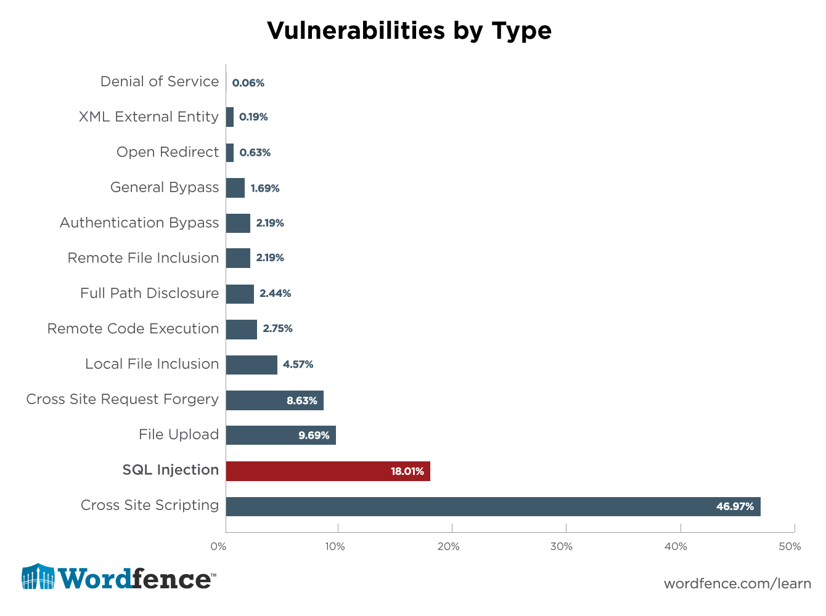
Notes:
Web Exploitation is a large field etc etc.
18.01% of attacks by SQL

Slide 3
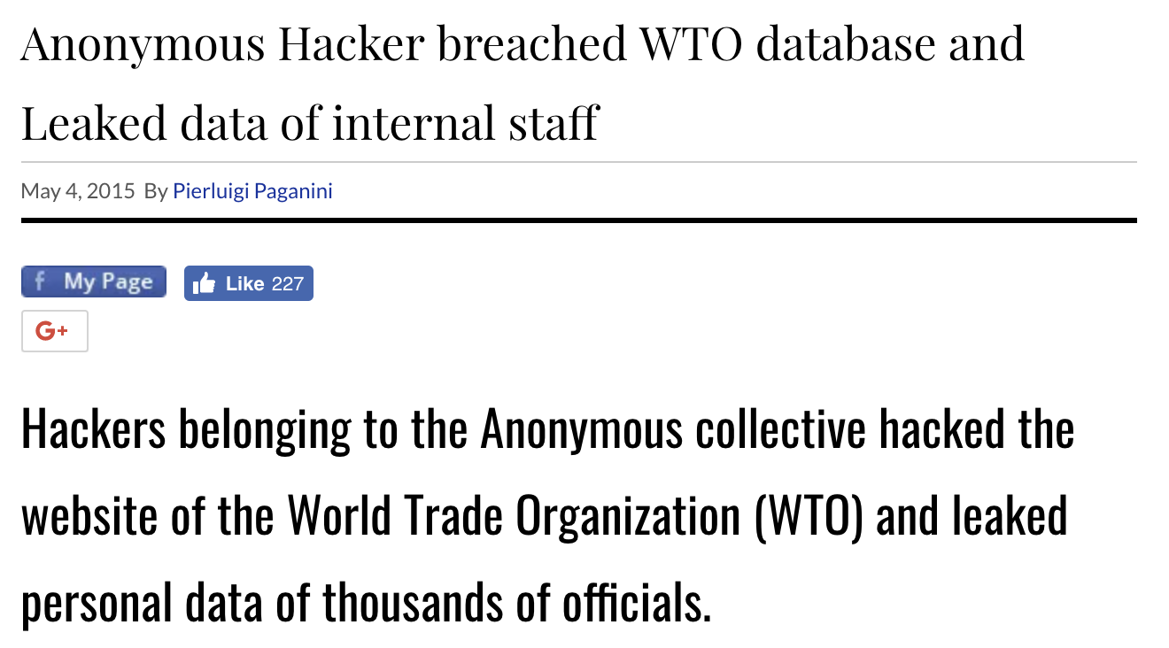
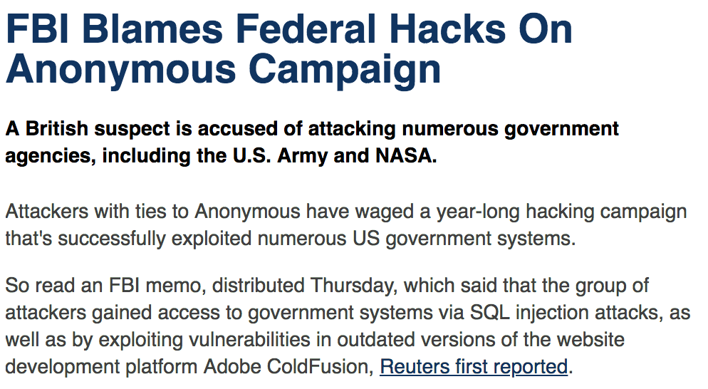






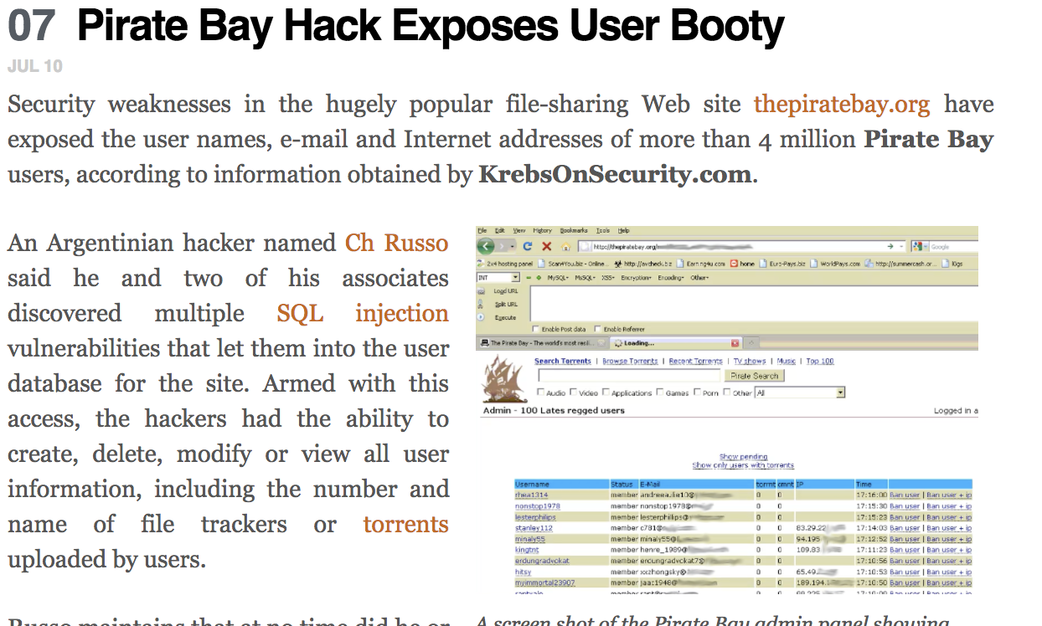
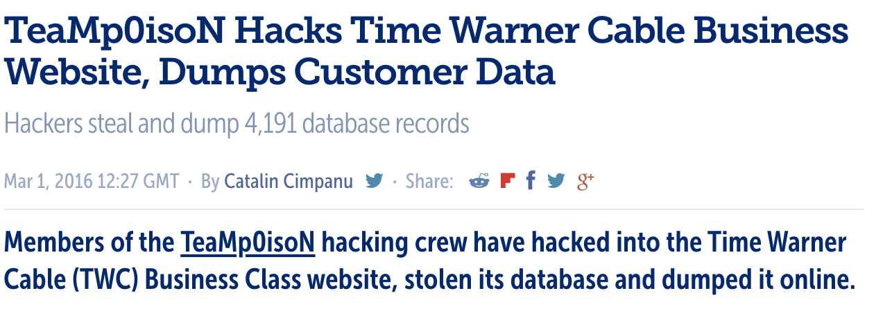

Notes:
Lots of SQL injections

Slide 4

Notes:
Funny meme

Slide 5

Cross Site Scripting
(XSS)
Notes:
Starting on Cross Site Scripting

