Slide 1
Duck Debug
Your friendly rubber-duck debugger
DATANOVA 2026 Global Data-thon
Track: Generative AI and Responsible AI
Velu Murugan • Solo • November 10, 2026
github.com/Velu2k03/duck-debug

Slide 2
The problem
Error messages are written for experts, not beginners.
• New programmers hit errors in their first week. — The message names the problem in jargon they have not learned yet.
• The failing line is not obvious. — A traceback points at the crash, not the cause.
• Most tools hand over an answer. — A copy-paste fix teaches nothing, so the same error comes back.
• Asking for help feels risky. — Beginners stay stuck rather than look foolish.
Duck Debug • DATANOVA 2026 Global Data-thon

Slide 3
The solution
Paste broken code. The duck explains it in plain language.
• One fixed shape, every time. — One sentence, the line, why it happens, one guiding question, one fix to try.
• Zero unexplained jargon. — Under 200 words, warm tone, never condescending.
• It teaches, not just fixes. — The guiding question makes the learner think, so the error stays fixed.
• Free to start. — Runs on the free Gemini API tier; no key needed to try a sample answer.
Duck Debug • DATANOVA 2026 Global Data-thon

Slide 4
How it works
A small web app with one AI call.
• Browser UI. — Paste code and the error, pick a language, ask the duck.
• Express server. — One endpoint builds the duck persona prompt and calls Gemini.
• Gemini API, free tier. — Model gemini-3.1-flash-lite, structured reply, 25-second timeout.
• Friendly failures. — Missing key, bad key, rate limit and timeout each get a plain-language fix, not a stack trace.
• Safe by design. — Answers render as text, inputs are length-checked, pasted code is never stored.
Duck Debug • DATANOVA 2026 Global Data-thon

Slide 5
What is new for DATANOVA
Error Insights: the duck learns from its own sessions.
• Session logging, metadata only. — Language, error signature, outcome, latency, whether the reply named the line. Pasted code is never logged.
• Insights page and API. — /insights.html and GET /api/insights aggregate live sessions plus the evaluation set.
• Sample-answer mode. — Try the duck with no API key: a real recorded answer, labeled as a sample.
• Honest about reuse. — Duck Debug was built Oct 17, 2026 for Build With AI: Basics. Error Insights is the new work for DATANOVA.
Duck Debug • DATANOVA 2026 Global Data-thon

Slide 6
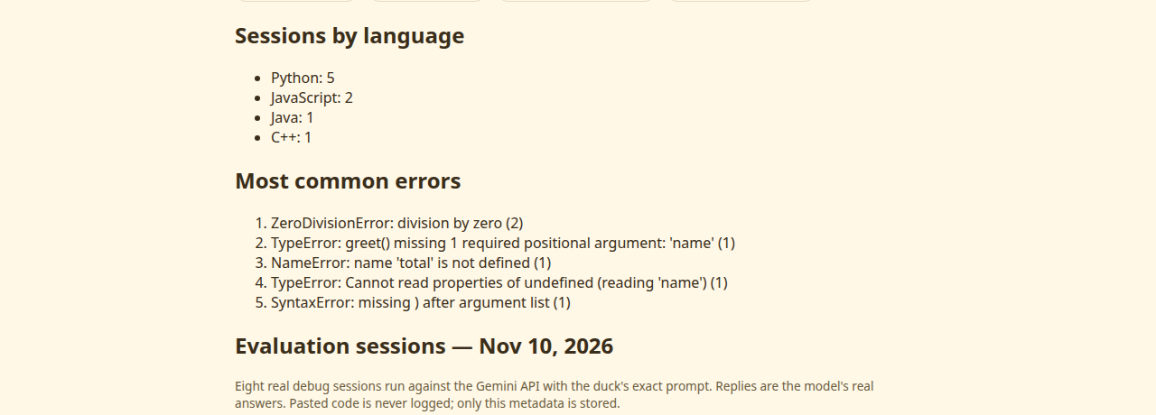
Evaluation results
Eight real debug sessions, run Nov 10, 2026 against the Gemini API.
• 8 of 8 answered OK. — Every session got a full duck reply.
• 8 of 8 named the faulty line. — 100% of replies pointed at the right line.
• Median answer time 2.3s. — Fastest 1.5s, slowest 30.1s (first-call warm-up).
• Languages: Python 4, JavaScript 2, Java 1, C++ 1. — Real errors: ZeroDivisionError, TypeError, NameError, NullPointerException, SyntaxError, IndentationError.
Duck Debug • DATANOVA 2026 Global Data-thon

Slide 7
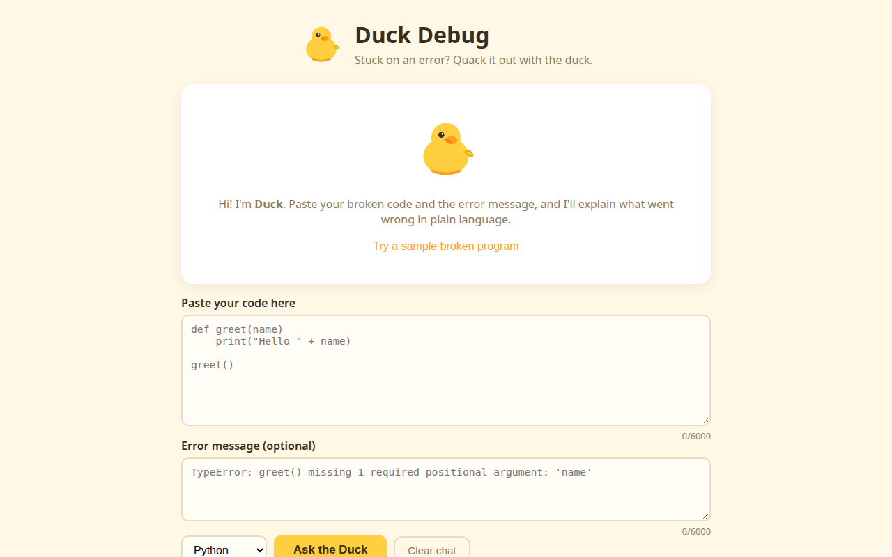
Try it
Live demo, repository, and video.
• Repository. — github.com/Velu2k03/duck-debug (MIT).
• Demo video. — youtube.com/watch?v=cuCroIKtxFM, plus a new 31-second DATANOVA clip.
• Live demo. — Deploying to Vercel; link goes on the Devpost form once the deploy lands.
• Insights. — Live at /insights.html on the demo.
Duck Debug • DATANOVA 2026 Global Data-thon

Slide 8
Tech stack and responsible AI
Small, free-tier, and honest about data.
• Node.js + Express 5. — One server file, one endpoint, static frontend.
• Gemini API, free tier. — No paid services anywhere in the project.
• Open source, MIT. — Anyone can read, run, and improve it.
• Privacy first. — Pasted code is never logged or stored; only session metadata is counted.
• Beginner-safe by design. — Plain language, no jargon, encouragement over condescension.
Duck Debug • DATANOVA 2026 Global Data-thon

Slide 9
Impact and next steps
Who it helps, and what comes next.
• Beginners and students. — A patient explainer that is always available, in plain language.
• Teachers and bootcamps. — The Insights page shows which errors a class hits most.
• Next: more languages. — Go, Rust, and SQL error patterns.
• Next: a bigger evaluation. — 100 sessions with a second judge checking the named line.
• Next: classroom mode. — Shared class dashboards from the same metadata log.
Duck Debug • DATANOVA 2026 Global Data-thon

Slide 10
Thank you
• Repository. — github.com/Velu2k03/duck-debug
• Demo video. — youtube.com/watch?v=cuCroIKtxFM
• Contact. — velu2k03@gmail.com • drvelu.com

