Slide 1
WebRTC
Real-time communications

Slide 2
Overview
Motivation
Demo
Establishing a connection
What is WebRTC?
Signaling protocol
Hands on code

Slide 3
Motivation
Stream video/data between two web browsers
No plugins required
Encrypted data
Tolerate packet loss
No webserver in the middle

Slide 4
Demo

Slide 5
Establishing a connection
Hello!
This is my IP
Dude…
It’s not working
192.168.1.2
192.168.1.3

Slide 6
Establishing a connection
STUN/TURN
IPv4
NAT
3.3.3.3
1.1.1.1
2.2.2.2
4.4.4.4
WebServer
Notes:
IPv4 address limit
What is NAT
- Private Network
- IP:port mapping
How to know you public mapping
- symmeetric NAT maps different ports for different apps (problematic)

Slide 7
Establishing a connection
Session Traversal Utilities for NAT (STUN)
Traversal Using Relay NAT (TURN)
Interactive Connectivity Establishment (ICE)
ICE = STUN + TURN

Slide 8
Establishing multiple connections
(mesh)
Each client sends and receives n-1 streams
Requires too much bandwidth

Slide 9
Establishing multiple connections
(MCU)
Multipoint Control Unit (MCU)
Each client sends/receives 1 stream
Server merges all streams and send to all clients
Requires transcoding (expensive)

Slide 10
Establishing multiple connections
(SFU)
Selective Forwarding Unit (SFU)
Each client sends 1 stream
Each client receives n-1 streams
No transcoding (cheap)

Slide 11

What is WebRTC?

Slide 12
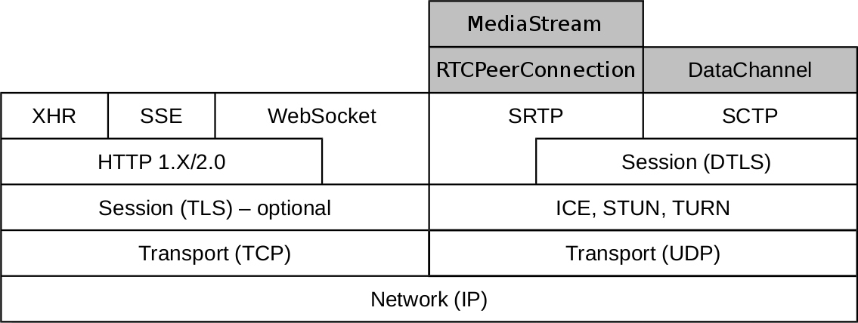
What is WebRTC?

Slide 13
Signaling protocol
Exchange media information (SDP)
Exchange connection information (ICE candidates)
Establish connection between two peers
*WebRTC has no signaling protocol

Slide 14
Signaling protocol
SIP
XMPP
Custom

Slide 15
Signaling protocol
(hello)
WebServer
ICE
hello
hello
hello

Slide 16
Signaling protocol
(sdp offer)
WebServer
ICE
offer

Slide 17
Signaling protocol
(sdp answer)
WebServer
ICE
answer

Slide 18
Signaling protocol
(ice discovery)
WebServer
ICE
ice
ice

Slide 19
Signaling protocol
(ice exchange)
WebServer
ICE
ice
ice

Slide 20
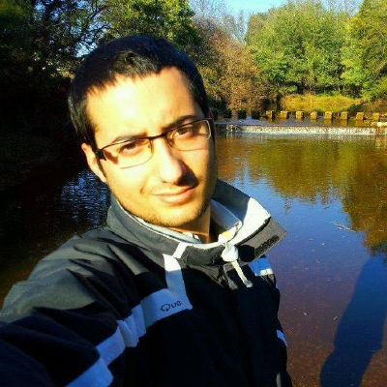

Signaling protocol
(stream)
WebServer
ICE

Slide 21
Hands on code
https://github.com/hdlopesrocha/webrtc.example

Slide 22
Questions?

